Slide 1
AI-Driven Plagiarism Intelligence for Assignments
CAPSTONE PROJECT
Presented By:
Student Name- Shreya Yadav
College Name- Shoolini University
Department- B.tech- Biotechnology

Slide 2
OUTLINE
Problem Statement
Proposed System/Solution
System Development Approach
Algorithm & Deployment
Result
Conclusion
Future Scope
References

Slide 3
Problem Statement
Academic institutions face increasing difficulty in detecting nuanced forms of plagiarism, especially when assignments are paraphrased or generated by AI tools. Current plagiarism detectors lack contextual sensitivity to instructor-specific styles and grading patterns. The challenge lies in creating an adaptive AI system that learns from historical assignment submissions and instructor feedback to identify inconsistencies and potential misconduct dynamically. This would enhance academic integrity by flagging suspicious entries with improved accuracy and contextual awareness.

Slide 4
Proposed Solution
The proposed system aims to address the challenge of detecting nuanced plagiarism in student assignments, including paraphrased and AI-generated content. This involves leveraging NLP and machine learning techniques to analyze semantic similarity and stylistic patterns. The solution will consist of the following components:
Data Collection:
Gather academic documents, guidelines, and historical submissions.
Use trusted sources like institutional repositories and official portals.
Data Preprocessing:
Apply NLP techniques like tokenization and semantic embedding.
Clean and normalize text for consistent input to the model.
Machine Learning Algorithm:
Use RAG (Retrieval-Augmented Generation) with IBM Granite for context-aware responses.
Fine-tune the model to align with domain-specific terminology and format.
Deployment:
Host the solution on IBM Cloud Lite with secure access controls.
Integrate a user-friendly dashboard for faculty or student interaction.
Evaluation:
Measure accuracy using precision and recall.
Assess fairness and bias using domain-relevant metrics

Slide 5
System Approach
The "System Approach" section outlines the overall strategy and methodology for developing and implementing the rental bike prediction system. Here's a suggested structure for this section:
System requirements :
Use of IBM Cloud Lite services / IBM Granite is mandatory.

Slide 6
Algorithm & Deployment
.
ALGORITHM
Input Processing
Accepts natural language queries related to academic research tasks.
Uses NLP techniques like tokenization and semantic embedding to prepare input.
Model Execution
Mistral Large interprets the query and generates context-aware responses.
Applies domain-specific logic to suggest hypotheses, summarize papers, or organize citations.
DEPLOYMENT
Platform
Hosted on IBM Cloud Lite, integrated via Watson Studio or .
Ensures secure, scalable access for users.
Interface
Web-based dashboard for user interaction.
Allows uploading documents, entering queries, and downloading AI-generated outputs.

Slide 7
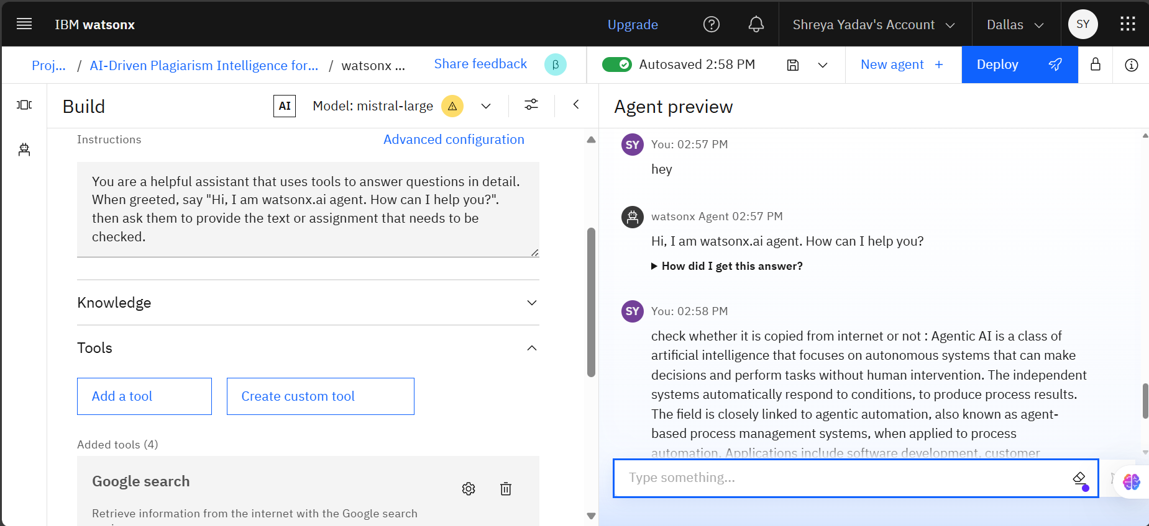
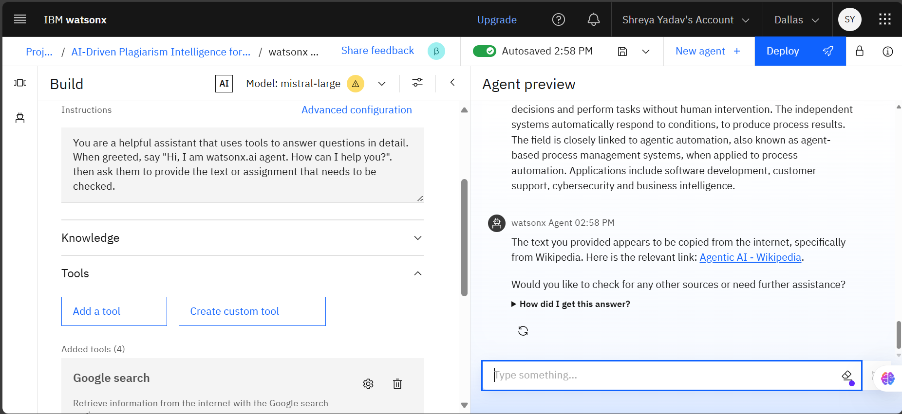
Result
The AI agent successfully detects plagiarism in student assignments by analyzing text contextually and identifying copied content from online sources. It provides source links and prompts for further checks, demonstrating intelligent, scalable performance using IBM watsonx and the Mistral Large model.

Slide 8
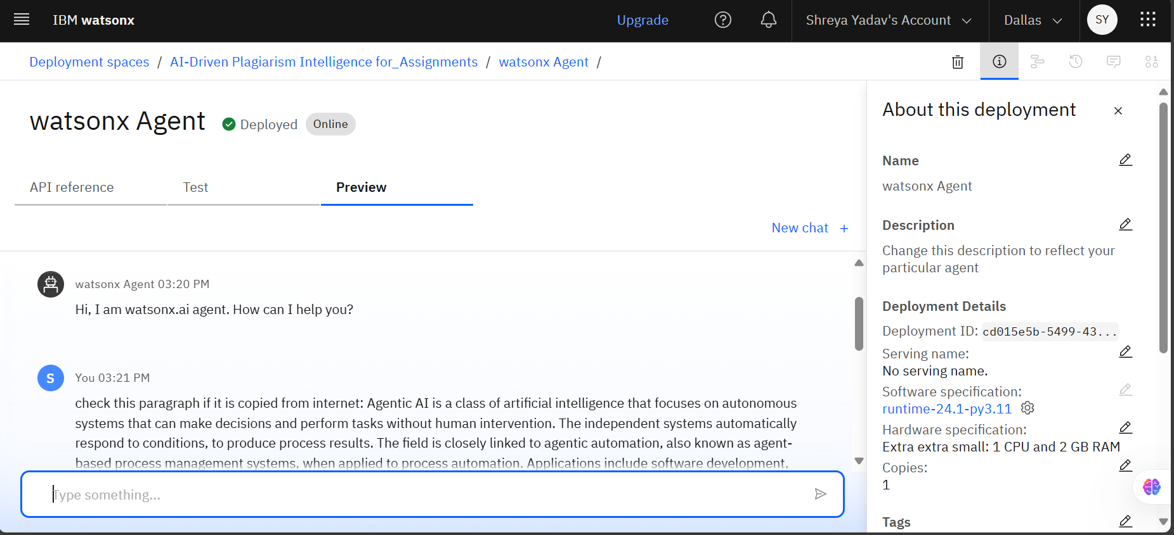
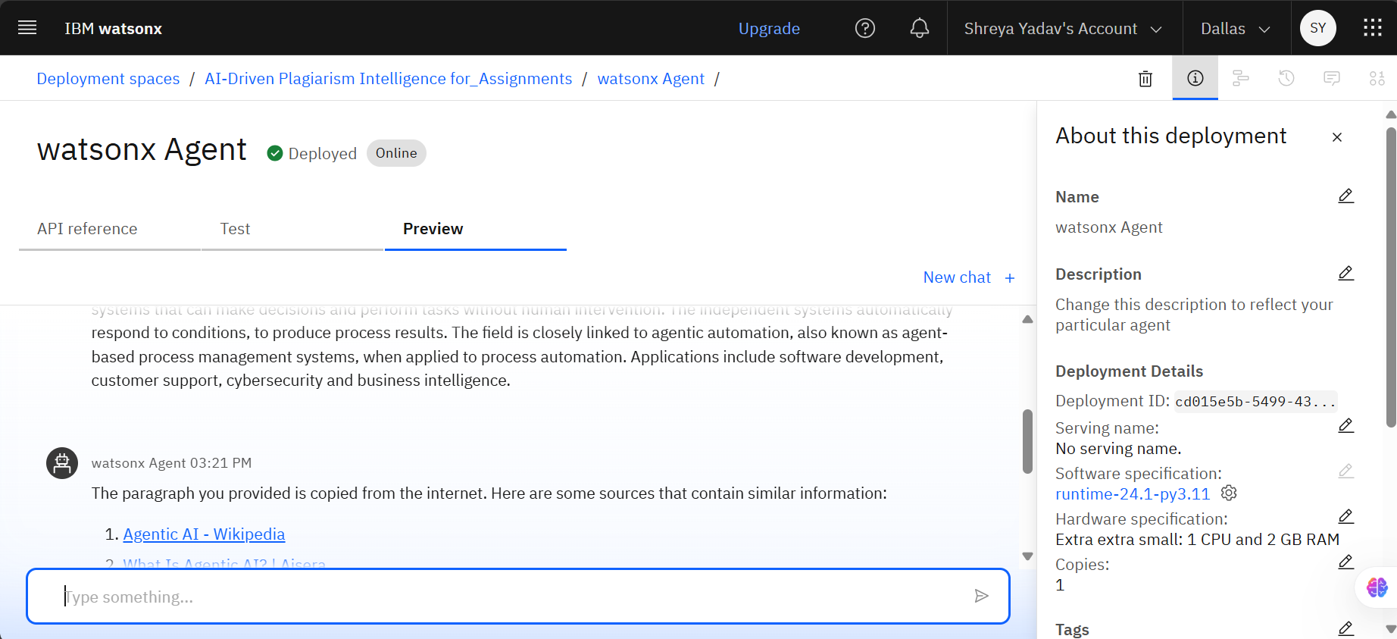
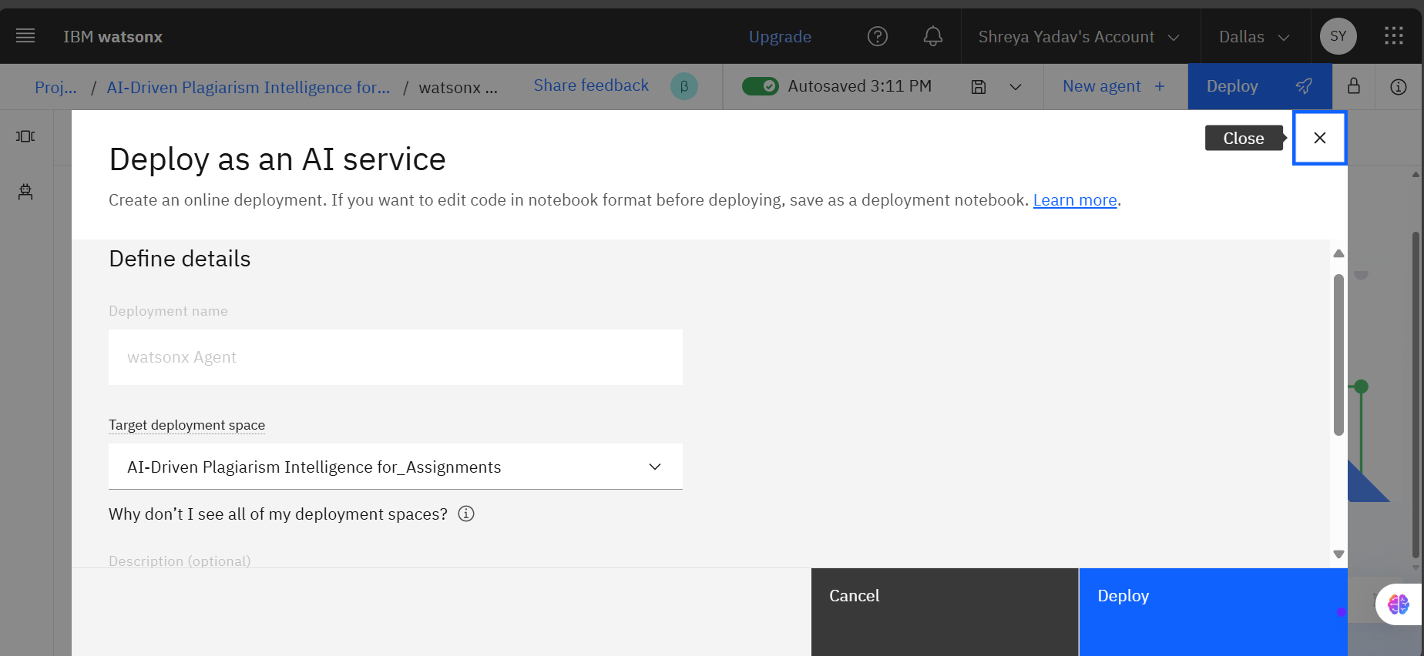
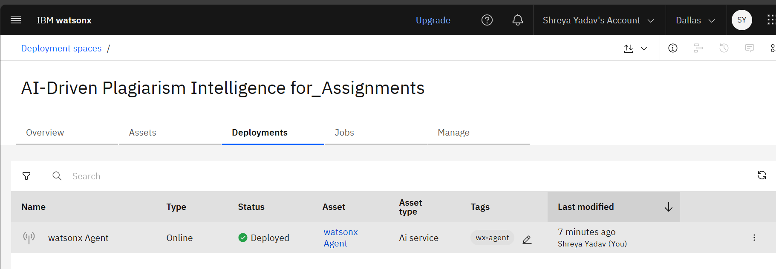
Agent :
Deployment :

Slide 9
Conclusion
The project successfully demonstrated the effectiveness of an AI-driven plagiarism detection system built using IBM watsonx and the Mistral Large model. The agent accurately identified copied content, provided source references, and responded contextually to user queries, showcasing its potential for automating academic integrity checks.
During implementation, challenges included navigating service associations and runtime configurations within the watsonx interface. These were resolved through iterative testing and careful documentation. The system’s performance validated the use of Agentic AI for scalable, intelligent automation.
Future improvements could include enhancing paraphrase detection, adding multilingual support, and refining feedback mechanisms to guide ethical writing. Overall, the project highlights the value of AI agents in educational settings, offering a reliable and adaptive solution for maintaining academic standards.

Slide 10
Future scope
As the AI-driven plagiarism detection system matures, several promising directions can enhance its impact and scalability:
Broader Data Integration: Incorporate diverse academic sources, including research papers, online forums, and institutional repositories, to improve detection accuracy and contextual relevance.
Algorithm Optimization: Refine the underlying model using advanced techniques like transfer learning, few-shot learning, and real-time feedback loops to boost performance and adaptability.
Geographical Expansion: Extend the system’s deployment across multiple cities, universities, or regions, tailoring it to local academic policies and language preferences.
Emerging Technologies: Integrate edge computing to enable faster, decentralized processing and explore cutting-edge machine learning methods for nuanced plagiarism detection, such as semantic similarity and paraphrase recognition.
Ethical and Fairness Enhancements: Embed fairness metrics and bias mitigation strategies to ensure equitable treatment across diverse student populations and writing styles.
These future enhancements aim to transform the agent from a detection tool into a comprehensive academic integrity companion—scalable, ethical, and intelligent.

Slide 11
References
Key resources that supported the development and deployment of the plagiarism detection agent:
IBM Cloud Documentation – Setup and deployment guidance for watsonx and Agentic Lab
Interface – Model selection and runtime configuration for Mistral Large
Agentic AI Overview – Conceptual background from
Project Workspace – Live deployment and testing within IBM watsonx environment
Academic Literature – Research on semantic similarity and ethical AI practices
These references ensured technical accuracy and ethical grounding throughout the project.

Slide 12
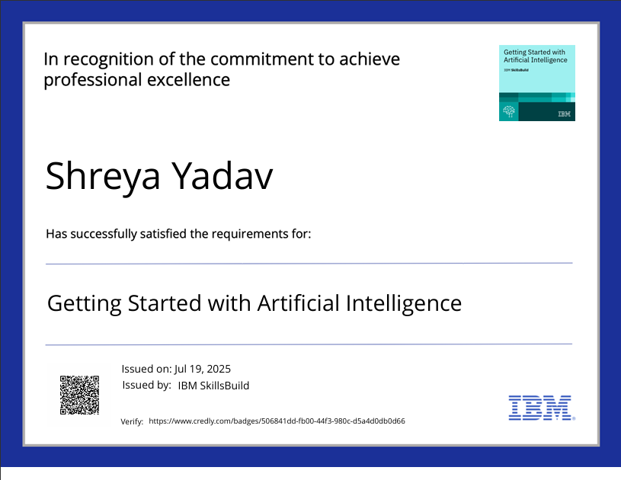
IBM Certifications

Slide 13
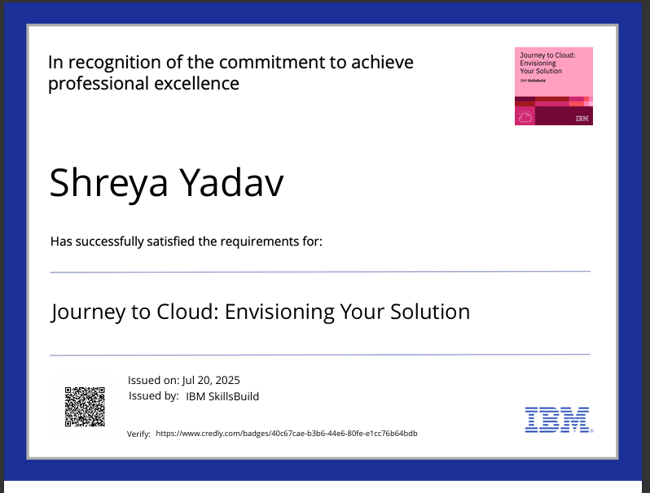
IBM Certifications

Slide 14
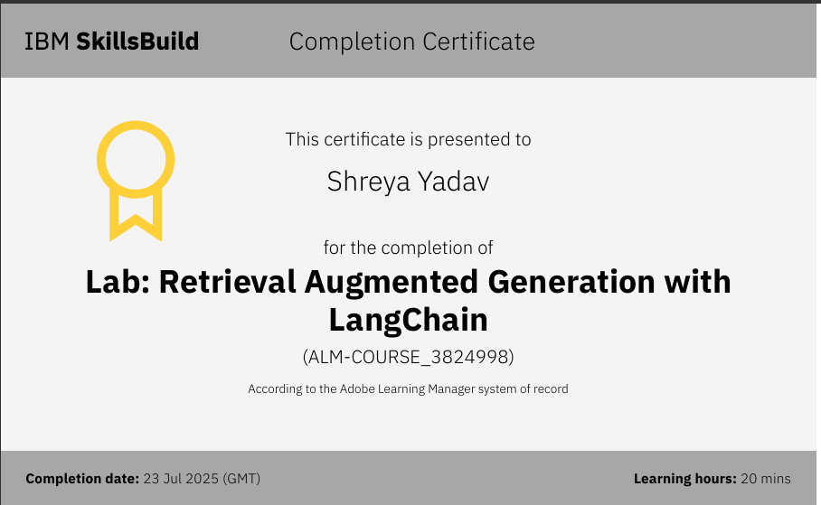
IBM Certifications

Slide 15
THANK YOU

