Slide 1
Electric Fly Zapper Circuit
Using
Voltage Multiplier

Slide 2
Why we choose voltage multiplier??
Most common circuit
Very versatile
Uniform stress per stage on diodes & capacitors.
Wide range of multiplication stages.
Low cost

Slide 3
Application of voltage multiplier
Television Crt's, Voltage Multipliers Are Now Used For Lasers, X-ray Systems, Traveling Wave Tubes, Photomultiplier Tubes, Ion Pumps, Electrostatic Systems, Copy Machines, And Many Other Applications That Utilize High Voltage DC.

Slide 4
What is a multiplier??
An electronic circuit that provides an output voltage higher than the input voltage

Slide 5
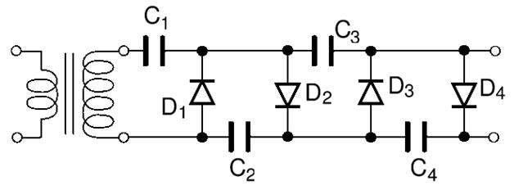
HALF – WAVE VOLTAGE MULTIPLIER

Slide 6
Equipments for HALF – WAVE VOLTAGE MULTIPLIER

Slide 7
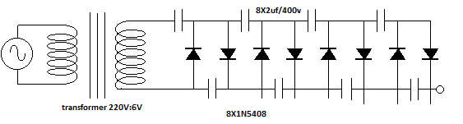
Circuit diagram of 8 stages half wave voltage multiplier

Slide 8
REAL PICTURE OF VOLTAGE MULTIPLIER

Slide 9
INPUT and output of voltage multiplier

Slide 10
Why WE need a fly zapper??
To kill flying harmful insects

Slide 11
Equipments for Fly zapper

Slide 12
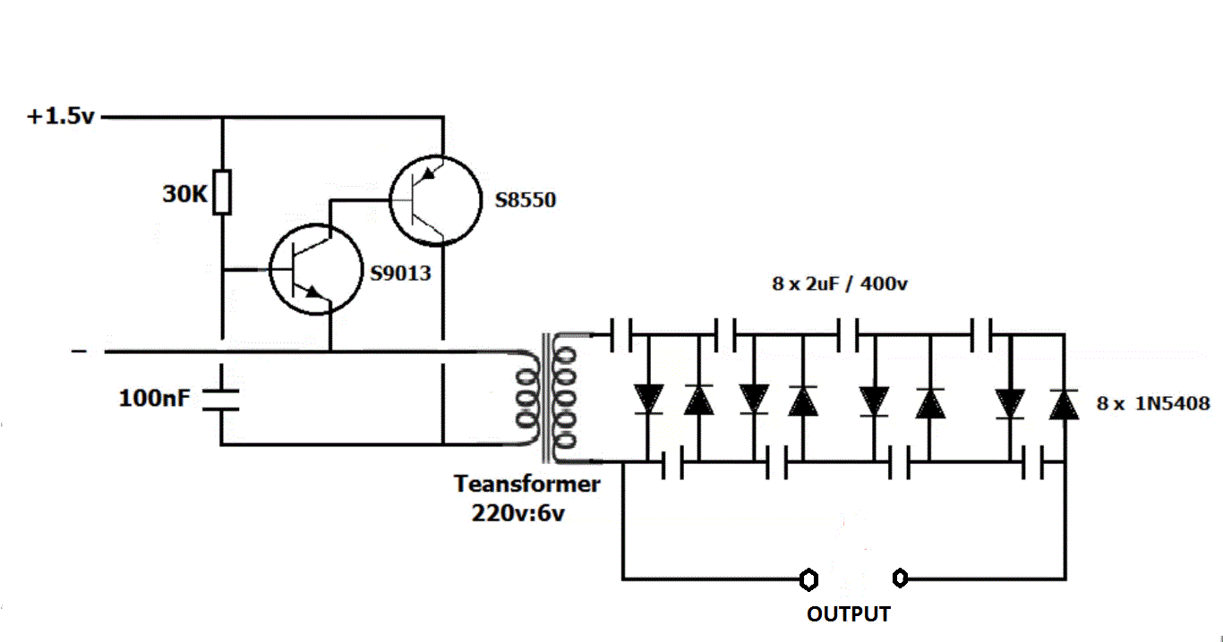
Circuit diagram of fly zapper using 8 stages half wave voltage multiplier

Slide 13
Real picture of fly zapper circuit

