Slide 1

Combining PQC and Image Stegangraphy for Secure Communication Project submitted by
S. Mohammad Fahed (208R1A0547)
S. Aswini (208R1A0543)
B. Sai Vineela (208R1A0508)
U. Nagarjuna (208R1A0553)
To
Department of Computer Science and Engineering,
SRI SAI RAJESWARI INSTITUTE OF TECHNOLOGY,
Lingapuram, Proddatur,516362

Slide 2
Table of Contents
Abstract 8. System Architecture
Introduction 9. Encryption
Existing System 10. Decryption
Proposed System 11. Results
Methodology used 12. Advantages and Applications
Hardware Requirements 13. Conclusion
Software Requirements 14. Future Scope

Slide 3
1.Abstract
With the rapid advancement of quantum computing and the increasing threat it poses to traditional cryptographic methods, there is a pressing need for post-quantum cryptography (PQC) solutions to ensure secure communication in the future. This work introduces a groundbreaking approach combines RSA techniques with image steganography to achieve enhanced security in communication systems. The proposed system leverages RSA algorithms, which are resistant to attacks from both classical and quantum computers, to encrypt the communication data. By employing these algorithms, we ensure that the confidentiality and integrity of the transmitted information are preserved even in the presence of powerful quantum adversaries. In addition to RSA, we integrate image steganography techniques into our system to further enhance security and concealment. Steganography involves embedding secret data within innocuous cover images, making it difficult for unauthorized parties to detect the existence of hidden information. By embedding encrypted communication data into images using steganographic methods, we add an additional layer of obfuscation, thereby strengthening the security of the communication channel. To assess our approach's effectiveness, we implement the system using MATLAB, a widely-used platform for research and development in image processing and cryptography.
Our results demonstrate that the combination of RSA and image steganography offers a robust solution for secure communication in the post-quantum era. By leveraging the strengths of both techniques, we achieve heightened security while maintaining practicality and efficiency in real-world applications. This research contributes to the ongoing efforts to develop secure communication protocols that can withstand the challenges posed by quantum computing advancements.

Slide 4
2. Introduction
This Chapter serves as an introductory section, emphasizing the critical importance of information security in today's digital landscape and the multifaceted challenges encountered in safeguarding data during transmission. It elucidates the foundational pillars of information security, including confidentiality, integrity, and availability, while also introducing cryptography and steganography as pivotal techniques for concealing information.
Steganography, a method for covertly embedding data within an innocuous carrier, is presented as a clandestine communication method, alongside watermarking. In steganography, the primary information or payload is concealed within secondary information, often obscured from plain view, resulting in a steganography signal or file. However, traditional steganographic methods may be vulnerable to attacks during transmission, storage, or format conversion.
A crucial distinction is made between steganography and watermarking: whereas steganography conceals information entirely, watermarking allows the message to be discernible to a third party. Both techniques entail embedding information into host media discreetly, with invisible watermarking being particularly suitable for scenarios where revealing the concealed information could lead to alterations.
In today's digital age, ensuring the security of sensitive information is paramount. With the rapid advancement of technology, the processing, transmission, and storage of data have become ubiquitous, necessitating robust security measures to protect against unauthorized access and manipulation. Two primary methods employed for information security are cryptography and steganography.

Slide 5
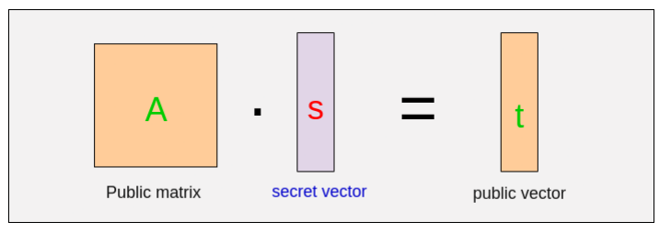
Post Quantum Cryptography
The main algorithms were lattice-based, code-based, multivariate, hash-based, and Isogeny based cryptography.
We are integrating PQC Cryptography using RSA Algorithm in our proposed model.
So, in Lattice Based Cryptography we are using Mathematical term lattices like vectors.
So, In our Proposed model we are storing the set of parameters which are used to generate keys in form of lattices i.e, in arrays and vectors .

Slide 6
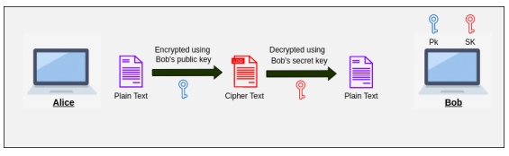
b. RSA Algorithm
In this cryptography instead of using a single key, we now use key pairs. Now both the sender and receiver will carry two-two keys i.e. Public key and the Secret Key(Private key) on both sides, which means now there will be a total of four numbers of keys.
As the name suggests public key will be known to everyone and the secret key or private key will remain secret i.e. will be known only to the person carrying it.
The sender will now use the public key of the receiver to encrypt the data and since the data is encrypted with the public key of the receiver, only the secret key of the receiver will be able to decrypt it.

Slide 7
3.Existing system
In the existing system, the existing model uses image steganography in securing embedded data for various applications, existing techniques often overlook message integrity.
The widely used Least Significant Bit (LSB) method lacks encryption prior to embedding secret messages, rendering them susceptible to interception or manipulation during transmission.
Disadvantages:
The existing system lacks more security.
It is less secure and weak method of information exchange.
Confidential and private data is not protected.

Slide 8
4.Proposed system
The proposed system, we proposed a system in light of the limitations of the LSB method, this study proposes the development of an advanced image steganography method, leveraging LSB substitution alongside RSA encryption.
The primary objective is to bolster the security aspects of image steganography while also integrating measures for verifying message integrity.
We proposed RSA algorithm which inspires from the PQC algorithm which deals with the quantum computers and give our model a great level of security.

Slide 9
a. Advantages of proposed system
The existing system converges both the cryptographic and steganography models which gives us more security.
It is more secure and robust method of information exchange so that confidential and private data must be protected against the traditional and some of the small quantum attacks.
Resistant from traditional and quantum attacks.

Slide 10
5. Methodology Used
Integration of RSA and LSB Substitution in Image Steganography, Combining RSA encryption with LSB substitution presents a promising strategy for bolstering data security in image steganography.
RSA encryption offers robust encryption, ensuring confidentiality, while LSB substitution enables covert embedding within digital images.
This integration establishes a multilayered approach to data security, reinforcing the integrity of the steganographic process.
We proposed RSA algorithm which inspires from the PQC algorithm which deals with the quantum computers and give our model a great level of security.

Slide 11
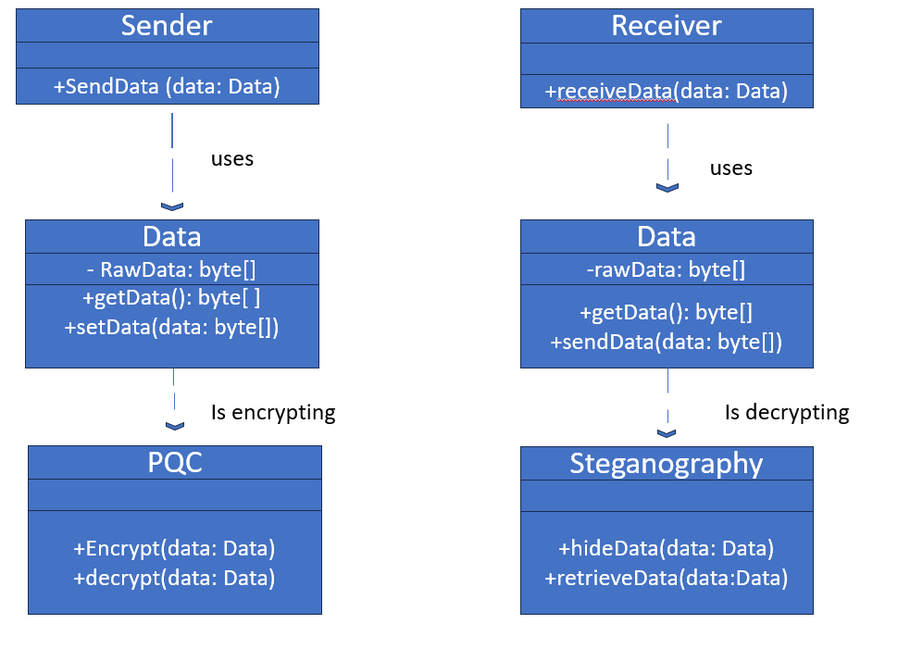
CLASS DIAGRAM

Slide 12
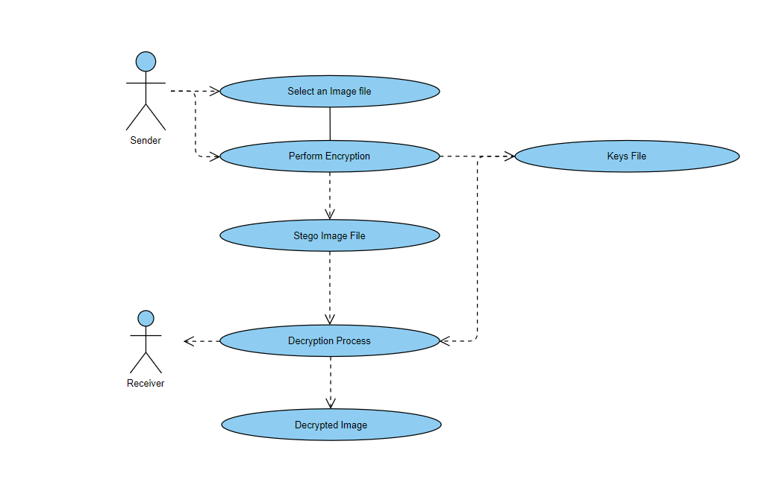
USECASE DIAGRAM

Slide 13
6.Hardware Requirements
Computer/server with adequate processing power and RAM.
Storage space for MATLAB, data, and output.

Slide 14
7.Software Requirements
Post-Quantum Cryptography Libraries.
Operating System compatible with MATLAB.

Slide 15
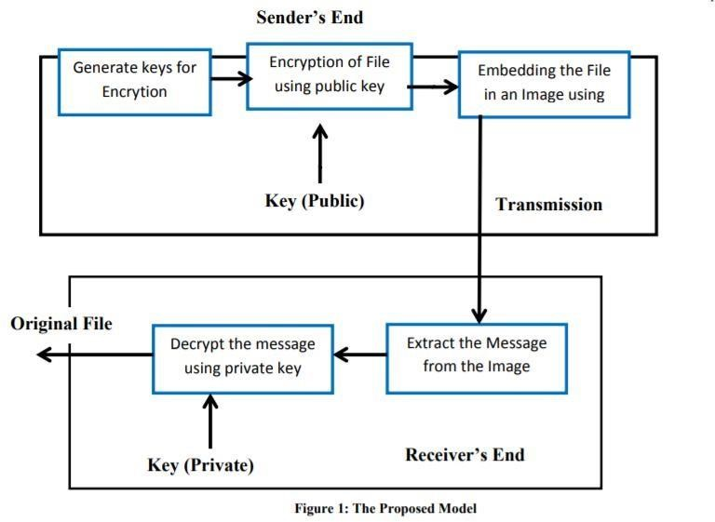
8.System Architecture

Slide 16
9. Encryption
Encryption code description and Key Generation:
Prime numbers `p` and `q` are chosen.
Modulus `n` and Euler's totient function `phi` are calculated.
Public exponent `e` is set to 17, and it is verified that `e` and `phi` are coprime.
Private key `d` is computed using the modular inverse function `modinv`. Key pairs (public and private keys) are stored.
File Selection:
The user is prompted to select a file using a dialog box. If a file is selected, its full path is obtained.

Slide 17
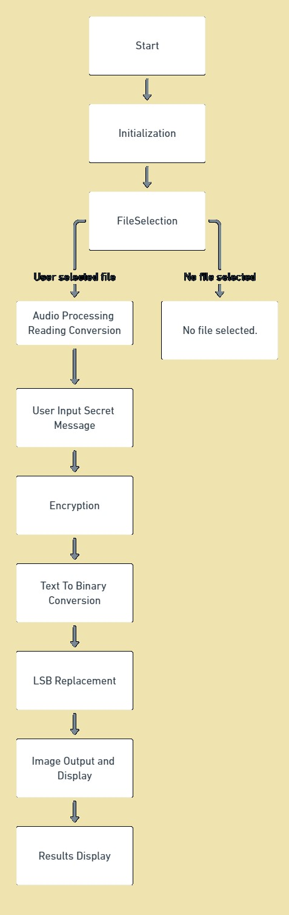

Slide 18
10. Decryption
Decryption description:
Clear Environment: Clears the command window, workspace, and closes all figures.
Load Keys: Loads the previously saved RSA private and public keys (`d`, `n`, `textlen`).
File Selection:
User Interaction: A dialog box prompts the user to select a stego image file.
File Check: If a file is selected, its full path is obtained.

Slide 19
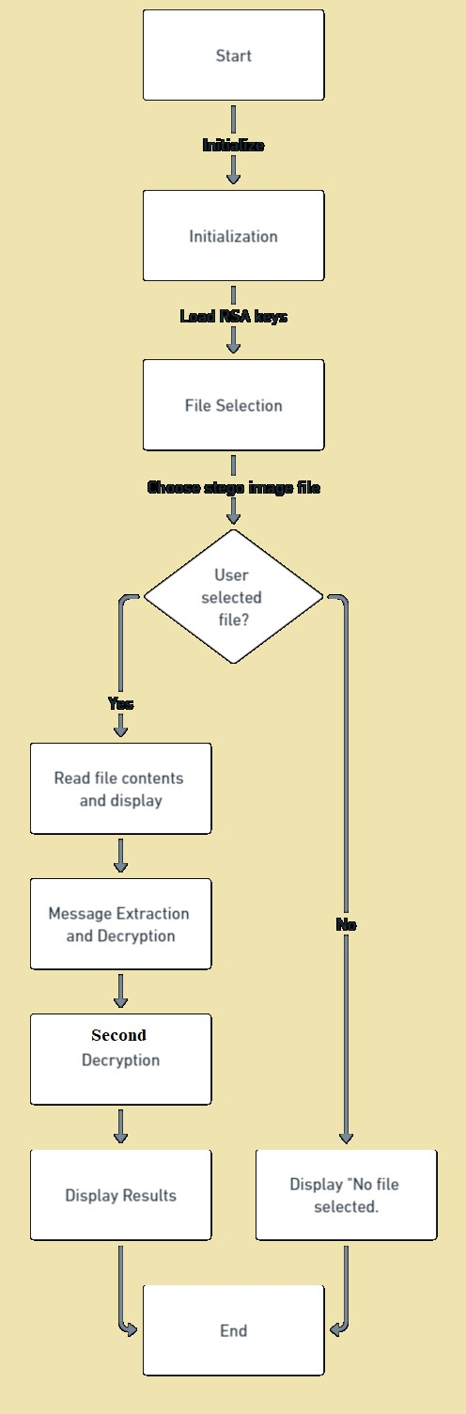

Slide 20
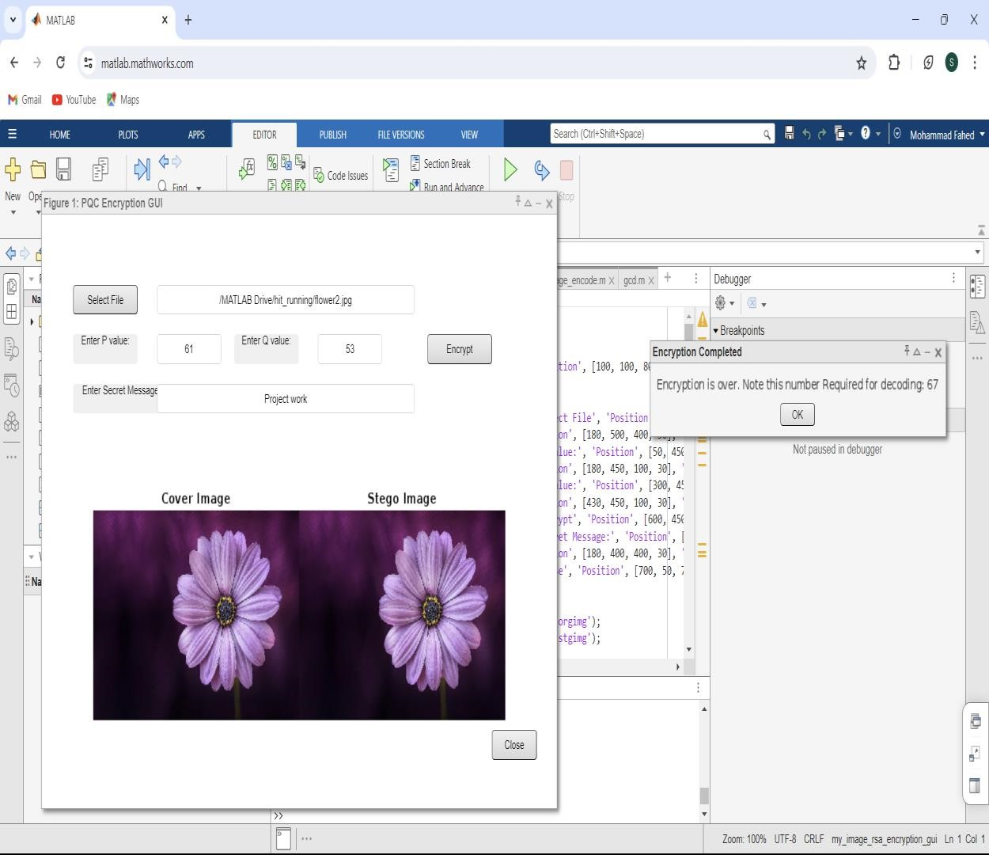
11. Results Encryption:

Slide 21
Testing Conditions
Test Case Title: Combination of Post-Quantum Cryptography (PQC) and Image Steganography
Objective: To verify that the integration of Post-Quantum Cryptography and Image Steganography functionalities works as expected.
1. Post-Quantum Cryptography (PQC) and Image Steganography modules are integrated into the system.
Test Steps:
1. Input Data Preparation:
- Prepare a sample data file to be used for testing.
- Encrypt the data file using the RSA encryption algorithm.
- Prepare a sample cover image for steganography.

Slide 22
a. Integration Testing:
a. Encryption and Steganography Integration:
i. Encrypt the prepared data file using the RSA encryption module.
ii. Embed the encrypted data into the cover image using the Image Steganography module. iii. Save the steganographic image as the output.
b. Steganography and Decryption Integration:
i. Extract the hidden data from the steganographic image using the Image Steganography module.
ii. Decrypt the extracted data using the RSA decryption algorithm.
iii. Compare the decrypted data with the original input data.

Slide 23
3. Validation: -
Ensure that the decrypted data matches the original input data.
- Verify that the integration process did not introduce any errors or corruption in the data.
- Check for any performance issues or delays during the integration process. Expected Results:
1. The integration test should pass without any errors.
2. The decrypted data should match the original input data, indicating successful integration of RSA and Image Steganography.
3. The integration process should not introduce any data corruption or loss.
4. The integration should not cause any significant performance degradation.

Slide 24
Test Data: - Sample data file for encryption.
- Sample cover image for steganography.
- Expected output: decrypted data matching the original input data.
Test Environment: -
Operating System: Windows 11
- Programming Language: MATLAB
- Integrated Development Environment (IDE)
Test Execution: - Execute the integration test script.
- Monitor for any errors or failures during test execution.
- Record the test results and any deviations from the expected outcomes.
Test Case Status: [Pass]

Slide 25
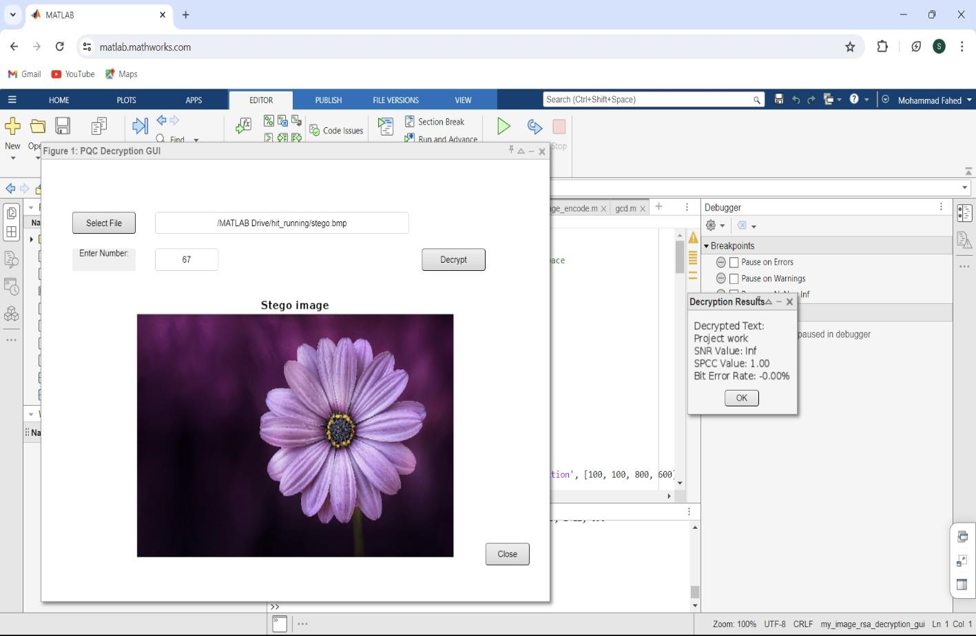
Encrypted Image:

Slide 26
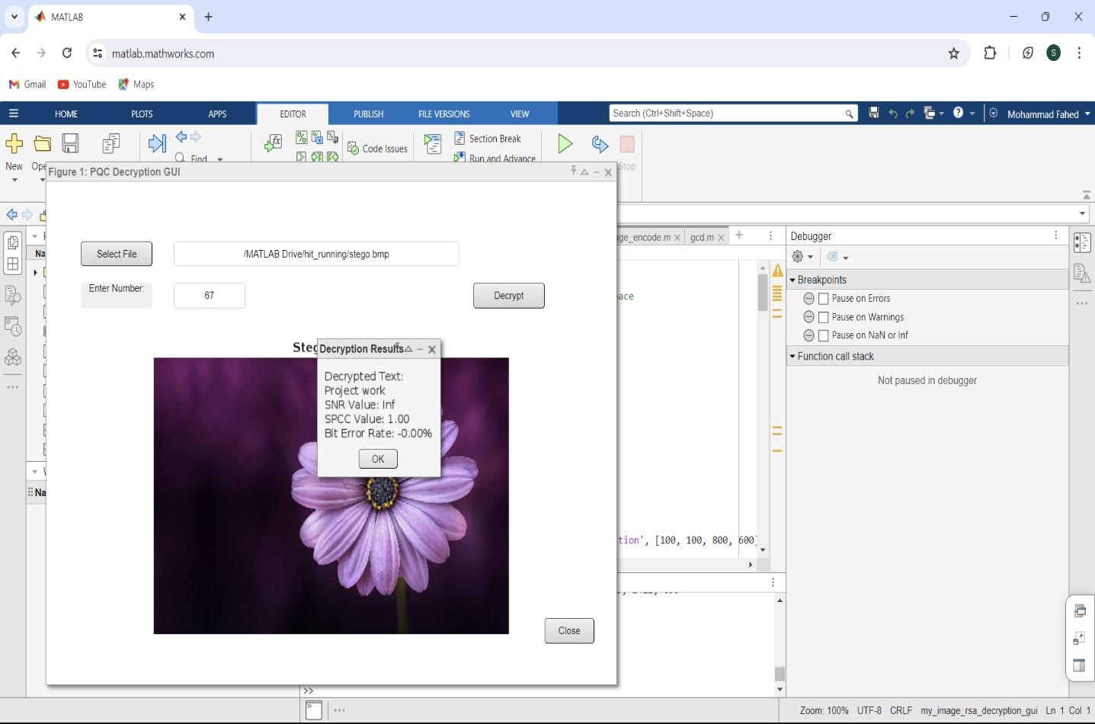
Decryption:

Slide 27
12. Advantages and Applications
Very Simple Interface and Easy to Understand.
Robust and Secure.
Provides Security over online Communication.
Combines RSA and Image Steganography for better security.
Initializes the topic of PQC and Quantum Computers.
It is easy to maintain and also cost - effective.
The integration of RSA encryption and LSB substitution provides a multi-layered approach to image steganography, enhancing both security and reliability.
The proposed method ensures the confidentiality of the embedded message while maintaining the integrity and quality of the cover image.

Slide 28
13. Conclusion
In conclusion, the integration of RSA encryption adds an additional layer of security to the steganographic process. RSA, a widely utilized asymmetric encryption algorithm, employs a public-private key pair mechanism that enhances confidentiality.
The use of RSA ensures that only intended recipients possessing the private key can decrypt the hidden message within the image.
RSA encryption, based on the computational complexity of prime factorization, provides a formidable defense against brute-force and cryptanalysis attacks.
Additionally, LSB substitution, by embedding data in the least significant bits of pixel values, ensures minimal perceptual distortion, thereby reducing the likelihood of detection by visual inspection.
Consequently, the proposed method stands as a robust solution for secure and clandestine communication in scenarios where confidentiality is paramount.

Slide 29
14. Future Scope
The integration of RSA encryption and LSB substitution provides a multi-layered approach to image steganography, enhancing both security and reliability.
The proposed method ensures the confidentiality of the embedded message while maintaining the integrity and quality of the cover image.
Evaluation of performance metrics such as SNR, BER, and SPCC demonstrates the effectiveness of the method in concealing information within images.
Future research may focus on optimizing embedding algorithms and exploring alternative encryption techniques to further improve security and reliability.

