Slide 1

Comparative Study of Statistical and Deep Learning Model for Stock Price Prediction.
Submitted by: Sanford Rodrigues (20033869)
Supervised by: Anesu Nyabadza

Slide 2

Research background
Stock price prediction is one of the most challenging time-series forecasting tasks, with market prices influenced by a complex web of political, economic, and social factors. This research confronts this challenge head-on, focusing on the FTSE 100, the UK's premier stock market index.
Problem Statement
In spite of London stock exchange FTSE 100 index’s crucial role in global financial market, there
has been a significant gap in current research for the use of machine learning techniques and
specifically comparison of traditional statistical models ARIMA and SARIMA and advance deep
learning model LSTM. This causes or hampers analysts, investors and other stakeholders from
utilizing more efficient methods to forecast and comprehend market changes. This study will
compare the performances of ARIMA, SARIMA, LSTM and hybrid ARIMA-LSTM models in
forecasting on FTSE 100 index to address the gap of previous studies. The finding and results will
help improve stock price prediction techniques and provide insight for decision making.

Slide 3




Aims and objectives
This study aims to implement and rigorously compare statistical and deep learning models to predict the stock price for the FTSE 100, ultimately identifying the optimal and best fitted model for the task
Analyze the trends and performance of FTSE 100 historically using both univariate and multivariate data.
Build and train ARIMA, SARIMA, LSTM and hybrid ARIMA-LSTM model to predict
stock price.
Compare the performance of these models to determine the best model fitted.
Implement visualization for ease of understanding the results and outcomes.

Slide 4
Identifying gaps in past studies
Statistical models (ARIMA/SARIMA)
Deep learning model (LSTM)
Showcases best performance and lesser error for short term forecast and in stable non-linear market conditions.
Failed to capture market changes, high volatility and non-linear patterns.
SARIMA performs better than ARIMA by modelling seasonality, but still shares ARIMA’s limitations.
Outperforms other models due to its ability to capture non-linear patterns and long term dependencies.
Better performance with Principal Component Analysis, which reduces data dimensionality and noise.
Research gaps
Very few studies provided a direct comparison of ARIMA/SARIMA with univariate data and LSTM with multivariate data
Limited research focus on FTSE 100 data.

Slide 5



Novelty
Direct comparison
Focus on FTSE100
Robust model frameworks
This study directly compares the performances of ARIMA, SARIMA, LSTM and hybrid model on same dataset.
Fresh insights on forecasting accuracy of the one of Europe’s most significant and diverse stock market
The study employs a robust process, using statistical test for ARIMA and SARIMA and a well defined 3 layer LSTM framework.

Slide 6




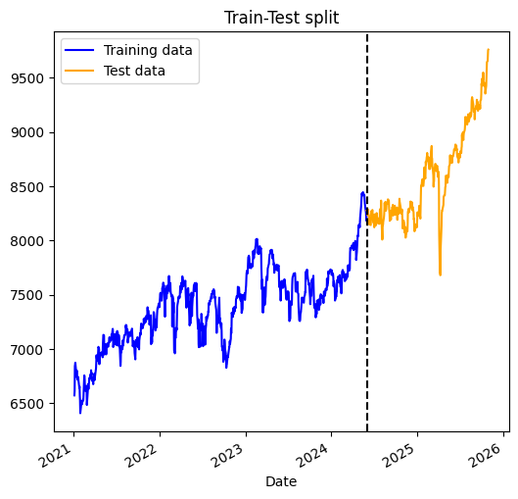
Data Analysis
Data collection
Data cleaning
EDA
Train-test split
Source: Yahoo Finance
Dataset: FTSE100 based in London Stock Exchange
Time period: January, 2021 to October 2025
Features: Open, Close, High, Low, Adj. Close, Volume.
Data cleaning: no null values, outliers identified and retained as actual market events.
Training set: 70% (January 2021 to May, 2024)
Test set: 30% (June 2024 to October 2025)

Slide 7



Traditional/statistical models
ARIMA (Auto regressive integrated moving average)
SARIMA (Seasonal auto regressive integrated moving average)
A linear statistical model that forecast future value based on its past values. It assumes the data is stationary, which means its statistical properties don’t change over time.
A extension of ARIMA to handle data with seasonality.
Adds seasonal parameters (P, D, Q)m, where m is the number of time steps in seasonal period.
For this study pmdarima library was used to automatically select the model with best combination of seasonal and non-seasonal parameters.
Box Jenkins method
Identification: Used Augmented Dicker Fuller test (ADF) to check stationarity and applied differencing (d).
Estimation: Auto Correlation Function (ACF) and Partial Auto Correlation Function (PACF) plots were used to determine the AR(p) and MA(q).
Model selection: Choose the best model based on lowest Akaike Information Criterion (AIC) and Bayesian Information Criterion (BIC).

Slide 8
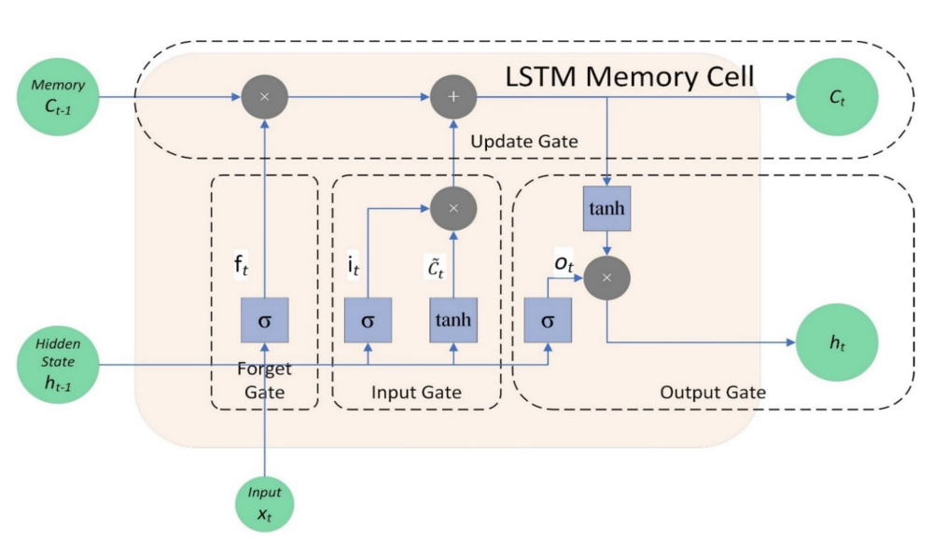
Deep learning models
LSTM (Long Short Term Memory)
A specialized type of Recurrent Neural Network (RNN) that excels at learning long-term dependencies. It uses internal 'gates" (Forget, Input, Output) to regulate information flow, allowing it to remember important patterns over long sequences and avoid the "vanishing gradient" problem.
Our Architecture:
Layers: 3 stacked LSTM layers with 50 neurons each.
Regularization: Dropout rate of 0.2 to prevent overfitting.
Optimization: Adam optimizer with a Mean Squared Error loss function.
Hybrid ARIMA-LSTM
A two stage model where ARIMA first captures linear trends. The residual, which contains non-linear data is processed by LSTM.

Slide 9
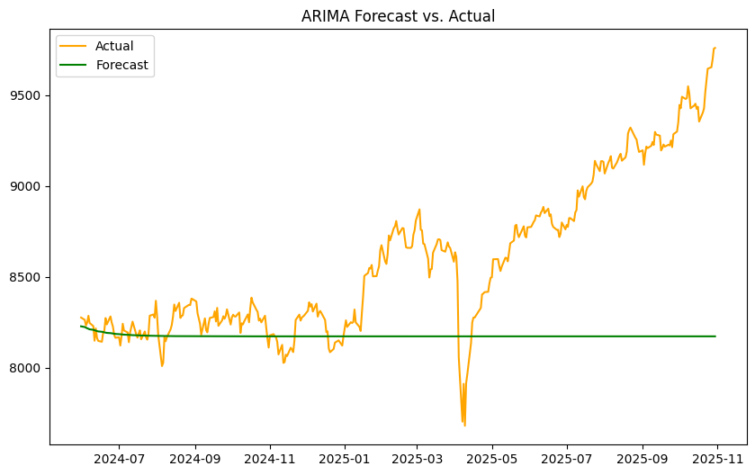

Results and Analysis: ARIMA (p,d,q)
ADF test confirmed that the data became stationary in first differencing (d=1)
Based on lowest AIC and BIC scores, ARIMA (1,1,1) and ARIMA (0,1,0) were selected.
 | RMSE | MSE | MAE
ARIMA(1,1,1) | 599.682 | 359620 | 437.961
ARIMA(0,1,0) | 560.169 | 313790 | 400.169
Visual representation of ARIMA (1,1,1) actual vs forecast
Both models performed poorly. The identical results indicated that ARIMA is fundamentally incapable of capturing the patterns in the FTSE 100 data.
Visual representation of ARIMA (0,1,0) actual vs forecast

Slide 10
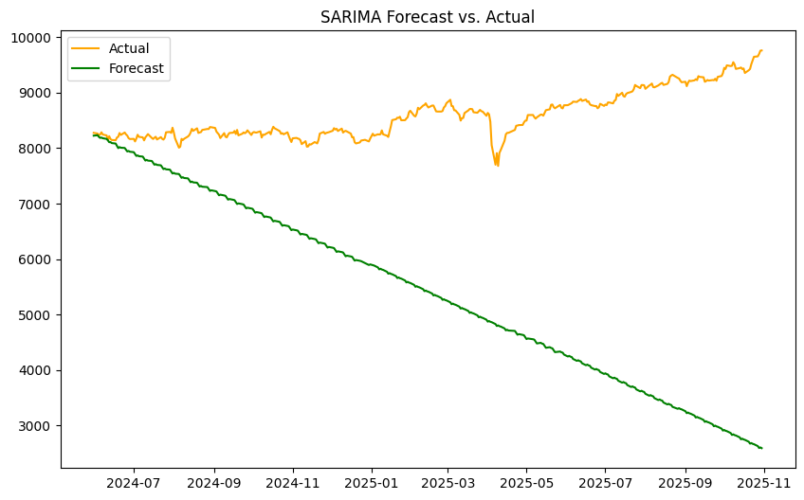

Results and Analysis: SARIMA (p,d,q)(P,D,Q)m
Seasonality was set to 5 trading days (m=5)
The ‘pmdarima’ library identified SARIMA (1,1,1)(2,1,0)[5] based on lowest AIC and SARIMA (0,1,0)(2,1,0)[5] based on lowest BIC.
 | RMSE | MSE | MAE
SARIMA (1,1,1)(2,1,0)[5] | 3764.267 | 14169708.443 | 3175.984
SARIMA (0,1,0)(2,1,0)[5] | 3757.375 | 14117867.496 | 3169.779
Visual representation of SARIMA (1,1,1)(2,1,0)[5] actual vs forecast
SARIMA performed significantly worse than ARIMA, with error values an order of magnitude higher. The model consistently predicted values far below the actual market price.
Visual representation of SARIMA (0,1,0)(2,1,0)[5] actual vs forecast

Slide 11
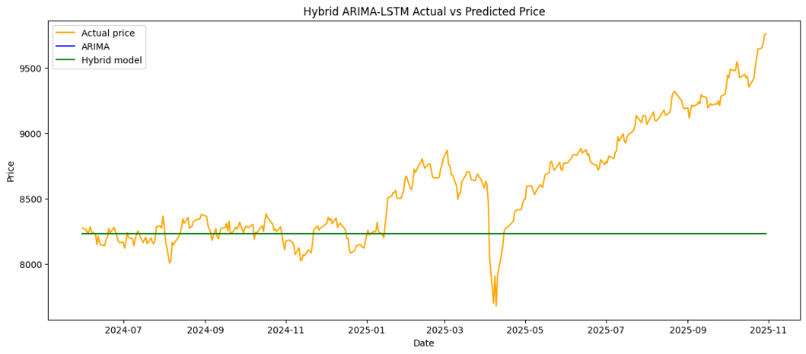
Results and Analysis: Hybrid ARIMA-LSTM
The ARIMA model selected using ‘pmdarima’. ARIMA (0,1,0) was used to make predictions. The residual was passed on to LSTM to make further prediction as it is able to handle non-linear trends.
 | RMSE | MSE | MAE
ARIMA | 560.16 | 313789.80 | 400.26
Hybrid ARIMA-LSTM | 560.16 | 313789.80 | 400.26
The performance metrics are nearly identical to the standalone ARIMA model. This indicates the LSTM component was unable to identify any patterns in the residuals, adding no predictive value.
Visual representation of hybrid ARIMA-LSTM actual vs forecast

Slide 12
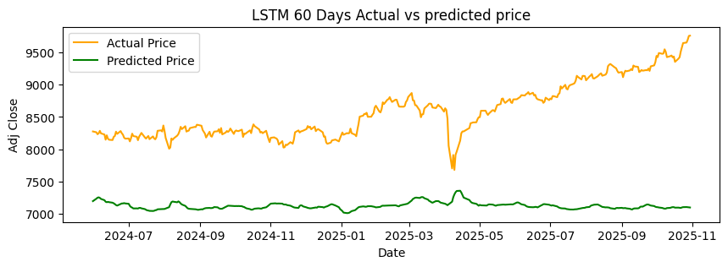
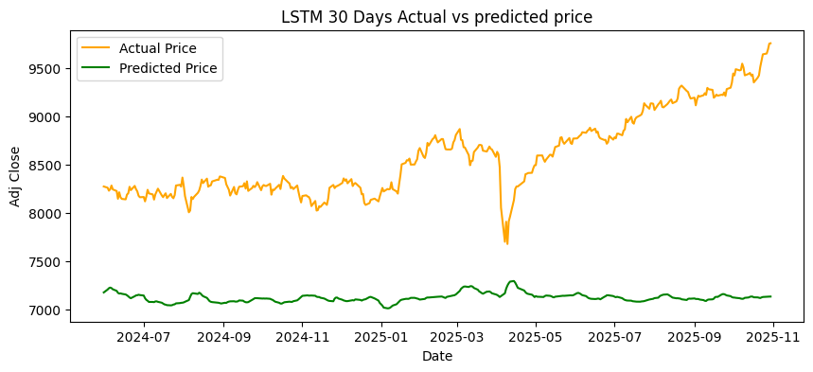
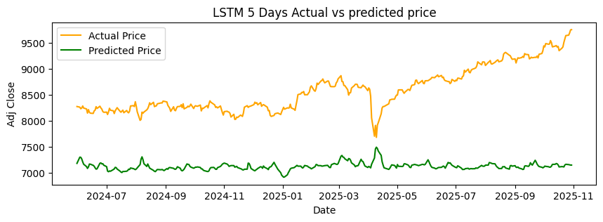
Results and Analysis: LSTM
LSTM was tested with different sequence length of 5, 30, & 60 days. For all these model a 3 layer LSTM framework was used.
Visual representation of LSTM 60 days actual vs forecast
 | RMSE | MSE | MAE
LSTM_60_days | 225.97 | 50612.01 | 179.06
LSTM_30_days | 220.92 | 48367.59 | 172.20
LSTM_5_days | 249.49 | 62246.01 | 209.74
Visual representation of LSTM 30 days actual vs forecast
The performance metrics showed a improved performance as compared to other models. LSTM still wasn’t able to predict the values accurately giving high error values.
Visual representation of LSTM 5 days actual vs forecast

Slide 13
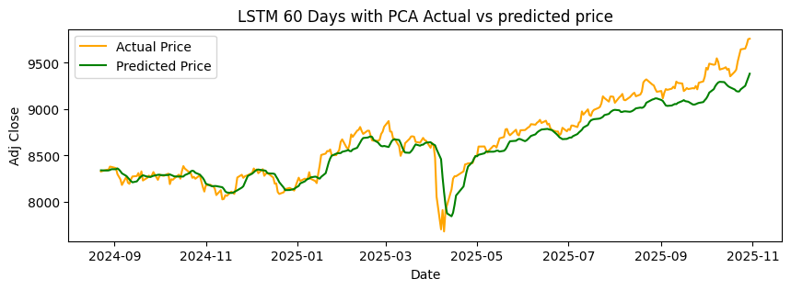
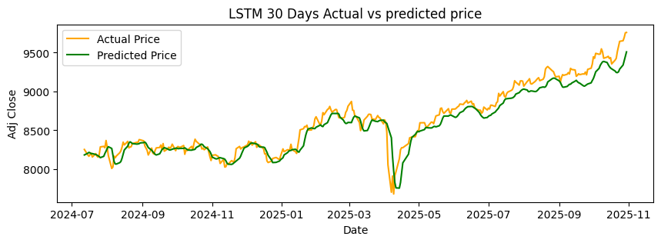
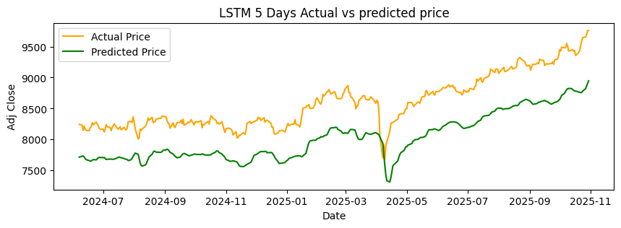
Results and Analysis: LSTM with PCA
Since LSTM wasn’t able to predict accurately, it was tested with PCA. After implementing PCA, it gave us two features with the most information or variance.
Visual representation of LSTM 60 days actual vs forecast
 | RMSE | MSE | MAE
LSTM_60_days | 89.91 | 8085.21 | 60.35
LSTM_30_days | 120.72 | 14573.87 | 92.20
LSTM_5_days | 155.27 | 24107.66 | 123.75
Visual representation of LSTM 30 days actual vs forecast
LSTM when implemented with PCA was able to predict value closely to actual price and also achieved the lowest error values. Out all three model the best performance was achieved by LSTM 60 day sequence.
Visual representation of LSTM 5 days actual vs forecast

Slide 14






Limitation & Future Works
Limitations
Future works
Single index focus: Findings are specific to the FTSE 100 and may not generalize to other markets.
Advanced Hybrid Models: Investigate a SARIMAX + LSTM-PCA hybrid to formally model seasonality and external variables.
Limited test set: The model's performance was evaluated on a relatively short time frame.
Alternative Architectures: Implement a Prophet-LSTM-PCA hybrid to leverage Prophet's superior trend decomposition capabilities.
Exclusion of external factors: The analysis relies solely on price history and does not incorporate data like technical indicators or macroeconomic news.
Cross-Market Validation: Replicate the study across multiple international indices (e.g., S&P 500, Nikkei 225, Niffty 50, etc.) to test generalization.

Slide 15
Conclusion
The LSTM model, together with the addition of PCA, is a clear winner over the traditional statistical models (ARIMA, SARIMA) and a basic hybrid solution.
The fact that LSTM is capable of capturing complex and non-linear patterns was the distinguishing feature. PCA was crucial to the elimination of noise and concentration of the model.
ARIMA and SARIMA were essentially are not equipped to deal with the volatility and non-stationary behavior of the financial data since they are linear in nature.

Slide 16


Thank you

