Slide 1
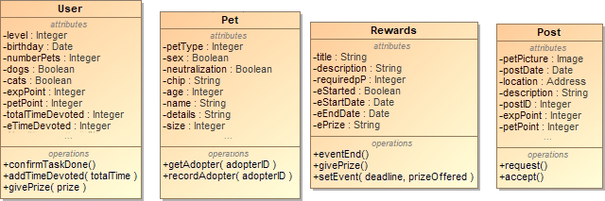
Principles
Single Responsibility Principle
Every class has a role in the system
Every class has one reason to change

Slide 2
Patterns
Singleton
- The Manager classes need to instantiate only once
- There must be only one User per session
Facade
- Classes like Post and Account are facades, consisting
of other classes

Slide 3
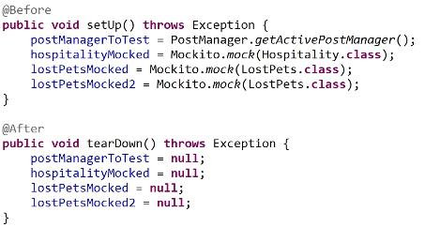
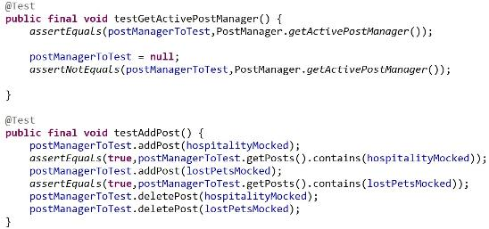
Testing

