Slide 1
Architecture
This is how it works in our application
USER
SUBSCRIBER
USER
PUBLISHER
addPost();
POSTMANAGER
USER
SUBSCRIBER
USER
PUBLISHER
getNotificationsForAPost();
USER
SUBSCRIBER
USER
PUBLISHER
NOTIFICATION
MANAGER
sendNotification();
USER
SUBSCRIBER

Slide 2
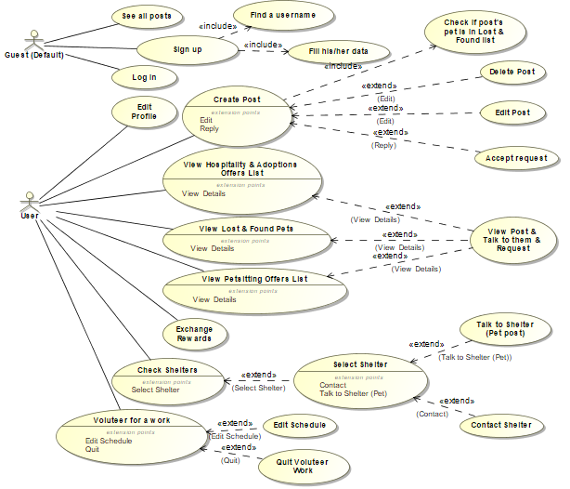
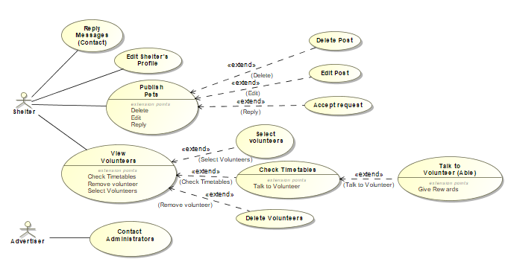
Models
UML Use-Case (Road Map)

Slide 3
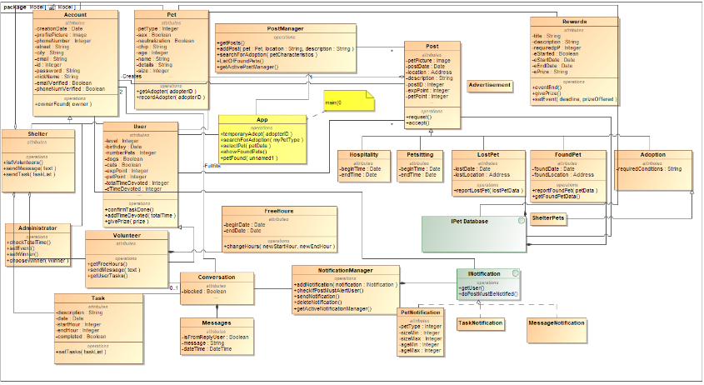
Models
UML Class Model

Slide 4
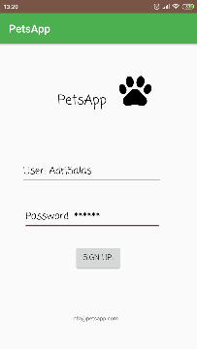
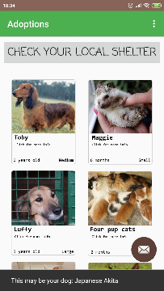
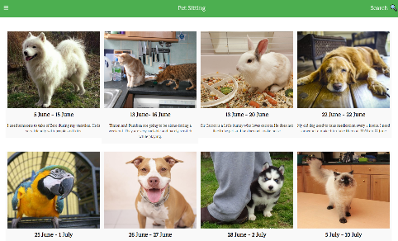
Models
UI Design

Slide 5
Implementation Models
NEED TO ADD
REAL CLASS MODEL
ADRI WILL CREATE IT
WHEN EVERYONE FINISH CODING

