Slide 1
Team and teamwork (1/2)
Name of the team: Halkidiki
Team members:
Sanggil Han - UI Designer
Michał Mazurkiewicz - QA Engineer
Konstantina Marantidou - Software Engineer
Antoni Pięta - Software Engineer
Adrián Salas Troya - Software Engineer
George Karamalis - Back-end Designer

Slide 2
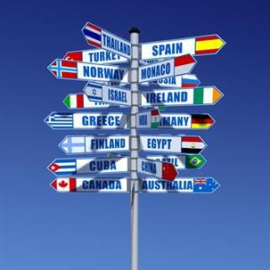
Team and teamwork (2/2)
We are a group of 6 people from different countries -> different cultures -> problems
We did the best effort that we could to solve the problems in our coordination and work together like a team until the end.
Some people tried more than other people but finally we have the project done.

Slide 3
Solution
Proposed solution
Developing a social app/web to share resources and help pets and owners
Collaborative aspects of the chosen approach
People can upload an animal's information they have found on a street
-So that other people who have interests can take care of them
-Or that the shelter can rescue them
People can help owners, taking care of their pets during holidays or when they can't
Contributors will be rewarded with resources which will help them with taking care of animals

