Slide 1
Architecture
Our Architecture is Publish–subscribe pattern
SUBSCRIBER
PUBLISHER
SUBSCRIBER
Event
Notify
PUBLISHER
SERVER
SUBSCRIBER
PUBLISHER
SUBSCRIBER

Slide 2
Architecture
This is how it works in our application
USER
SUBSCRIBER
USER
PUBLISHER
addPost();
POSTMANAGER
USER
SUBSCRIBER
USER
PUBLISHER
getNotificationsForAPost();
USER
SUBSCRIBER
USER
PUBLISHER
NOTIFICATION
MANAGER
sendNotification();
USER
SUBSCRIBER

Slide 3
Architecture
Why did we picked Publish–subscribe pattern?
A user may want to adopt a dog but the user does not want to check the rest of posts.
A user may have lost his/her cat, and want to get notify if someone post a similar cat.
Notifications are easy to implement following a Publish-subscribe pattern.
The application is going to be very versatile to add future “tags” or conditions to get notified.
A user doesn’t need to check the application several times to check what he/she wants

Slide 4
Architecture
Advantages
Personalized notifications
Client (User) does not need to check manually the app
Scalability
Loose Coupling (between Publishers-Subscribers)
Disadvantages
As the system grows, it becomes slower (Need to check if there is any subscriber waiting for that “published post”)
Loose Coupling has a side effect, publishers can not know if the subscribers have received the notification, as there is a loose couple between Publishers-Subscribers

Slide 5
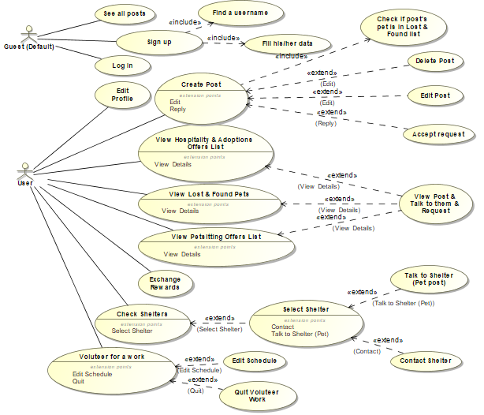
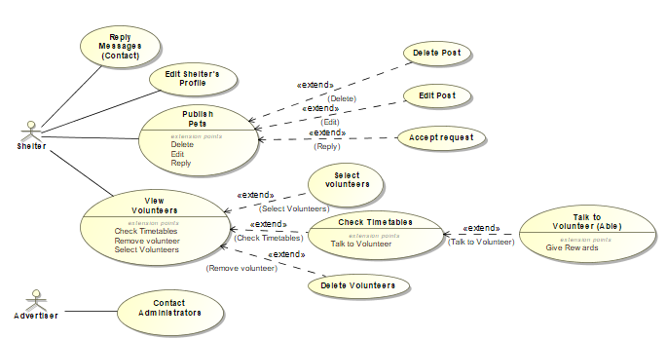
Models
UML Use-Case (Road Map)

Slide 6
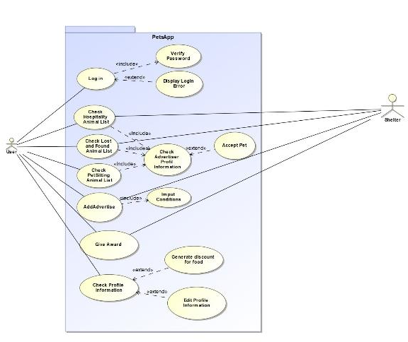
Models
UML Use-Case (Simplified)

Slide 7
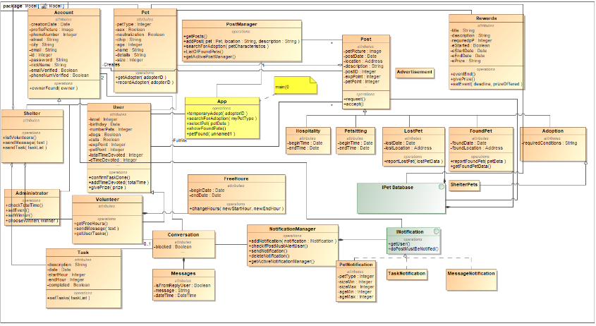
Models
UML Class Model

Slide 8
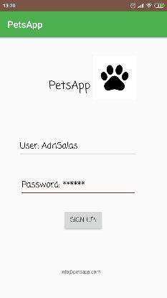
Models
UI Mobile-Design

Slide 9
Models
UI Web-Design

Slide 10
Implementation Models
NEED TO ADD
REAL USE-CASE MODEL
ADRI WILL CREATE IT
WHEN EVERYONE FINISH CODING

Slide 11
Implementation Models
NEED TO ADD
REAL CLASS MODEL
ADRI WILL CREATE IT
WHEN EVERYONE FINISH CODING

