Slide 1
USCoffee Group 109

Slide 2
01
Positioning of the project

Slide 3
Problem statement
- The challenge at hand revolves around the buying and selling of coffee, beverages, and select snacks, as well as the provision of related services. This issue directly impacts salespersons at coffee shops, coffee shop owners, and customers seeking to purchase coffee.
- For coffee shop owners, it poses a dual challenge: not only do they need to effectively sell their coffee and manage their shop operations, but they also need to adapt to the evolving customer preferences and market demands.
- On the customer side, there's a growing desire to purchase coffee and related products without the inconvenience of leaving their homes. This convenience factor is increasingly crucial to meet customer expectations.

Slide 4
Problem statement
Impact:
- Coffee Shop Owners: Find it challenging to sell products efficiently and run their coffee shop while adapting to market changes.
- Customers: Experience inconvenience by needing to visit a coffee shop in person for their coffee or beverages, which may not suit their busy schedules or preferences.
Successful solution
The ideal solution would help coffee shop owners sell more efficiently and manage their shops better. Additionally, it would make it easy for customers to order coffee and food from coffee shops without the need to leave their homes, simplifying their purchasing experience.

Slide 5
Product Position Statement
- Product Name: USCoffee
- For: Salepersons, coffee shop owners, and customers
- Who: Sell and buy coffee, drinks, cake, candy...
- The USCoffee empowers coffee shop owners to easily sell and manage their shops online with just an internet connection, while offering customers the convenience of ordering their favorite beverages.
- Unlike competitors like Highlands, The Coffee House, and Phuc Long, our product creates an environmentally friendly platform that benefits both coffee shop owners and customers.

Slide 6

Project management

Slide 7
Team structure
Team Lead, PM: Nguyen Dac Khoi
Architecture, Dev:
Tran Van Quyet
Design, BA:
Duong Phuoc Sang
Tester:
Nguyen Hoang Duc Nguyen
Developer Assistant:
Nguyen Dac Khoi
Design, BA Assistant:
Nguyen Hoang Duc Nguyen

Slide 8

Software requirements

Slide 9
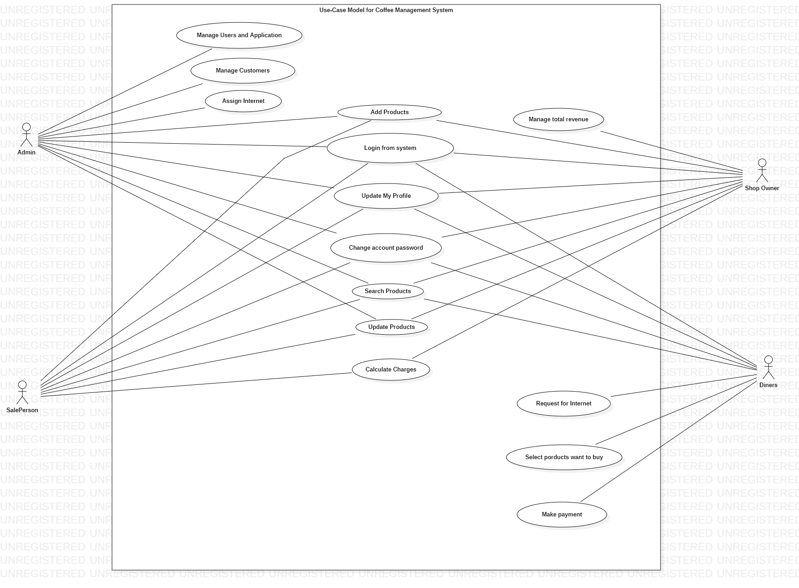
Use-case model

Slide 10
Non-functional requirements
Applicable Standards:
+ The desktop user-interface shall be Windows 7 or higher, with at least 4GB of RAM and a good processor should be able to support most typical websites. .
+ Web browser: a modern web browser installed, such as Google Chrome, Mozilla Firefox, or Microsoft Edge, etc.
+ Resolution: A common resolution is 1024x768 pixels or higher
+ OS: Windows, macOS, or Linux, and the operating system version should be supported and regularly updated
Environmental:
+ Internet Connection: The data center hosting the website should have a high-speed internet connection to handle the expected user traffic
+ The data center should monitor environmental factors, such as temperature and humidity, to maintain optimal conditions for server operation. Data centers should ensure that the server environment is kept within a temperature range of 50-60 degrees Celsius.

Slide 11
Privacy:
+ User's personal information should remain confidential and inaccessible to other users
+ User data, especially sensitive information like passwords or financial details, should be encrypted both during transmission and storage
Usability:
+ User interface: The website should have an intuitive and user-friendly interface that is easy to navigate
+ Responsiveness: The website should be responsive and adapt to different screen sizes and devices.
+ Accessibility: The website should be accessible to users with disabilities, conforming to accessibility guidelines and standards.

Slide 12
04
Analysis and design

Slide 13
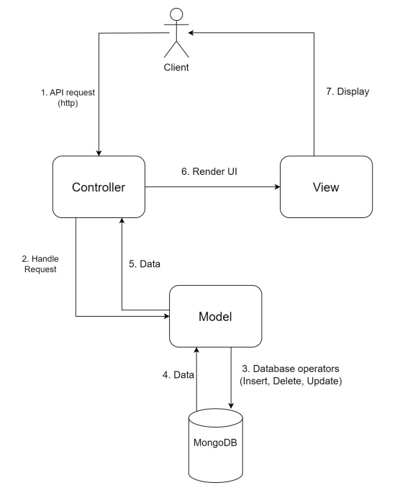
Architecture
In software architecture, we use MVC pattern
- Controller: It acts as an intermediary between the Model and View. It handles user events from the View, interacts with the Model to update data, and then updates the View to display the updated information. The framework use for controller component is Next.js
- View: It's the user interface that displays data to the user and interacts with them. The View does not contain business logic; it simply displays information from the Model and sends user events to the Controller. For front-end, we use ReactJS, CSS for styling
- Model: This is the part of the application responsible for managing data and data processing logic. The Model represents specific data and business rules. Because the controller use Next.js, the Model will use MongoDB with Mongoose (an ORM library) for a MongoDB database

Slide 14

Software testing

Slide 15
Test environment
Hardware requirements:
+ A standard desktop computer, laptop, or even a tablet or smartphone with at least 4 GB of RAM is recommended for smooth testing, required internet connection
+ Test across common resolutions, including 1366x768, 1920x1080, and 1440x900.
+ For PC:
o CPU: intel i3 or later, in this project, we use i5 11400f, i5 8250
o GPU: Intel HD Graphics, intel UHD Graphics, AMD Radeons Graphics, NVIDIA GeForce GT 1030,… For this project, we use RTX 2060, UHD620
Software requirements:
+ Browser: Microsoft edge version 115.0.1901.203,
Chrome version 116.0.5845.141
+ Operating System: Windows 10, 64 bits version 22H2 Windows 11 Pro, 64 bits version 22H2

Slide 16
Test environment
Productivity and Support Tools:
+ Defect tracking: MS Excel 2019
+ Write test plan: MS Word 2019
+ Defect fixing: Visual Studio Code 2019
+ Sharing documents: Drive
+ Sharing source: Github
+ Test automation: Katalon
Responsibility:
+ Test manager: Nguyễn Đắc Khôi
+ Tester: Nguyễn Hoàng Đức Nguyên
Nguyễn Đắc Khôi
Dương Phước Sang

Slide 17
Thanks for listening

