Slide 1

Handwritten text recognition
Mentor: Nguyen Thanh Tuan
Member : Nguyen Van Sang, Nguyen Minh Anh
21 Jan 2022

Slide 2

Problem
Dataset
Input - Output
Data Preprocessing
Modeling
Outcomes
OUTLINE
KEY DISCUSSION POINTS

Slide 3
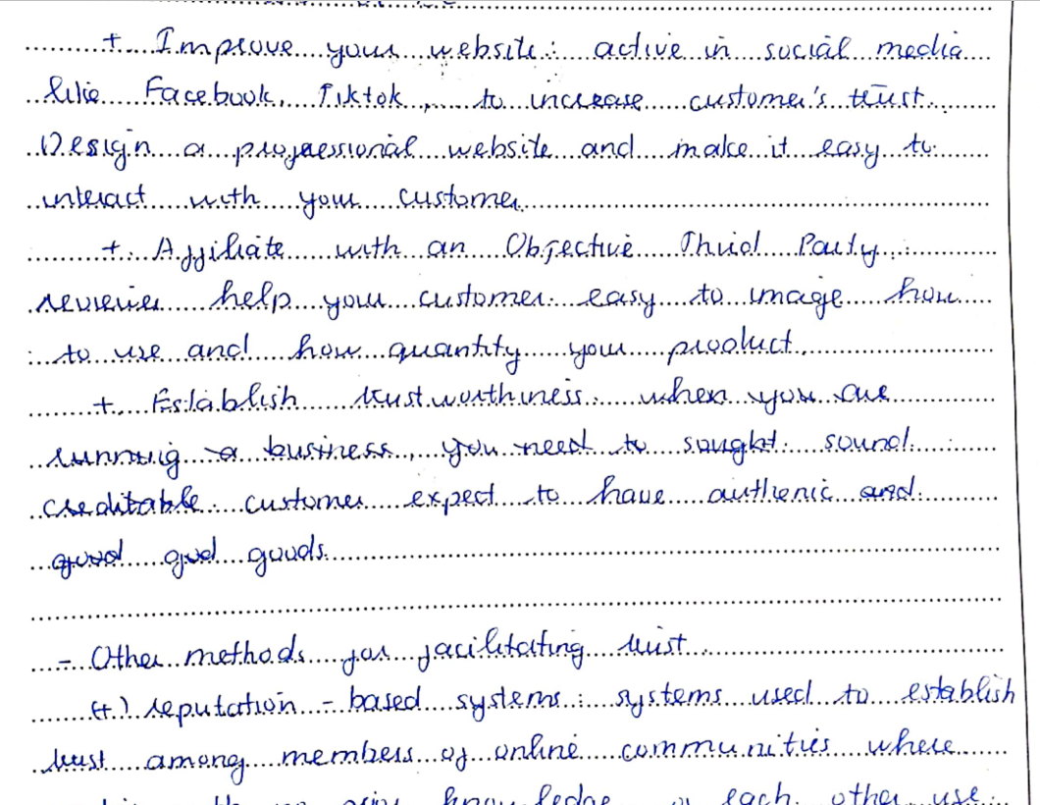
PROBLEM

Slide 4
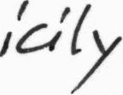
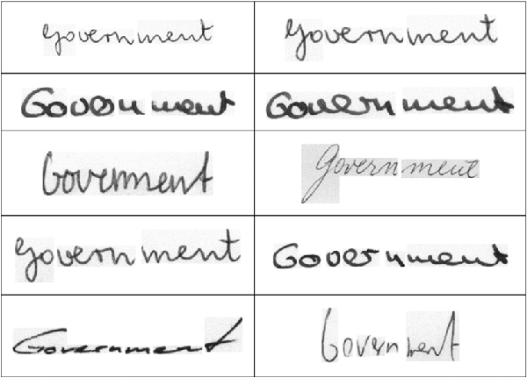



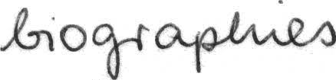
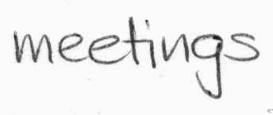
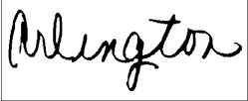
2. DATASET
The IAM database contains 15,320 images of handwritten words

Slide 5
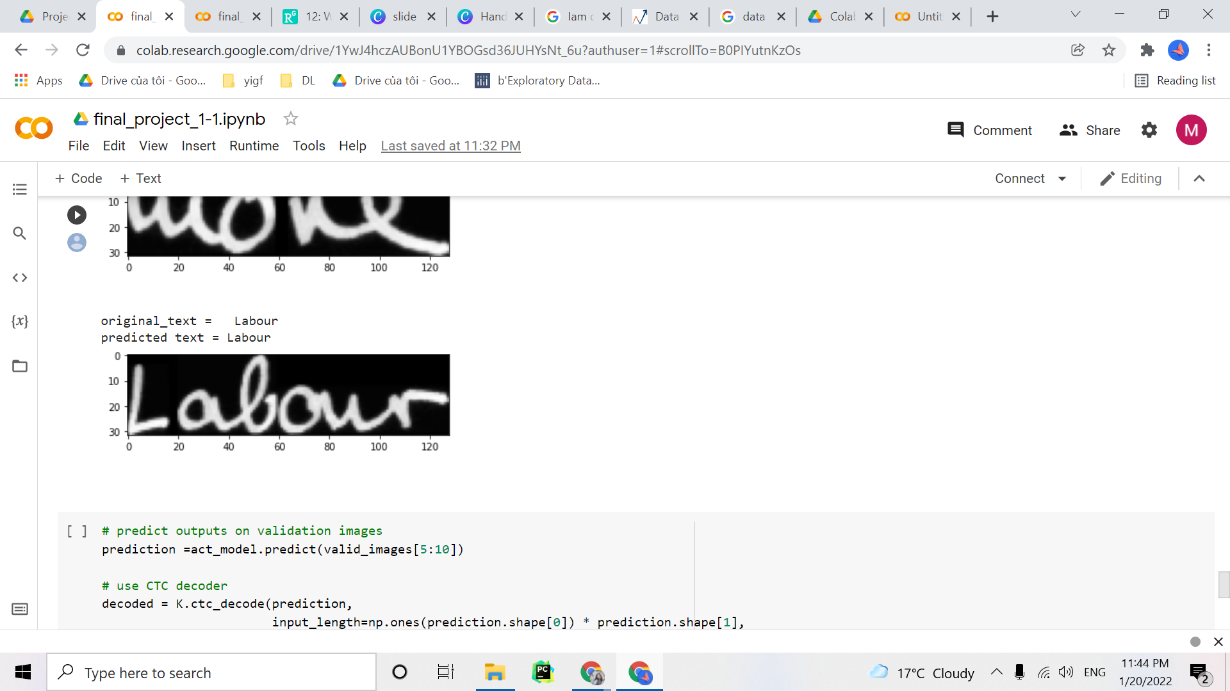
3. INPUT - OUTPUT

Slide 6
4. DATA PREPROCESSING
Encode to label
"!\"#&'()*+,-./0123456789:;?ABCDEFGHIJKLMNOPQRSTUVWXYZabcdefghijklmnopqrstuvwxyz"
UNIVERSITY=>[46, 39, 34, 47, 30, 43, 44, 34, 45, 50]
table =>[71, 52, 53, 63, 56]
Generate padded label
value = 80
Converts image to shape (32, 128, 1) & normalize

Slide 7
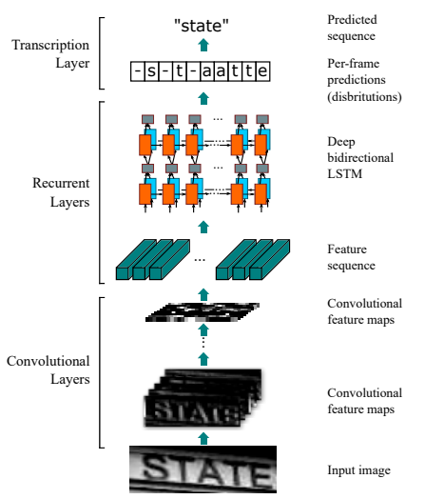
5. MODEL
CRNN + CTC loss

Slide 8
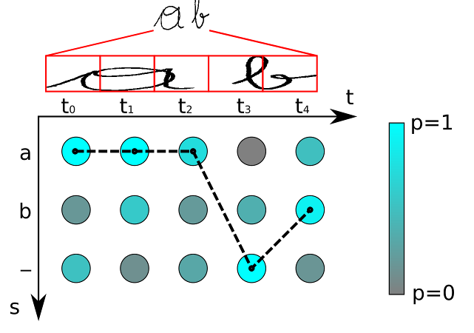
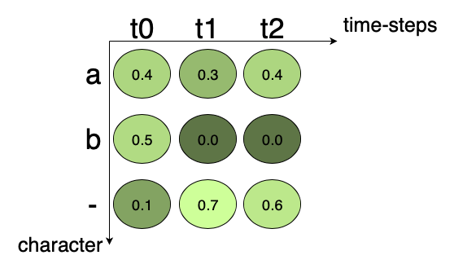
5. MODEL
CTC Loss (connectionist temporal classification)
1.Encoding Text: Mỗi timestep là 1 ký tự, nếu trùng nhau -> gộp thành 1, đối với các words có ký tự trùng nhau, thêm ký tự blank “-” :
VD: meet -> mm-ee-ee-t, m-e-ee-t
2.Calculate loss
3.Decoding Text

Slide 9
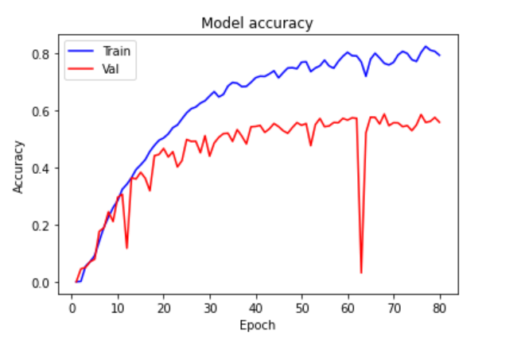
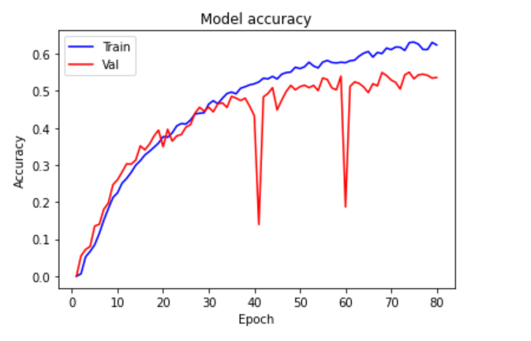
6.OUTCOMES
128 units LSTM, dropout = 0.2
128 units LSTM, dropout = 0.5

Slide 10
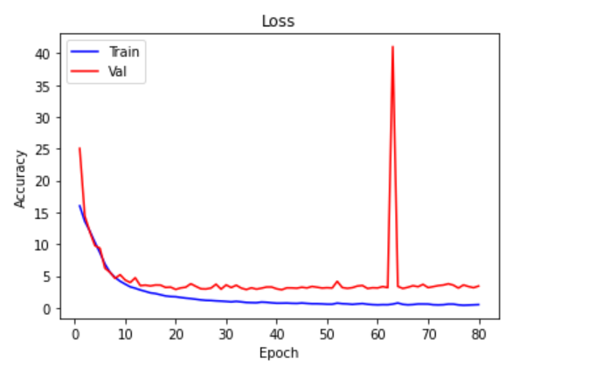
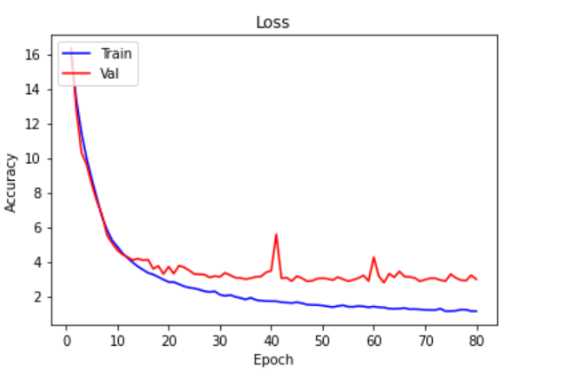
6.OUTCOMES
128 Nodes, dropout = 0.2
128 Nodes, dropout = 0.5

Slide 11
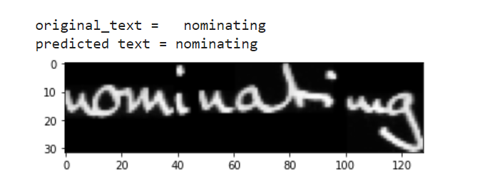
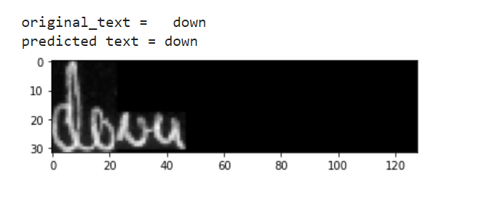
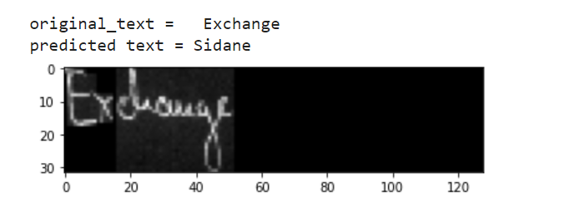
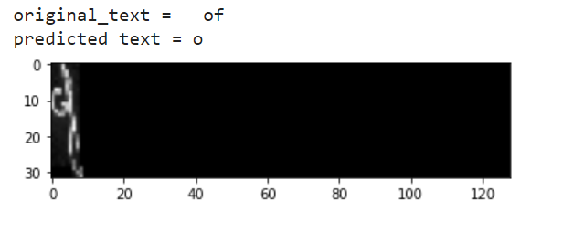
6.OUTCOMES

