Slide 1
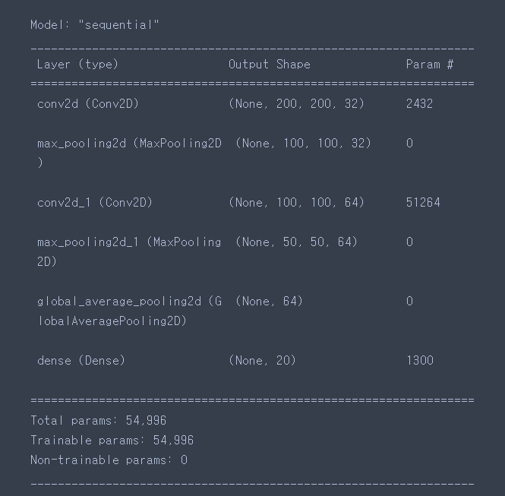
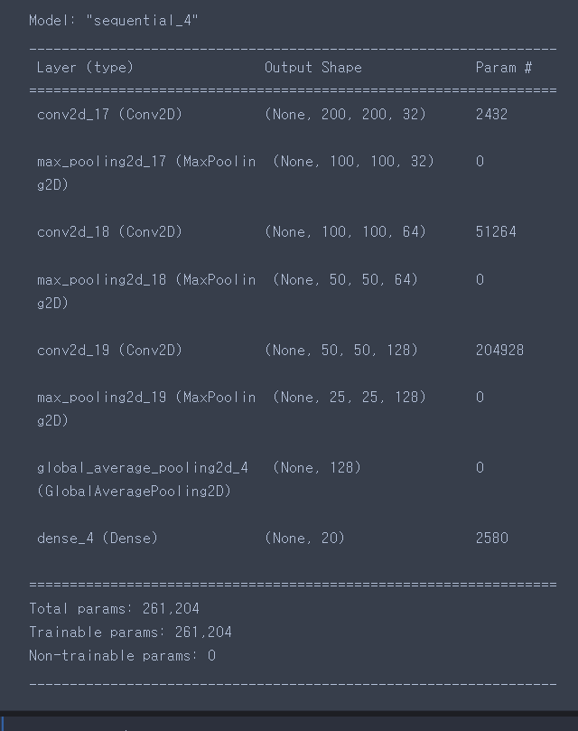
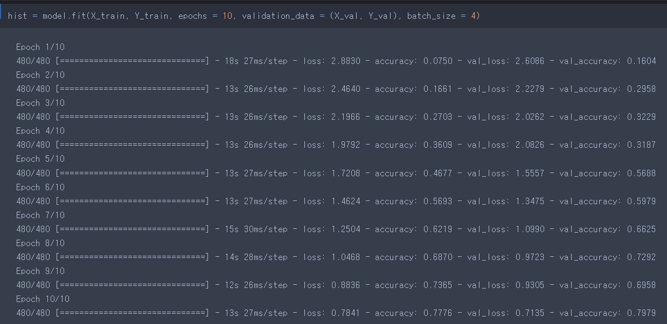
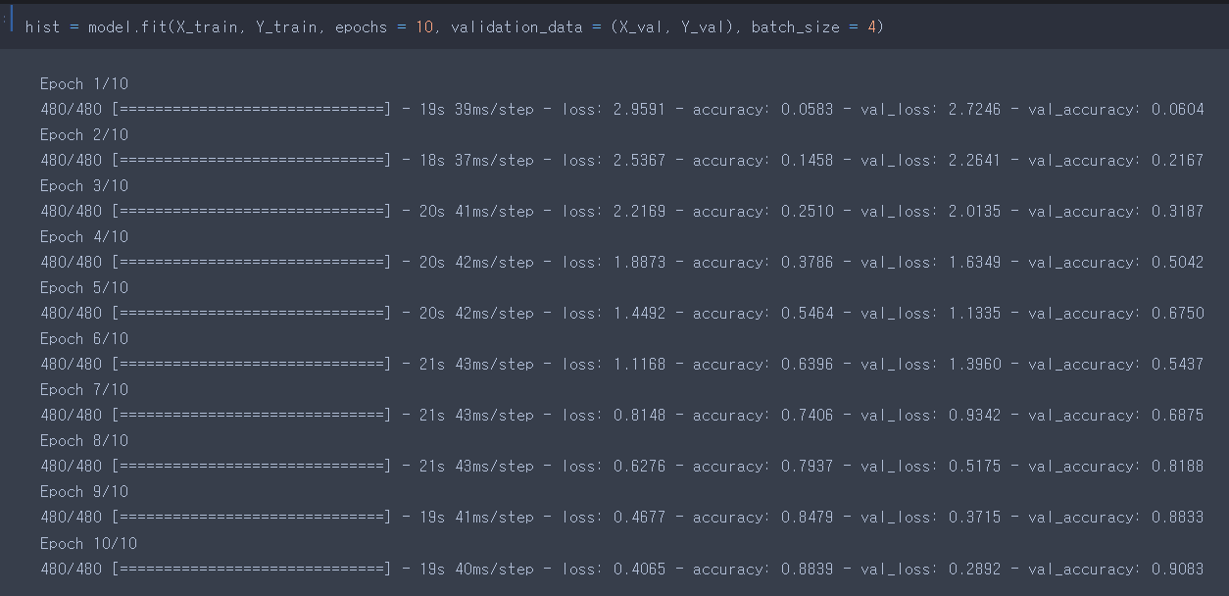
Layer 개수 2개
Accuracy : 0.7776
Val_accuracy : 0.7979
Layer 개수 3개
Accuracy : 0.8839
Val_accuracy : 0.9063

Slide 2
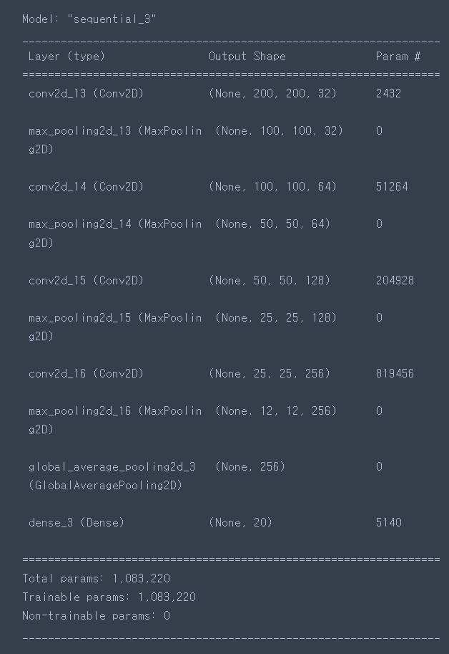
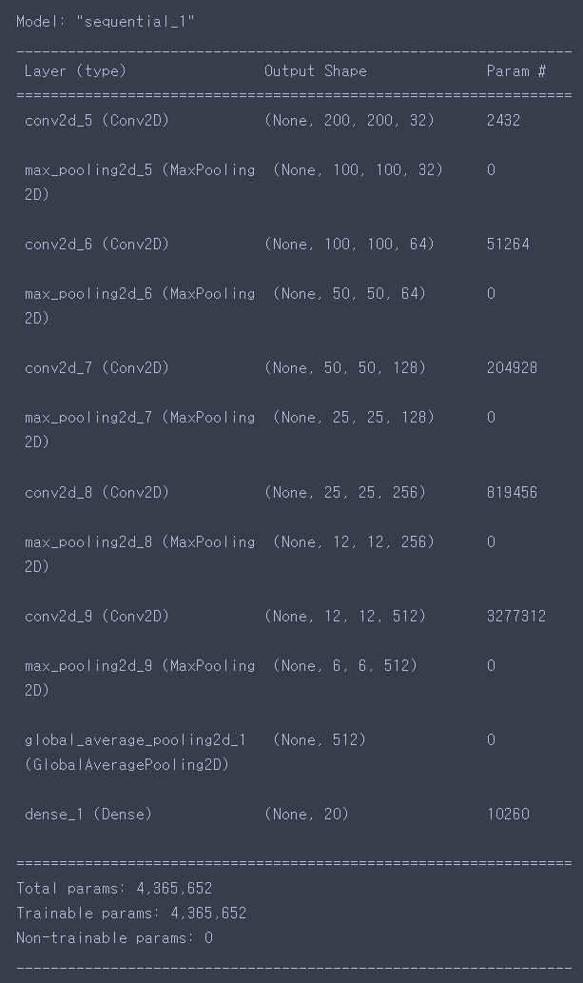
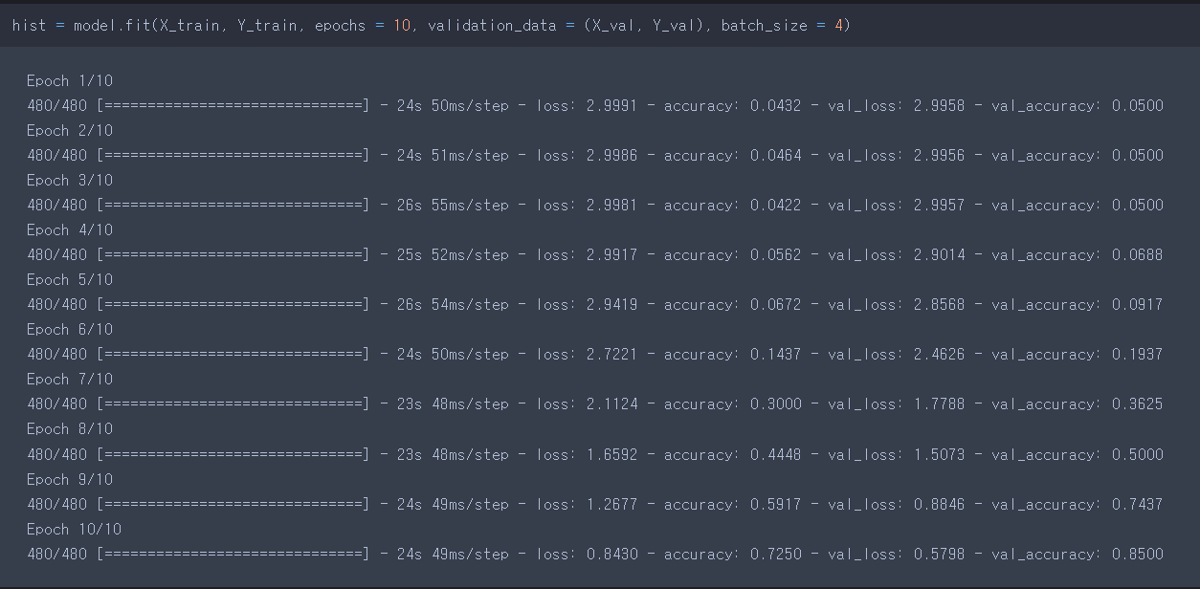
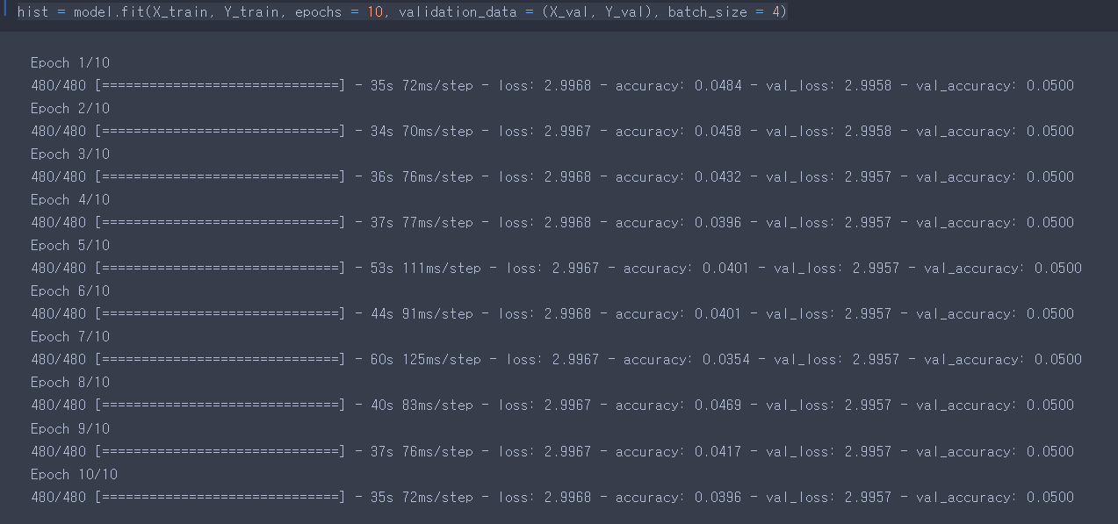
Layer 개수 4개
Accuracy : 0.7250
Val_accuracy : 0.8500
Layer 개수 5개
Accuracy : 0.0336
Val_accuracy : 0.0500

Slide 3
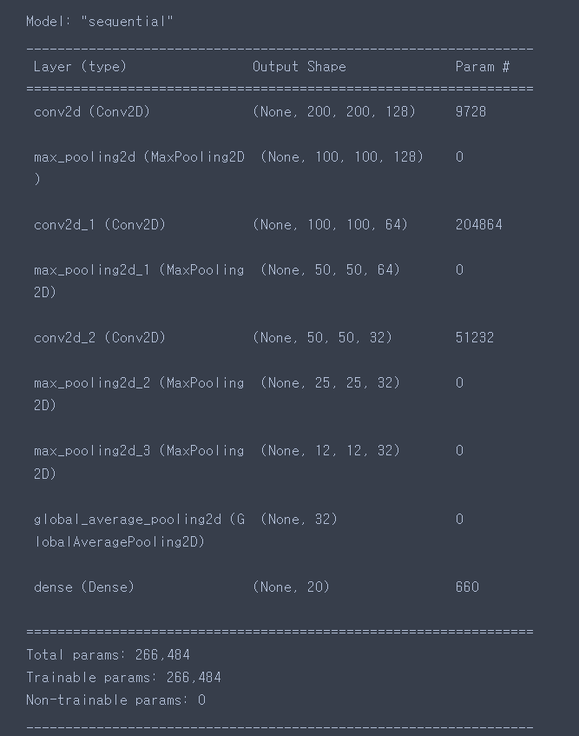
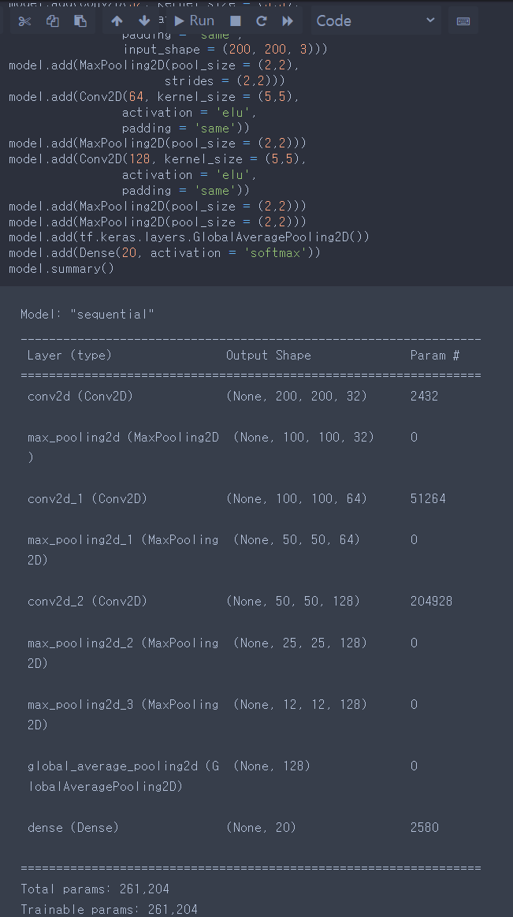
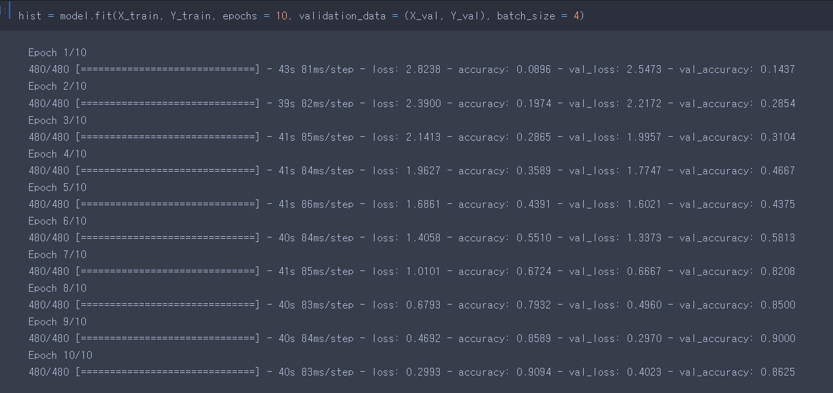
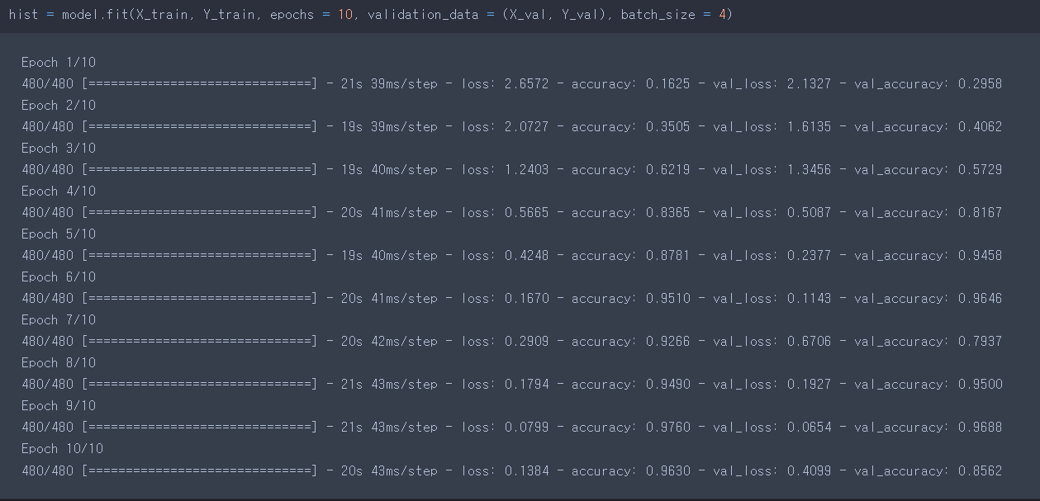
Cell 개수 128-64-32
Accuracy : 0.9094
Val_accuracy : 0.8625
Activation Function : ELU
Accuracy : 0.9630
Val_accuracy : 0.8562

