Slide 1
NLP Term Indexing Project
Crime vs Family
20154637 박 상 현

Slide 2
Agenda
1
Coding 1
Index Script files
Data Chart
Set Hypothesis
Coding 2
Compare output
Result
2
3
4
5
Hypothesis
There will be differences in the frequency and type of vocabulary that expresses the positive and negative used in family and crime films.

Slide 3
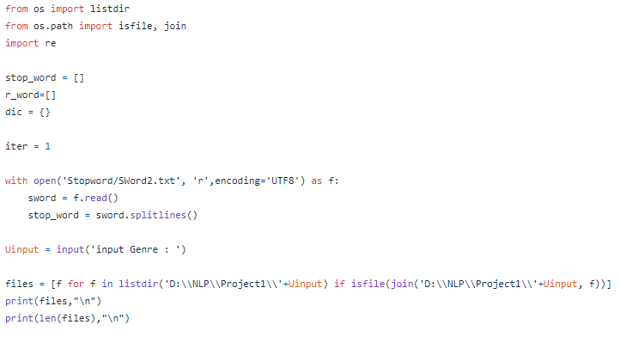
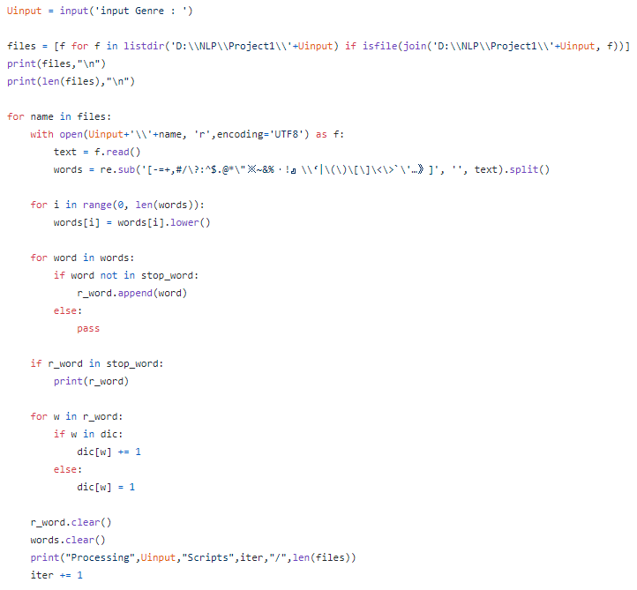
Coding 1 - Indexing
Add stop word & set Data directory
Get script files at set directory
Use Regular expression to remove special Character
Using stop_word list to remove stop word
add word to dictionary (indexing) and save as txt

Slide 4
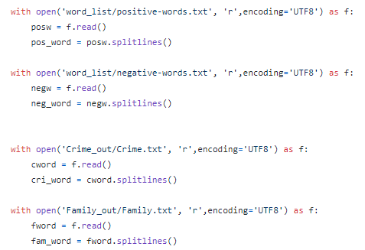
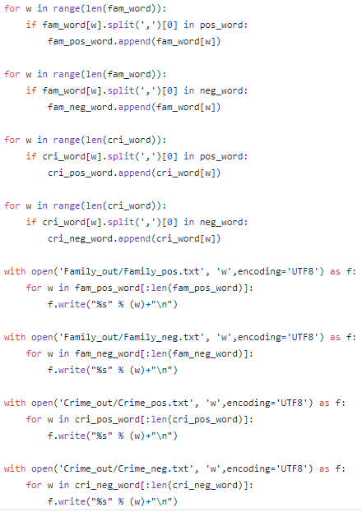
Coding 2 – Compare1
Open each genre’s word dictionary file
Open positive & negative word list file
Compare genre dict file with positive & negative file
Save Result file as txt ( for excel chart)

Slide 5
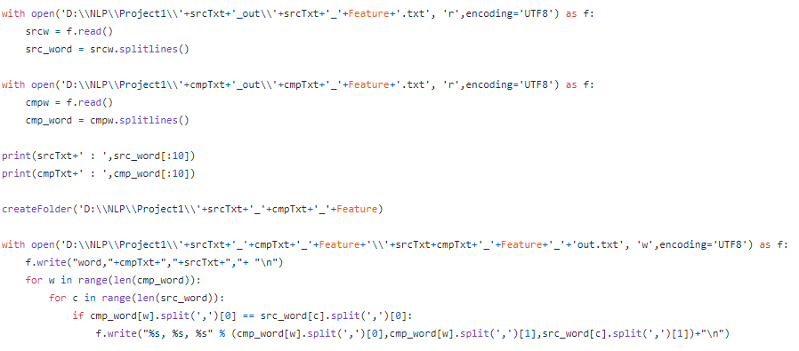
Coding 2 – Compare2
Open each genre’s word compare dictionary file
Compare each file – word, Frequency - Cmp , Frequency - Src
Save file with txt

Slide 6
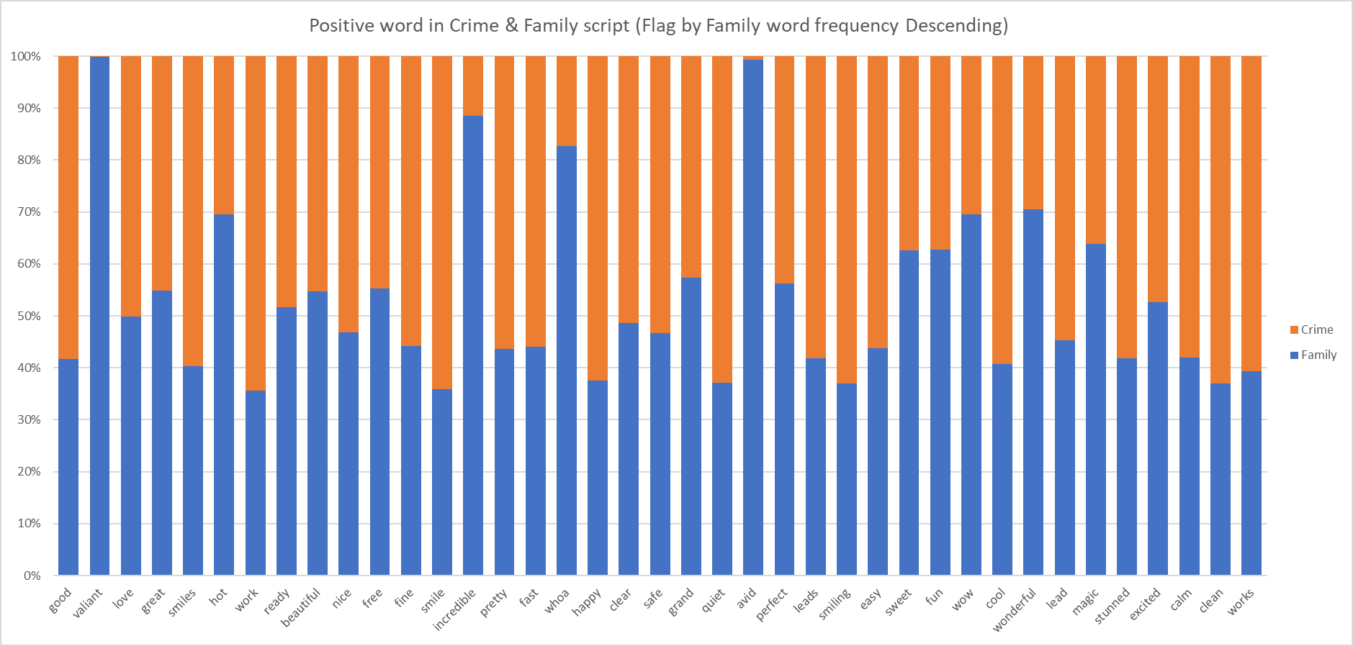
Data Chart – Positive word

Slide 7
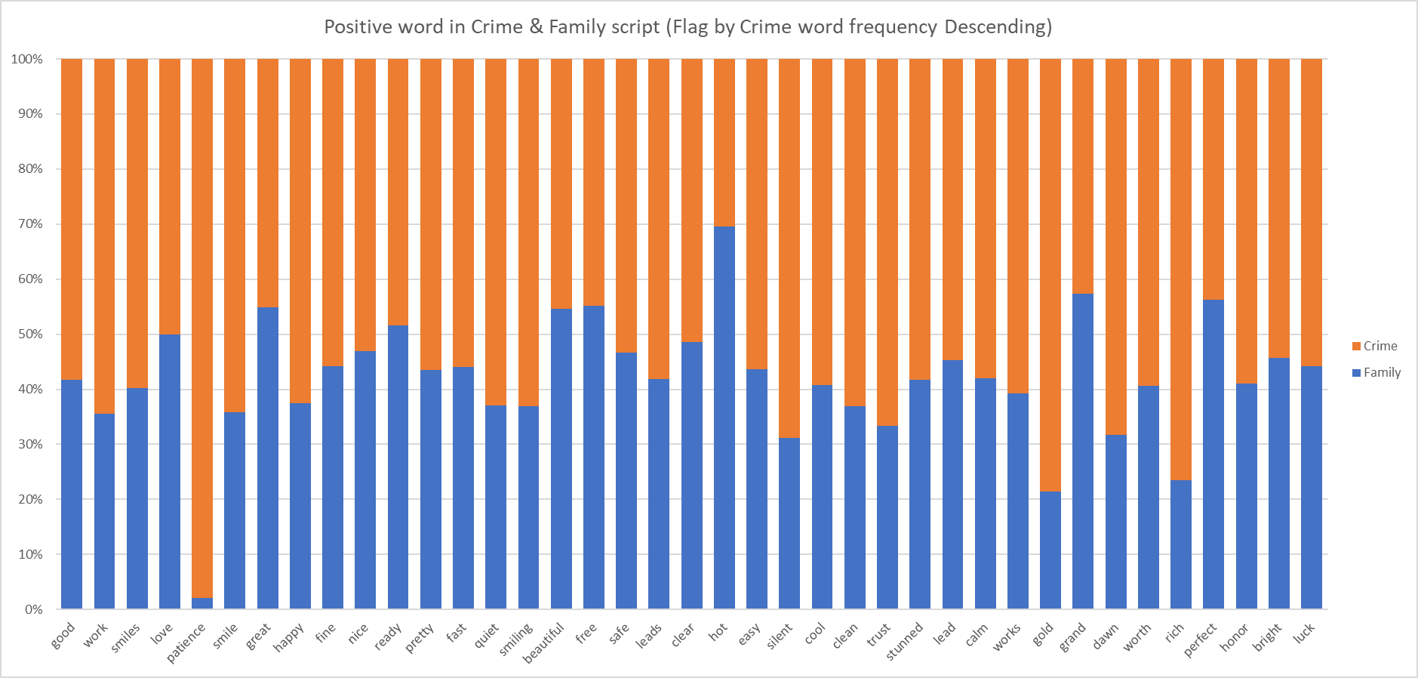
Data Chart – Positive word

Slide 8
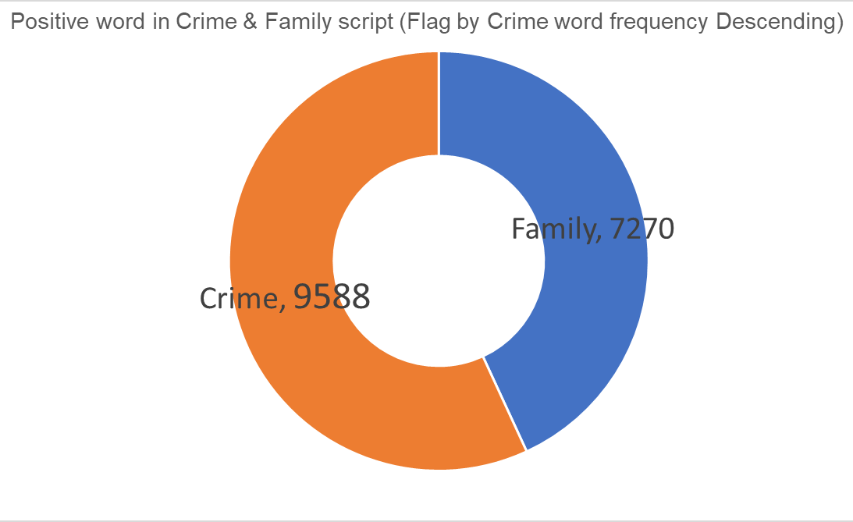
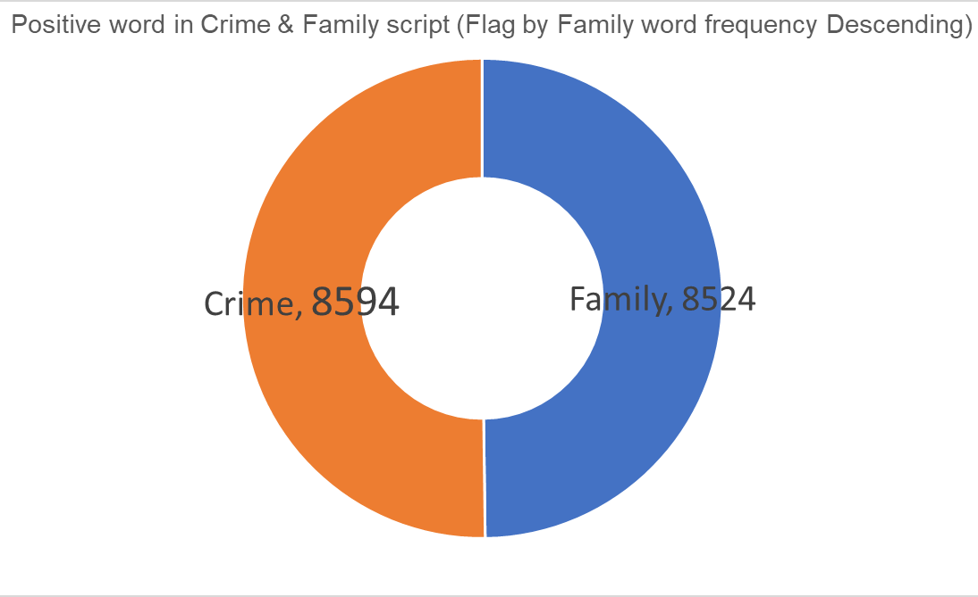
Data Chart – Positive word

Slide 9
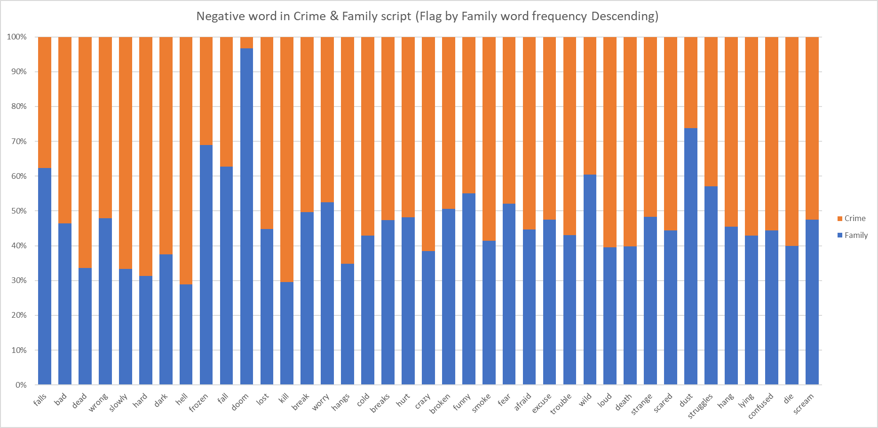
Data Chart – Negative word

Slide 10
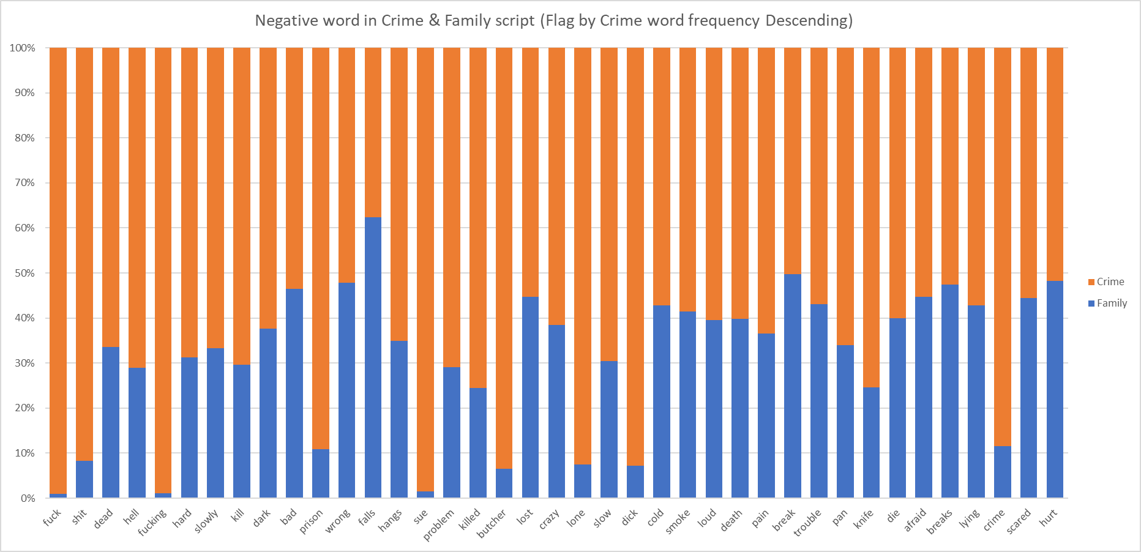
Data Chart – Negative word

Slide 11
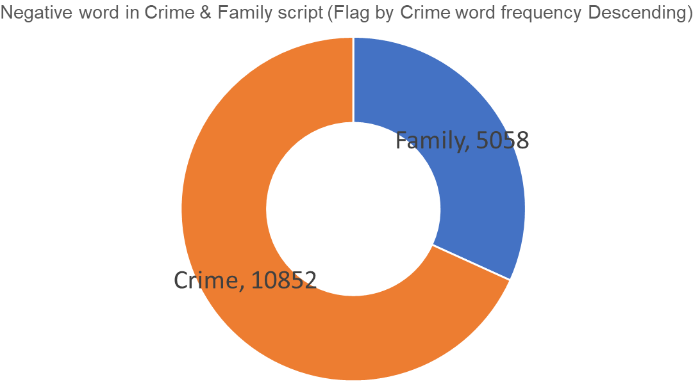
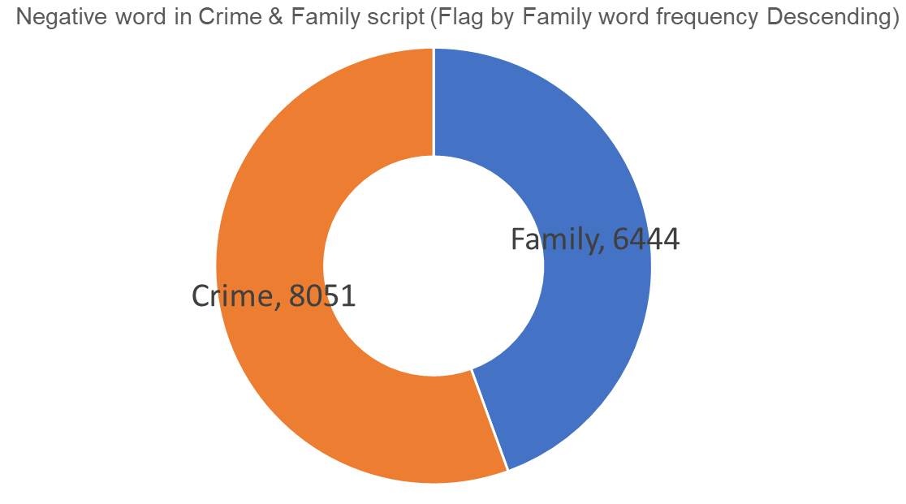
Data Chart – Negative word

Slide 12
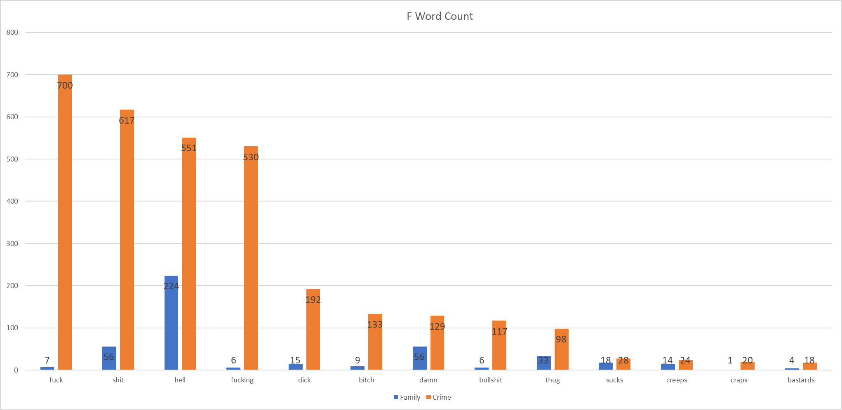
Data Chart – F word

Slide 13
Result
# F-word
Crime movie F-word count : 3157
# Negative
7X
increase
Family F-word count : 446

