Slide 1
NLP Term Indexing Project
Crime vs Family
20154637 박 상 현

Slide 2
Agenda
1
Coding 1
Index Script files
Data Chart
Set Hypothesis
Coding 2
Compare output
Result
2
3
4
5
Hypothesis
There will be differences in the frequency and type of vocabulary that expresses the positive and negative used in family and crime films.

Slide 3
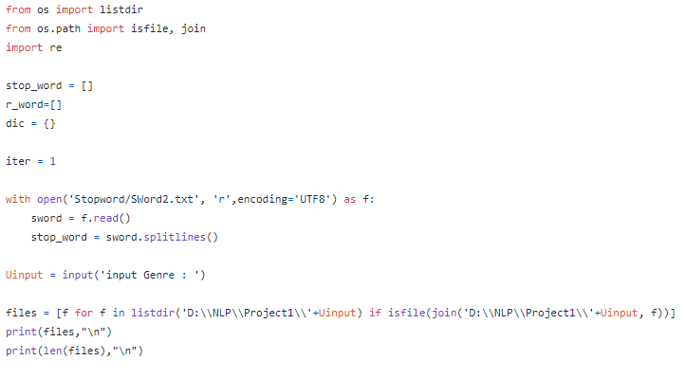
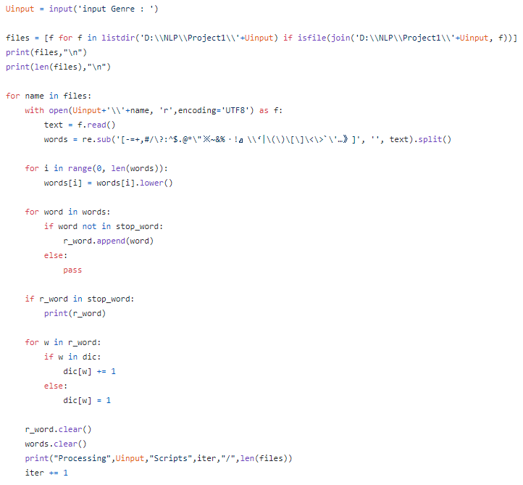
Coding 1 – Indexing word
Add stop word & set Data directory
Get script files at set directory
Use Regular expression to remove special Character
Using stop_word list to remove stop word
add word to dictionary (indexing) and save as txt

Slide 4
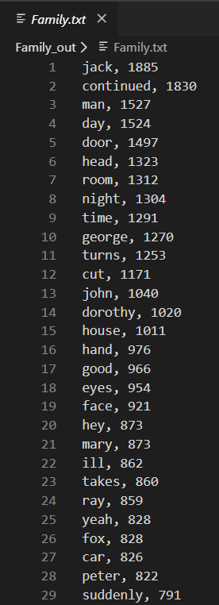
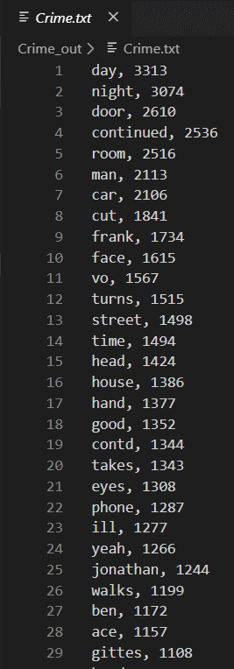
Indexing result

Slide 5
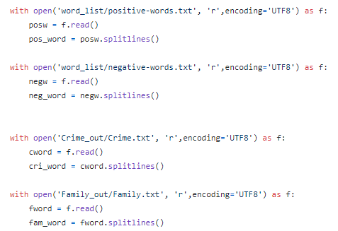
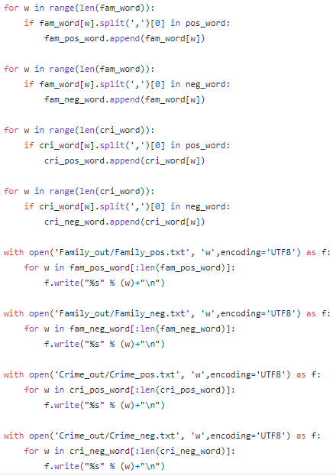
Coding 2 – Compare positive & negative
Open each genre’s word dictionary file
Open positive & negative word list file
Compare genre dict file with positive & negative file
Save Result file as txt ( for excel chart)

Slide 6
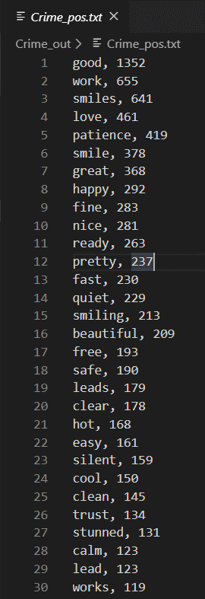
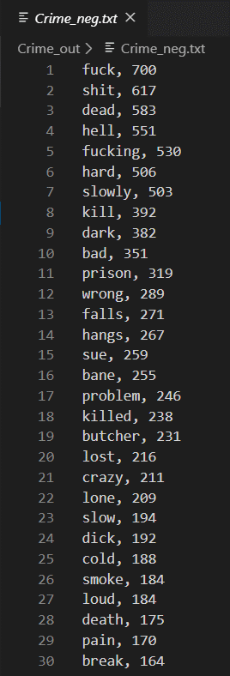
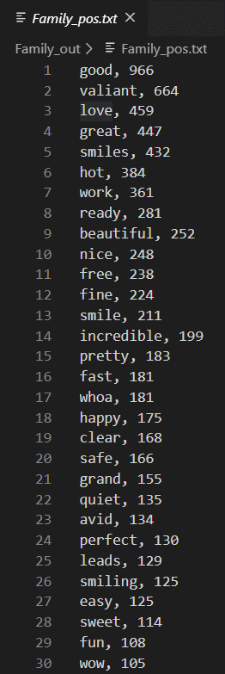
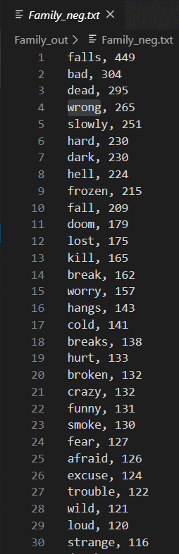
Classification result

Slide 7
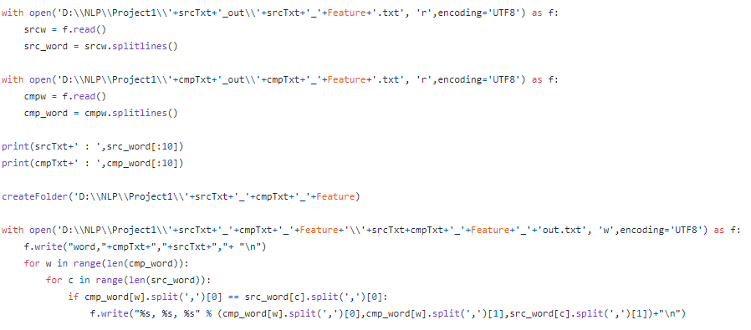
Coding 2 – Compare each text
Open each genre’s word compare dictionary file
Compare each file – word, Frequency - Cmp , Frequency - Src
Save file with txt

Slide 8
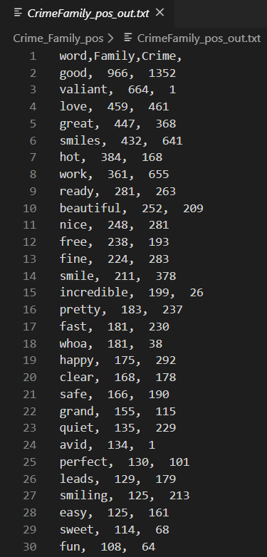
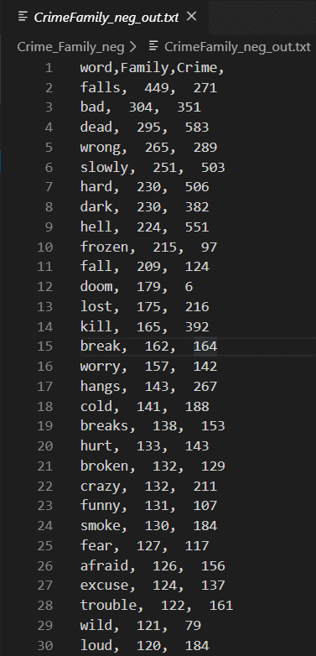
Compare result

Slide 9
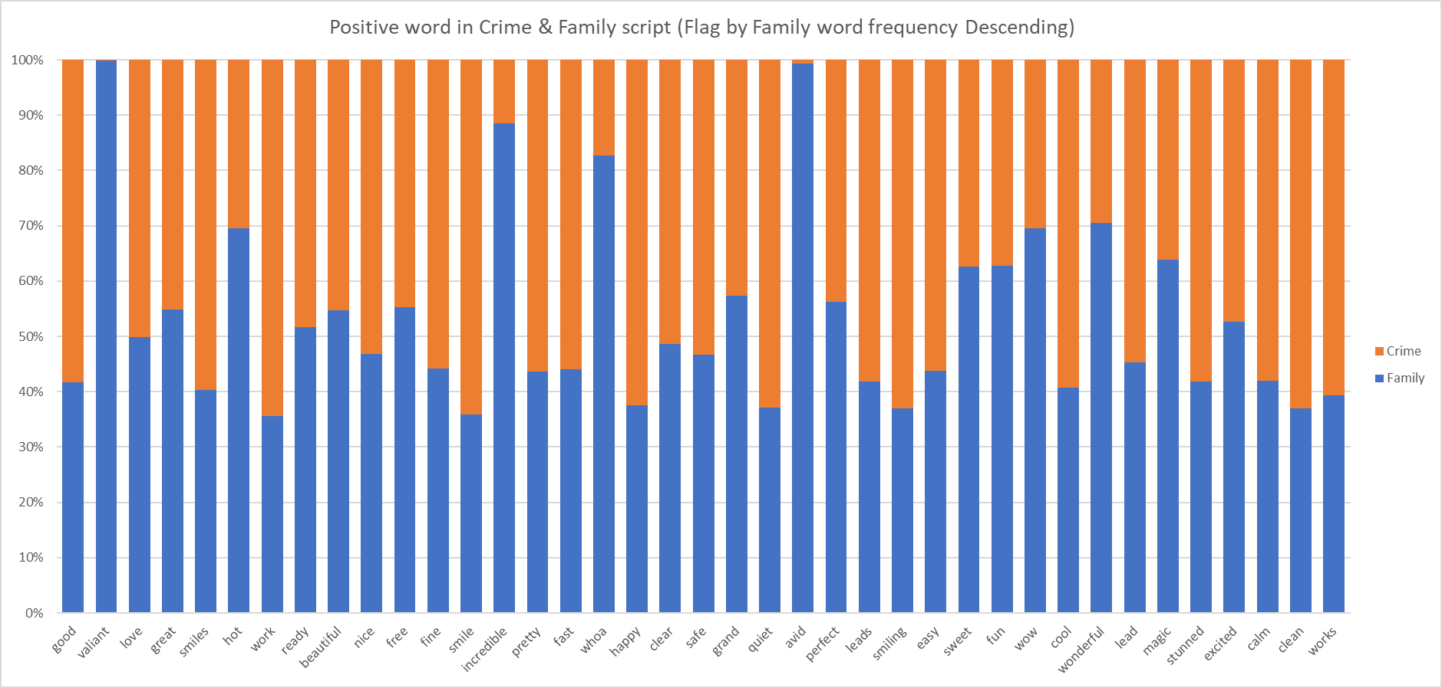
Data Chart – Positive word
Flag = Family movie script’s Positive word by Descending order

Slide 10
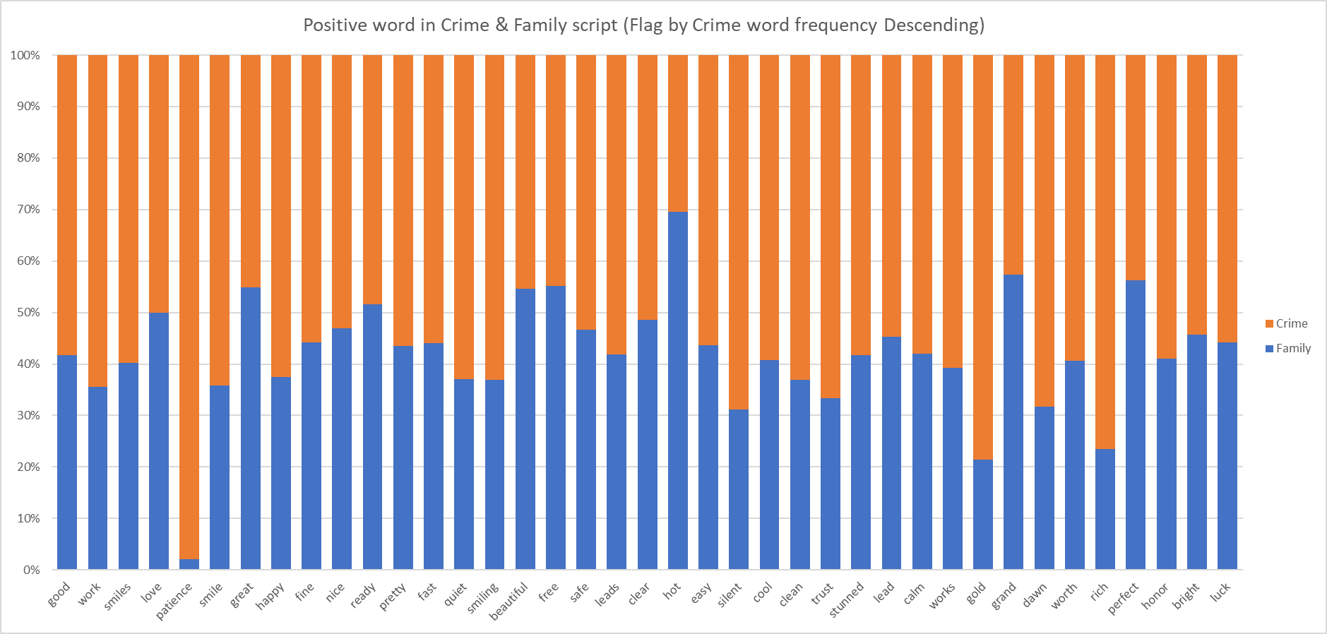
Data Chart – Positive word
Flag = Crime movie script’s Positive word by Descending order

Slide 11
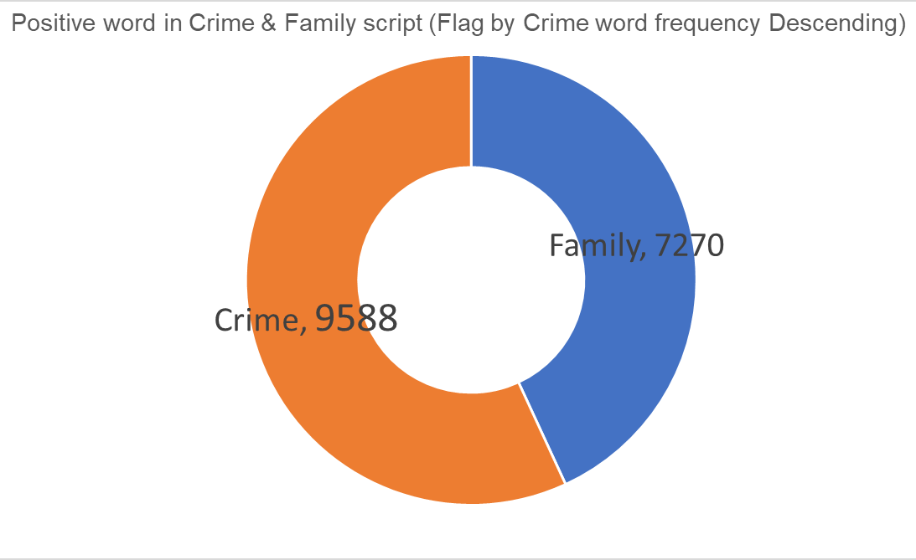
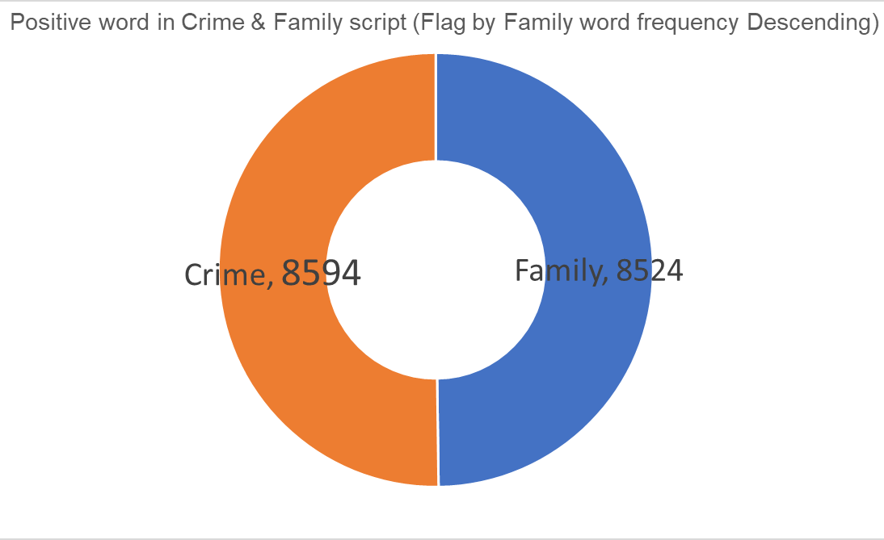
Data Chart – Positive word

Slide 12
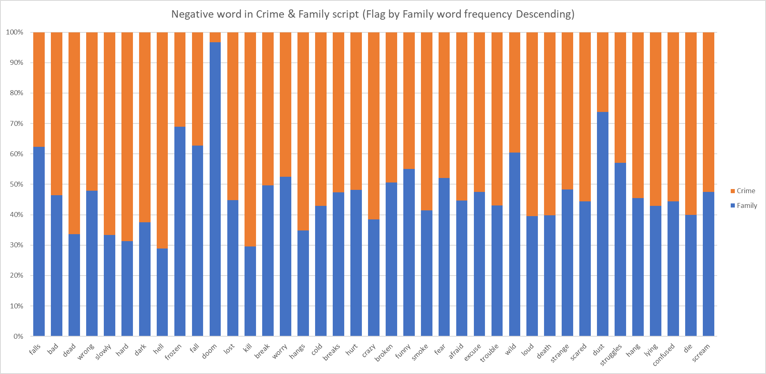
Data Chart – Negative word
Flag = Family movie script’s Negative word by Descending order

Slide 13
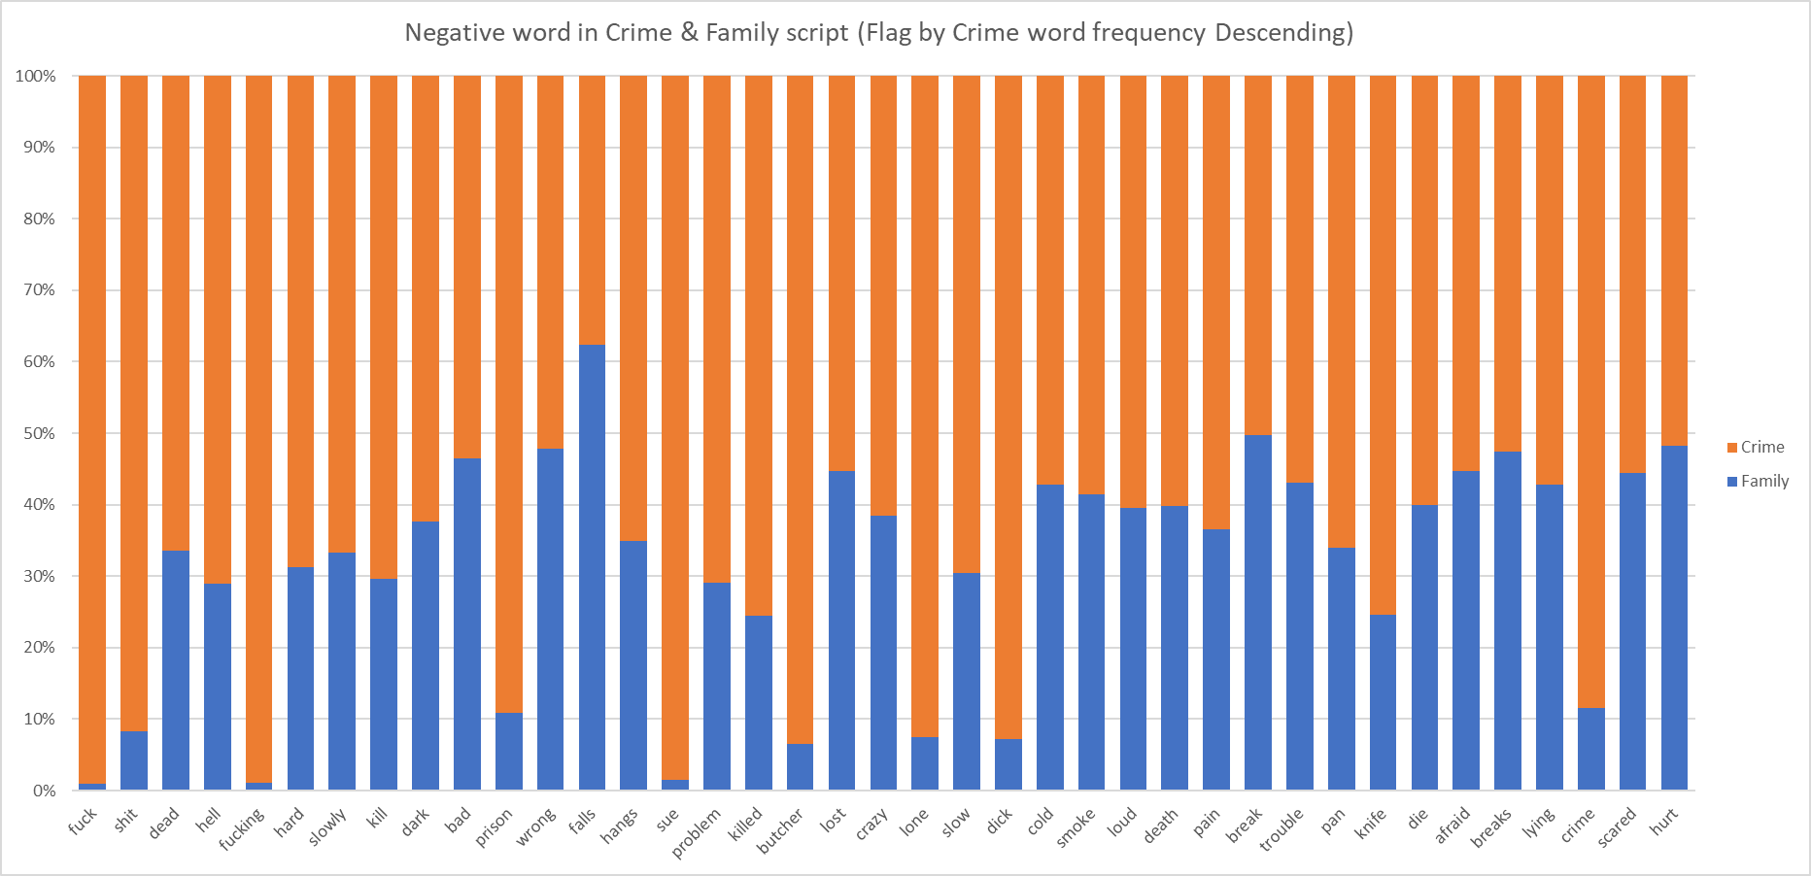
Data Chart – Negative word
Flag = Crime movie script’s Negative word by Descending order

Slide 14
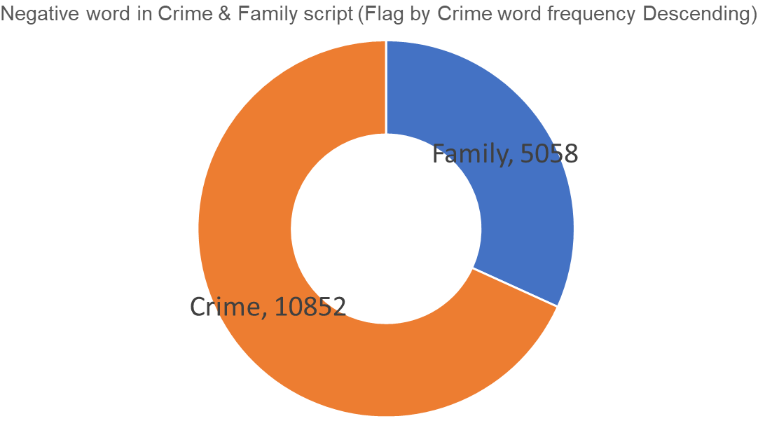
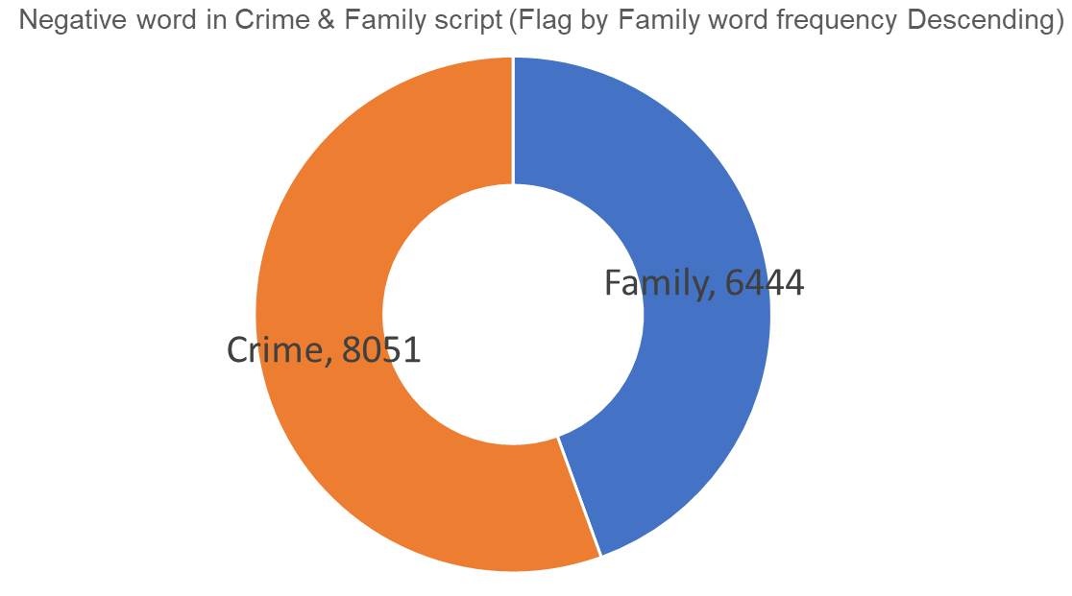
Data Chart – Negative word

Slide 15
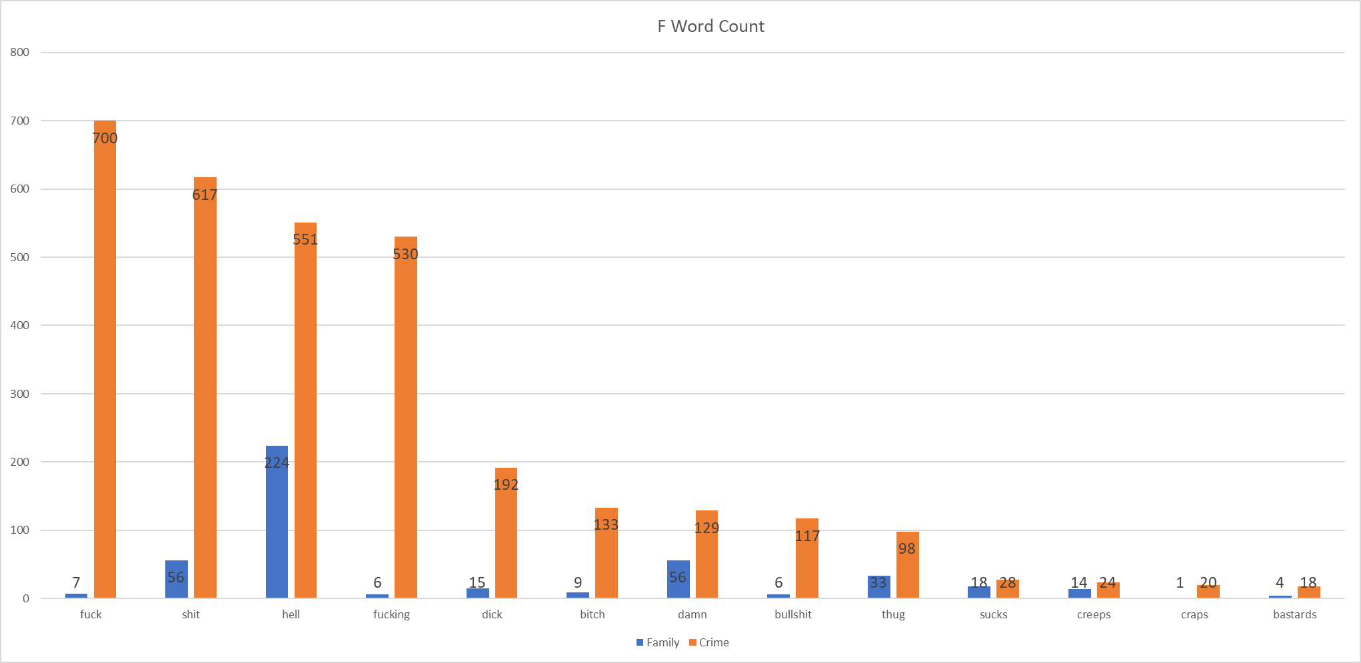
Data Chart – F word

Slide 16
Result
# F-word
Crime movie F-word count : 3157
# Negative
7X
increase
Family F-word count : 446

Slide 17
Reference
Stop word Txt file -
https://countwordsfree.com/stopwords
Positive word Txt file -
https://gist.github.com/mkulakowski2/4289437
Negative word Txt file -
https://gist.github.com/mkulakowski2/4289441
My Project Git hub Link -
https://github.com/SangHyune546/NLP/tree/master/Project1

