Slide 1
발제 1단원
Introduction to Python:
Matplotlib
Dictionaries
Pandas
Logic, control flow and filtering
Loop data structures

Slide 2
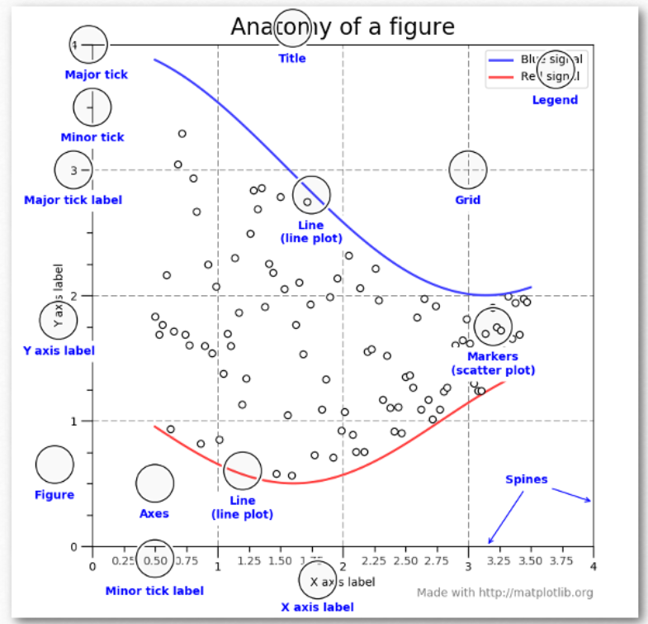
matplotlib
https://pbpython.com/effective-matplotlib.html

Slide 3
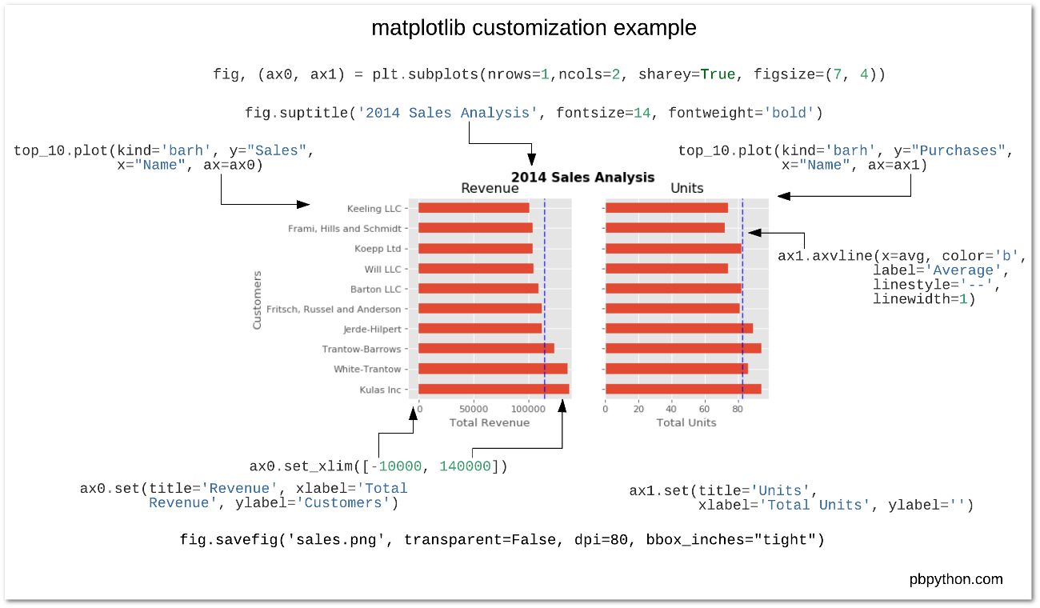

Slide 4
plt.figure(): To create a new figure plt.plot(): Plot y versus x as lines and/or markers plt.xlabel(): Set the label for the x-axis plt.ylabel(): Set the label for the y-axis plt.title(): Set a title for the axes plt.grid(): Configure the grid lines plt.legend(): Place a legend on the axes plt.savefig(): To save the current figure on the disk plt.show(): Display a figure plt.clf(): Clear the current figure(useful to plot multiple figures in the same code)

Slide 5
3D 플롯
http://jakevdp.github.io/blog/2012/08/18/matplotlib-animation-tutorial/

Slide 6
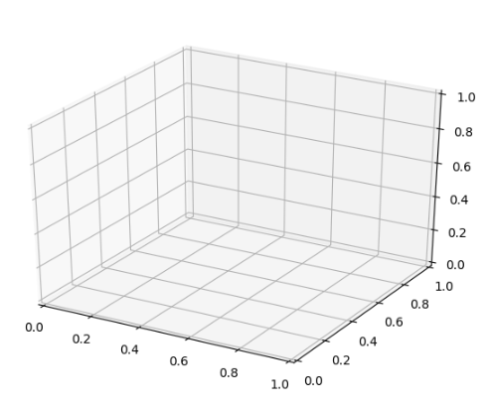
from mpl_toolkits import mplot3d import numpy as np import matplotlib.pyplot as plt fig = plt.figure() ax = plt.axes(projection="3d") plt.show()

Slide 7
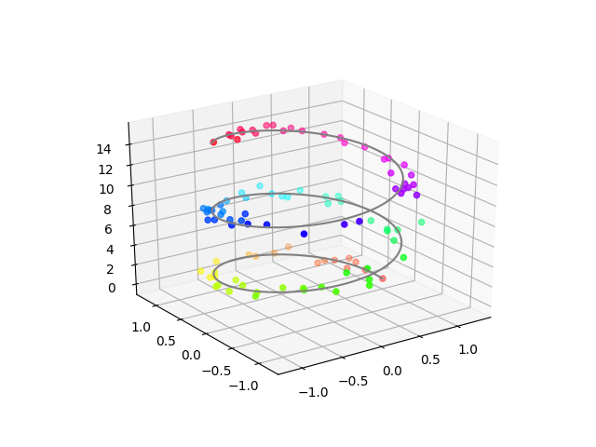
fig = plt.figure() ax = plt.axes(projection="3d") z_line = np.linspace(0, 15, 1000) x_line = np.cos(z_line) y_line = np.sin(z_line) ax.plot3D(x_line, y_line, z_line, 'gray') z_points = 15 * np.random.random(100) x_points = np.cos(z_points) + 0.1 * np.random.randn(100) y_points = np.sin(z_points) + 0.1 * np.random.randn(100) ax.scatter3D(x_points, y_points, z_points, c=z_points, cmap='hsv'); plt.show()

Slide 8
https://matplotlib.org/3.1.1/users/interactive.html
간략한 소개였습니다.
딕셔너리는 key:value 만 알아도 됩니다.

Slide 9
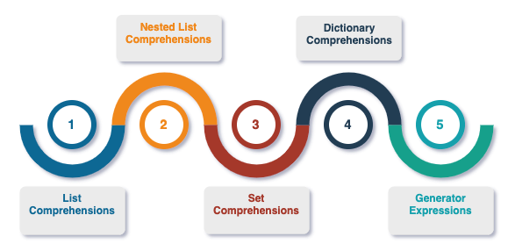

Slide 10
even_squares = [] >>> for num in range(11): ... if num%2 == 0: ... even_squares.append(num * num)>>> even_squares [0, 4, 16, 36, 64, 100]
even_squares = [num * num for num in range(11) if num%2 == 0] even_squares [0, 4, 16, 36, 64, 100]

Slide 11
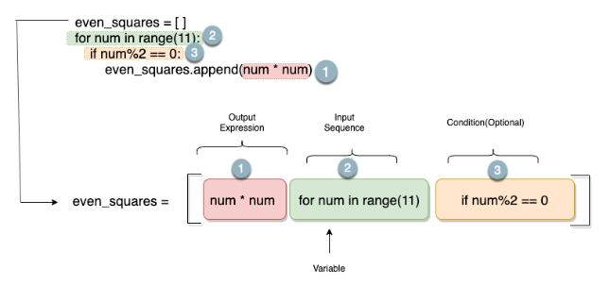

Slide 12
char_dict = {'A' : 4,'z': 2, 'D' : 8, 'a': 5, 'Z' : 10 }
{ k.lower() : char_dict.get(k.lower(), 0) + char_dict.get(k.upper(), 0) for k in char_dict.keys()}{'a': 9, 'z': 12, 'd': 8}

