Slide 1
Linked Lists
You’ll never use ‘em
but you gotta know ‘em
Dalal & Glenna
August 11, 2015

Slide 2

What are they?
Datum
Pointer
Way of organizing and storing data
Linked lists are NOT arrays (or what we know as arrays), although they function very similarly
A linked list consists of a series of Nodes, each of which have some sort of datum/data and a pointer to the next Node in the series
It is a collection of Node objects
Node

Slide 3
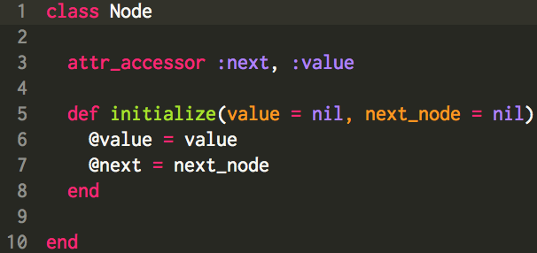

Slide 4
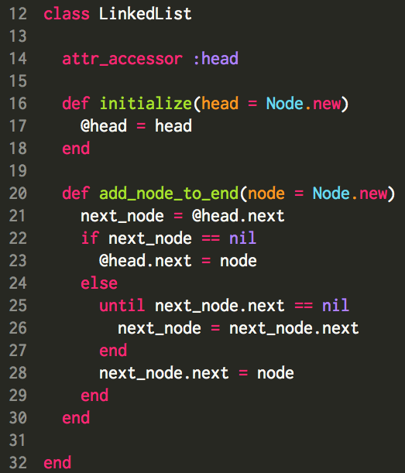

Slide 5
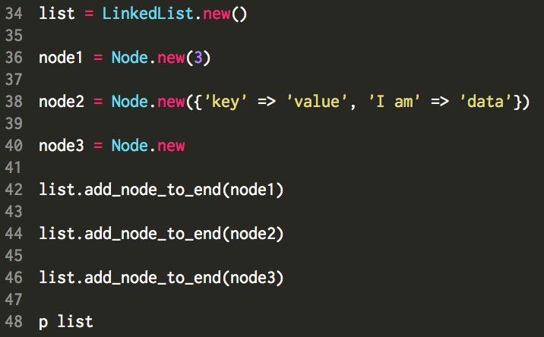

Slide 6
Node object instantiated by
default when we instantiated “list”
LinkedList object “list”
Node object “node1”
Node object “node2”
Node object “node3”

Slide 7
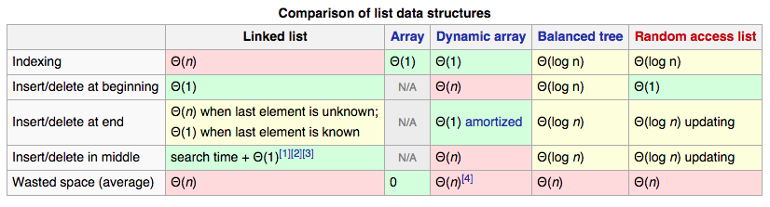
What are they good for?
Methods that frequently need to add to the beginning of a series of data – especially if the series of data is huge
Keeping data in order in a language without dynamic arrays
Interview questions

Slide 8
Why do I care about Linked Lists?
They’re frequently an interview question topic
They’re the foundation of lots of other (cooler) data structures (trees, heaps (which are really trees), b-trees, etc.). Basically anything with a “pointer” is some sort of linked list!
The concept of a “pointer” is easily applicable to real-world applications. Sudoku, anyone?

Slide 9
Question 1!
Implement three basic methods (#[], #insert, #remove) in the LinkedList class. Do not use any arrays in these methods!
LinkedList#[] accepts one argument which is an integer representing the position in the linked list of the node you want, and returns the Node object at that position
LinkedList#insert accepts two arguments which are an instance of the Node class and an integer representing the position in the list at which the node is to be inserted, and returns the Node object that was inserted
LinkedList#remove accepts one argument which is an “index” number in the linked list, and returns the Node object which is removed from the LinkedList

Slide 10
Question 2!
Implement LinkedList#zip (again, no arrays!)
LinkedList#zip accepts one argument which is a LinkedList object, and returns one LinkedList object
list1 = [0,2,4,6]
list2 = [1,3,5,7]
p list1.zip(list2) # returns LinkedList object [0,1,2,3,4,5,6,7]
p list2.zip(list1) # returns LinkedList object [1,0,3,2,5,4,7,6]

Slide 11
Question 3!
Implement LinkedList#sort (I shouldn’t have to say it, but I will – NO ARRAYS!)
LinkedList#sort sorts a Linked List, with nodes whose values are all integers, from smallest to largest based on node value. It accepts no arguments, and it returns a sorted LinkedList object.
list=[1,0,3,2,5,4,7,6]
list.sort # returns LinkedList object [0,1,2,3,4,5,6,7]

