Slide 1



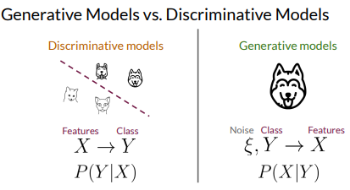
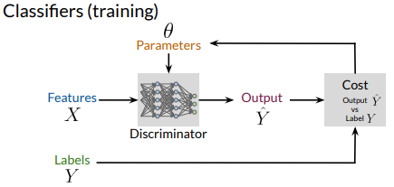
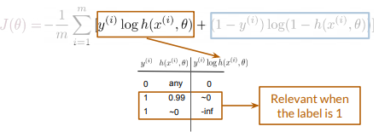
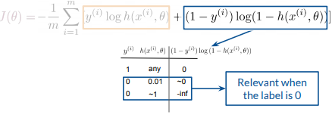


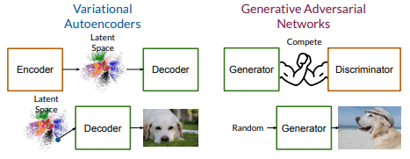
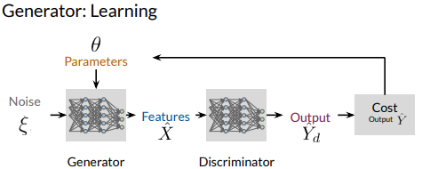
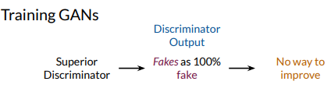
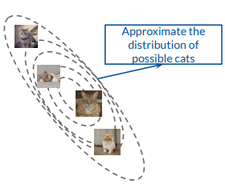
The Discriminator is a classifier
It learns the probability of class Y(real or fake) given features X
The Probabilities are the feedback for the generator
Close to zero when the label and the prediction are similar
Approaches infinity when the label and the prediction are different
The generator produces fake data.
It learns the probability of features X.
The generator takes as input noise
(random features)
Generative models learn to produce examples
Discriminative models distinguish between classes
2022-11-21 v0.1

Slide 2



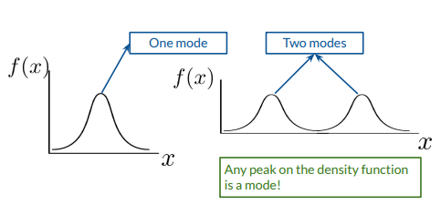
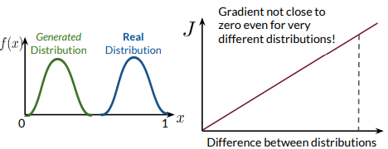
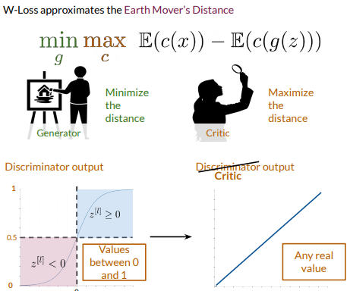
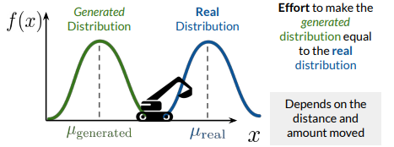
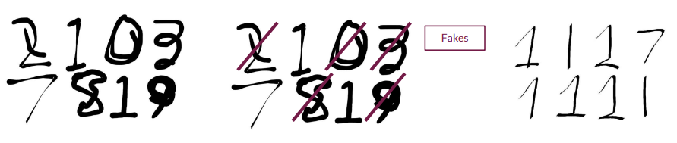

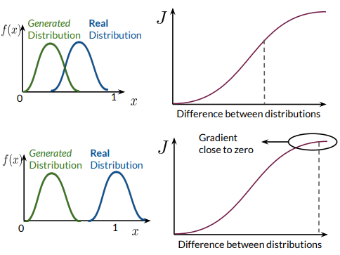
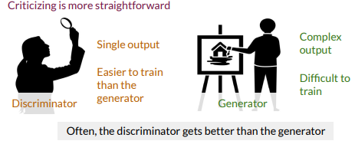
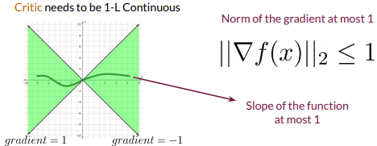
Modes are peaks in the distribution of features
Mode collapse happens when the generator gets
stuck in one mode
Earth mover’s distance (EMD) is a function of amount
and distance
Doesn’t have flat regions when the distributions are very
Approximating EMD solves the problems associated
with BCE
W-Loss looks very similar to BCE Loss
W-Loss prevents mode collapse and vanishing
gradient problems
GANs try to make the real and generated distributions
look similar
When the discriminator improves too much, the function
approximated by BCE Loss will contain flat regions
Flat regions on the cost function = vanishing gradients
Critic’s neural network needs to be 1-L Continuous when using W-Loss
This condition ensures that W-Loss is validly approximating Earth Mover’s Distance

Slide 3

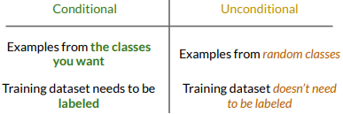
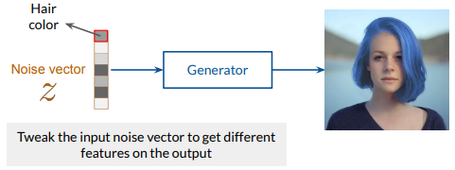
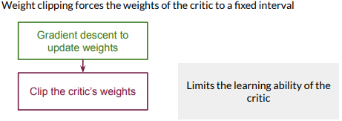
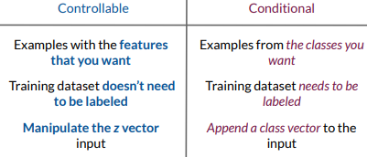
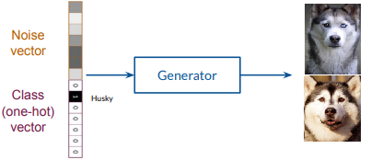

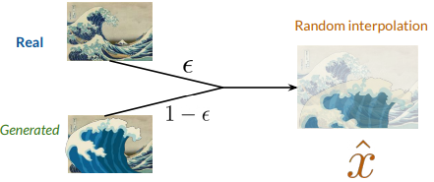


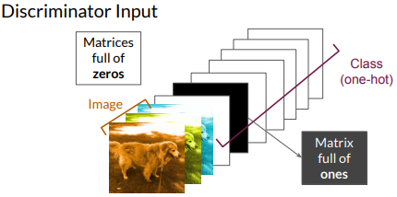
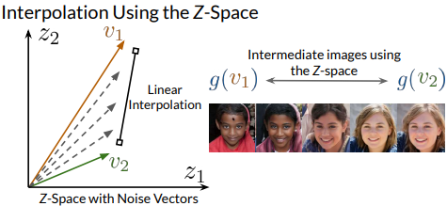
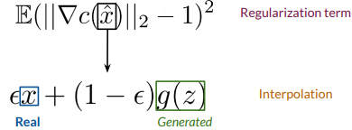


The class is passed to the generator as one-hot vectors
The class is passed to the discriminator as one-hot matrices
The size of the vector and the number of matrices represent
the number of classes

Slide 4


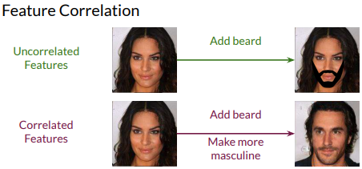
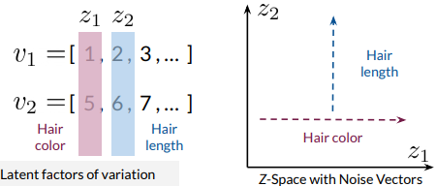
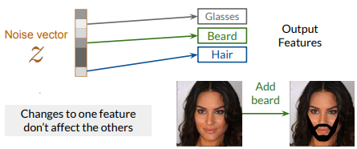
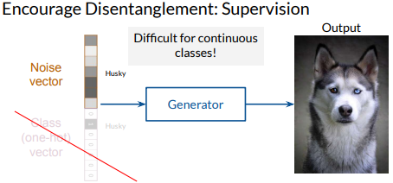
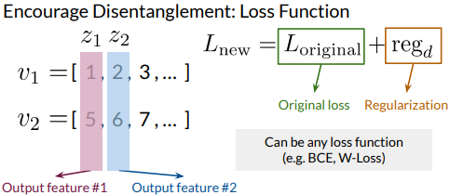
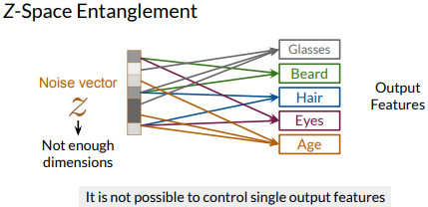

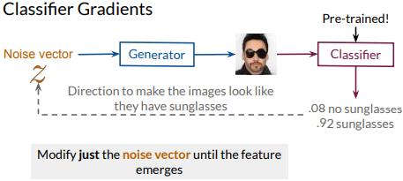
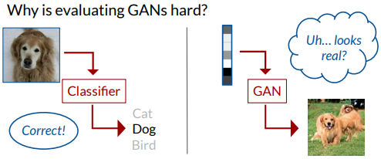
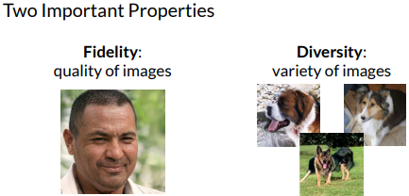
When trying to control one feature, others that are
correlated change
Disentangled Z-spaces let you control individual features by corresponding z values directly to them
There are supervised and unsupervised methods to achieve disentanglement
Entanglement happens when z does not have enough
dimensions
Classifiers can be used to find directions in the Z-space
To find directions, the updates are done just to the noise vector
No ground-truth = challenging to evaluate
Fidelity measures image quality and diversity measures variety
Evaluation metrics try to quantify fidelity & diversity

Slide 5

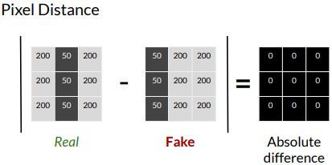
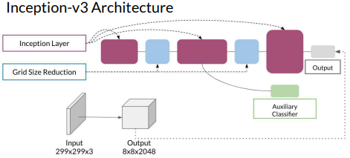


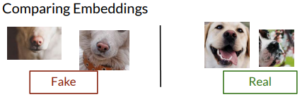
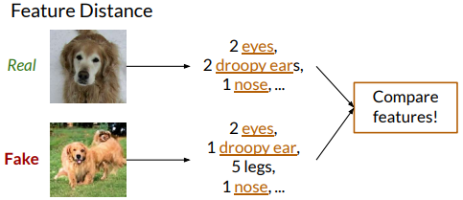
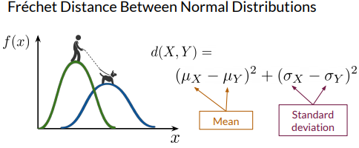
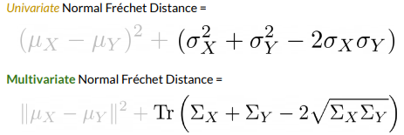




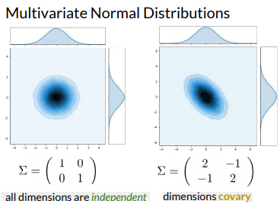
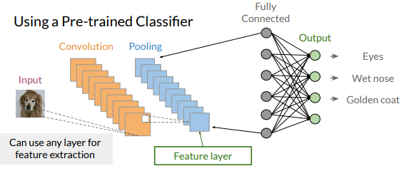
FID calculates the difference between reals and fakes
FID uses the Inception model and multivariate normal Fréchet distance
Sample size needs to be large for FID to work well
Uses pre-trained Inception model, which may not capture all features
Needs a large sample size
Slow to run
Limited statistics used: only mean and covariance
Classifiers can be used as feature extractors by cutting the network
at earlier layers
The last pooling layer is most commonly used for feature extraction
Best to use classifiers that have been trained on large datasets
ImageNet

Slide 6


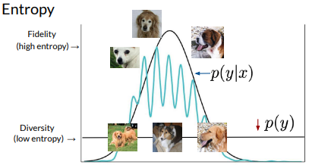

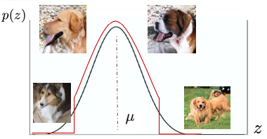
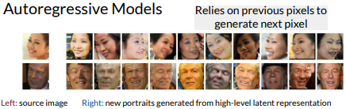
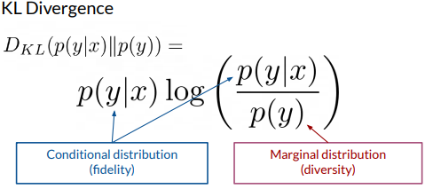
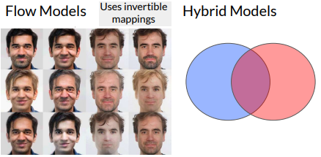
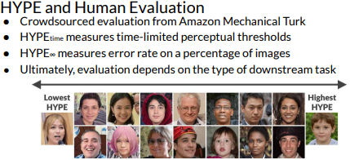
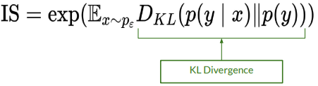

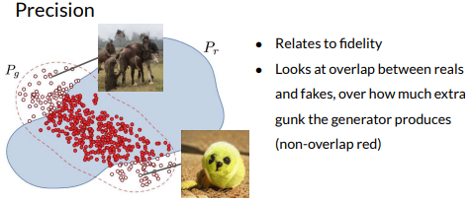

VAEs have the opposite pros/cons as GANs
  Often lower fidelity results
  Density estimation, inversion, stable training
Fakes are sampled using the training or prior distribution of z
Truncate more for higher fidelity, lower diversity
Human evaluation is still necessary for sampling
HYPE(Human eYe Perceptual Evaluation)
Inception Score tries to capture fidelity & diversity
Inception Score has many shortcomings
  Can be gamed too easily
  Only looks at fake images, not reals
  ImageNet doesn’t teach a model all features
Worse than Fréchet Inception Distance

Slide 7











Style mixing increases diversity that the model sees during training
Stochastic noise causes small variations to output
Coarse or fineness depends where in the network style or noise is added
  Earlier for coarser variation
  Later for finer variation
Progressive growing gradually doubles image resolution
Helps with faster, more stable training for higher resolutions
AdaIN transfers style information onto the generated image from the intermediate noise vector W
Instance Normalization is used to normalize individual examples before apply style statistics from W
Main components of StyleGAN:
  Progressive Growing
  Noise Mapping Network
  AdaIN
  Style Mixing
  Stochastic Noise
StyleGAN Goals:
  Greater fidelity on high-resolution images
  Increased diversity of outputs
  More control over image features
Noise mapping allows for a more disentangled noise space
The intermediate noise vector is used as input to the generator

Slide 8









Inputs and outputs are similar to a conditional GAN
  Take in the original image, instead of the class vector
  No explicit noise as input
Generator and discriminator models are upgraded
Softly encourages the generator with this additional supervision
  The target output labels are the supervision
  Generator essentially “sees” these labels
Pix2Pix’s generator is a U-Net
U-Net is an encoder-decoder, with same-size inputs and outputs
U-Net uses skip connections
  Skip connections help the decoder learn details from the encoder directly
  Skip connections the encoder learn from more
  gradients flowing from decoder
PatchGAN discriminator outputs a matrix of values,
each between 0 and 1
Label matrices: 0’s = fake, 1’s = real
U-Net generator: image → image
PatchGAN discriminator
  Inputs input image and paired output (either real target or fake
  Outputs classification matrix
Generator loss has a regularization term

Slide 9












Cycle consistency helps transfer uncommon style elements
between the two GANs, while maintaining common content
Add an extra loss term to each generator to softly encourage
cycle consistency
Cycle consistency is used in both directions
Identity Loss takes a real image in domain B and inputs it into Generator: A → B, expecting an identity mapping
  the output is the same as the input
Pixel distance is used
  Ideally, no difference between input and output!
Identity Loss is optionally added to help with color preservation
Unpaired image-to-image translation: (this method is unsupervised)
  Learns a mapping between two piles of images
  Examines common elements of the two piles (content) and unique elements of each pile (style)
CycleGAN uses two GANs for unpaired image-to-image translation
The discriminators are PatchGAN
The generators are similar to a U-Net and DCGAN generator
with additional skip connections
Components
  Two GANs
  Cycle Consistency Loss
  Least Squares Adversarial Loss
  Identity Loss
Least squares fits a line from several points
Least Squares Loss is used as the Adversarial Loss function in CycleGAN
More stable than BCELoss, since the gradient is only flat when prediction is exactly correct

