Slide 1
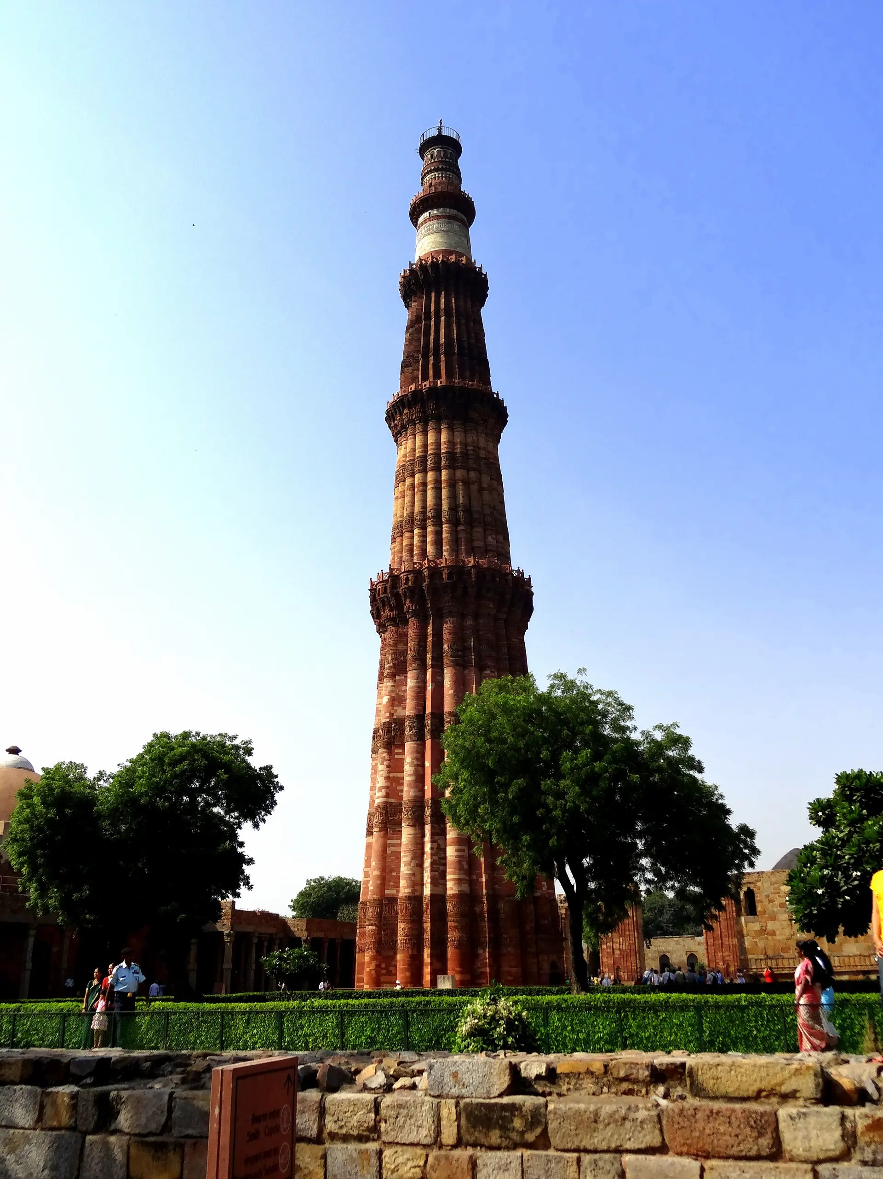

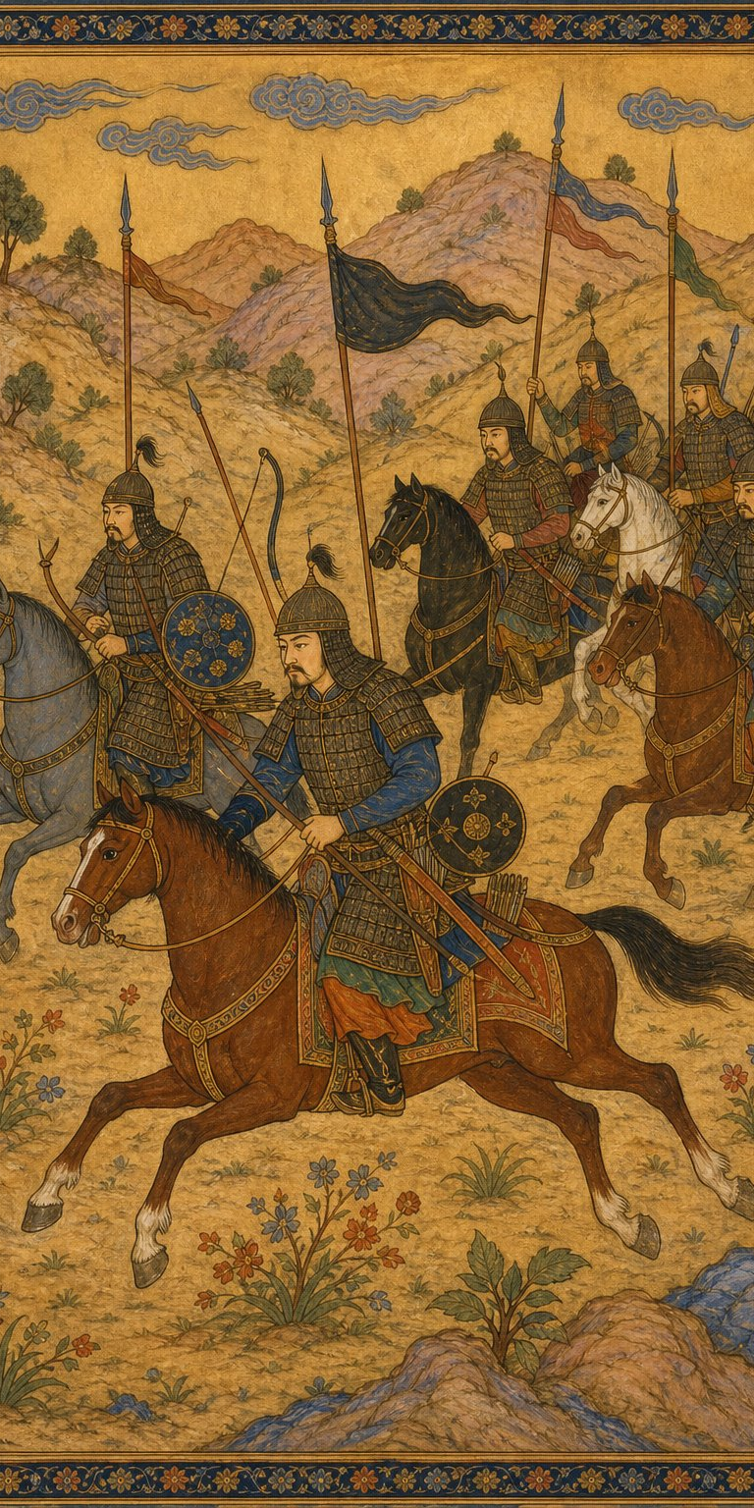
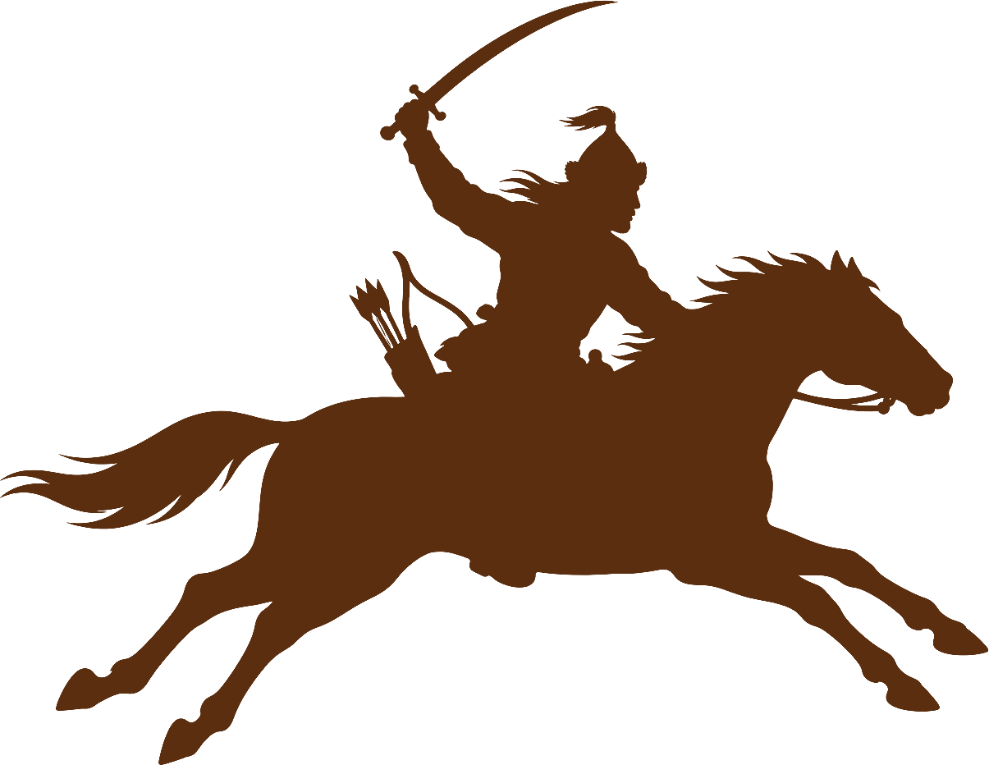
LOVELY PROFESSIONAL UNIVERSITY
SCHOOL OF LAW
CA – 01 HISTORY (SSC231)
SLAVE DYNASTY (MAMLUK DYNASTY)
Delhi Sultanate • 1206 – 1290 CE
Submitted by :
Sangam Sitapuri
Reg. no. – RK202406B65
Course – SSC231
Submitted to :
Dr. Vandana Arya

Slide 2
TABLE OF CONTENT
01. Introduction
02. Timeline at a Glance
03. Who Were the Mamluks?
04. 1206 – Birth of the Sultanate
05. Qutb-ud-din Aibak
06. Iltutmish – The Real Founder
07. The Mongol Storm (1221)
08. Razia Sultan
09. The Puppet Years (1240–66)
10. Balban – Blood and Iron
11. Fall of the Dynasty (1290)
12. Administration
13. Art and Architecture
14. Legacy and Significance
15. Conclusion
2 | Page

Slide 3
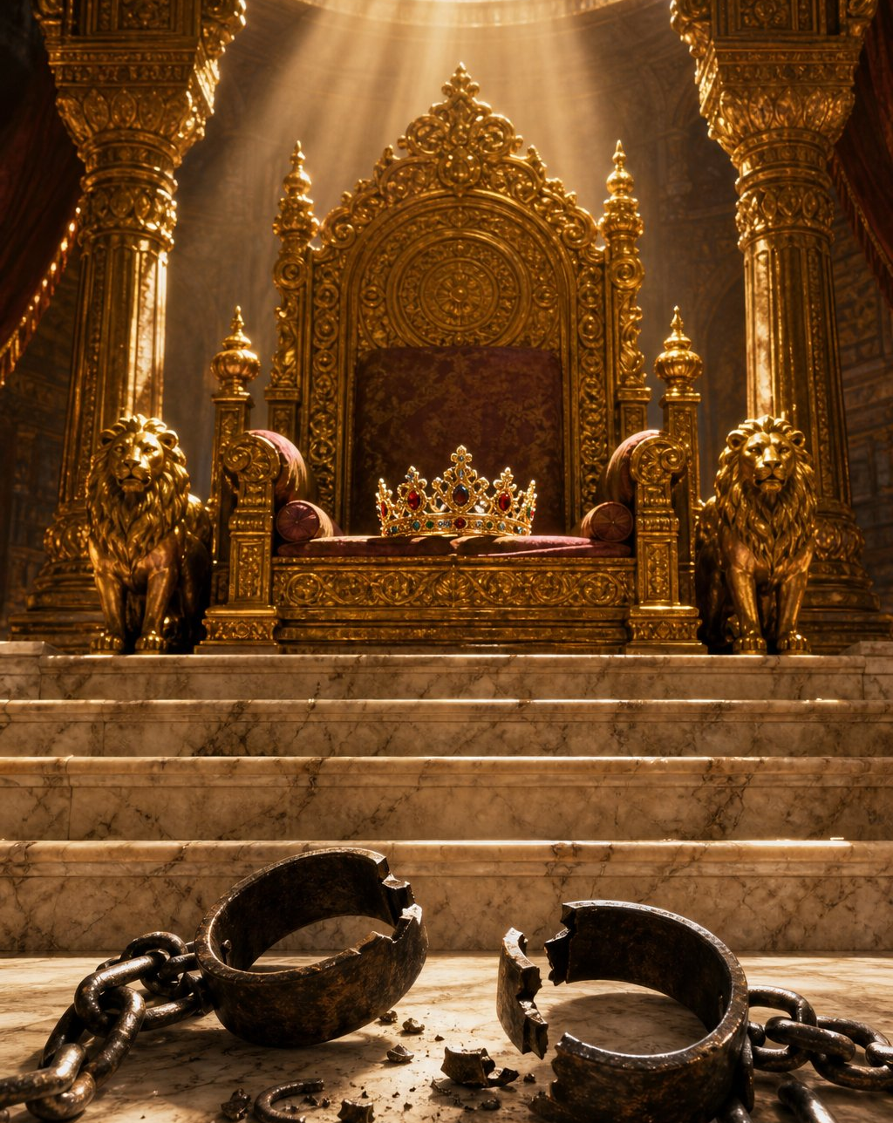
INTRODUCTION
➢ Rulers of Delhi, 1206–1290 CE — the first dynasty of the Delhi Sultanate, founded after Muhammad Ghori's death.
➢ 'Mamluk' is Arabic for 'one who is owned'. Every sultan of this line was a former slave or a slave's descendant.
➢ Nobody ruled as a slave — each ruler was legally freed (manumitted) before taking the throne.
➢ Really three families: the houses of Aibak, Iltutmish and Balban, one after another.
➢ Why it matters: it laid the foundation of the Delhi Sultanate — Delhi as capital, the tanka coin, the iqta system, the Qutb Minar — shaping north India for 300 years.
From chains to crowns — the story begins
3 | Page

Slide 4
TIMELINE AT A GLANCE
1206–10
Qutb-ud-din
Aibak
Founder,
'Lakh Baksh'
1211–36
Iltutmish
Real founder,
tanka, Caliph
1240–66
Puppet
Sultans
Rule of
'The Forty'
1287–90
Kaiqubad
& fall
Khalji
Revolution
1210–11
Aram
Shah
Weak interlude
1236–40
Razia
Sultan
Only woman
on the throne
1266–87
Balban
Blood & iron,
Zil-e-Ilahi
4 | Page

Slide 5
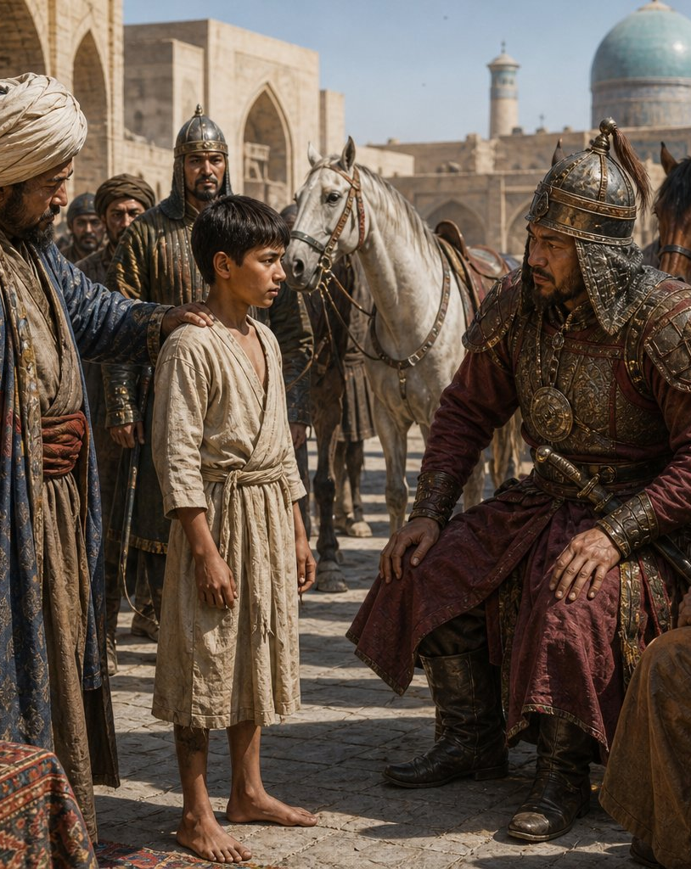
WHO WERE THE MAMLUKS?
➢ Elite military slaves (bandagan) — Turkic boys bought in Central Asian markets, trained in war, horsemanship and court manners.
➢ Loyalty by design: cut off from family and clan, a slave soldier had nobody except his master.
➢ Promotion purely on merit — a talented slave could rise to general, governor… and eventually king.
➢ Not plantation slavery: they ate well, commanded armies, married into noble families — apprenticeship plus bonded loyalty.
➢ Ghori's 'sons': asked about having no heir, Ghori said his thousands of Turkish slaves would carry his name — and they did.
A boy is bought in Bukhara… a sultan is made
5 | Page

Slide 6
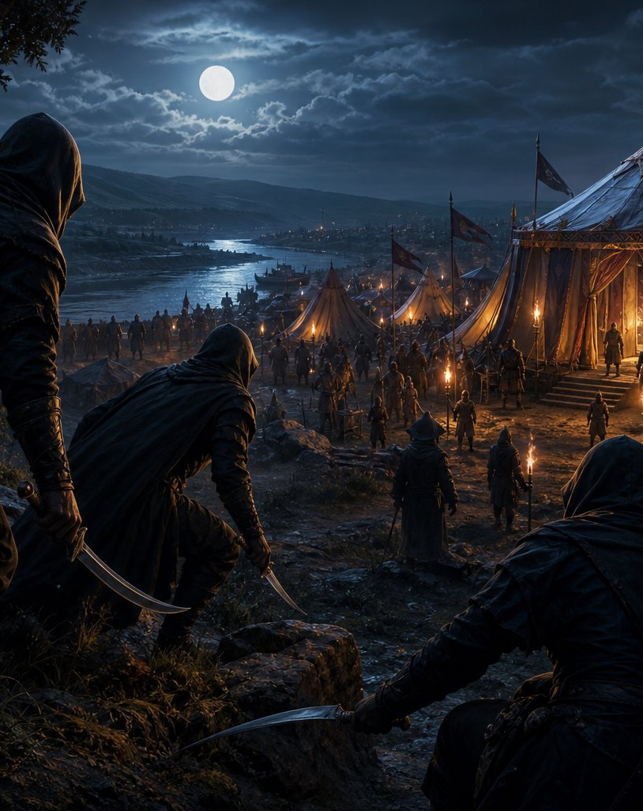
1206 – BIRTH OF THE SULTANATE
➢ March 1206: Muhammad Ghori assassinated at Damyak on the Indus — no son, only ambitious slave generals.
➢ Three rivals: Yildiz at Ghazni, Qabacha at Multan-Uch, Qutb-ud-din Aibak holding the Indian territories.
➢ Aibak moved fastest: invited by the nobles and citizens of Lahore, he took charge of Hindustan within months.
➢ Legitimacy mattered: he used modest titles (Malik, Sipahsalar) until formally freed and recognised (c. 1208).
➢ The result: an independent Indian kingdom owing nothing to Ghazni — the Delhi Sultanate begins here.
Damyak, March 1206 — daggers in the night
6 | Page

Slide 7
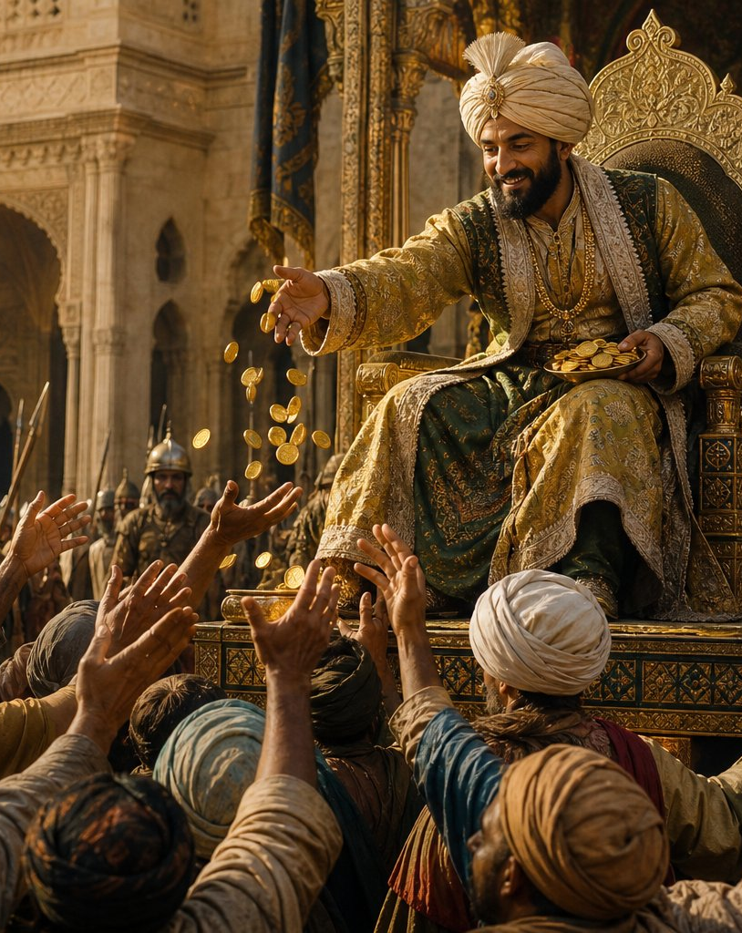
QUTB-UD-DIN AIBAK (r. 1206–1210)
➢ Slave market to throne: sold as a child at Nishapur, educated by a qazi, bought by Ghori — rose to be his best general.
➢ Conqueror of the north: consolidated Delhi, Meerut, Ranthambore and Gujarat campaigns after Tarain (1192).
➢ 'Lakh Baksh' — the giver of lakhs — famous above all for open-handed generosity.
➢ Builder: began the Quwwat-ul-Islam mosque and Qutb Minar at Delhi; Adhai Din ka Jhonpra at Ajmer.
➢ Sudden end (1210): died in a fall while playing chaugan (polo) at Lahore. His short reign turned a general's command into a kingdom.
Lakh Baksh — gold flows from the throne
7 | Page

Slide 8
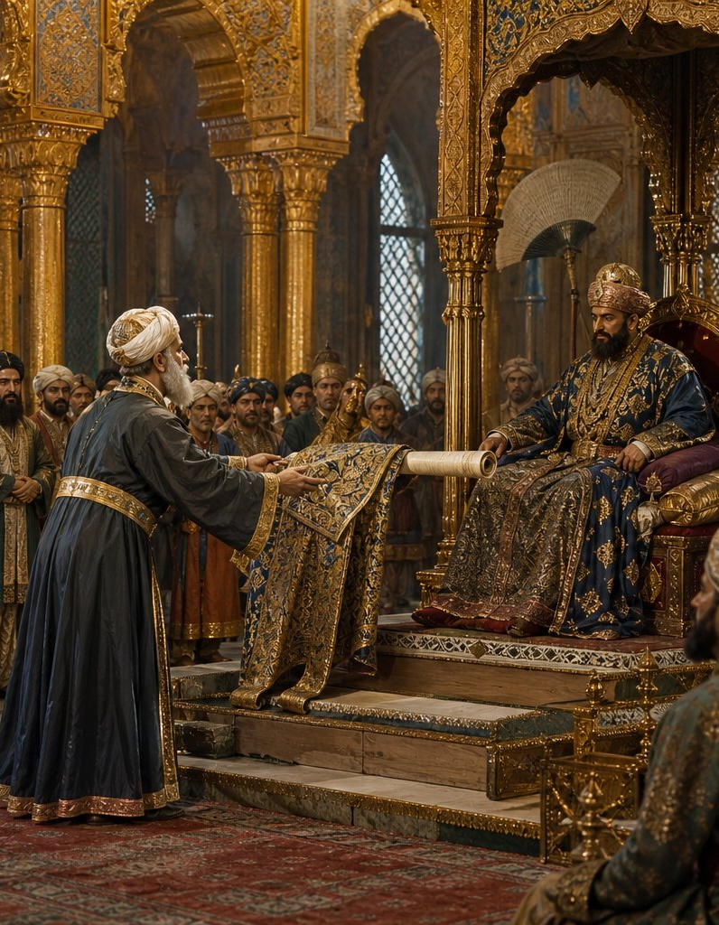
ILTUTMISH (r. 1211–1236) – THE REAL FOUNDER
➢ Sold by his own brothers out of jealousy — rose through sheer ability.
➢ Defeated every rival: Yildiz (1216), Qabacha (1228); recovered Ranthambore, Gwalior; brought Bengal back.
➢ Caliph's investiture (1229): Baghdad's recognition made the Sultanate a lawful state in the Islamic world.
➢ Institution builder: the Forty (Chahalgani), the iqta system, Delhi as permanent capital.
➢ Currency reform: silver tanka + copper jital — ancestors of the rupee.
➢ Boldest decision: nominated his daughter Razia as heir over his sons.
1229 — the Caliph’s robe arrives from Baghdad
8 | Page

Slide 9
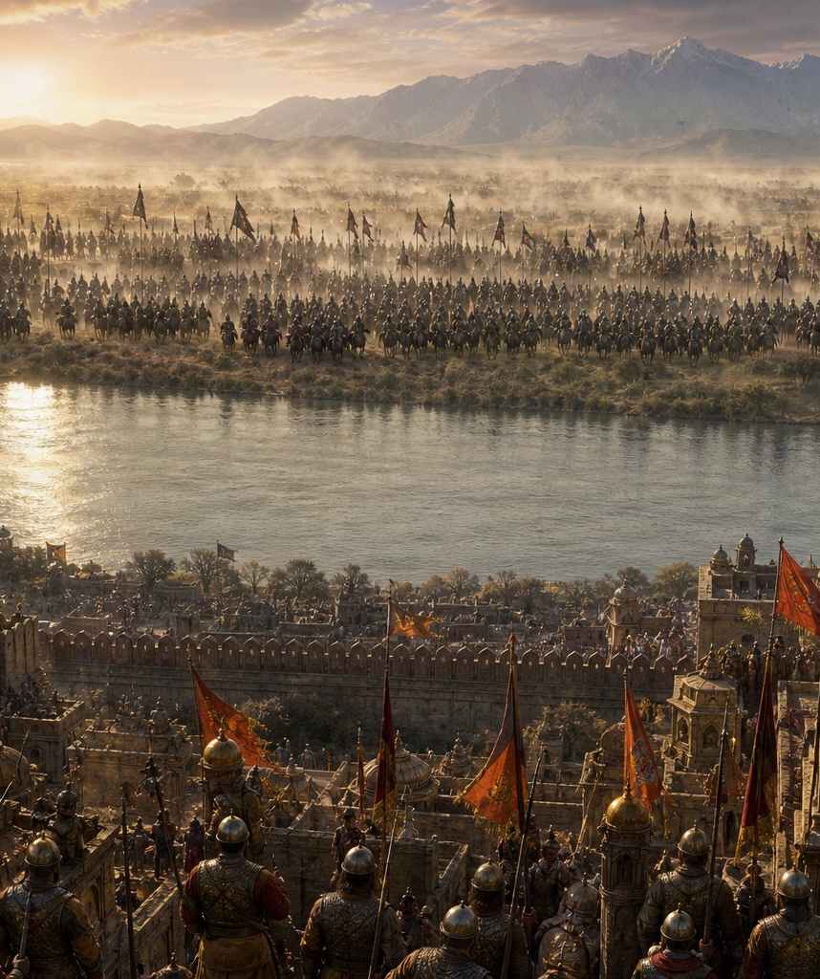

THE MONGOL STORM (1221)
➢ Chingiz Khan on the Indus: after destroying Khwarazm, the Mongols chased prince Jalal-ud-din to India's doorstep.
➢ The dilemma: shelter the fugitive prince and invite Chingiz Khan in — or refuse and look cowardly?
➢ Iltutmish's masterstroke: he politely replied that Delhi's climate 'would not suit' the prince — and quietly moved troops.
➢ Result: the Mongols withdrew; India escaped the fate of Merv, Nishapur and Baghdad.
➢ One wrong step in 1221 and the thirty-year-old Sultanate might have ended there.
1221 — the horde waits across the Indus
9 | Page

Slide 10
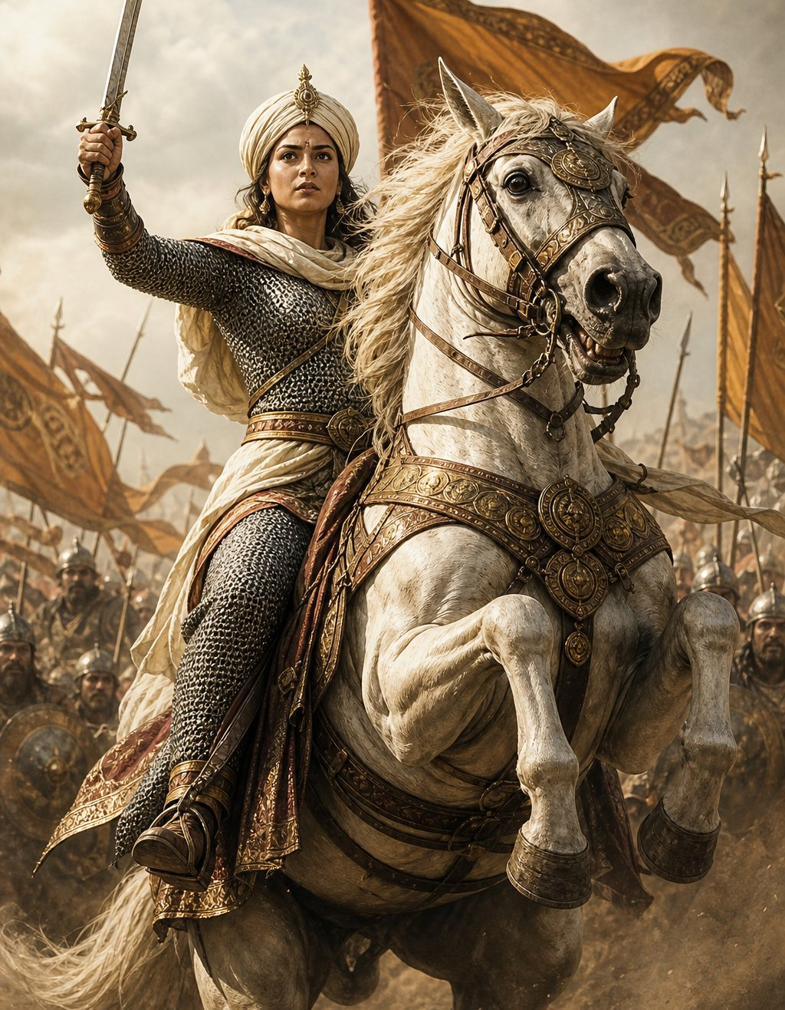
RAZIA SULTAN (r. 1236–1240)
➢ First and only woman to rule from the throne of Delhi — crowned after Delhi's citizens rose against Ruknuddin Firuz.
➢ Ruled as a king: abandoned purdah, wore tunic and cap, led armies in person, used the title 'Sultan'.
➢ Minhaj's verdict: every kingly quality 'except her sex' — one line that explains her whole struggle.
➢ Merit over birth: promoted able outsiders like the Abyssinian Yaqut — enraging the Turkish Forty.
➢ The fall (1240): betrayed, imprisoned, married the rebel Altunia, marched on Delhi — killed near Kaithal.
➢ She fell not for ruling badly — but for ruling too independently.
A Sultan, not a Sultana — leading from the front
10 | Page

Slide 11
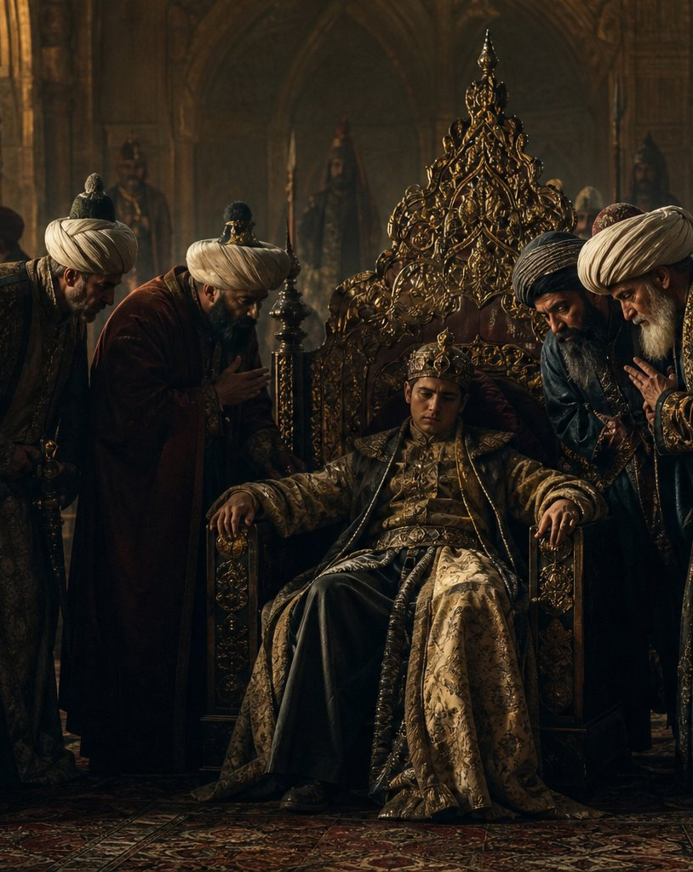
THE PUPPET YEARS (1240–1266)
➢ King-makers unleashed: the Forty crowned, controlled and destroyed Bahram Shah (1240–42) and Masud Shah (1242–46).
➢ The cost of chaos: the Mongols sacked Lahore in 1241 — and Delhi could do nothing.
➢ Nasiruddin Mahmud (1246–66): gentle and pious — wisely left the real work of government to his deputy, Balban.
➢ A historian's gift: Minhaj-us-Siraj dedicated his Tabaqat-i-Nasiri to this sultan — our most important source.
➢ 1266: Mahmud died without a son; the deputy finally took the crown himself.
A throne surrounded by whispers
11 | Page

Slide 12
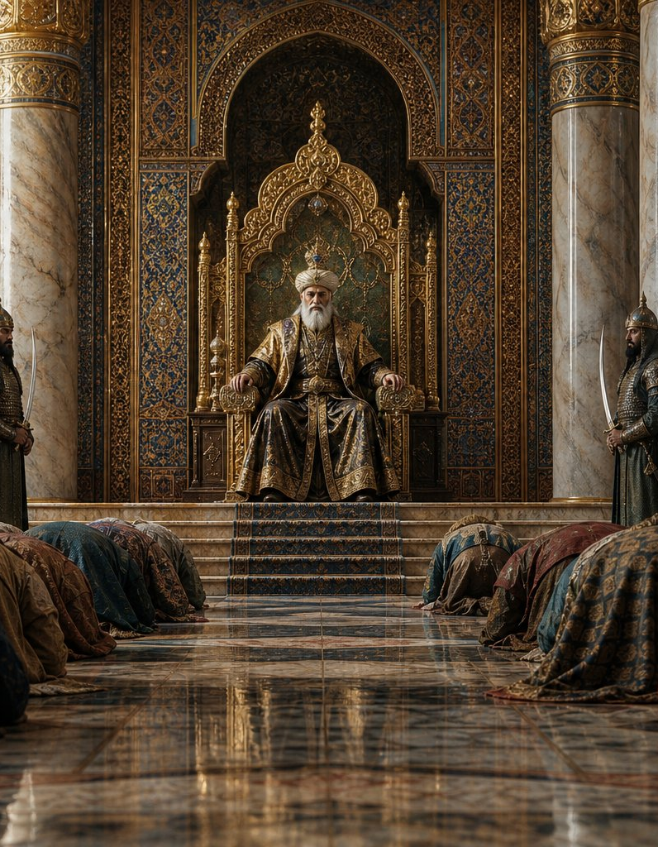
BALBAN (r. 1266–1287) – BLOOD AND IRON
➢ Water-carrier to 'Shadow of God': declared the Sultan Zil-e-Ilahi; court modelled on the Persian emperors.
➢ Theatre of majesty: sijda and paibos, Nauroz pomp, drawn swords — no laughter in open court.
➢ Blood and iron: cleared the Mewati bandits, crushed doab rebels, pacified Katehar — roads safe again.
➢ Broke the Forty: old comrades sidelined, poisoned or executed; barid spies in every province.
➢ Bengal (1279): marched there at nearly eighty; an example so harsh Bengal stayed quiet for a generation.
➢ The price: his heir Prince Muhammad fell to the Mongols (1285); Balban died broken in 1287.
A court where no one dared to laugh
12 | Page

Slide 13


FALL OF THE DYNASTY (1287–1290)
➢ Dynasties rarely survive their strongmen: nobles ignored Balban's chosen heir and crowned teenage Kaiqubad.
➢ Three wasted years: freed from suffocating discipline, Kaiqubad sank into pleasure — administration collapsed.
➢ Rise of the Khaljis: the old Turkish party lost ground to veteran commander Jalal-ud-din Khalji.
➢ 1290 – Khalji Revolution: the paralysed Kaiqubad was killed at Kilokhri; Jalal-ud-din took the throne.
➢ More than a family change: the Turkish slave elite's monopoly broke forever — the dynasty fell to the very principle that had raised it: power belongs to the capable.
1290 — the Khalji swords fall
13 | Page

Slide 14
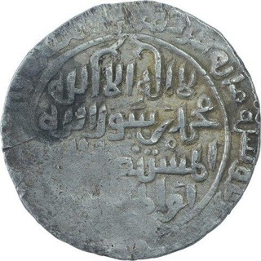
ADMINISTRATION
➢ The Sultan: absolute in theory — military power + Islamic legitimacy + (after Balban) a semi-divine aura.
➢ Great ministries: diwan-i-wizarat (finance), ariz-i-mamalik (army), diwan-i-insha (correspondence), qazi (justice).
➢ The iqta system: officers (muqtis) got a territory's land revenue instead of salary — troops, order, surplus to Delhi.
➢ Transferable, not hereditary: strong sultans shuffled muqtis so no officer could grow local roots.
➢ Army & intelligence: heavy cavalry and war elephants; Balban paid the central army directly; barids everywhere.
➢ Everyday India carried on: village life, caste society, customary law — taxed but rarely touched.
Silver tanka of Iltutmish — ancestor of the rupee
14 | Page

Slide 15
ART AND ARCHITECTURE
➢ Quwwat-ul-Islam mosque: Delhi's first great mosque — built on carved temple pillars; two artistic worlds merging.
➢ Qutb Minar: begun by Aibak, completed by Iltutmish — 72.5 m, world's tallest brick minaret.
➢ Tombs: Iltutmish's carved tomb; Sultan Ghari — earliest Islamic tomb in India.
➢ Balban's tomb: one of India's first true arches — pointing toward the Mughal domes to come.
The tower still rises over Delhi
15 | Page

Slide 16
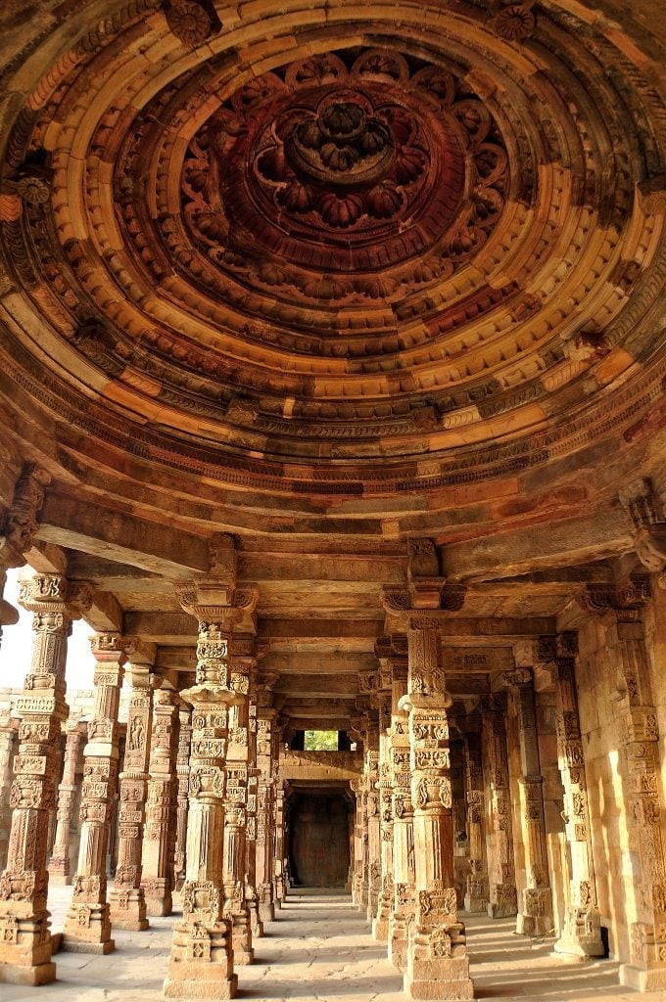
LEGACY AND SIGNIFICANCE
➢ Political: made Delhi the imperial centre of India — a status it has never really lost.
➢ Administrative: iqta, ministries, barid network, standing army — scaffolding for Khaljis, Tughlaqs, even Mughals.
➢ Economic: the tanka–jital currency anchored north Indian commerce for generations.
➢ Strategic: its defence of the north-west kept the Mongol catastrophe out of India.
➢ Cultural: Amir Khusrau's poetry, the Chishti saints, and the start of the Indo-Islamic synthesis.
➢ A radical idea: a slave could become sultan; a woman could rule — the throne of Delhi could be earned.
What they built still stands
16 | Page

Slide 17
CONCLUSION
➢ An empire founded by men who had once been merchandise — the strangest arc in medieval Indian history.
➢ Aibak turned a conqueror's garrisons into a kingdom.
➢ Iltutmish gave it law, money and legitimacy — and saved it from Chingiz Khan with one evasive letter.
➢ Razia showed how far ability could carry a person; her fate showed where the limits lay.
➢ Balban rebuilt the crown's majesty with ceremony and cruelty — and held the frontier at the cost of his son.
➢ Eighty-four years — an improvised occupation became a settled state with a capital, a currency and a culture. The dynasties that followed built higher, but on this foundation.
THANK YOU
17 | Page

