Slide 1


Department of Artificial Intelligence and Data
Science
Solar & Wind Energy Generation
Forecast using PySpark
Faculty
Team Members
Dr.SURESH KUMAR S
SANGAMITHRA V 231801147
MOGHANAPRIYA R 231801102

Slide 2

Introduction
Growing demand for renewable energy requires efficient forecasting of solar and wind generation.
Accurate predictions help grid stability, energy planning, and cost optimization.
Big Data & PySpark are used to handle large datasets from solar/wind sensors.
Focus: Time Series Forecasting using ARIMA.
Zeroth Review
Department of Artificial Intelligence and Data
3
Sci enc e

Slide 3
Abstract
Project predicts next 6 hours of solar and wind power generation.
Dataset upload via a web UI → processed in PySpark → forecast computed using ARIMA.
Output includes:
Numerical Forecast (kW)
Visual Charts for each energy parameter
Designed for scalable big data environment.
Zeroth Review
Department of Artificial Intelligence and Data
4
Sci enc e

Slide 4
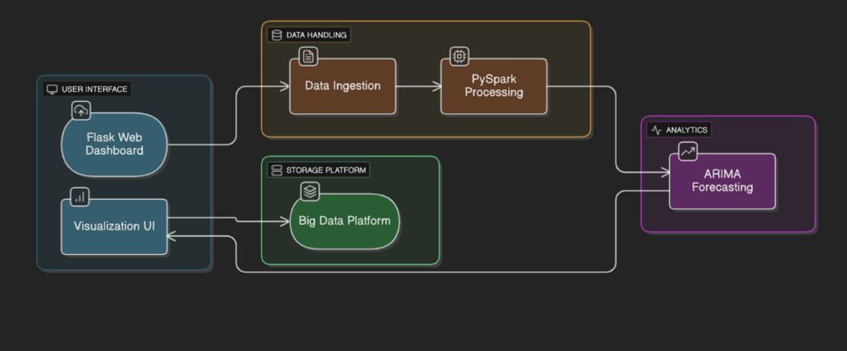
Architecture Diagram
Flask Web UI: CSV upload
PySpark Module: Data processing and cleaning
Forecast Model (ARIMA): Per-column time series prediction
Dashboard: Charts & tables
Big Data Environment: Hadoop/Databricks cluster
Zeroth Review
Department of Artificial Intelligence and Data
5
Sci enc e

Slide 5
Architecture Module Description
Data Ingestion: Upload CSV via Flask; stored in dataset/.
Data Processing: PySpark reads CSV, efficiently handles large datasets, and downsamples for demo.
Forecasting: ARIMA applied per numeric column with forward-fill; predicts next 6 hours.
Visualization: Chart.js line charts and forecast tables (kW) for each parameter.
Zeroth Review
Department of Artificial Intelligence and Data
5
Sci enc e

Slide 6
Implementation
Dataset Upload: Users upload CSV via Flask dashboard
Data Processing: PySpark reads, cleans, and sorts data; downsampling for demo
Forecast Generation: ARIMA applied per numeric column; next 6 hours predicted; forward-fill missing values
Visualization: Table (kW) + interactive line charts using Chart.js
Execution Environment: PySpark locally or on Hadoop/Databricks cluster
Zeroth Review
Department of Artificial Intelligence and Data
5
Sci enc e

Slide 7
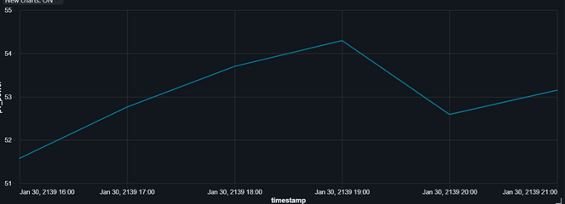
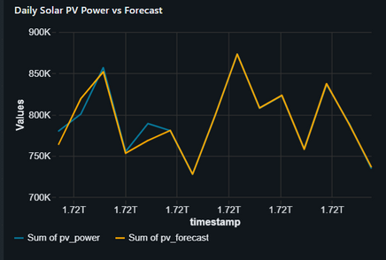
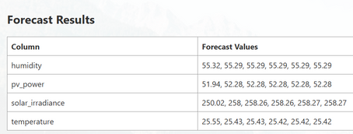
Results
Line charts per parameter using Chart.js
Forecast trends for next 6 hours
Multiple charts displayed in grid layout
Clear distinction between solar and wind trends
Zeroth Review
Department of Artificial Intelligence and Data
5
Sci enc e

Slide 8
Conclusion
Developed a scalable solar & wind energy forecasting system using PySpark and ARIMA.
Efficiently handles large datasets in a Big Data environment.
Interactive Flask UI allows dataset upload and visualization.
Provides numeric forecasts (kW) and interactive line charts.
Demonstrates a practical solution for energy planning and renewable energy integration.
Zeroth Review
Department of Artificial Intelligence and Data
5
Sci enc e

Slide 9
Future Enhancements
Implement real-time streaming using Kafka + Spark Streaming for live energy forecasting.
Integrate advanced ML/DL models like LSTM or Prophet to improve prediction accuracy.
Deploy on Databricks or Hadoop clusters for full scalability.
Expand to multi-site energy forecasting for regional grids.
Add automated alert systems for abnormal energy generation patterns.
Zeroth Review
Department of Artificial Intelligence and Data
5
Sci enc e

Slide 10
References
PySpark Documentation – https://spark.apache.org/docs/latest/
Statsmodels ARIMA Documentation – https://www.statsmodels.org/
Chart.js Documentation – https://www.chartjs.org/
Research Papers:
Solar & Wind Power Forecasting with ARIMA – ResearchGate
Big Data & Smart Grid Forecasting – Journal of Big Data
Hybrid Wind Forecasting Models – arXiv
Zeroth Review
Department of Artificial Intelligence and Data
5
Science

