Slide 1

Title
Carried out by
Suhas J 4VV17EC088
Shreya A 4VV17EC083
Sangamesh G Hiremath 4VV16EC079
Ramesha V 4VV17EC072
Under the guidance of
Prof. Chethan K
Assistant Professor
Dept. of ECE

Slide 2
CONTENTS
Introduction
Proposed Methodology
Progress till date
Results
Work to be carried out with deadline
Details of publications
References

Slide 3
Introduction
Alzheimer’s disease is a progressive and irreversible brain degenerative disorder
Around 50 million people in the world have dementia.
Every 3 seconds someone in the world develops dementia.
AD is a growing epidemic which changes the lives of families forever.
There is still no cure for AD, although there is medication available that can temporarily seize the symptoms.

Slide 4
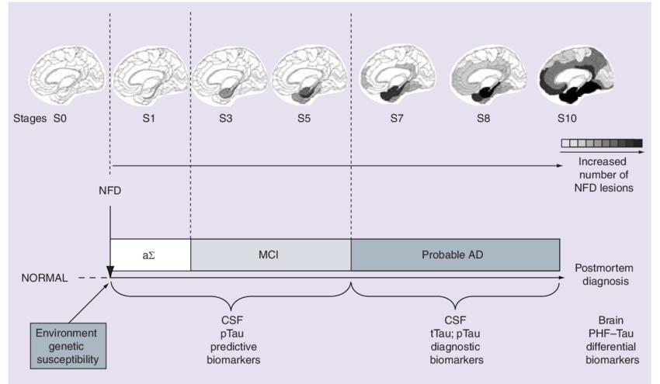
INTRODUCTION
Various stages of Alzheimer’s Disease:

Slide 5
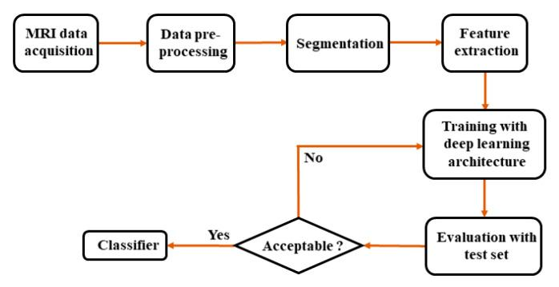
Methodology
The overall block diagram of AD diagnosis
Training
phase
-------------------------------------------------------------------------------------------------
Testing phase

Slide 6
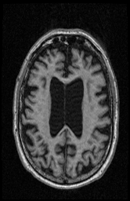
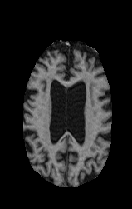
Progress till date
MRI data acquisition - ADNI dataset
Data Preprocessing
Skull-stripping
Histogram equalization
Transfer learning approach
Training the dataset using pre-trained CNN model
-VGG16

Slide 7
Results

Slide 8
Work to be carried out with deadline

Slide 9
Details of publications

Slide 10
References
[1] Liu, M., Li, F., Yan, H., Wang, K., Ma, Y., Shen, L., Xu, M., for the Alzheimer's Disease Neuroimaging Initiative, A multi-model deep convolutional neural network for automatic hippocampus segmentation and classification in Alzheimer's disease, NeuroImage, 2020.
[2] I. Beheshti, N. Maikusa, H. Matsuda, H. Demirel, G. Anbarjafari,Histogram-based feature extraction from individual gray matter similarity-matrix for Alzheimer’s disease classification, J. Alzheimer’s Dis. Journal of Alzheimer's Disease, vol. 55, no. 4, pp. 1571-1582, 2017.
[3] Jun Yu , Di Huang , Zhongliang Wei , Unsupervised Image Segmentation via Stacked Denoising Auto-encoder and Hierarchical Patch Indexing, Signal Processing (2017)
[4] Maqsood, M.; Nazir, F.; Khan, U.; Aadil, F.; Jamal, H.; Mehmood, I.; Song, O.-Y. Transfer Learning Assisted Classification and Detection of Alzheimer’s Disease Stages Using 3D MRI Scans. Sensors 2019

Slide 11


