Slide 1
Sunlight & Health: Beyond Vitamin D - Recent Discoveries
Generated by Gemini AI

Slide 2
Nitric Oxide & Cardiovascular Health
Sunlight exposure triggers nitric oxide (NO) release in the skin.
NO is a vasodilator – relaxes blood vessels, lowering blood pressure.
Research showing correlation between sunlight exposure & reduced risk of cardiovascular disease (cite studies - e.g., UK Biobank).
NO benefits extend to improved blood flow, potentially reducing stroke & heart attack risk.
Importance of *how* sunlight exposure affects NO – UV-A vs. UV-B, skin surface area exposed.

Slide 3

Sunlight, Circadian Rhythm & Mental Wellbeing
Sunlight is the primary zeitgeber (time giver) for our circadian rhythm.
Impact on melatonin production – suppression during daylight, release at night.
Disrupted circadian rhythms linked to mood disorders (depression, SAD).
Recent studies on the link between sunlight exposure, serotonin levels, and improved mood.
The role of light intensity and timing – morning sunlight is particularly beneficial.
Image: A graphic illustrating the circadian rhythm and sunlight's influence.

Slide 4
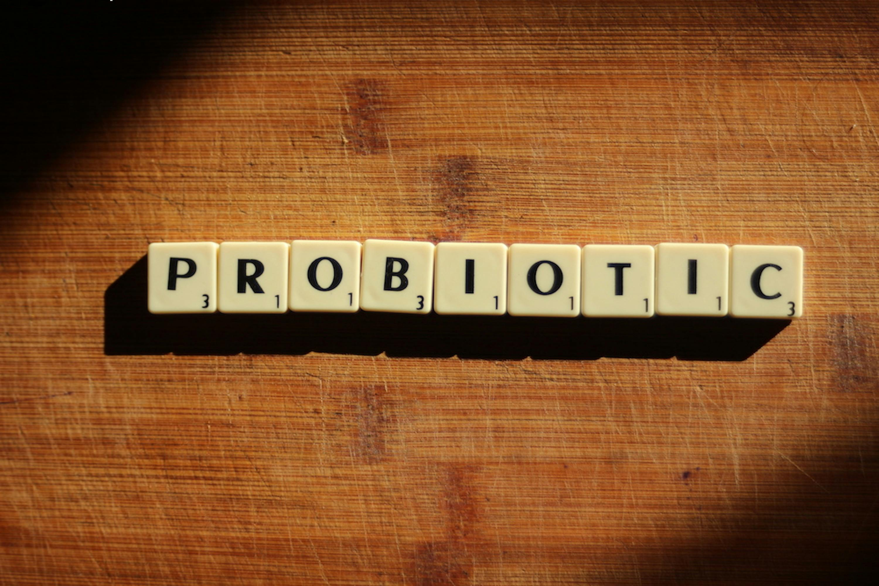
The Gut Microbiome & Sunlight
Emerging research suggests sunlight exposure can influence the gut microbiome.
Potential mechanisms: Vitamin D's role in gut barrier function, indirect effects via circadian rhythm.
Studies showing altered gut microbiome composition in individuals with limited sunlight exposure.
Link between gut microbiome health and overall health (immunity, mental health, chronic disease).
This is a relatively new area of research – more studies needed.

Slide 5
Balancing Benefits & Risks: Safe Sunlight Exposure
Skin cancer risk: Acknowledge the dangers of excessive UV exposure.
Recommendations for safe sun exposure:
- Time of day: Avoid peak UV hours (10am-4pm).
- Duration: Start with short exposures and gradually increase.
- Skin surface area: Expose larger areas for shorter durations.
- Skin type: Consider individual skin sensitivity.
- Sunscreen: Use strategically – not necessarily always.
Importance of individual assessment and consulting with a healthcare professional.

Slide 6
Conclusion: A Holistic View of Sunlight & Health
Sunlight offers benefits *beyond* Vitamin D – nitric oxide, circadian rhythm regulation, potential gut microbiome effects.
Safe and sensible sunlight exposure is crucial for optimal health.
Further research is ongoing to fully understand the complex interplay between sunlight and human health.
Encourage audience to prioritize regular, mindful sunlight exposure as part of a healthy lifestyle.
Q&A

