Slide 1
LearnMate ai agent
IBM HACKATHON PROJECT
Presented By:
Student name : T Sangavi
College Name & Department : GITAM (hyd) & CSE

Slide 2
OUTLINE
Problem Statement
Technology used
Wow factor
End users
Result
Conclusion
Git-hub Link
Future scope
IBM Certifications

Slide 3
Problem Statement
Students often struggle to identify the right learning path that aligns with their interests and long-term goals due to the overwhelming number of online courses and a lack of personalized guidance. LearnMate aims to solve this by acting as an Agentic AI coach that interacts with students, understands their interests (like Frontend Development, Cybersecurity, UI/UX Design, etc.), assesses their current skill level, and dynamically builds a personalized course roadmap that adapts over time based on progress and preferences.
Proposed Solution: An Agentic AI learning coach that uses NLP and IBM Granite models to assess user interests and skill levels, then dynamically generates personalized course roadmaps using free resources. It adapts to progress and preferences, helping students navigate overwhelming course options and stay on track with their goals.

Slide 4
Technology used
IBM cloud lite services
Natural Language Processing (NLP)
Agentic AI with Prompt Flow
IBM Granite model

Slide 5
IBM cloud services used
IBM Cloud Watsonx AI Studio
IBM Cloud Watsonx AI runtime
IBM Cloud Agent Lab
IBM Granite foundation model

Slide 6
Wow factors
This agent will significantly reduce confusion in course selection, improve learning efficiency, support skill-building for career goals, and empower learners with structured, personalized roadmaps — making online education more accessible and actionable.
Unique features:
- Step-by-step interactive questioning like a real mentor
- Personalized course roadmap generation using user input
- Weekly plans built from free, high-quality resources
- Dynamic roadmap updates based on progress and preferences
- Motivation-driven responses to encourage continuous learning
- No-code implementation using IBM Watsonx and Granite

Slide 7
End users
Students and Learners
Career Switchers
Colleges and Educational Institutes
Learning & Development Teams

Slide 8
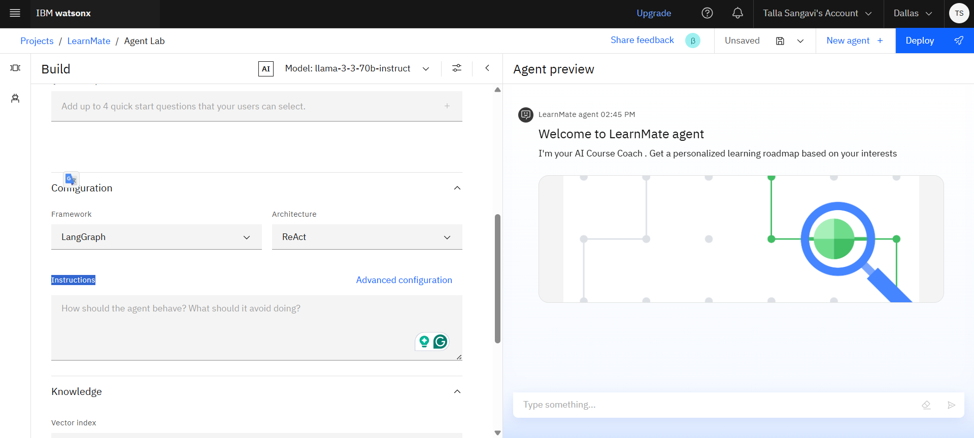
Results
Successfully deployed Agentic AI that generates personalized roadmaps

Slide 9
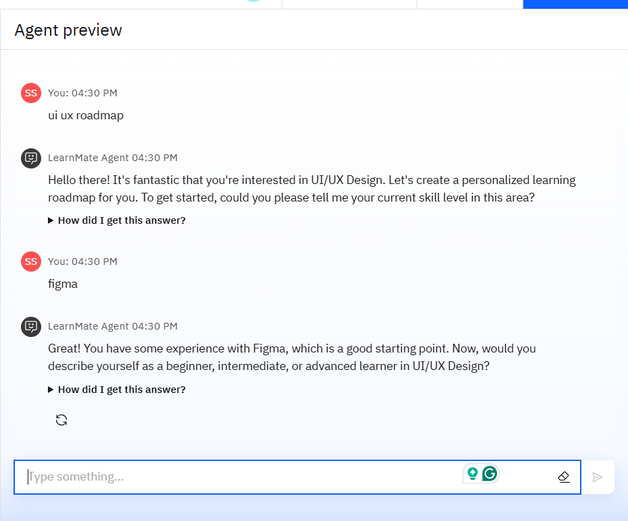
Results
Functional conversation flow using Watsonx Agent Lab.
Dynamically adapts course path using Granite and NLP.

Slide 10
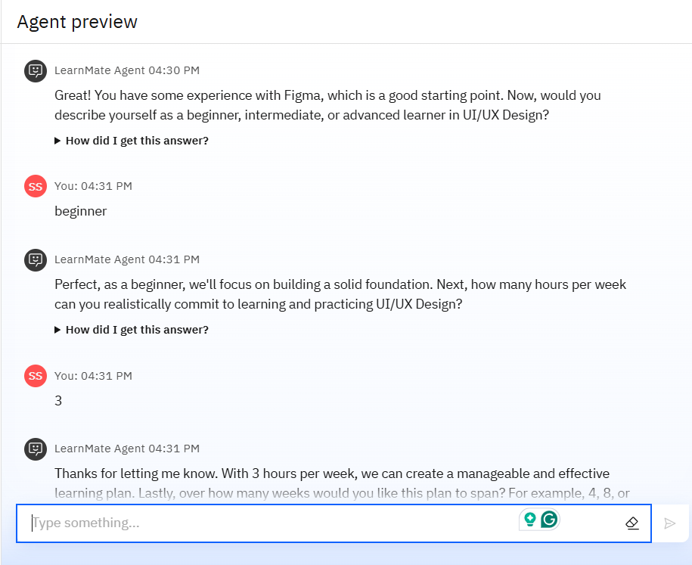
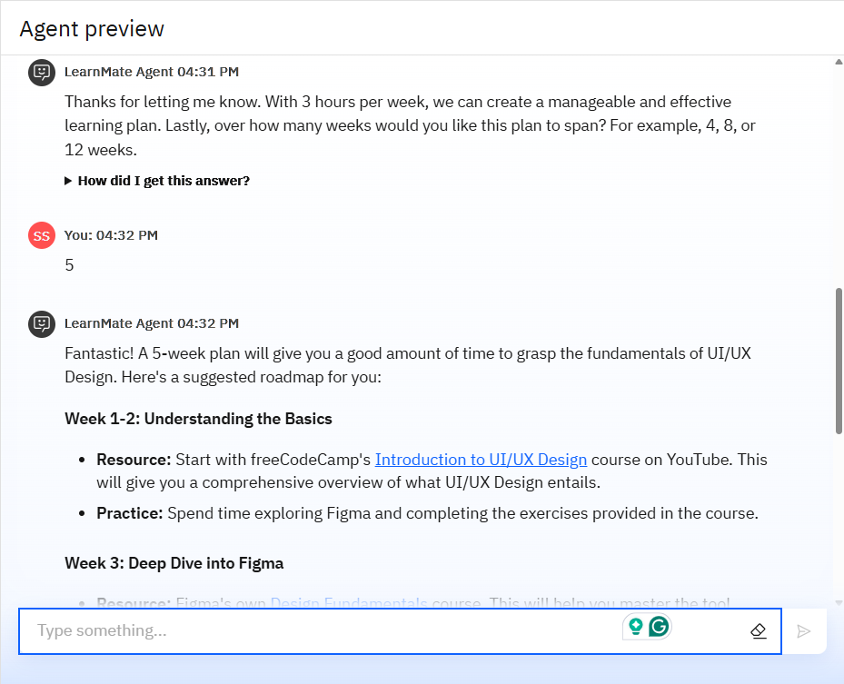
Results

Slide 11
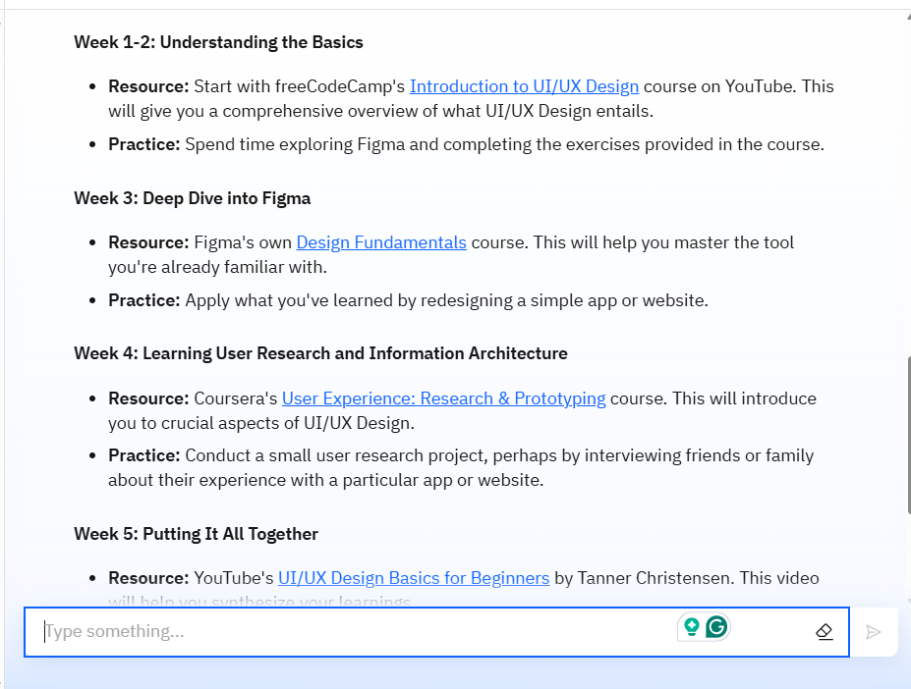
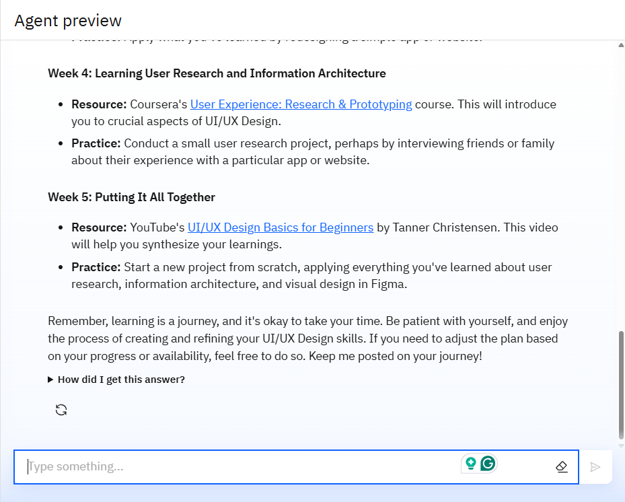
Results

Slide 12
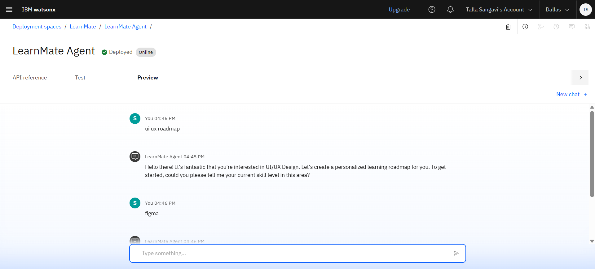
Results
Deployed AI Agent

Slide 13
Conclusion
LearnMate empowers learners by removing confusion in course selection and helping them stay on track.
It simulates a true AI mentor with a conversational, adaptive, and personalized approach.
Built using IBM’s Watsonx and Granite stack, it offers an impactful, scalable no-code education solution.

Slide 14
Future scope
Multilingual learning roadmap generation
Voice input and spoken feedback
Integration with LMS platforms
Dynamic progress tracking and reminders
Real-time mentorship suggestions

Slide 15
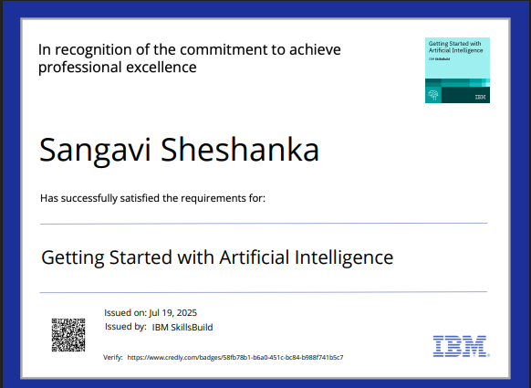
IBM Certifications

Slide 16
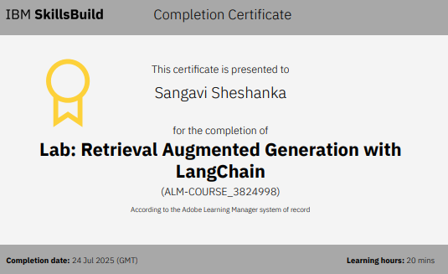
IBM Certifications

Slide 17
THANK YOU

