Slide 1

Pneumonia Detection & Classification Using Deep Learning
Abbey Singh Gill
Yokeshwar Boopathy
Snega Murugan
Anand Vinoy
Aravindsamy Sivanandam
Muthu Laxman Kumarappan
Sangavi Sambath Kumar

Slide 2
Introduction
In this project we are going to build a neural network model using CNN to find out if chest x-rays provided has pneumonia or are normal. The main objective of this project is to employ a Convolutional Neural Network (CNN) to categorize X-ray images into two classes: those indicative of pneumonia infection and those showing normal lung conditions. Additionally, the model should distinguish between viral and bacterial pneumonia within the pneumonia-infected category.
This dataset comprises chest X-ray images depicting both normal and pneumonia-affected patients, totaling 5840 images. It is structured into two main folders: "train" and "test". Each of these folders contains sub-folders labeled "NORMAL" and "PNEUMONIA", respectively.

Slide 3

Industry/Domain Overview
Healthcare Technology
Incorporating advanced technologies into healthcare for better patient care and treatment outcomes.
Medical Research
Exploring innovative methods to enhance medical diagnostics and disease identification.
Data Science
Utilizing data analysis to derive insights for medical decision-making and diagnosis improvements.
Photos provided by Pexels

Slide 4
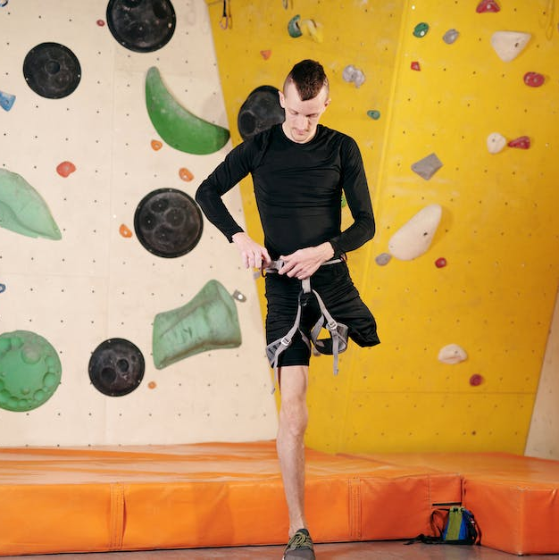

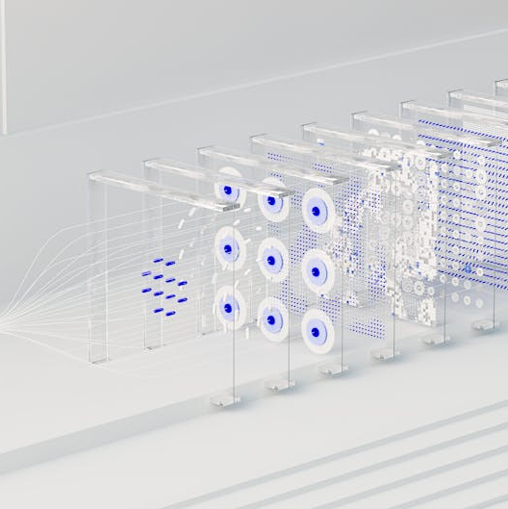
Problem or Opportunity Identification
Impact on Patient Care
Pneumonia Classification
Medical Diagnostic Challenge
Improving patient care by enabling timely and accurate identification of pneumonia types for targeted treatment.
Developing deep learning models to accurately classify chest x-rays for pneumonia classification.
Utilizing a precise training model enhances accuracy, minimizing human error in identifying chest X-ray abnormalities.
Photos provided by Pexels

Slide 5
Literature Survey (Minimum 10 references from 2021,2020,2019, 2018, 2017,….)
S.No | Paper Title | Name of the Conference/Journal, Year | Proposed Concept
1 | Pneumonia Detection Using an Improved Algorithm Based on Faster R-CNN | Hindawi Journal, 2021 | Low-complexity dilated bottleneck avoids the computational lag associated with network depth and the problems involved in the large numbers of parameters associated with network width and integrates into the FPN [8] network.
2 | Pneumonia Detection from Chest X-ray Images Based on Convolutional Neural Network | MDPI, 2021 | Data Pre-Processing, Proposed Network, Classification Evaluation Metrics, CNN Model, t-SNE visualisation
3 | Pneumonia Detection Using Deep Learning Based on Convolutional Neural Network | 2021 25th International Conference on Information Technology (IT) | This model has the task to help with a classification problem that is detecting whether a chest X-ray shows changes consistent with pneumonia or not, and classifying the X-ray images in two groups depending on the detection results.
4 | Multi-Objective Evolutionary Design of Deep Convolutional Neural Networks for Image Classification | 3 Dec 2019 | approach improves computational efficiency by carefully down-scaling the architectures during the search as well as reinforcing the patterns commonly shared among past successful architectures through Bayesian model learning.
Photos provided by Pexels

Slide 6
Differentiation
We are using the CNN and mainly focused on CNN rather that RNN(Recurrent Neural Network), Interception Network, VGG Networks(Visual Geometry Group) or other deep learning models because CNN is designed to automatically learn spacial hierachies of features from the input images. Since our project is solely based on classifying the images for both training and testing we are most likely to get the best and the most accurate result by using CNN. This differentiated our project and the deep learning models apart from the other models.

Slide 7
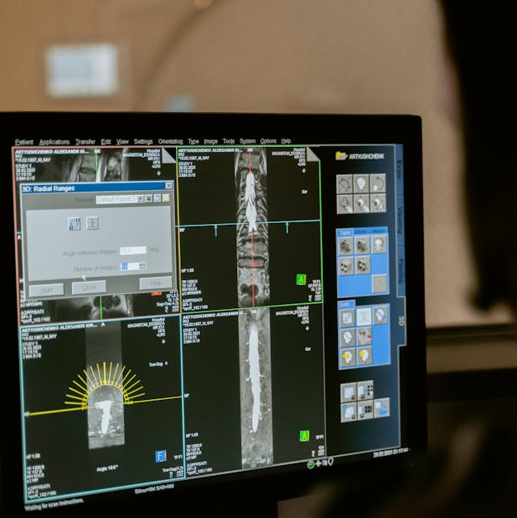
Data Gathering (Kaggle Chest X-Ray Dataset)
Large Chest X-Ray Dataset
Utilizing a comprehensive dataset of chest x-ray images for model training and testing.
Pneumonia Detection Labels
The dataset includes labeled images for both pneumonia-infected and normal chest x-rays.
Viral vs. Bacterial Pneumonia
The dataset supports classification of pneumonia x-rays into viral and bacterial types for targeted analysis.
Photos provided by Pexels

Slide 8
Wireframes for the Project
Model Architecture
Leveraging convolutional neural network (CNN) for accurate image classification and pneumonia type identification. In CNN the number of parameters is independent of the size of the original image. You can run the same CNN on a 300 × 300 image, and the number of parameters won’t change in the convolution layer.
Training and Validation
The training data consists of 5,216 chest x-ray images with 3,875 images shown to have pneumonia and 1,341 images shown to be normal.
Diagnostic Tool Development
We will be using Hugging Face for creating a UI. This will make it easier for the users to interact with our project.

Slide 9

Conclusion
Medical Impact
The project aims to bring about a positive impact on medical diagnostics and patient care through advanced image classification.
Technological Advancements
Contributing to the advancements in medical technology with the fusion of deep learning and diagnostic imaging.
Future Opportunities
Opening doors for further research and development in the field of medical image analysis and disease classification.
Photos provided by Pexels

