Slide 1
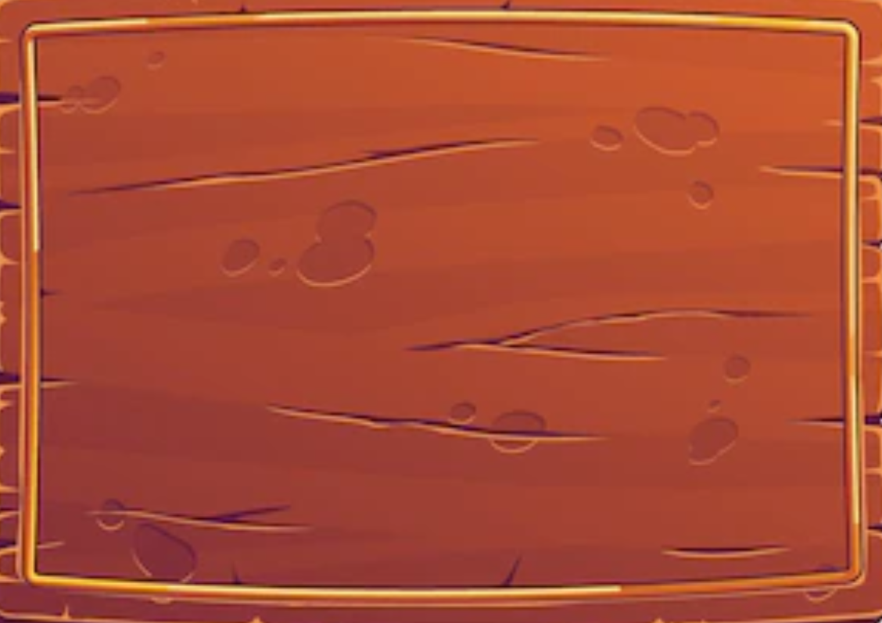






SETTINGS
AUDIO:ON
MUSIC:ON
BACK
Developed by Sangeet Chourasia and Deepansh Jindal

Slide 2
GAME PAUSED
RESUME GAME
RESTART GAME
MAIN MENU
Developed by Sangeet Chourasia and Deepansh Jindal

Slide 3
HOW TO PLAY
Single Player : Use arrow keys to move around the Map. Complex with maximum number of Points.
Multiplayer: Two Windows will be displayed on the screen for each player.
Since game is played in one system. Only one player can play at a time.
Each player should use arrow keys for moving the player to target position.
-- Try to avoid angry Professors
-- Try to avoid angry Dogs
-- Reach Lecture Hall
-- In multiplayer ,the one who reaches the Lecture Hall first , wins the game.
Developed by Sangeet Chourasia and Deepansh Jindal

Slide 4
ABOUT
Apparently Offline lectures have begun and as expected you woke up late. Professor has announced surprise quiz and hence you cannot miss the class . You can access cycles at Yulu Stand to reach the class on time. Try to reach Lecture Hall as fast as possible , maximizing your score. Beware of Angry Professors and Dogs in your journey .
All the Best!
This game is designed under a course project COP290. It is developed by Sangeet Chourasia and Deepansh Jindal.
Developed by Sangeet Chourasia and Deepansh Jindal

Slide 5
MAIN MENU
PLAY GAME
HOW TO PLAY
SETTINGS
Developed by Sangeet Chourasia and Deepansh Jindal

Slide 6
MAIN MENU
PLAY GAME
HOW TO PLAY
SETTINGS
Developed by Sangeet Chourasia and Deepansh Jindal

Slide 7

GAME MODE
SINGLE PLAYER
MULTIPLAYER
Developed by Sangeet Chourasia and Deepansh Jindal

Slide 8
MAIN MENU
PLAY GAME
HOW TO PLAY
SETTINGS
Developed by Sangeet Chourasia and Deepansh Jindal

Slide 9
WELCOME TO THE GAME
REACH THE CLASS
Developed by Sangeet Chourasia and Deepansh Jindal

