Slide 1

Bapatla Engineering College :: Bapatla, (Autonomous)
Department of Computer Science and Engineering
Detection of Fake Profiles in Twitter
Under the guidance of
Mr.Srikanth Nalluri
Batch C4:
S. Komala Sangeeta - Y20ACS556
S. B.G Sai Vamsi - Y20ACS566
R. L.K. Maha Lakshmi - Y20ACS548
P. Naga Satwik – Y20ACS525

Slide 2

CONTENTS
1 | Abstract
2 | Existing system
3 | Proposed system
4 | Design Methodology
5 | Implementation
6 | Results
7 | Conclusion

Slide 3
Abstract
The rise of fake profiles on Twitter presents a significant challenge, as these accounts can impersonate real people and spread misinformation.
To address this issue we want to use a machine learning-based model for detection of fake profiles via a web interface which helps in accurately identifying and mitigating fake profiles.

Slide 4
Existing System
The existing system aims to tackle the issue of fake profiles on online social networks (OSNs) by proposing a machine learning-based solution.
It collects and preprocesses data, selects relevant features, and employs the Random Forest classifier for fake profile detection.
The system evaluates its performance against other methods like SVM, Decision tree, Naïve Bayes.

Slide 5
Proposed System
The proposed system aims to enhance fake profile detection in twitter using machine learning technique: Gradient Boosting Classifier .
The proposed system includes additional and enhanced attributes in the dataset to improve the accuracy and efficacy of fake profile detection.

Slide 6
These attributes provide richer information for the machine learning models, leading to more accurate and reliable predictions of fake profiles.
Used more number of data samples.
The system features a user-friendly graphical user interface (GUI), which improves user accessibility and engagement.

Slide 7
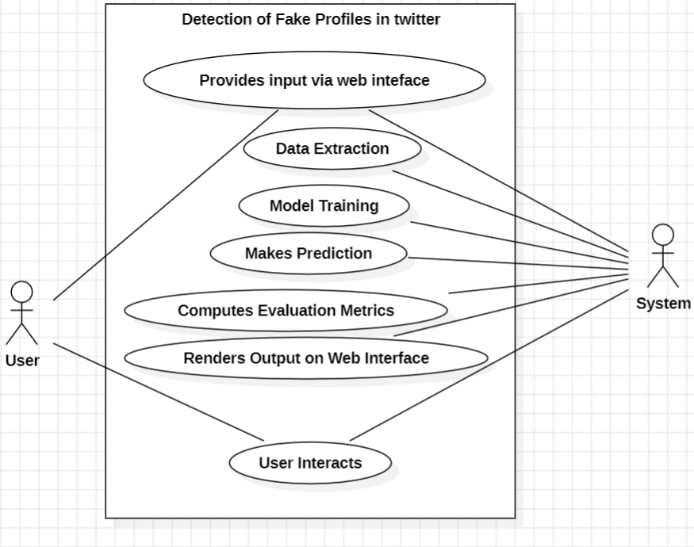
Design Methodology
Use case Diagram

Slide 8
Implementation
Importing Data form CSV File
Preprocessing
Label Encoding
Feature Extraction
Feature Selection
Model Selection and Training
Evaluating the Model
Making Predictions through web interface

Slide 9
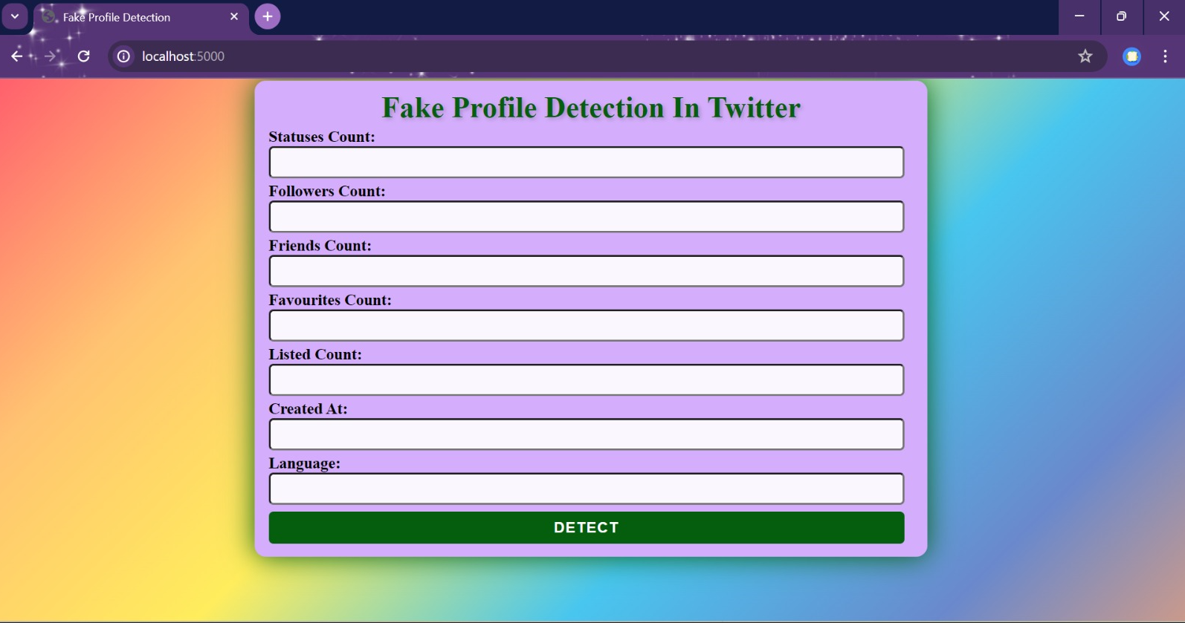
RESULT
Home Page

Slide 10
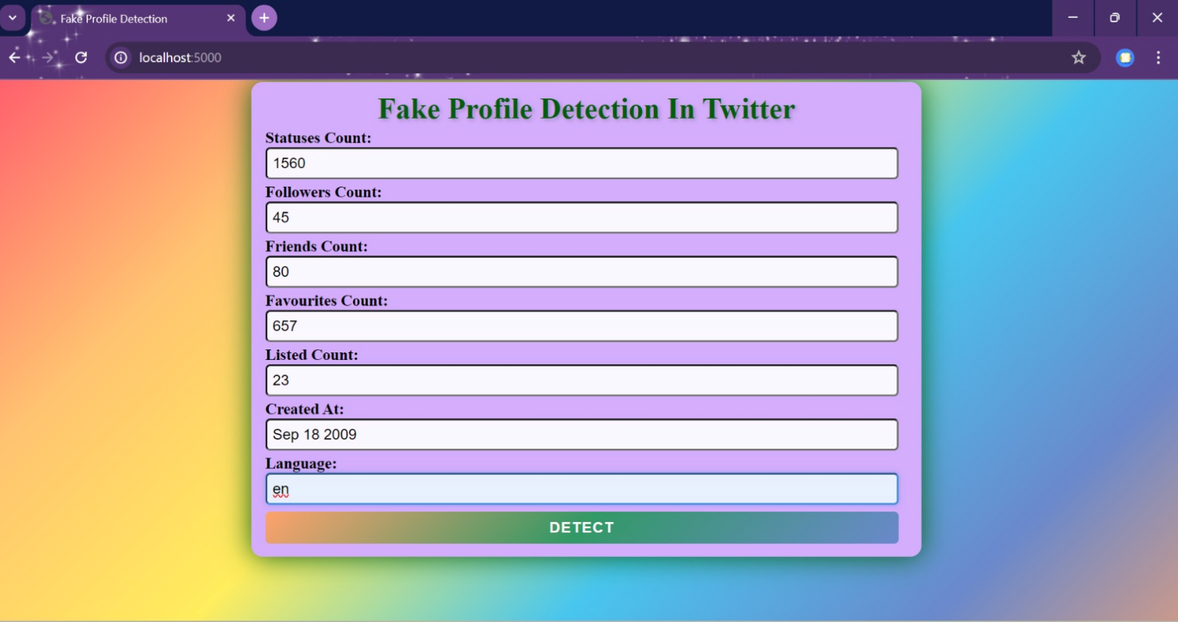
Home Page After Filling details

Slide 11
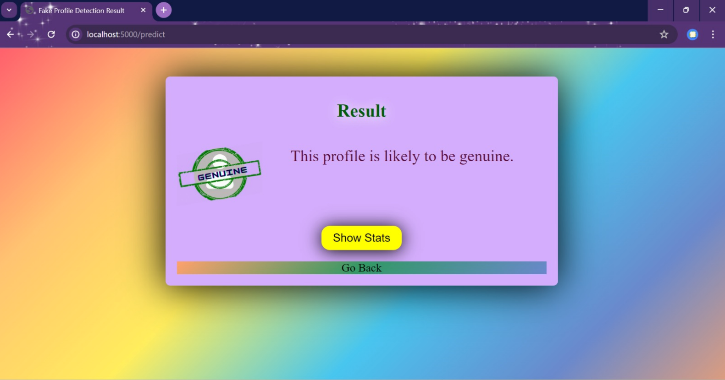
After submitting Details the result(genuine)

Slide 12
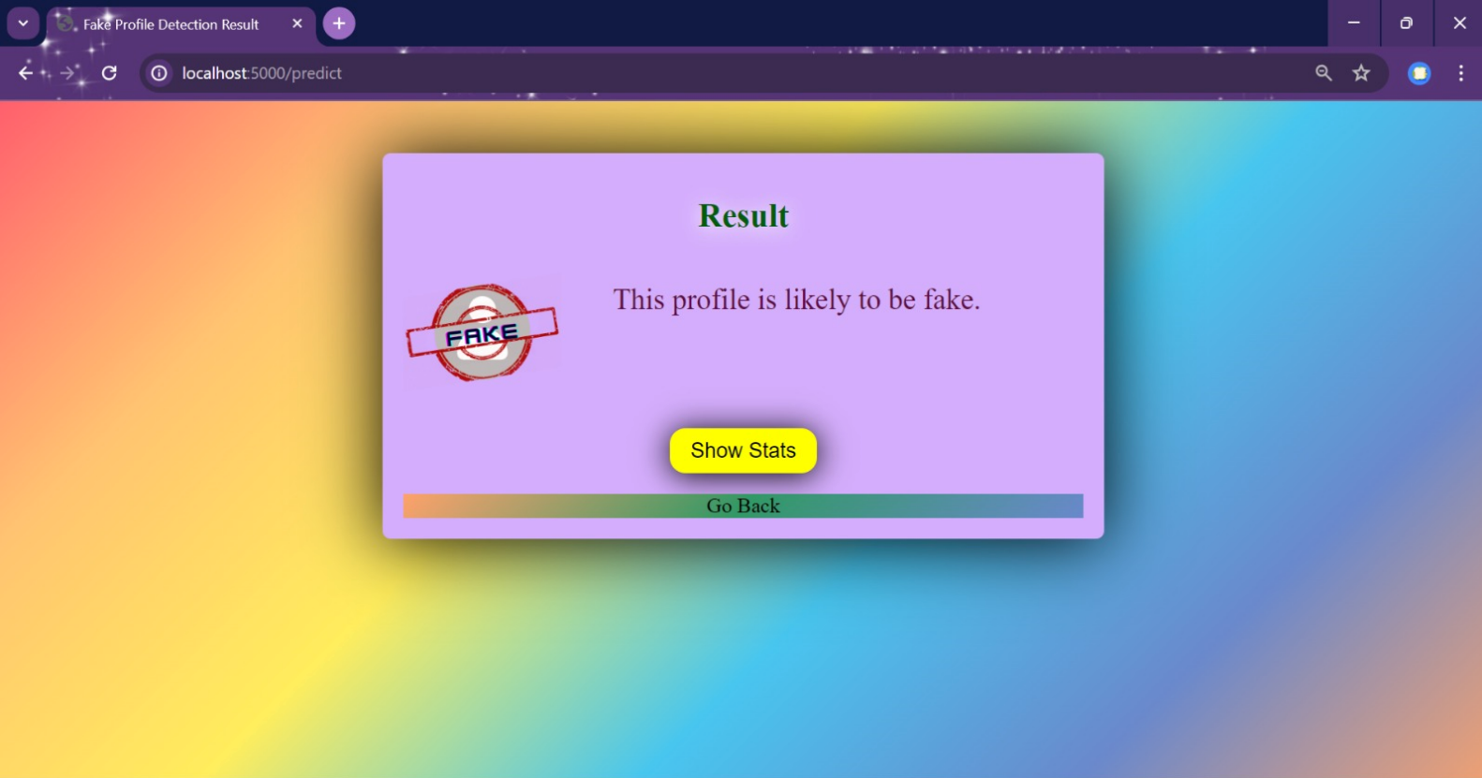
After submitting Details the result(fake)

Slide 13
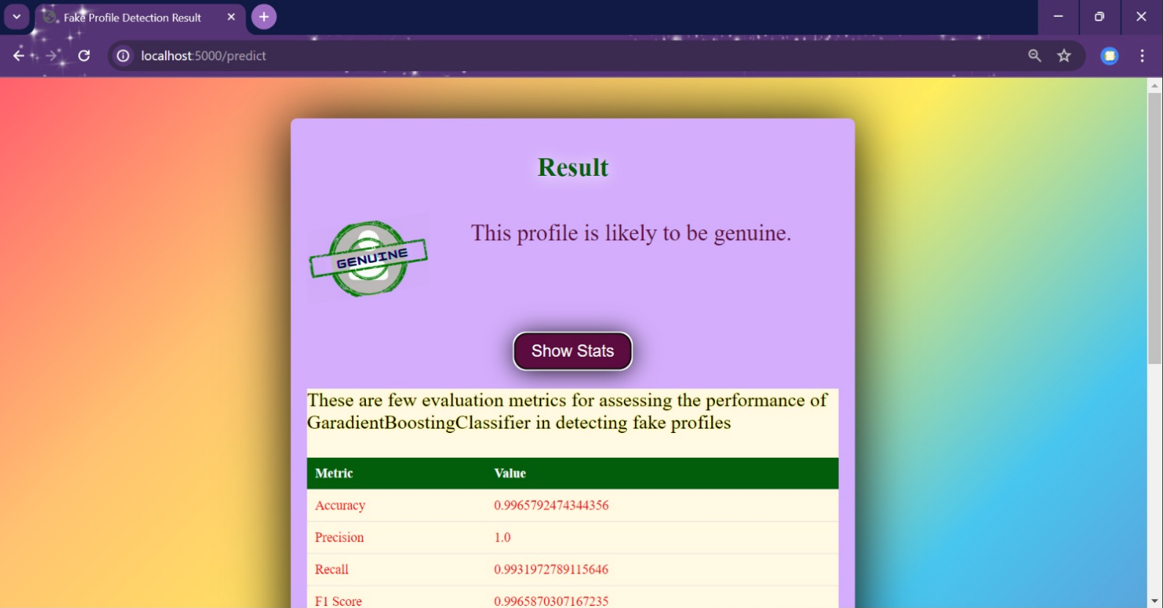
Evaluation Metrics

Slide 14
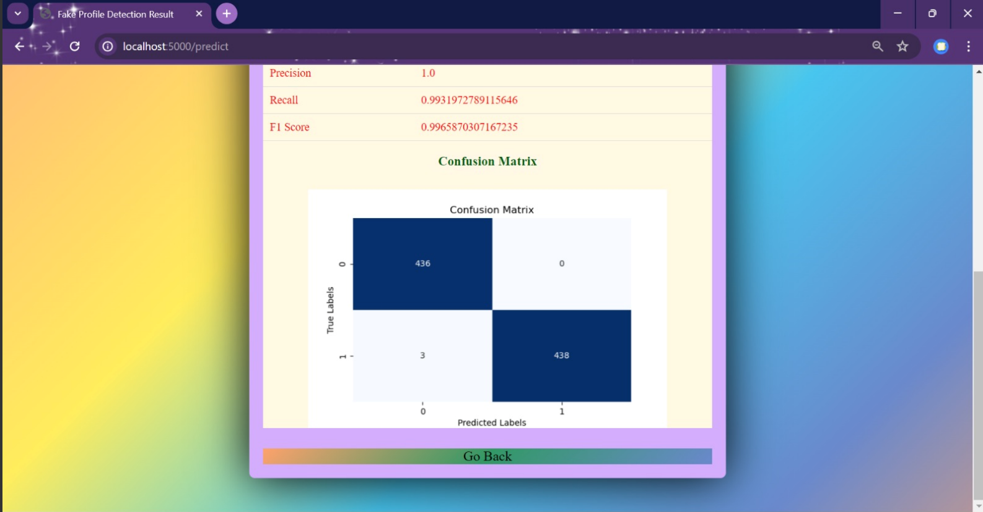
Confusion Matrix

Slide 15
Conclusion
Through rigorous experimentation and analysis ,we conclude that gradient boosting algorithm surpasses other classifiers in terms of effectiveness and reliability.
Gradient boosting, on the other hand, fared better with default values, achieving accuracy more than the random forest classifier.

Slide 16
Thank you

