Slide 1
Autism Spectrum Disorder Detection in Children Using Facial Image
Project Guide
Dr.SABITHA S
SANGEETH.A.P
TVE19MCA048
S6 MCA

Slide 2
INTRODUCTION
Autism is the imperfect development of children's brains that interfere with their social interaction. Many of the problems with this disease are that children do not understand, learn precisely, and have difficulties interacting and communicating. 1 in every 54 children has autism problems. Nowadays, doctors or specialists review the behavior and growth of children to identify them as autistic or non-autistic, which is very time-consuming and requires very experienced physicians. It is a very challenging task for the doctors or physicians to identify autistic children just by seeing their behavioral activities for a certain period of time. A child can be diagnosed with ASD as early as 18 months old. Early detection and diagnosis are crucial for any patient with ASD, as this may significantly help them with their disorder.

Slide 3
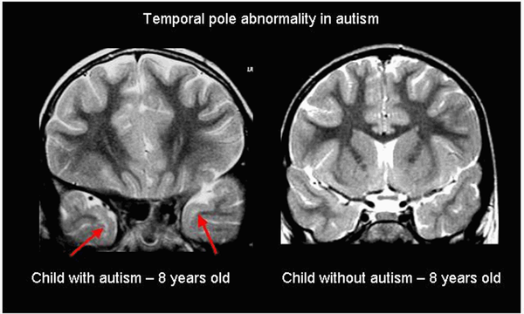
Existing System
To classify children with autism or not was based on the analysis of brain images.
Focused on analyzing images of cerebral white matter (CWM) in individuals.

Slide 4
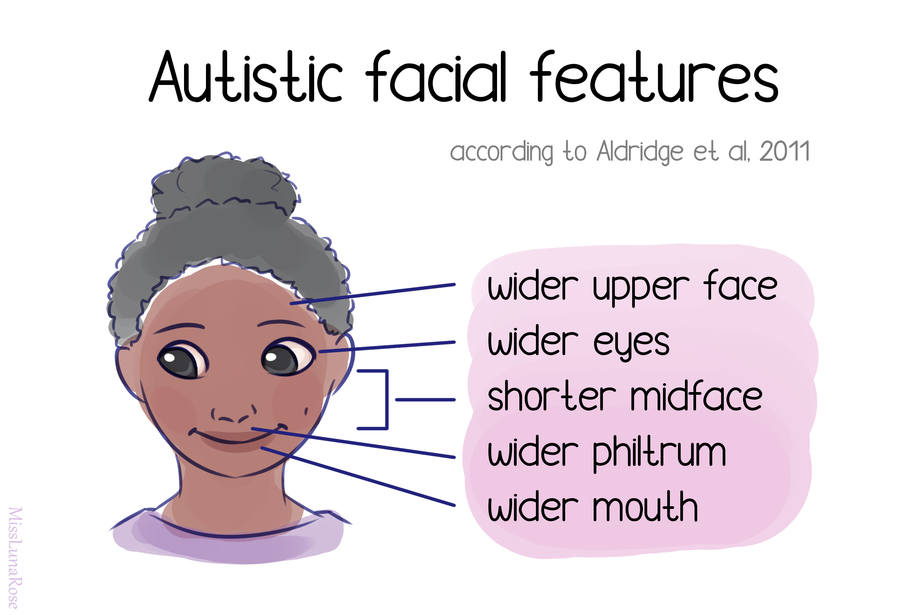
Proposed System
Children diagnosed with autism share common facial feature distinctions from children who are not diagnosed with the disease.
Conducting facial recognition binary classification on images of children with autism and children who are labeled as healthy could allow us to diagnose the disease earlier.

Slide 5
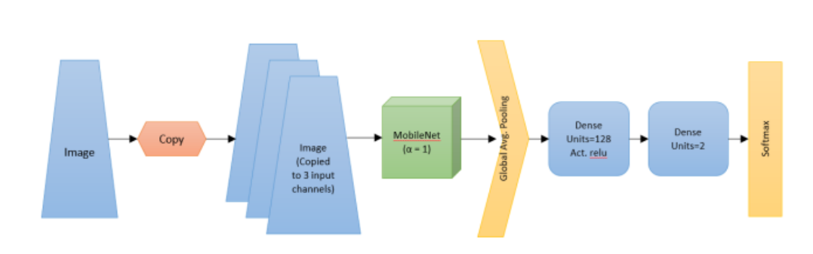
METHODOLOGY

Slide 6
REFERENCES
Madison Beary, Alex Hadsell, Ryan Messersmith, Mohammad-Parsa Hosseini, “Diagnosis of Autism in Children using Facial Analysis and Deep Learning” Department of Bioengineering,
Santa Clara University—Santa Clara, CA, USA
M. F. Rabbi, S. M. M. Hasan, A. I. Champa and M. A. Zaman, "A Convolutional Neural Network Model for
Early-Stage Detection of Autism Spectrum Disorder," 2021 International Conference on Information and
Communication Technology for Sustainable Development (ICICT4SD), 2021, pp. 110-114, doi:
10.1109/ICICT4SD50815.2021.9397020
Rifat Sadik, Sabbir Anwar, MD. Latifur Reza,” AutismNet: Recognition of Autism Spectrum Disorder from Facial Expressions using MobileNet Architecture”Jahangirnagar University, Savar, Dhaka-1342, Bangladesh

