Slide 1
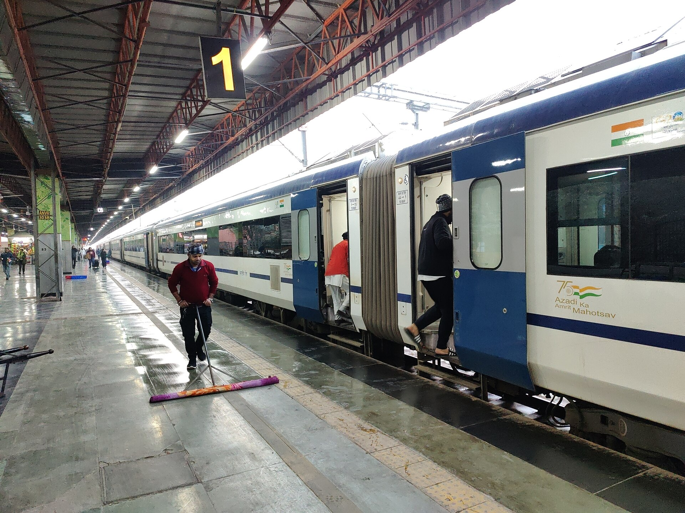
CONTROL SYSTEMS · PROJECT REVIEW
SwarmRide Bharat
A self-powered, load-adaptive, train-synchronised suspension for Indian Railways — the damper that harvests energy, tunes the ride, and watches the bogie’s safety.
Jaganath
Niranjan
CB.AI.U4AID24021
CB.AI.U4AID24035
Kowshik
Sangeeth
CB.AI.U4AID24036
CB.AI.U4AID24050
Amrita School of Artificial Intelligence, Coimbatore · Amrita Vishwa Vidyapeetham, India
Notes:
Introduce the team and the one-line idea: today’s oil damper on every train bogie becomes a smart electromagnetic damper that makes its own power, tunes the ride to the live load, gets a bump warning from the locomotive, and powers safety sensors on the bogie.

Slide 2
Today’s dampers waste energy, ride worse when the coach is full, and see nothing
01 · THE PROBLEM
171
≈ 3 / day
643
derailments from poor track maintenance, 2017–21
hot-axle cases, checked at only ~25 trackside sites
train partings + 2,059 wagon detachments, 2018–19
CAG Report 22 of 2022
Railway Board, 2025
Seen only at the last wagon
17–30%
20–90 W
0 W
of damping lost as a fixed-damper coach fills up
per coach bogie burned as heat by today’s dampers
of electricity on goods wagons — so no sensors at all
Our simulation, Stage 1
≈ 210 W per loaded wagon bogie · Stage 1
Indian Railways freight stock
Notes:
Three safety gaps (track, bearings, couplings) and three engineering gaps (comfort falls with load, energy wasted, no power on wagons). One device can close all six.

Slide 3
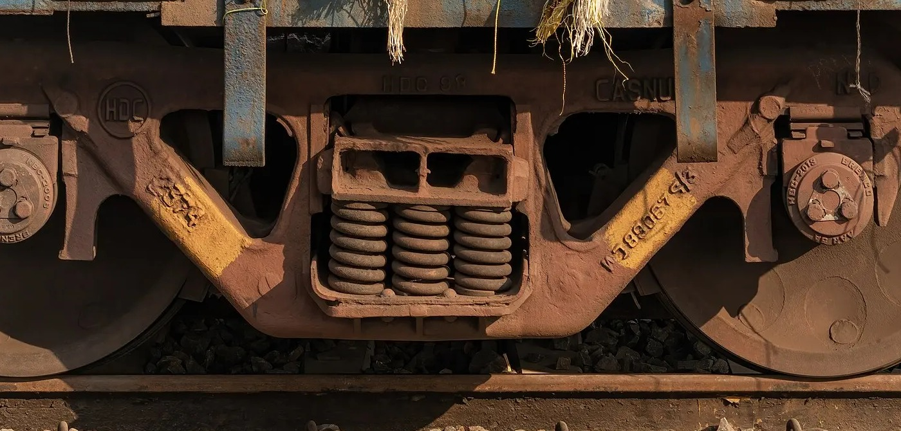
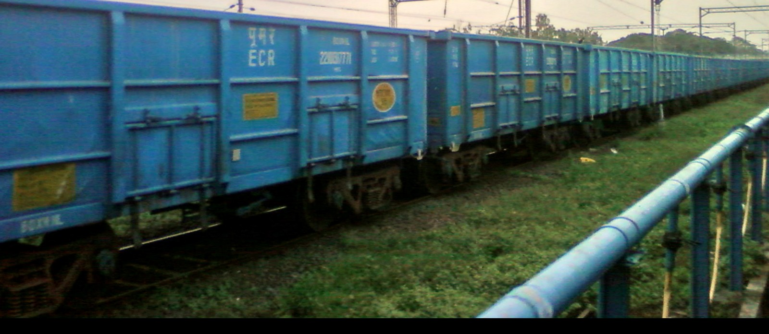
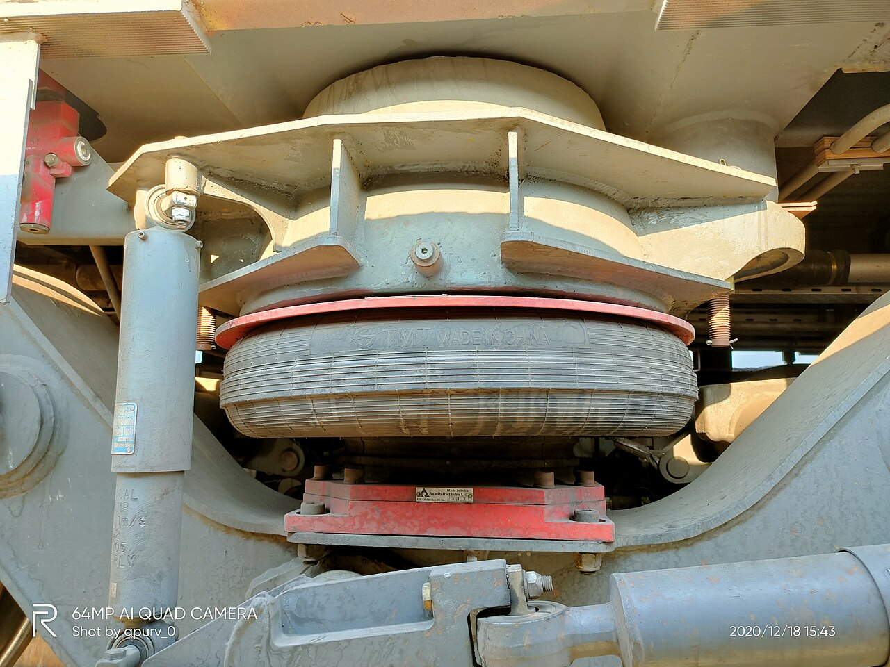
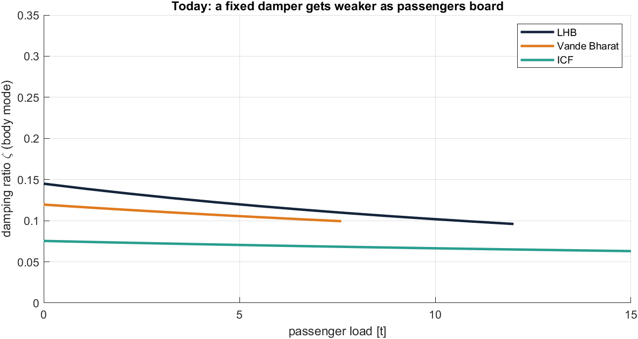
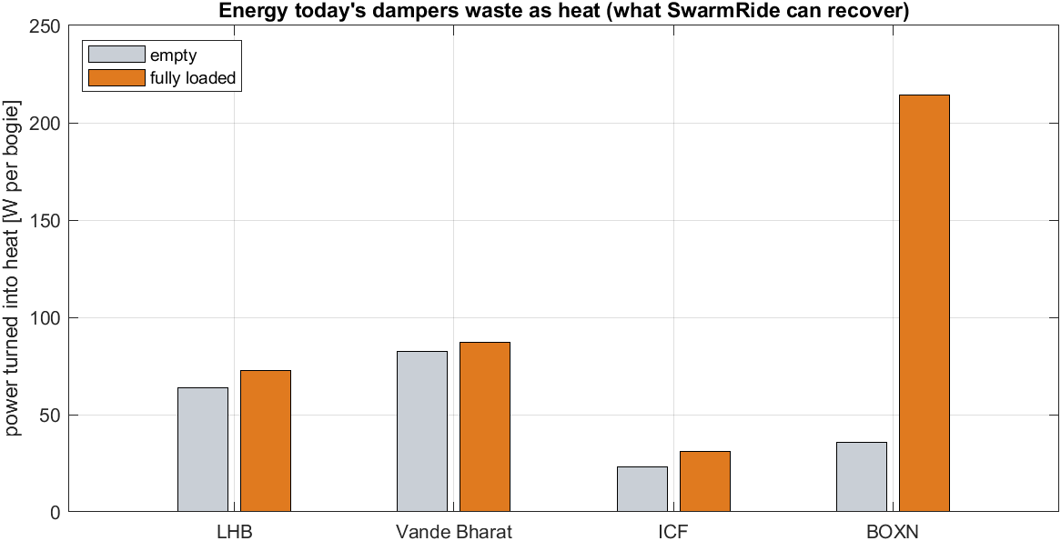
Today’s bogie: a passive damper tuned for one load
01 · THE PROBLEM
Comfort falls with load: damping ratio 0.14 → 0.10 on LHB as passengers board.
Energy thrown away: 64–73 W per LHB bogie, 214 W per loaded BOXN bogie.
Notes:
Photos: the Casnub wagon bogie, a goods train and an LHB air spring. Our Stage 1 simulation of today’s trains shows the two engineering gaps: fixed dampers lose damping as load rises, and all suspension energy becomes heat.

Slide 4
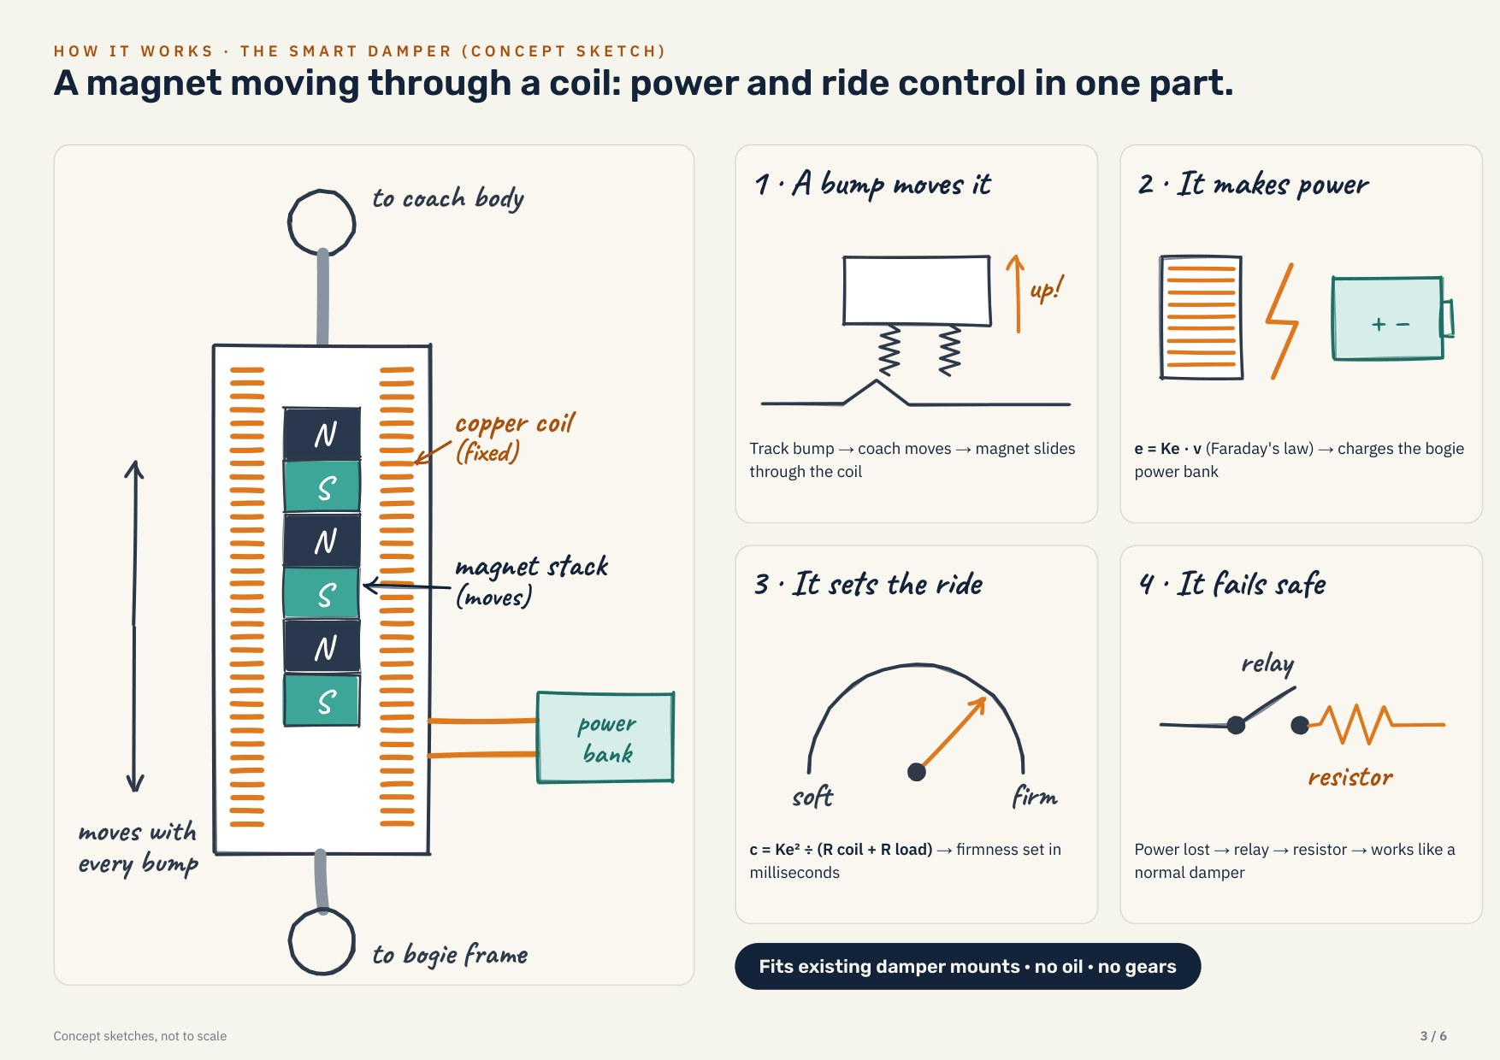
One smart electromagnetic damper. Five jobs.
02 · THE SOLUTION
1 · Harvest — motion in a coil charges the power bank
e = Ke · v
2 · Control — coil current sets damping, by load
F = Ke · i, c = Ke² / R
3 · Preview — the loco warns every coach ahead
tₙ = dₙ / v
4 · Protect — the bank powers safety sensors
P_harvest > P_sensors
5 · Fail-safe — a relay restores today’s damping
c_failsafe = c_today
Notes:
Same mounting points as today’s damper. A magnet moving through a coil makes electricity; the current drawn sets how firm the damper is. So one device harvests, controls the ride, powers sensors and fails safe.

Slide 5
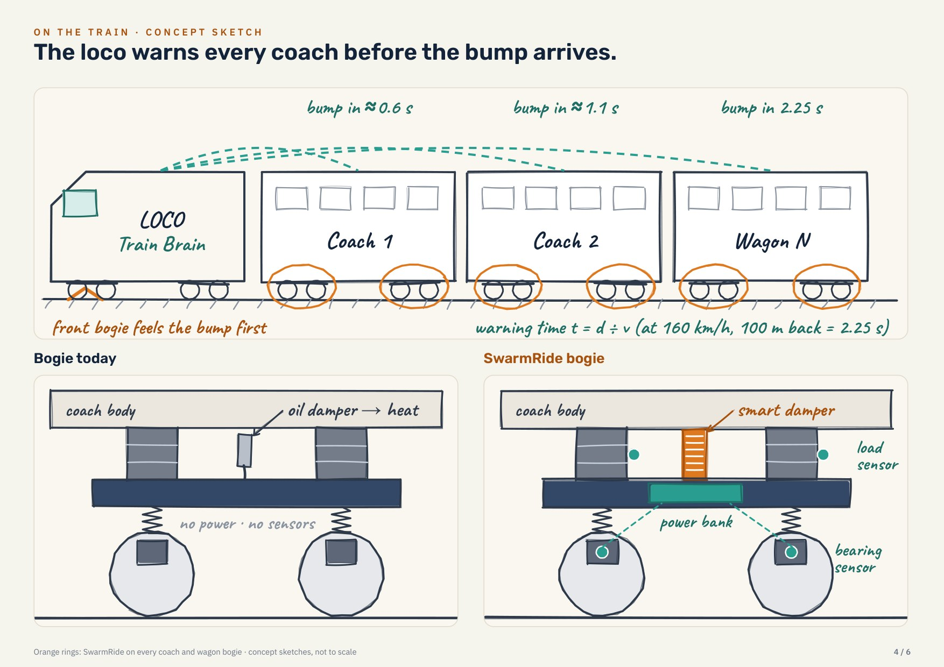
Train Brain: the loco warns every coach before the bump
02 · THE SOLUTION
The lead bogie feels every bump first. Coach n reaches the same spot after
tₙ = dₙ / v
At 160 km/h | Warning
Coach 1 | 0.5 s
Coach 5 | 2.6 s = 260 control steps
Coach 10 | 5.3 s
Tested robust to a ±20 ms late warning. The Train Brain also keeps a map of known bad spots for the push (C4).
Notes:
Distances: locomotive 20 m, LHB coach 23.5 m, measured to each coach’s front bogie. The controller runs at 100 Hz, so even coach 1 gets 50 steps to prepare.

Slide 6
Regenerative dampers: from cars to trains
03 · LITERATURE REVIEW
Year | Paper · venue | Key idea | SwarmRide adds
2013 | Li, Zuo et al. · IEEE Trans. Vehicular Technology | Energy-harvesting shock absorber, road tests (cars) | Train suspension, control
2022 | Hua, Cai, Zhu · IEEE Trans. Vehicular Technology — BASE PAPER | EM damper cum harvester, semi-active, high-speed train (lateral) | Load scheduling, preview, push, power bank
2024 | Dong et al. · J. Intell. Mater. Syst. Struct. | Harvest potential on freight wagons: 33–960 W per absorber | A controller that uses it
2024 | Tao et al. · IEEE Trans. Transportation Electrification | Energy harvesting for freight-train sensors | Sensors powered by the damper
2025 | Cheng et al. · IEEE Trans. Transportation Electrification | Self-powered PMSM damper, economic MPC | Railway duty, fail-safe
2025 | Xia, Ning et al. · IEEE/ASME Trans. Mechatronics | Supercapacitor-voltage control in an EM damper | Full-day bank on a train
All six verified in Crossref · DOIs in the speaker notes
Notes:
DOIs: 10.1109/TVT.2012.2229308 (Li, Zuo, Luhrs, Lin, Qin 2013); 10.1109/TVT.2022.3149265 (Hua, Cai, Zhu 2022, base paper); 10.1177/1045389X231200146 (Dong et al. 2024); 10.1109/TTE.2023.3314056 (Tao et al. 2024); 10.1109/TTE.2024.3481067 (Cheng et al. 2025); 10.1109/TMECH.2025.3582402 (Xia, Ning et al. 2025). The field moved from car shock absorbers (2013) to train suspensions (2022) and now to self-powered dampers with supercapacitor management (2025). No paper combines load-scheduled control, train-wide preview, active push, a full-day power bank and self-powered health sensing on Indian rolling stock — that is SwarmRide’s gap.

Slide 7
Hua, Cai & Zhu, IEEE Trans. Vehicular Technology 71(5), 2022
03 · BASE PAPER
“Energy-Regenerative Semiactive Lateral Suspension Control in High-Speed Trains Using Electromagnetic Damper Cum Energy Harvester”
What they did
Where SwarmRide goes further
Full-scale EM damper cum harvester (EMDEH), tested in cyclic tests
Damping tuned by the duty cycle of the harvesting circuit
Semi-active tracking of an LQG target force
Lateral secondary suspension, high-speed train, 200–350 km/h
Beat passive and fixed-duty dampers on car-body vibration; harvested 25.89–153.19 W
Vertical ride on LHB, Vande Bharat, ICF and BOXN freight
LPV gains scheduled on the measured load
Train Brain preview shared along the train
Active push (C4) from the bogie’s own bank
Full-day power bank + self-powered health sensing
Fail-safe, C firmware, bench design, 85 checks
Notes:
DOI 10.1109/TVT.2022.3149265, summary from the published abstract. Why this base paper: it is the IEEE Transactions paper closest to our idea — an electromagnetic damper on a train suspension that both controls vibration and harvests energy. Their controller is an LQG target force tracked semi-actively. We keep their core idea and extend it in five directions.

Slide 8
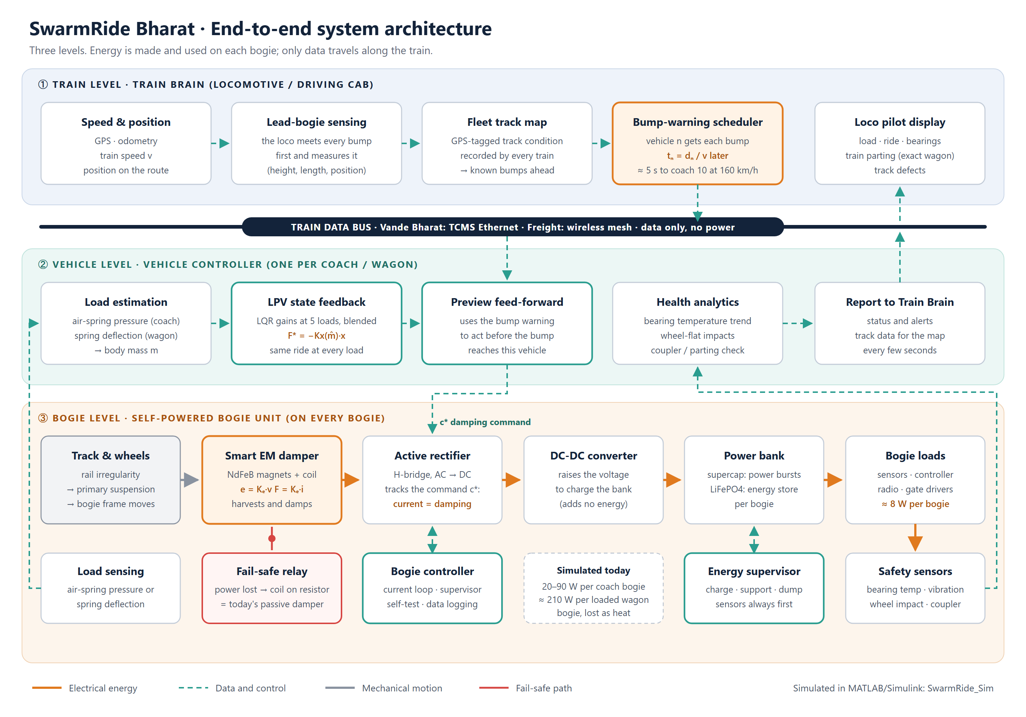
Three levels: train, vehicle, self-powered bogie
04 · ARCHITECTURE
① Train Brain · locomotive
Lead-bogie bump sensing, track map, timed warnings tₙ = dₙ / v
② Vehicle controller · 100 Hz
Load estimate, LPV-LQR + preview, push windows, health analytics
③ Bogie unit · self-powered
Smart dampers, 10 kHz drive, supercap + LiFePO4, sensors, fail-safe relay
Energy stays on the bogie; only data travels along the train.
Notes:
Walk the three levels top to bottom. The key architectural point versus the base paper: the harvested energy is stored and used on the bogie itself, so goods wagons with no electricity can run sensors.

Slide 9
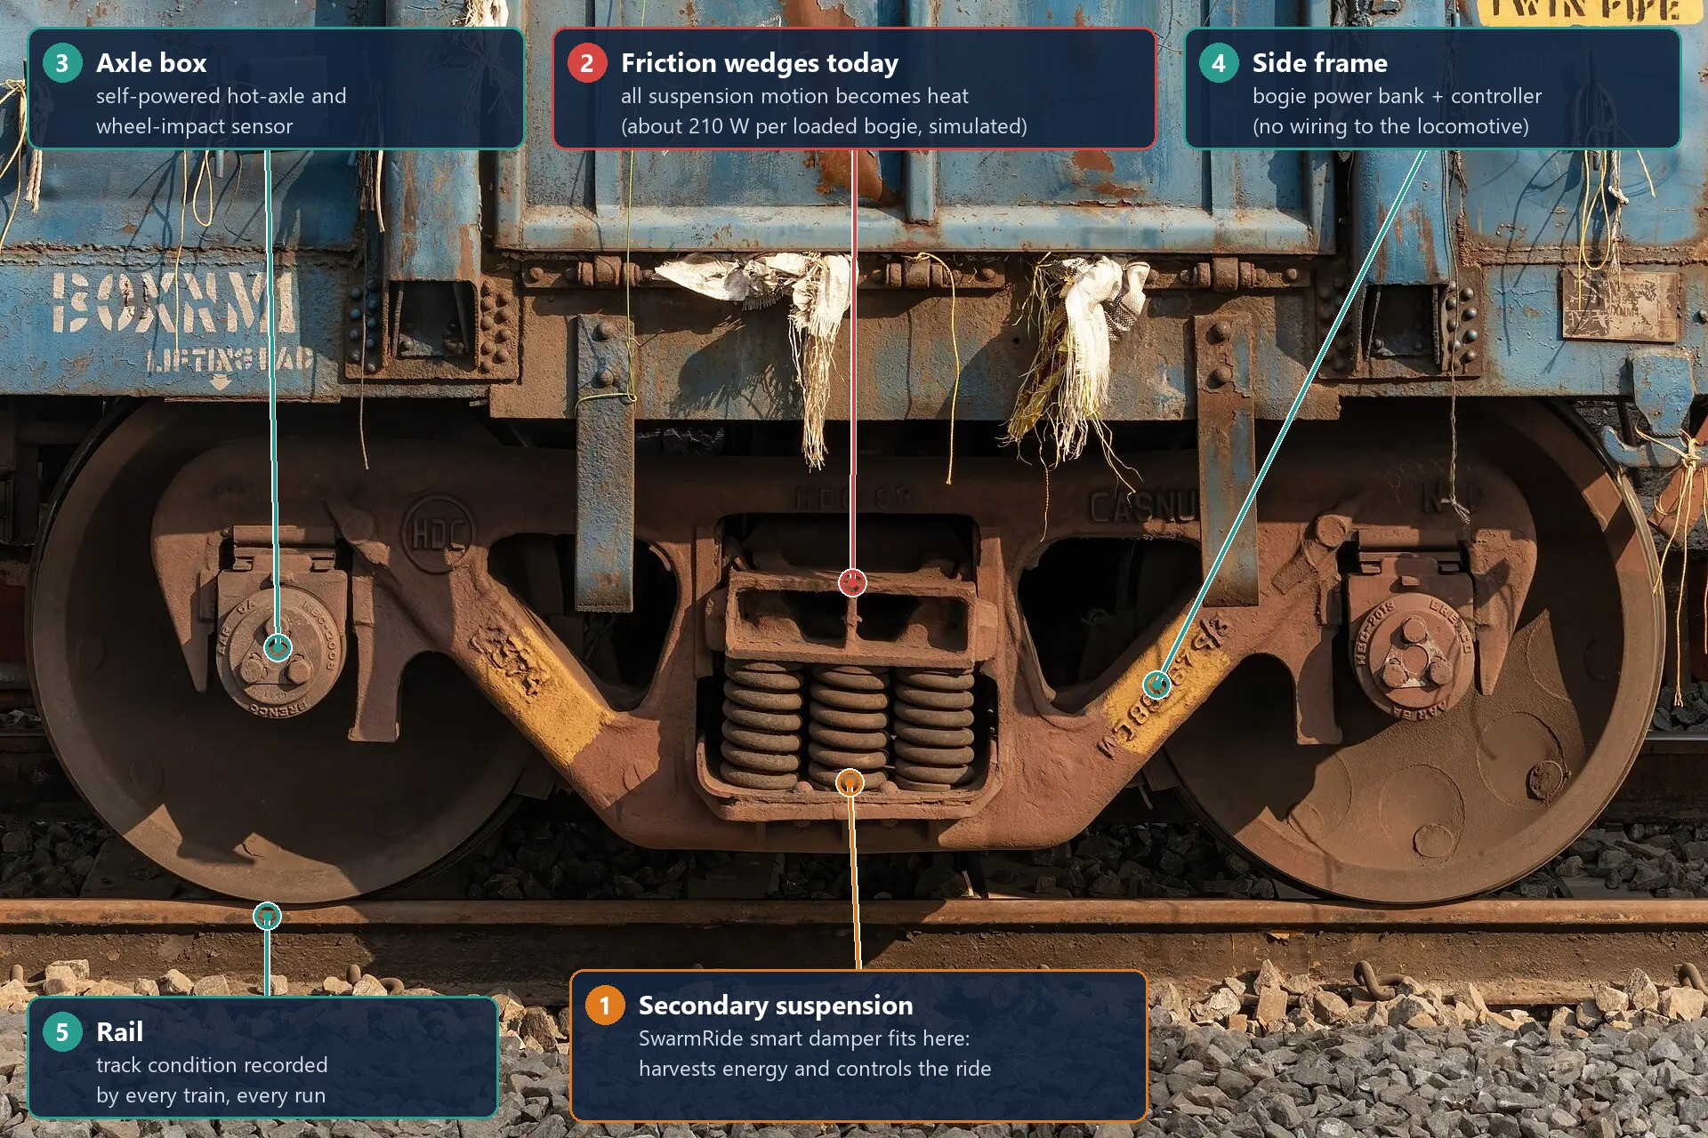
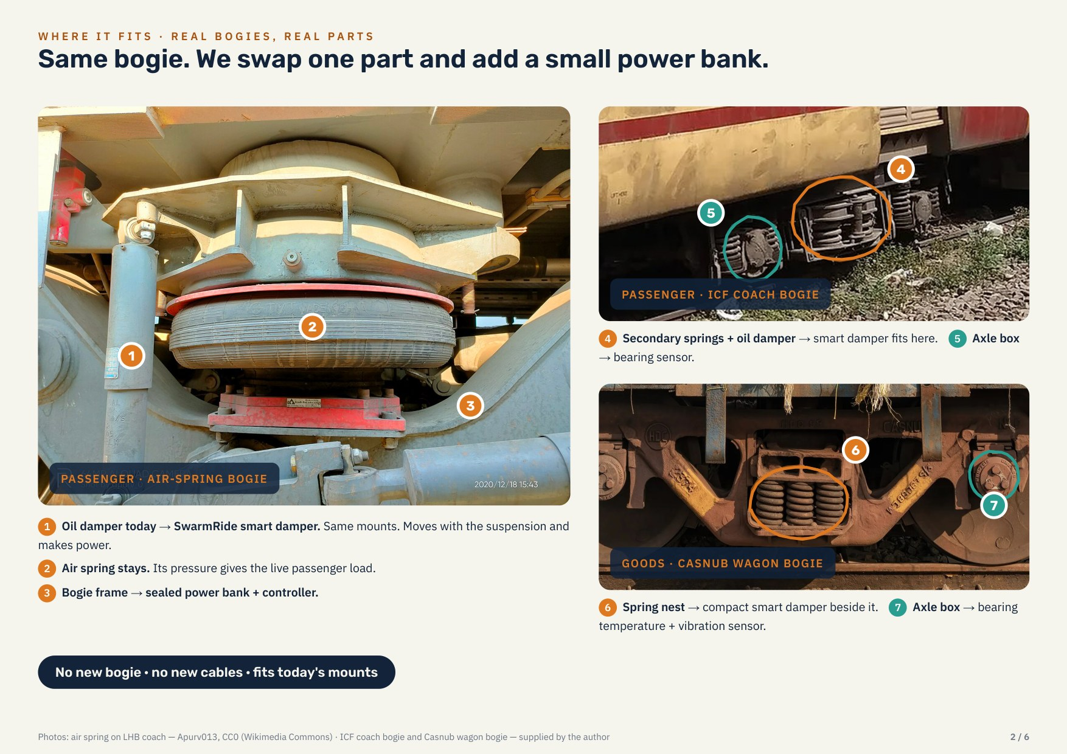
On a real bogie: no new bogie, no new cables
04 · ARCHITECTURE
Casnub (BOXN wagon): where each SwarmRide part goes
LHB · ICF · Casnub: one part swapped, same mounts
Notes:
LHB and Vande Bharat: replaces the vertical secondary dampers beside the air springs; load from air-spring pressure. ICF: secondary dampers on the bolster springs. BOXN: beside or in place of the friction wedges, with a geared smart damper.

Slide 10
Closed-loop block diagram: two loops, one plant
05 · CONTROL SYSTEM DESIGN
Train Brain
p = rail ahead
Preview gain
Kp(m)
Track w(t)
Controllers used
Outer: LPV-LQR state feedback + preview, 100 Hz
F* = −Kx(m)·x − Kp(m)·p
Inner: PI current loop + back-EMF feed-forward, 10 kHz, τ = 0.5 ms
−
PI current loop
+ back-EMF FF
coil: F = Ke·i
Σ
F*
Semi-active map
+ C4 push → i*
i*
Σ
−
−
F_d
i (meas.)
LPV-LQR gain
Kx(m)
State observer x̂
Half-coach vehicle G(s)
ẋ = A(m)x + B_F F + B_w w
x
m = measured load (air-spring pressure) schedules both gains · dashed = inner current feedback
Notes:
Outer loop: the state observer estimates body bounce, pitch and bogie motion; the LPV-LQR gain, blended between five load points by the measured load, gives the ideal force; the Train Brain preview adds a feed-forward term. The semi-active map turns F* into a damping command the damper can give (resist only), except inside a push window at a known bad spot (C4). Inner loop: a PI current controller with back-EMF feed-forward makes the coil current follow i* within 0.5 ms; the current is the force.

Slide 11
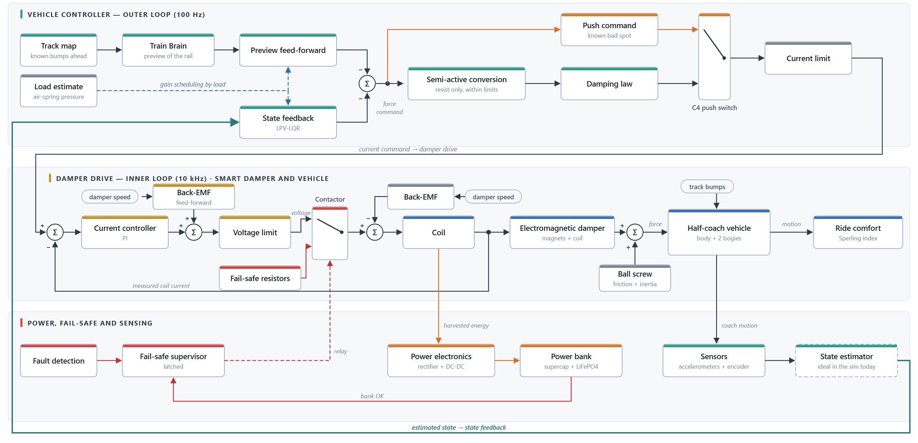
Control system architecture: two loops, self-powered, fail-safe
05 · CONTROL SYSTEM DESIGN
Outer loop 100 Hz · inner current loop 10 kHz · harvested energy to the bogie bank · contactor falls back to today’s damper on a fault
Notes:
Read it in three rows. Top, the vehicle controller (outer loop, 100 Hz): the track map and Train Brain give the preview feed-forward, the state feedback (LPV-LQR) uses the estimated coach state, and the load estimate schedules both gains. The force command goes through the semi-active conversion and the damping law, or, at a known bad spot, the push command; the C4 switch picks one, then the current limit. Middle, the damper drive (inner loop, 10 kHz): the PI current controller with back-EMF feed-forward, the voltage limit and the contactor drive the coil; the electromagnetic damper and the ball screw make the damper force on the half-coach vehicle, and the measured coil current is fed back. Bottom: harvested energy goes through the power electronics to the bogie's power bank; the fail-safe supervisor switches the contactor to the fail-safe resistors on a fault or a low bank; sensors and the state estimator close the outer loop. The Simulink version is SR_ControlDiagram.slx.

Slide 12
Controllers used: optimal, load-scheduled, with preview
05 · CONTROL SYSTEM DESIGN
Controller | Control law | Role
C0 Oil damper | Passive, fixed c = c_today | Baseline
C1 Fixed harvester | One fixed damping setting | Benchmark
C2 LPV-LQR | LQR at 5 loads, gains blended by load m, Tc = 10 ms | Core
C3 + preview | States [x; p], 221 rail samples ahead and behind | Full
C4 + push | Coil motors inside a window at a known bad spot | Stage 4
Drive PI | Kp = L/τ, Ki = R/τ, τ = 0.5 ms, back-EMF FF, anti-windup | 10 kHz
Optimal design (LQR)
J = Σ (a/a_ref)² + (d/s_ref)²
+ r_w·(F/F_ref)²
F* = −Kx(m)·x − Kp(m)·p
c* = F*·v / (v² + ε²)
c_floor ≤ c* ≤ c_cap
Stable at every load: closed-loop spectral radius 0.979–0.981 (LHB, < 1)
a = body acceleration over both bogies · d = suspension stroke · F = damper force · m = measured load
Notes:
The ladder of controllers proves each idea separately. C1 is the same kind of approach as the base paper’s fixed-duty-cycle damper. C2 is the optimal controller made load-adaptive (LPV). C3 adds the Train Brain preview, C4 the active push. The inner PI loop with back-EMF feed-forward cancels the coil’s own pole, so the current follows its reference as a first-order lag of 0.5 ms.

Slide 13
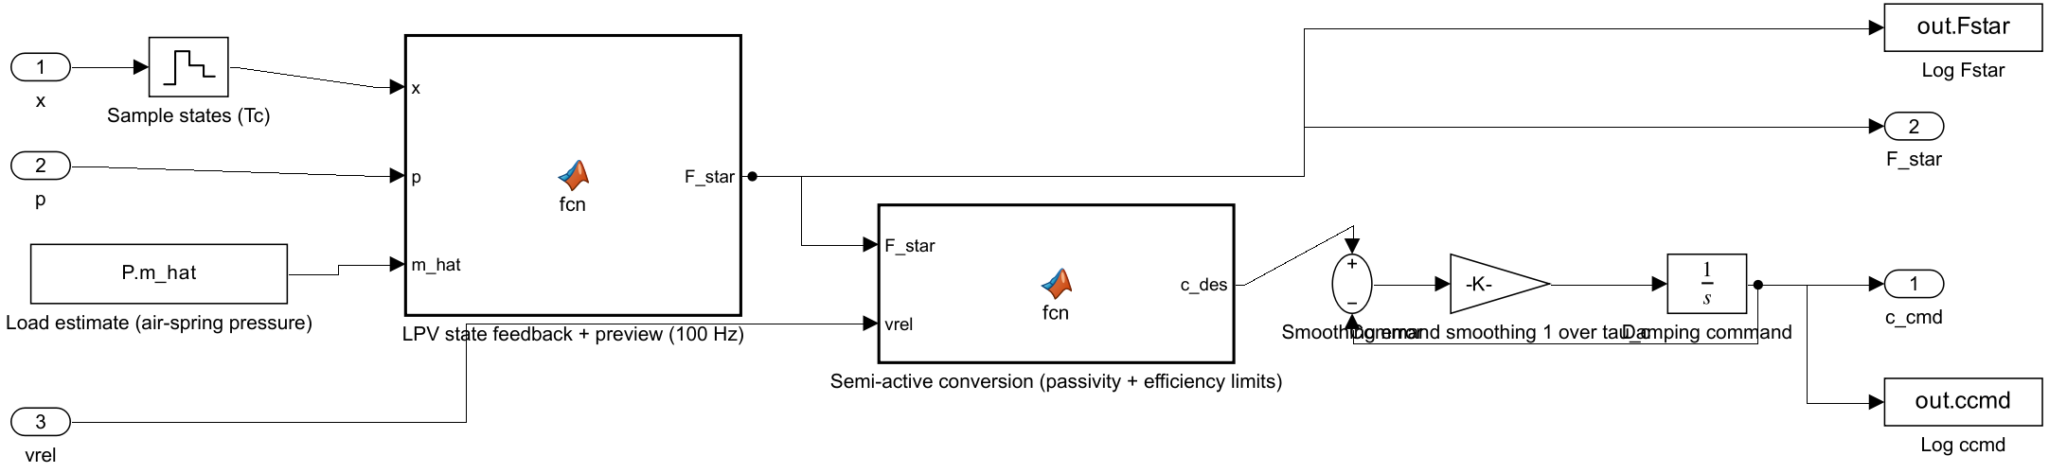
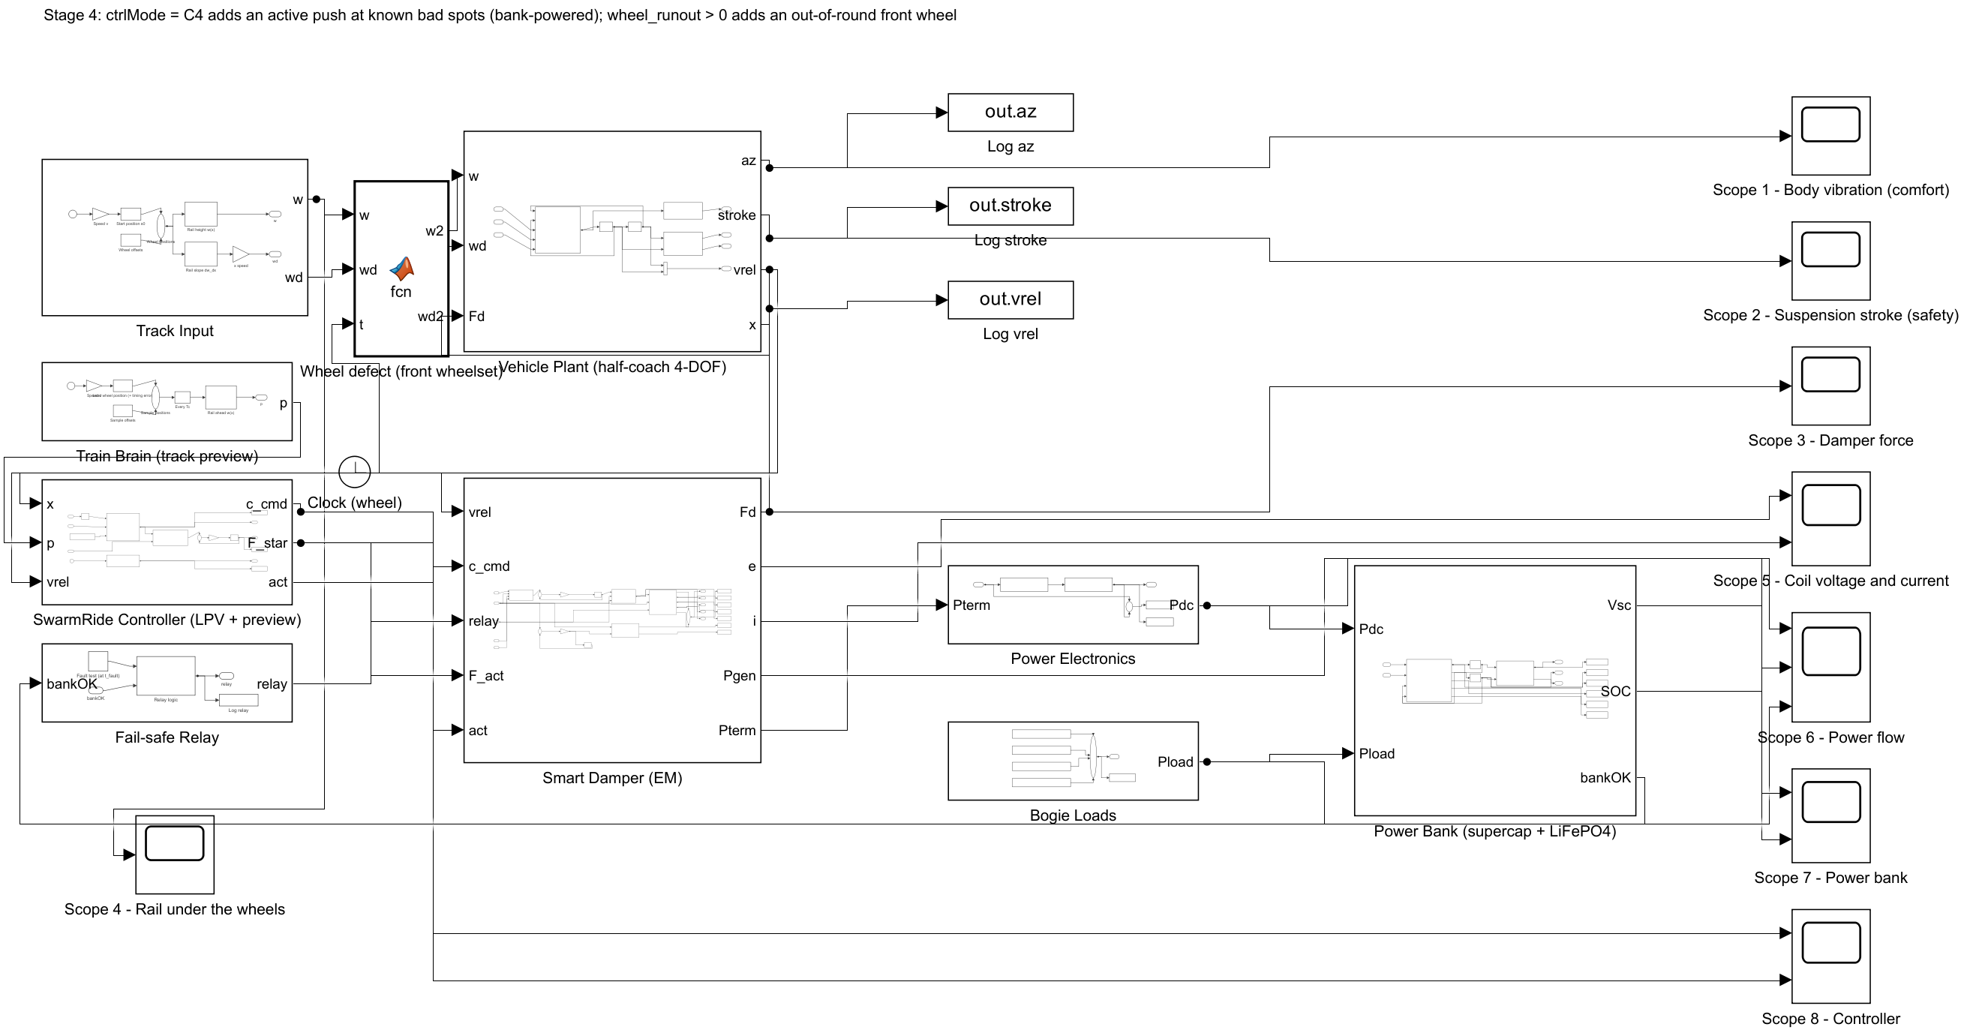
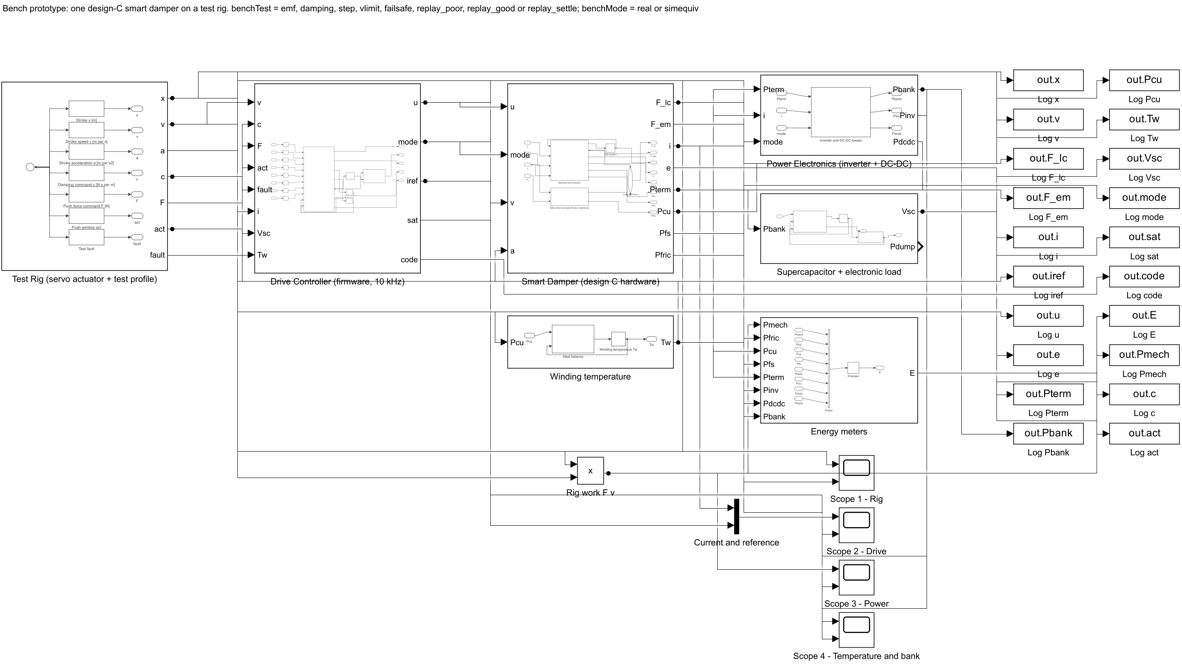
Built and run in MATLAB/Simulink R2024b
05 · IMPLEMENTATION
Controller: LPV + preview, semi-active map
SR_Stage4: track · Train Brain · controller · damper · bank · 8 live scopes
SR_Bench: one damper on a test rig
Notes:
Every model is generated by a MATLAB script, so the whole project rebuilds from code. Half-coach 4-DOF model; same coach, same rail, only the damper changes. The test suite checks the model against hand calculations, an independent state-space model, energy conservation and step-size convergence: 85 of 85 checks pass.

Slide 14
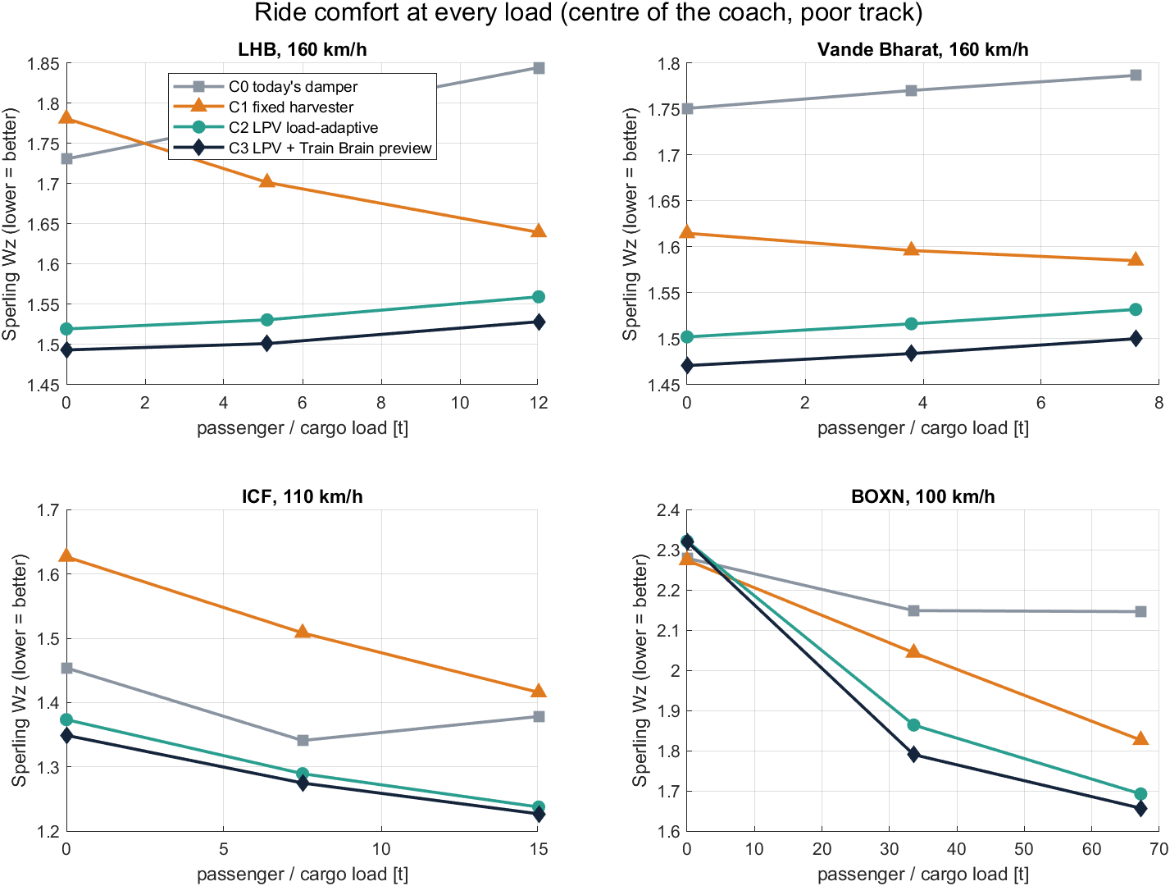
Better ride at every load, on every train
06 · RESULTS · RIDE COMFORT
−17%
Sperling Wz, crowded LHB, 160 km/h · 1.844 → 1.528
−41%
body vibration RMS · 0.174 → 0.103 m/s²
−16% · −23%
Vande Bharat · loaded BOXN wagon
Notes:
Same coach, same rail, poor track; controller C3 (LPV-LQR + preview) against today’s damper. Today’s ride gets worse as passengers board, because a fixed damper is tuned for one load. SwarmRide’s line stays nearly flat. Lower Wz is more comfortable.

Slide 15
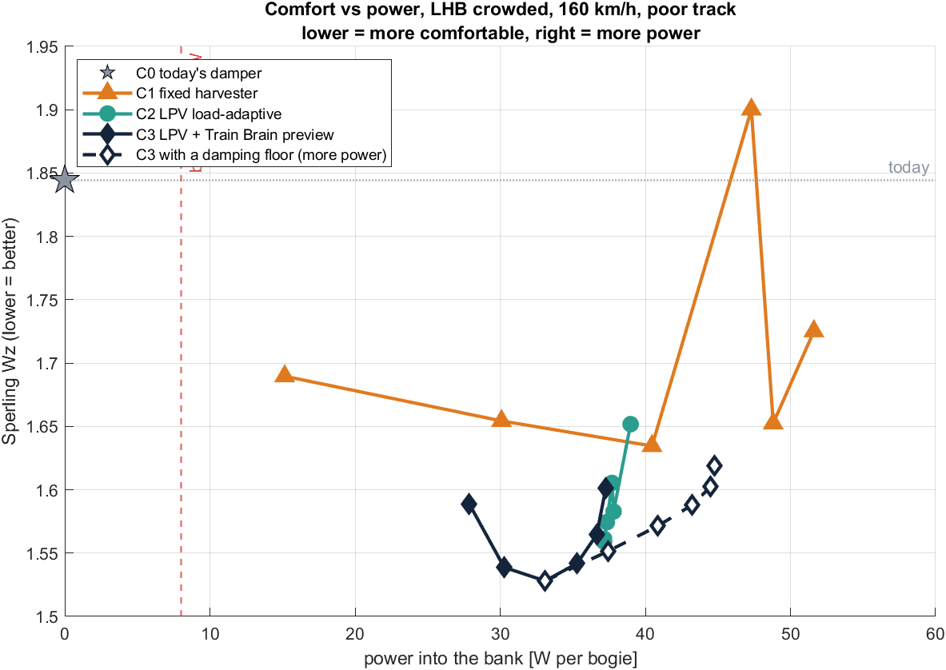
Each controller step buys comfort — and still makes power
06 · RESULTS · COMFORT AND POWER
Crowded LHB, rough track | Wz | RMS m/s² | Stroke | Bank
C0 today’s damper | 1.844 | 0.174 | 25 mm | 0 W
C1 fixed harvester | 1.639 | 0.124 | 12 mm | 37 W
C2 LPV-LQR | 1.559 | 0.109 | 17 mm | 37 W
C3 LPV + preview | 1.528 | 0.103 | 16 mm | 33 W
33 W into the bank against 8 W needed
by the bogie electronics — the bogie powers itself, with 25 W to spare.
No fixed setting reaches C3 — the best fixed one stops at Wz 1.635.
C1 corresponds to the base paper’s fixed-duty-cycle harvester · design C damper · 160 km/h · poor track
Notes:
This is the head-to-head ladder. C1, a fixed harvester, already beats today’s damper but only at one setting. The optimal LPV controller C2 does better at every load, and the preview C3 adds a little more. Power into the bank stays at 33–38 W per coach bogie across Vande Bharat and LHB.

Slide 16
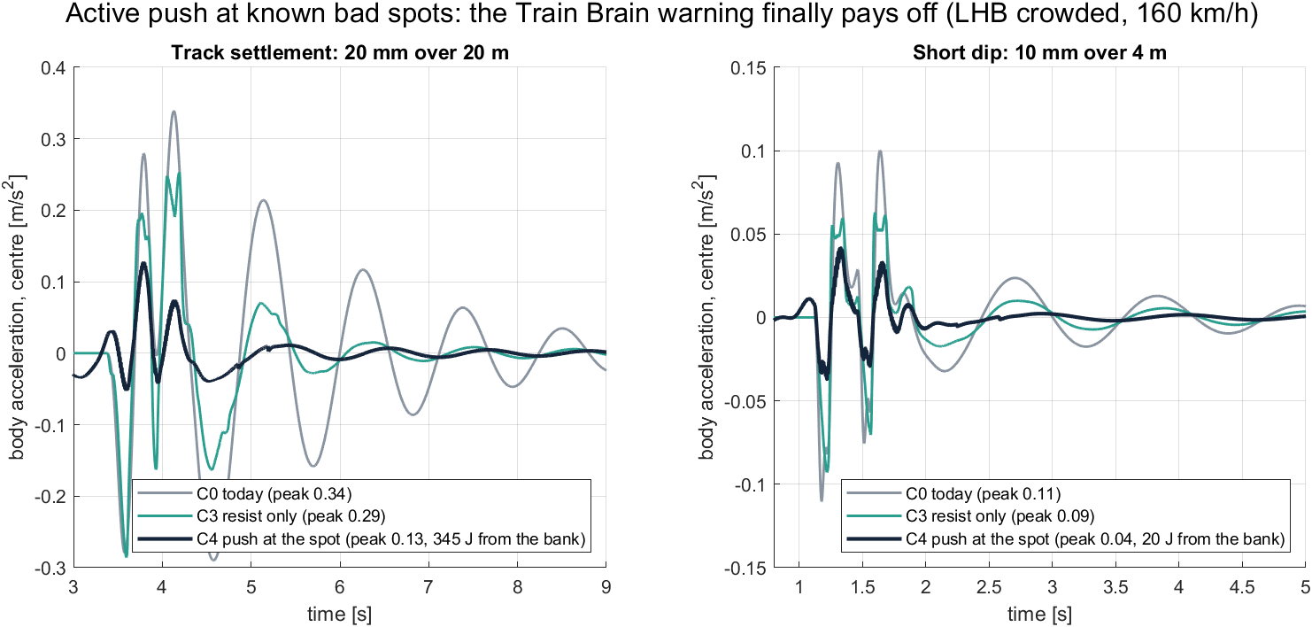
At a known bad spot, the damper pushes with its own energy
06 · RESULTS · ACTIVE PUSH (C4)
−80%
0.1 Wh
−67%
worst seat at a settlement: 0.97 → 0.76 (C3) → 0.20 m/s²
energy per push (345 J), peak 1.5 kW from the supercap
at a short dip, for just 20 J
Notes:
Crowded LHB, 160 km/h. A semi-active damper (like the base paper’s) can only resist, so it cannot act before the motion starts — that is why the preview added only 1–2% in Stage 3. In Stage 4 the same H-bridge drives the coil as a motor for about a second around a known bad spot, using banked energy. The Train Brain warning finally pays off.

Slide 17
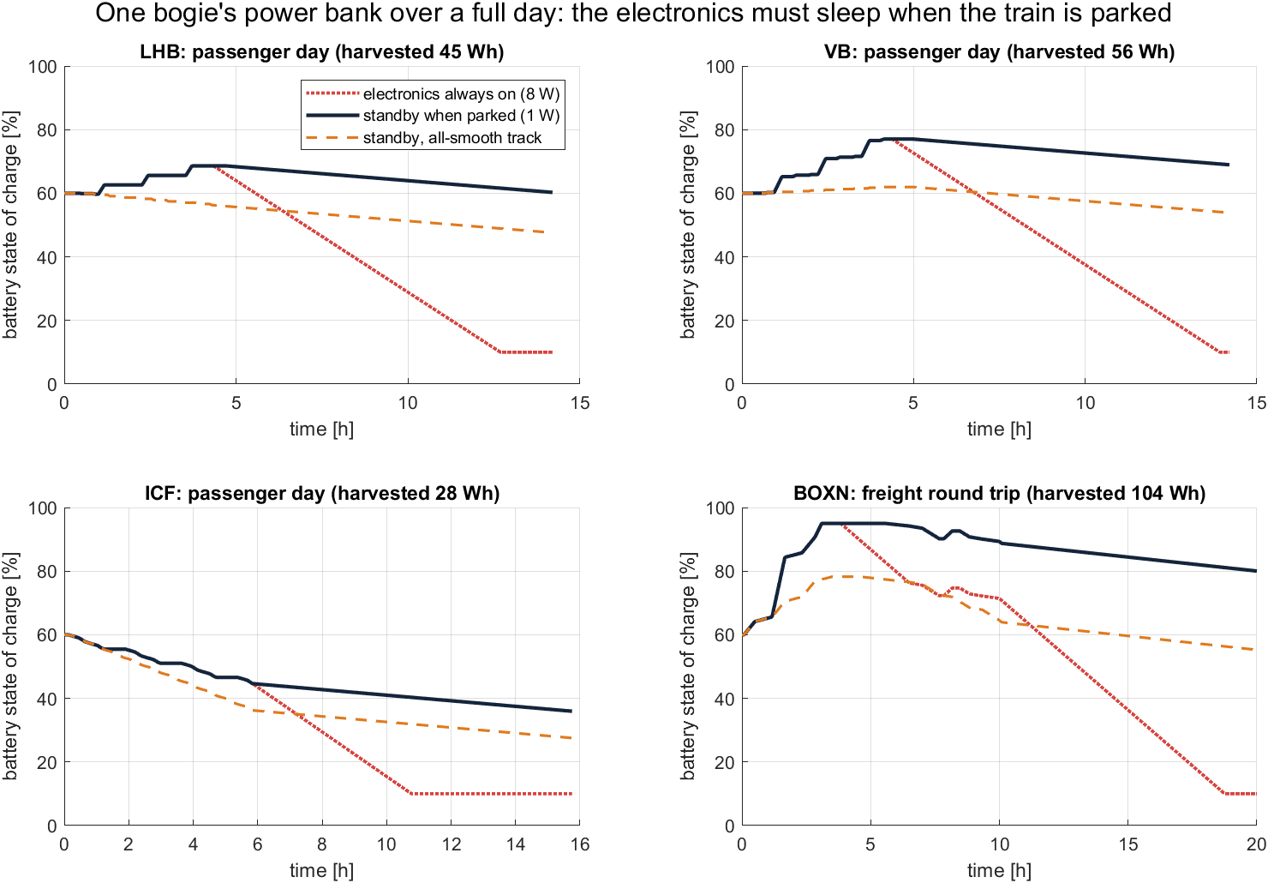
Self-powered through a whole day and night
06 · RESULTS · A FULL DAY
Battery, 1 W sleep | Start | End
LHB day | 60% | 60%
Vande Bharat | 60% | 69%
BOXN freight | 60% | 80%
ICF (slow) | 60% | 36%
Electronics left on at 8 W through a 10 h night drain every vehicle to its 10% floor. A 1 W sleep when parked fixes it — no load is ever left unpowered.
Notes:
Journey simulator stepping the Simulink power-bank rules over 14–20 h, with power tables from Simulink. Honest finding: the slow ICF coach and all-smooth track still drain slowly, so they need a small top-up or a lower sensing rate. That is a design rule for the product, not a showstopper.

Slide 18
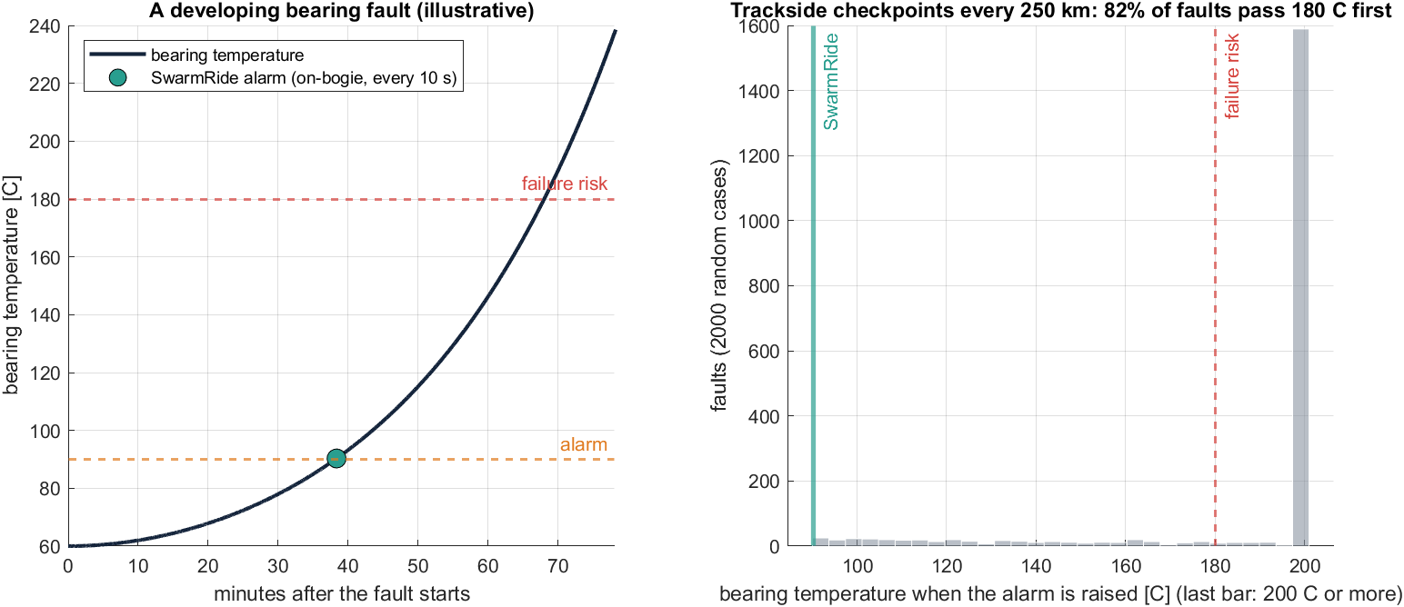
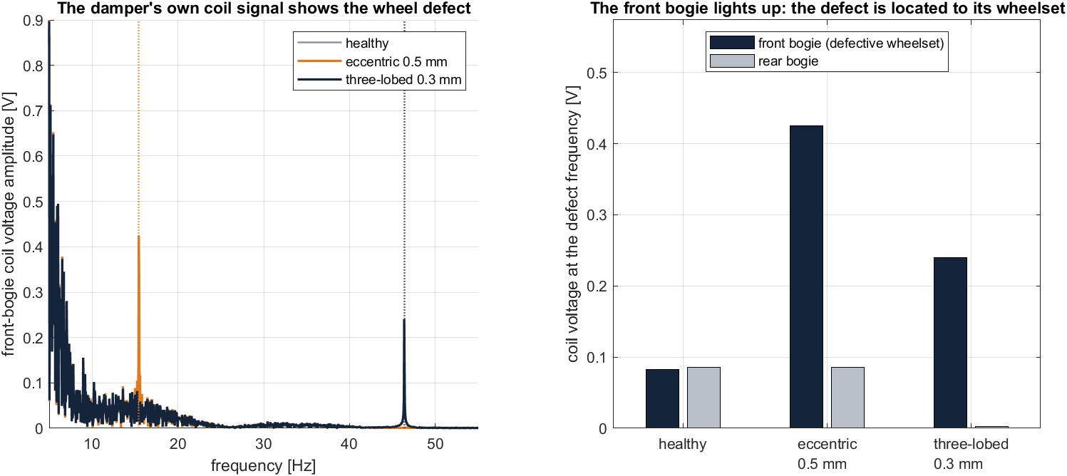
The damper is also a safety sensor
06 · RESULTS · SELF-POWERED SAFETY SENSING
10 s
82%
×5 – ×204
hot-axle alarm by the on-bogie sensor
of faults pass 180 °C before a trackside check
wheel-defect signal in the coil, located to the wheelset
Notes:
Hot axle: illustrative bearing model, checkpoints every 250 km. The danger window between the alarm temperature and failure is about 30 minutes, much shorter than the 2.5 h between trackside checkpoints. A sensor riding on the bogie, powered by the damper, is the only reliable way. Wheel: eccentric 0.5 mm and three-lobed 0.3 mm; the damper’s coil voltage already contains the wheel’s signature, so no extra sensor is needed.

Slide 19
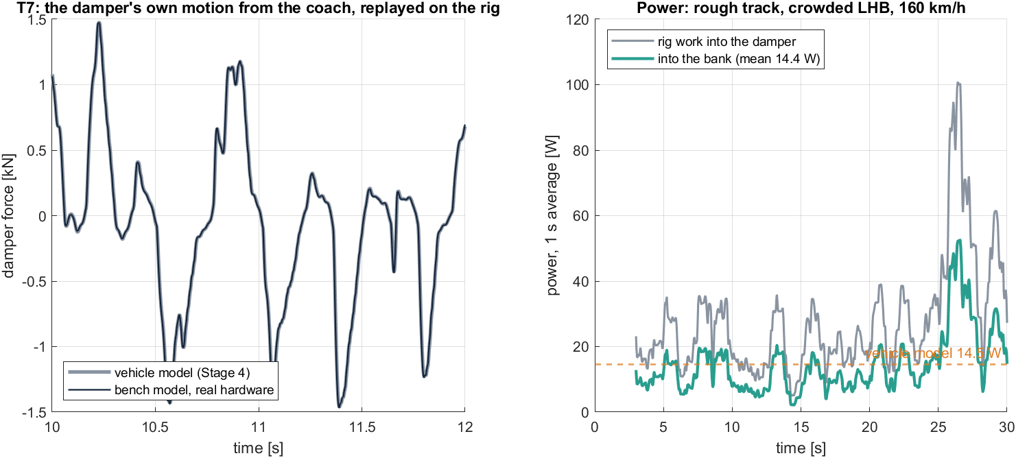
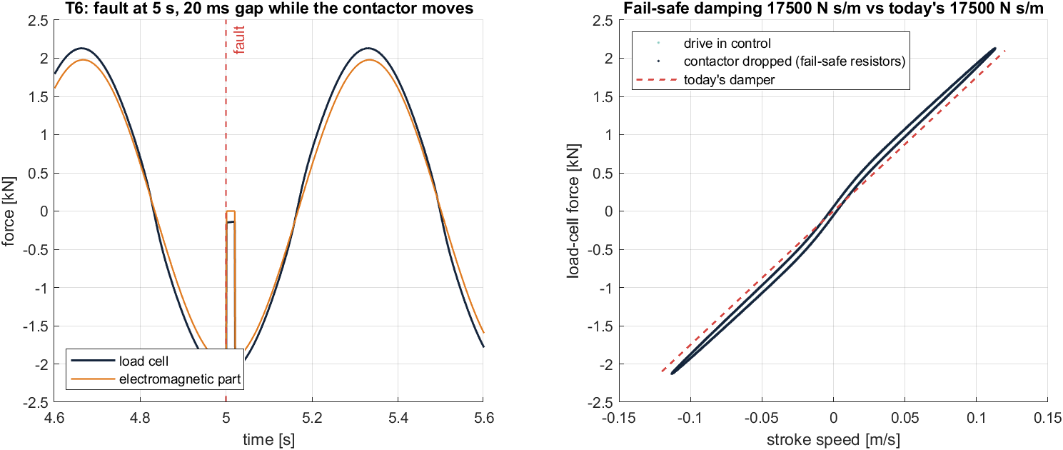
Ready for hardware: the bench model agrees
06 · RESULTS · BENCH PROTOTYPE (STAGE 5)
14.4 W
17,500
10 / 10
85 / 85
into the bank on replayed track (coach model 14.5 W)
N s/m after a fault = today’s damper (20 ms gap)
C firmware = MATLAB, double and float
automatic verification checks pass
Notes:
Design-C damper: 48 V servo, 25 mm × 10 mm ball screw, 8 kN, 60 V / 46 A drive, 10 F supercap. The bench model adds everything the coach model idealised: a 10 kHz current loop with a voltage limit, inverter and DC-DC losses, a contactor that takes 20 ms, and winding heat. It still predicts the same power into the bank, and the fail-safe gives exactly today’s damping. The C firmware matches MATLAB on 2,700 test vectors.

Slide 20
Architecture: same core idea, five new capabilities
07 · BASE PAPER VS SWARMRIDE
Aspect | Base paper · Hua et al., IEEE TVT 2022 | SwarmRide (ours)
Vehicle, axis | High-speed train, lateral | LHB, Vande Bharat, ICF, BOXN freight — vertical
Damper drive | Damping set by harvesting-circuit duty cycle | Ball-screw servo + 4-quadrant H-bridge: current = force
Controller | LQG target force, semi-active tracking | LPV-LQR scheduled on measured load + 10 kHz PI loop
Look-ahead | — | Train Brain preview, 221 rail samples
Active push | No (semi-active, resist only) | Yes — C4 at known bad spots, from banked energy
Energy use | Harvested power reported | Bogie power bank, full-day self-powered
Safety sensing | — | Hot axle in 10 s, wheel defects in the coil signal
Fail-safe | — | Hardware contactor → today’s damping
Validation | Prototype cyclic tests + simulation | 85 automated checks, bench model, C firmware
“—” = not part of the base paper’s study as described in its published abstract (DOI 10.1109/TVT.2022.3149265)
Notes:
We keep the base paper’s core idea — one electromagnetic device that both controls vibration and harvests energy on a train — and add the capabilities highlighted in teal: look-ahead, push, a power bank that actually runs the bogie, safety sensing, plus a hardware fail-safe and a verified firmware path to hardware.

Slide 21
Results side by side
07 · BASE PAPER VS SWARMRIDE
Metric | Base paper (lateral, high-speed train) | SwarmRide (vertical, crowded LHB)
Speed | 200–350 km/h | 160 km/h (LHB / Vande Bharat top speed)
Ride | Better than passive and fixed-duty dampers | Wz −17% (1.844 → 1.528), RMS −41%
Bad spots | Resist only | −80% worst seat at a settlement, for 0.1 Wh
Power | 25.89–153.19 W (semi-active) | 33–38 W per coach bogie; 55 W loaded wagon
vs fixed harvester | Fixed duty harvested more power | Fixed (C1) Wz 1.639 at 37 W vs C3 1.528 at 33 W
Load change | One design load | Flat comfort: Wz 1.493 empty → 1.528 crowded
Power use | Not reported | Bogie self-powered all day (1 W sleep when parked)
The axis and speeds differ, so the two power figures are not like-for-like. What is directly comparable is the capability: ours adapts to load, looks ahead, can push, and uses its energy on the bogie.
Base-paper values from its abstract · SwarmRide values from SwarmRide_Sim/results (Stages 3–4)
Notes:
Be honest with the examiners: the base paper studies lateral ride at higher speeds, so their watts and ours are not a like-for-like contest. The comparison that matters is architectural, and our own controller ladder (C0 to C4) shows each new capability’s value on the same coach and rail.

Slide 22
08 · WHY IT MATTERS
Not a better damper. A self-powered, train-aware suspension.
Adapts
Anticipates
Acts
Protects
Comfort stays flat from empty to crowded
The loco warns every coach, t = d / v
Pushes at bad spots: −80% jolt
Powers its own safety sensors, all day
Notes:
This is the pitch line. One part swapped, same mounts, fail-safe to today’s damper. Freight wagons have no electricity today; SwarmRide makes every wagon self-powered and watched. Passenger coaches get a ride tuned to their load and to the bump ahead.

Slide 23
Proven in simulation. Next: proven in metal.
08 · ROADMAP
DONE
DONE
NEXT · 16 WEEKS
LATER
Simulation, Stages 1–4
Bench design, Stage 5
Gate B: bench prototype
Field run, RDSO, pilot
Gate A met: better ride at every load, self-powered all day
Ratings, bench model, C firmware, test plan T1–T10
One damper on a rig; ≈ ₹4.4–13.5 lakh (indicative)
Instrumented bogie; freight first, then Vande Bharat
Honest limits: vehicle parameters are estimates until RDSO data; vertical model only; hardware costs not yet quoted.
Urgent: file a provisional patent — the repository is now public.
Notes:
Gate B criteria: tests T1–T8 within their bands, T9 under the trip temperature, and the hardware-in-the-loop run at least 10% better than today’s damper. Then a field run on one LHB bogie with RDSO.

Slide 24
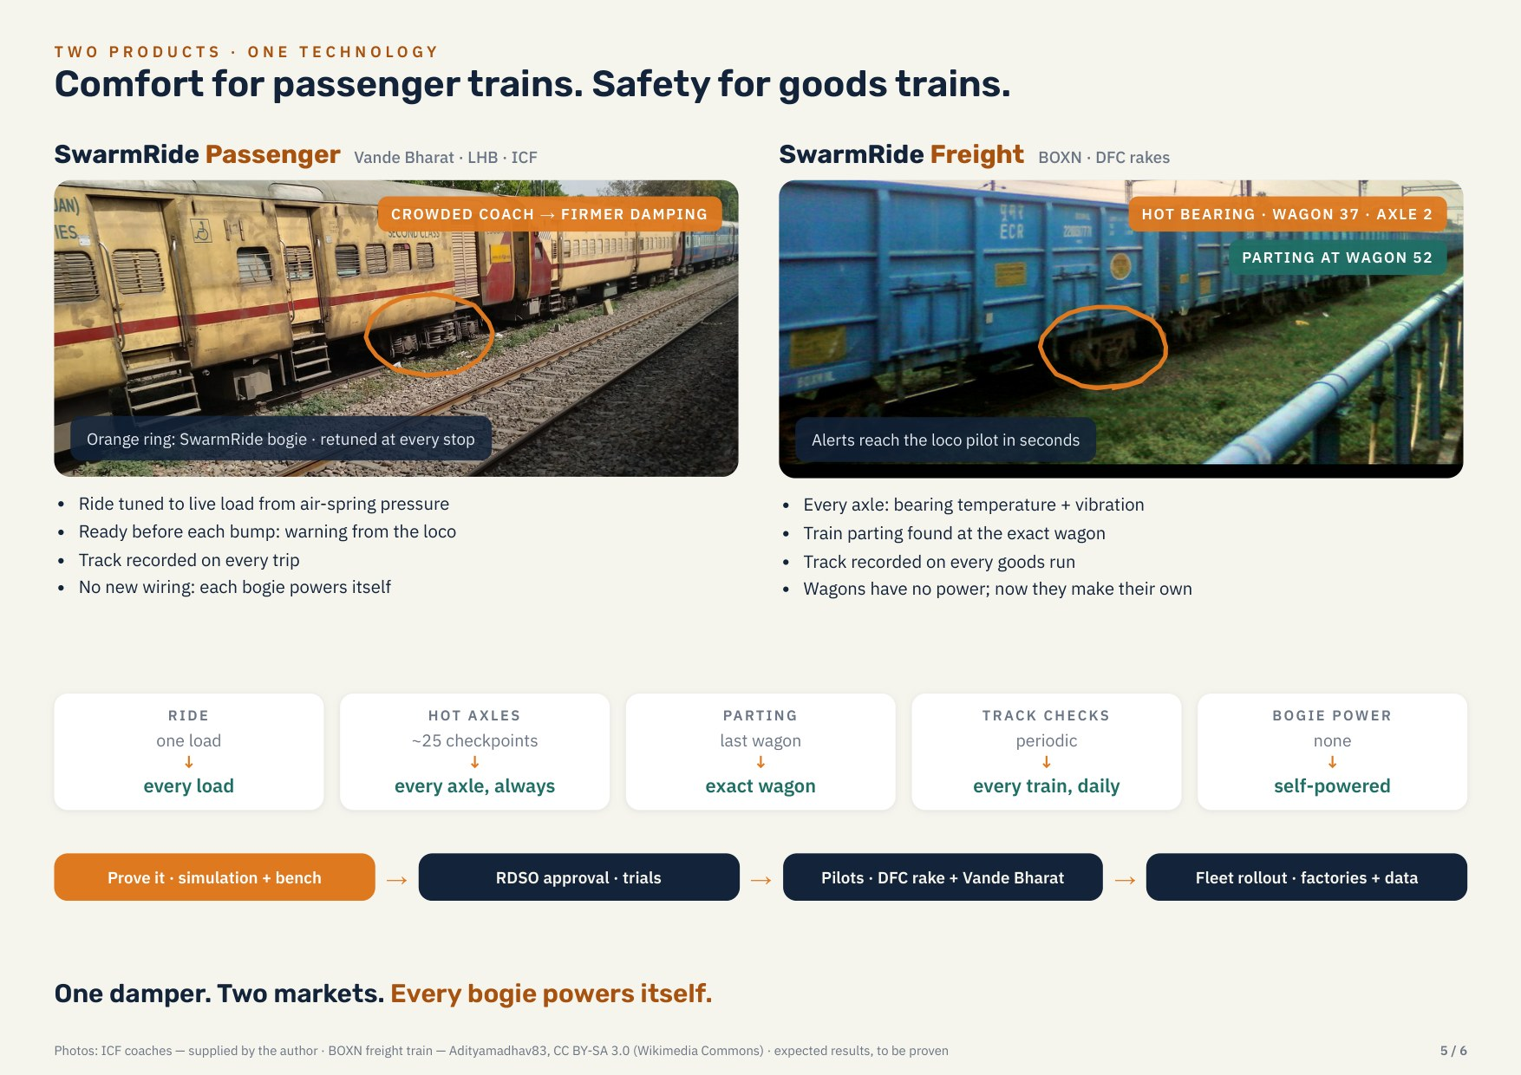
THANK YOU · QUESTIONS
Every bogie powers itself.
Tunes its own ride, watches its own safety — while the locomotive warns every coach of the bump ahead.
Jaganath · Niranjan · Kowshik · Sangeeth
Website: sangeeth0301.github.io/SwarmRide-Bharat
Code and data: github.com/Sangeeth0301/SwarmRide-Bharat
Notes:
Close on the one-line promise and invite questions. The website and repository have every model, result, the firmware and the bench prototype package.

