Slide 1
Dual-Manifold ContextSync
Keeping stability and plasticity together in long, multi-user chat threads with a classical memory and a 10-qubit circuit
Project A_14 · Neuro-Plasticity
Python · PyTorch · PennyLane · Qiskit · FAISS · SQLite

Slide 2
What this deck covers
From the problem to the results
01
The problem
02
Background
Why long shared chats are hard for a language model
What is already known and what is missing
03
Design
04
Data and build
The memory, the circuit and how they connect
The dataset and the ten build phases
05
What we changed
06
Results
Reading out every qubit instead of one
Remembering, learning, and both together
07
Limits and next steps
What is still open
2

Slide 3
The problem
Why a long shared chat is hard for a language model
Two things a model has to do at once
600+
turns in a single thread, more than a context window can hold
Stability means keeping what was learned earlier.
Plasticity means being able to learn new or changed information.
In an ordinary network both live in the same weights, so they compete. If the weights are held still, the model cannot adapt. If they move freely, older knowledge is overwritten.
This is the stability-plasticity dilemma.
5
participants, who sometimes state facts that contradict each other
13%
of the time plain similarity search returns a fact that was already replaced
Measured on the project corpus with a cosine retriever.
3

Slide 4
Three ways it goes wrong
They are often lumped together, but each needs its own fix
1
2
3
Catastrophic forgetting
Loss of plasticity
Context overload
Training on turn 500 overwrites what the model stored about turn 40. Once it is gone, no retrieval method can bring it back.
Weights grow and units saturate over time. The parameters are still there, but the model can no longer learn much from new data.
The simple fix is to put more into the prompt. Attention spreads thin and answers get worse even when the right fact is in the window.
Our design addresses each one: the memory cannot be overwritten, the circuit is built to keep its ability to adapt, and the prompt is filled under a fixed token budget.
4

Slide 5
Related work
What is established and what each line of work leaves open
Work | Contribution | What it leaves open
McCloskey and Cohen (1989) | Named catastrophic interference | Describes the problem, no way to prevent it
Kirkpatrick et al. (2017), EWC | Penalty that anchors important weights | Knowledge still sits in the weights; sensitive to settings
Lopez-Paz and Ranzato (2017), GEM | Replay with gradient constraints; BWT and FWT metrics | Memory grows; says little about plasticity
Dohare et al. (2024), Nature | Showed deep networks gradually lose the ability to learn | Fixes are add-ons such as resets or noise injection
McClean (2018); Cerezo (2021) | Barren plateaus and their link to the observable | Points to local readouts and shallow circuits
Mitarai (2018); Schuld (2019) | Parameter-shift rule for exact gradients | Needs involutory generators, which a general SU(4) gate lacks
Lewis et al. (2020), RAG | Retrieval as external memory | The ranking is fixed and does not adapt over time
Liu et al. (2023) | Long contexts degrade even when the fact is present | Confirms overload, gives no allocation policy
Chen and Zhang (2026), PRX Quantum | Quantum models keep plasticity on a compact manifold | Says outright that this does not solve forgetting
Classic references are cited from the standard literature. The 2026 PRX Quantum paper is the direct basis of this project.
5

Slide 6
The gap
Quantum circuits keep the ability to learn, but not what they learned
The reference paper reports that both quantum and classical models still forget catastrophically unless something else holds the old knowledge. It suggests a hybrid: a plastic quantum part together with a classical memory.
That suggests splitting the work between the two.
Classical, append-only storage
A compact quantum circuit
Holds what must never be lost. Nothing in it is trained, so training cannot erase it.
Holds what must keep learning. Its angles wrap around, so they cannot grow without limit.
6

Slide 7
Our approach
Two properties, carried by two different objects
ℳ Stability: the memory
U Plasticity: the circuit
Every message unit is stored word for word, add-only
The database rejects edits and deletes through triggers
Nothing here is trained, so a gradient step cannot erase it
A lost fact can only appear as a ranking mistake, which can be corrected
A 10-qubit variational circuit with 1,080 angles
Angles wrap around a circle instead of growing
Every gate is unitary, so the state keeps unit length
The paper argues this keeps learning capacity from fading. We test it over 120 tasks
The two sides meet at one point. The circuit reads a feature vector for a (query, candidate) pair and returns one relevance score between 0 and 1. Because the interface is this narrow, a classical scorer with the same interface can replace the circuit, which makes the comparison fair.
7

Slide 8
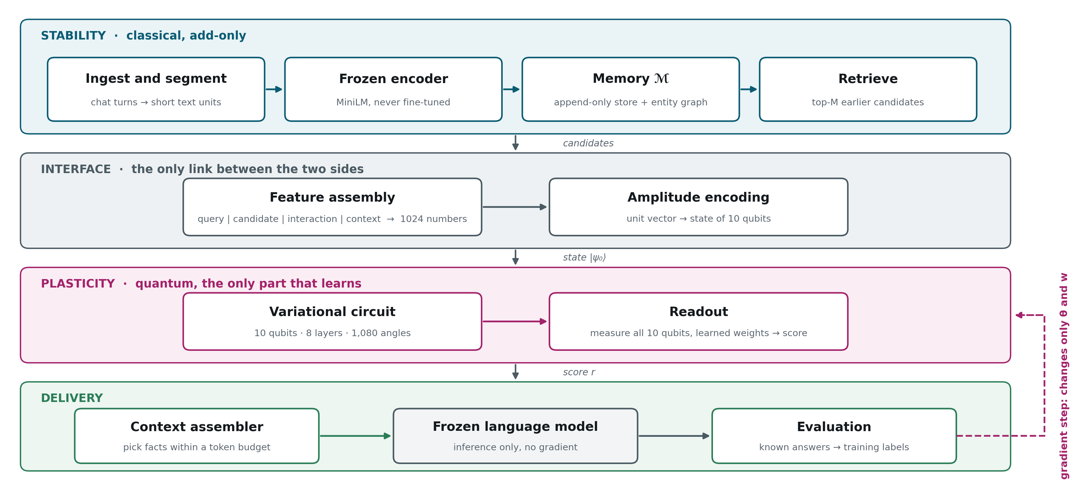
System architecture
Four bands, one direction of data flow, one place where learning happens
Teal: classical and add-only. Pink: the quantum part, the only component that is trained. Green and grey: delivery, with the language model frozen.
8

Slide 9
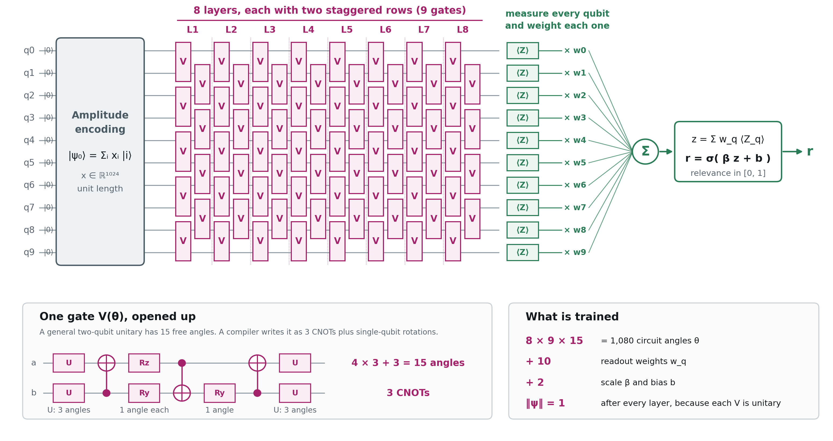
The quantum circuit
The simulator multiplies each gate's 4×4 unitary directly. The CNOT form is what a compiler would give for hardware.
9

Slide 10
The dataset
Generated in two steps, so the correct answer is known exactly
Turn type | What it is | Why it is there
fact | a participant states an (entity, attribute, value) | the target to retrieve
update | a later turn changes that fact | creates old-versus-new traps
probe | a question answerable from stated facts | the measurement point
distractor | mentions a real entity with no usable value | defeats keyword matching
filler | ordinary conversation | dilutes the thread
1. Plan
Each thread is planned first: who states which fact, which later turn changes it, and which turn asks about it and how far back.
2. Write the text
Templates turn the plan into chat messages. The wording can never add or remove a fact, so the ground truth stays exact.
Three kinds of thread rotate: one owner, several owners, and adversarial. Only adversarial threads contain updates (about 35% of their facts are replaced later).
18,000
1,800
1,920
1.000
0.042
turns
probes
facts
oracle recall
random recall
10

Slide 11
Ten build phases
Each phase has an exit test that has to pass before the next one starts
0
1
2
3
4
Foundations
Dataset
Encoding
Memory
Quantum core
one config file, fixed seeds
ground truth by construction
text to a unit vector in 1024 dimensions
append-only, enforced by the database
verified circuit, depth chosen from evidence
5
6
7
8
9
Baselines
Continual training
Assembly
Evaluation
Hardening
each model at its own best learning rate
120 tasks, full logging
budgeted prompt, frozen generator
seeds, ablations, noise, sealed test split
long run, hardware, real LLM (not started)
Phases 0 to 8 are finished. Phase 9 is the remaining work.
11

Slide 12
What each phase measured
The main check recorded for every finished phase
Phase | What happens | Result
0 Foundations | All settings in one file, seeds fixed with a stable hash | two runs with the same seed give the same output
1 Dataset | Plan each thread, then fill in text from templates | oracle recall 1.000, random 0.042
2 Encoding | Frozen encoder, whitening, projection trained once | held-out recall@20 rose from 0.879 to 0.996
3 Memory | Verbatim store, summaries added beside sources, supersession graph | prefilter recall 1.000, 3 mutation tests rejected
4 Quantum core | General SU(4) gate, amplitude encoding, brickwall layers | fidelity 1.000 against PennyLane, gradients agree to 8.6e-9
5 Baselines | Linear twin, MLP, cosine, recency, random, oracle | tuning the learning rate moved linear from 0.063 to 0.965 MRR
6 Continual training | 120 tasks in order, replay, quantum Fisher anchor | backward transfer positive for every model
7 Assembly | Exact token counts, greedy selection, stale-fact filter | budget never exceeded, no unlabelled stale fact served
8 Evaluation | 3 seeds, ablations, noise, sealed split, bootstrap | ranking unchanged under depolarising noise up to p = 1e-3
12

Slide 13
What we changed
Read out every qubit instead of one
Sealed test split | 1-qubit | 10-qubit | Linear
MRR | 0.861 ± 0.028 | 0.974 ± 0.005 | 0.974 ± 0.001
Rank-1 | 0.778 ± 0.039 | 0.951 ± 0.008 | 0.951 ± 0.001
Stale fact ranked first | 0.052 ± 0.019 | 0.043 ± 0.019 | 0.000 ± 0.000
The problem we found
The original circuit measured a single qubit. That gives a quadratic function of the features, which cannot reproduce the cosine-similarity signal in the data. It trailed the linear model on ranking.
The change
Measure all 10 qubits and learn one weight for each: z = Σ w_q⟨Z_q⟩, then r = σ(βz + b). The weights start at the old setting, so step 0 is identical to the original model.
Tried and dropped: a fixed similarity prior (worse), deeper circuits, larger β, more epochs (capacity became erratic).
The change adds 0.114 MRR on the test split (95% CI 0.098 to 0.131).
Against the linear model the difference is 0.001 (CI -0.007 to 0.009). That is a tie.
Seed 7 first run, then 3 seeds. The test split is the sealed one.
13

Slide 14
How we test stability and plasticity
Three questions, each with its own measurement
STABILITY
PLASTICITY
COMBINED
Does it remember the old?
Can it learn something new?
Both together
After every 10th task, re-test the model on every task it has seen. Also ask for facts stated up to 500 turns earlier.
Stop after a given number of tasks, copy the model, and train it for 40 steps on a reversed rule: the replaced fact is now the correct answer.
Take the harmonic mean of the two scores, so a model has to do well on both. Track it as training goes on.
MRR (mean reciprocal rank) is 1 when the correct fact is ranked first and falls as it moves down the list.
14

Slide 15
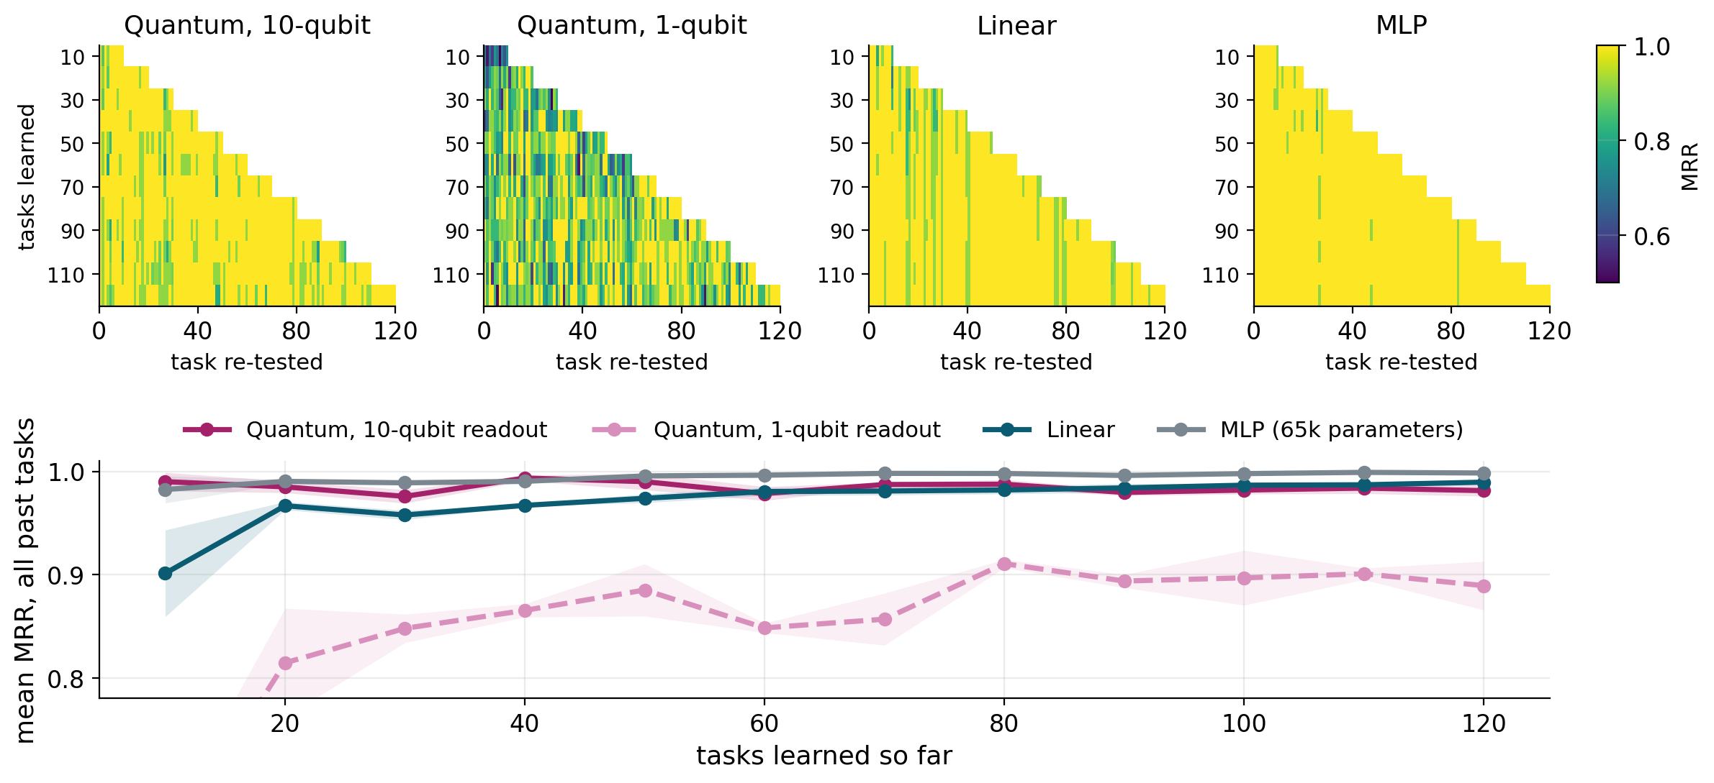
Result 1: it remembers the old
Every past task re-tested as training continued (seed 7 shown, mean of 3 seeds below)
Yellow means remembered. No model forgets catastrophically. After 120 tasks the 10-qubit circuit averages 0.98 over all past tasks, against 0.99 for linear and 1.00 for the MLP.
15

Slide 16
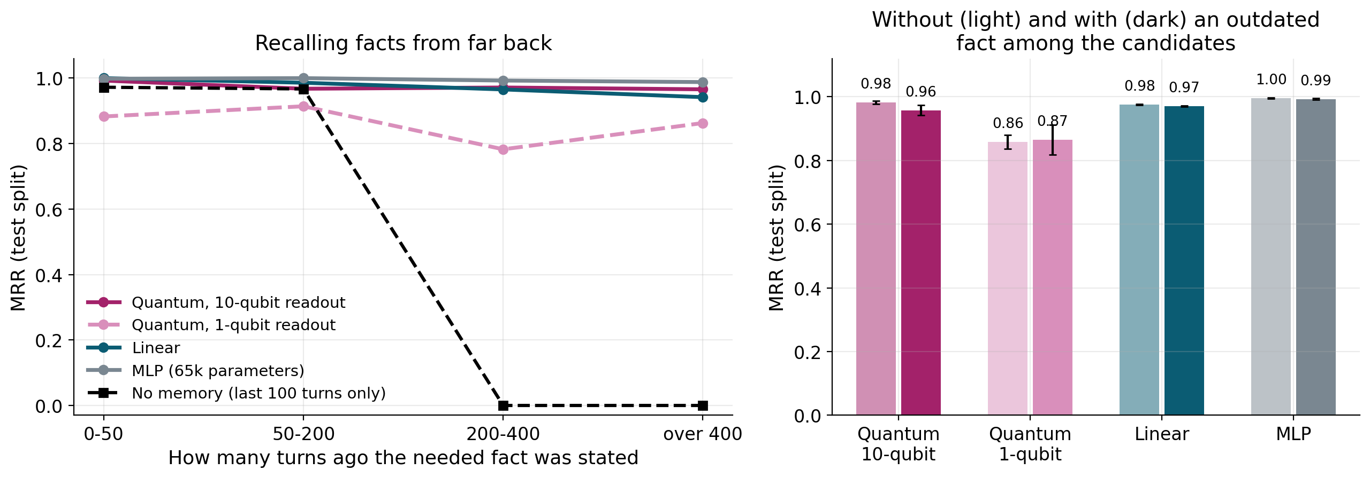
Result 2: it recalls facts from far back
Sealed test split, grouped by how long ago the needed fact was stated
A model that sees only the last 100 turns scores 0 beyond 200 turns. With the memory, facts older than 400 turns are still found: 0.97 for the 10-qubit circuit, 0.94 for linear, 0.99 for the MLP.
16

Slide 17
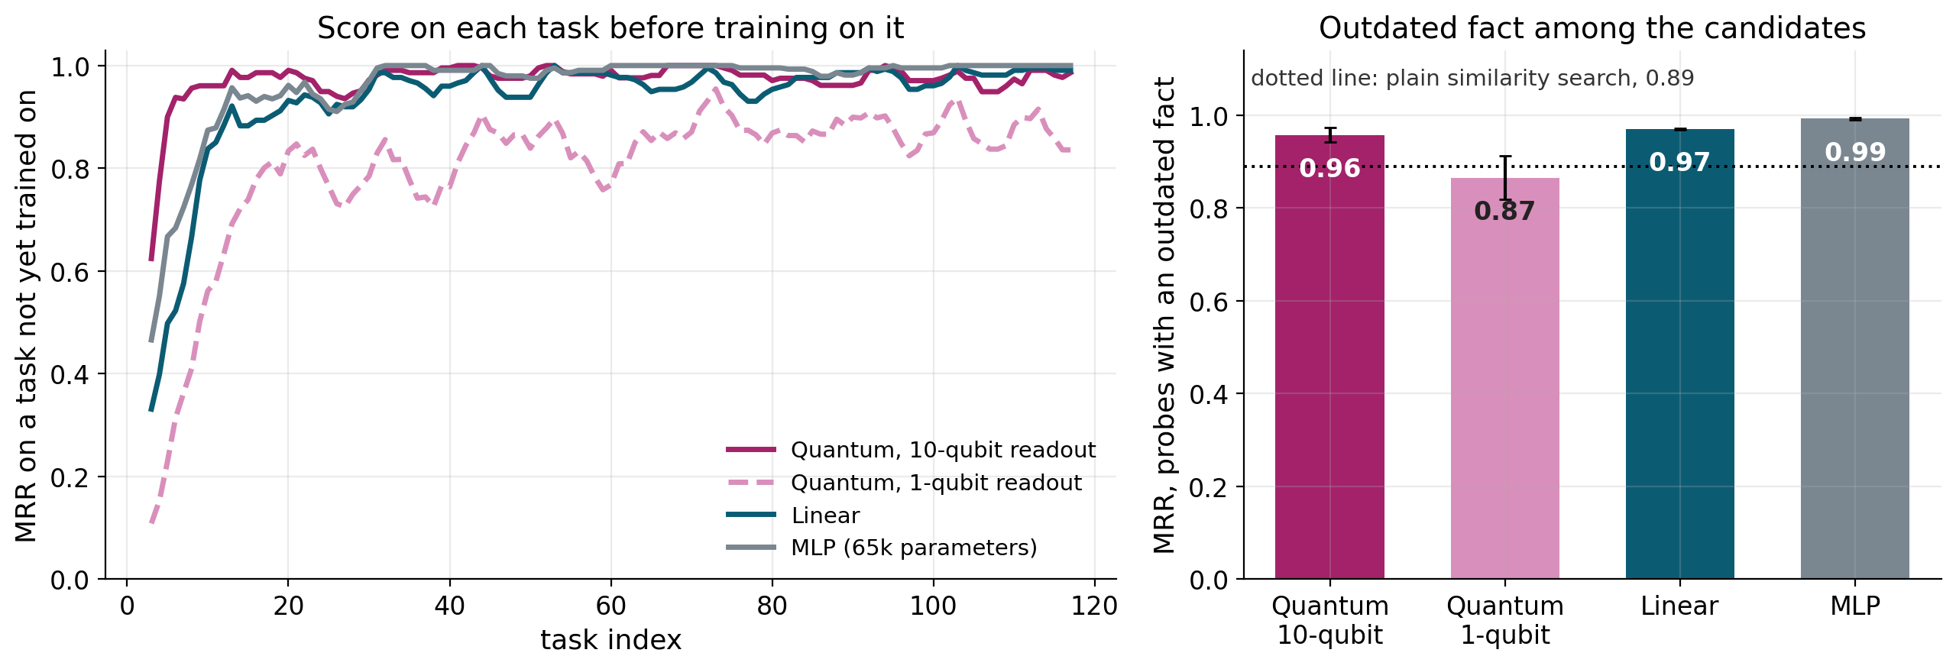
Result 3: it learns new things
Score on tasks it has not trained on, and on probes that have an outdated fact among the candidates
Every model starts untrained and picks up the task within about 15 tasks. On probes with an outdated fact among the candidates (the situation an update creates), the 10-qubit circuit scores 0.96, compared with 0.89 for plain similarity search. After the first tasks, a trained model already does well on unseen tasks, so the reversed-rule test on the next slide is the sharper check of plasticity.
17

Slide 18
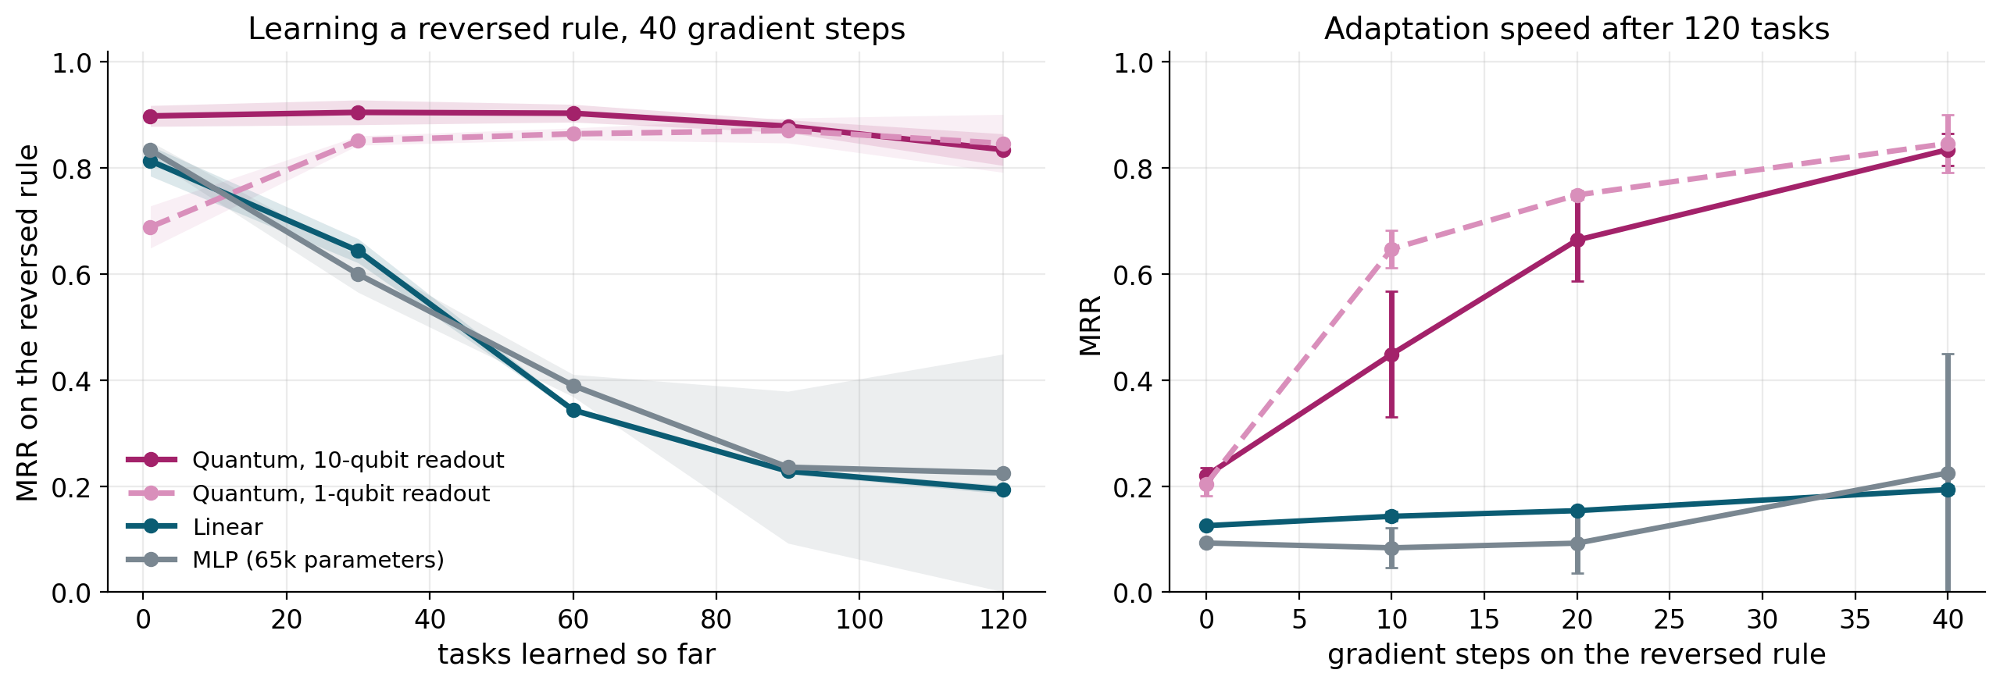
Result 4: learning a reversed rule
After many tasks, can the model still learn something that contradicts what it knows?
At each model's training learning rate, linear and MLP lose most of this ability over 120 tasks (about 0.8 down to about 0.2). Both quantum models keep it at about 0.84. The next slides check how much of that is down to the learning rate.
18

Slide 19
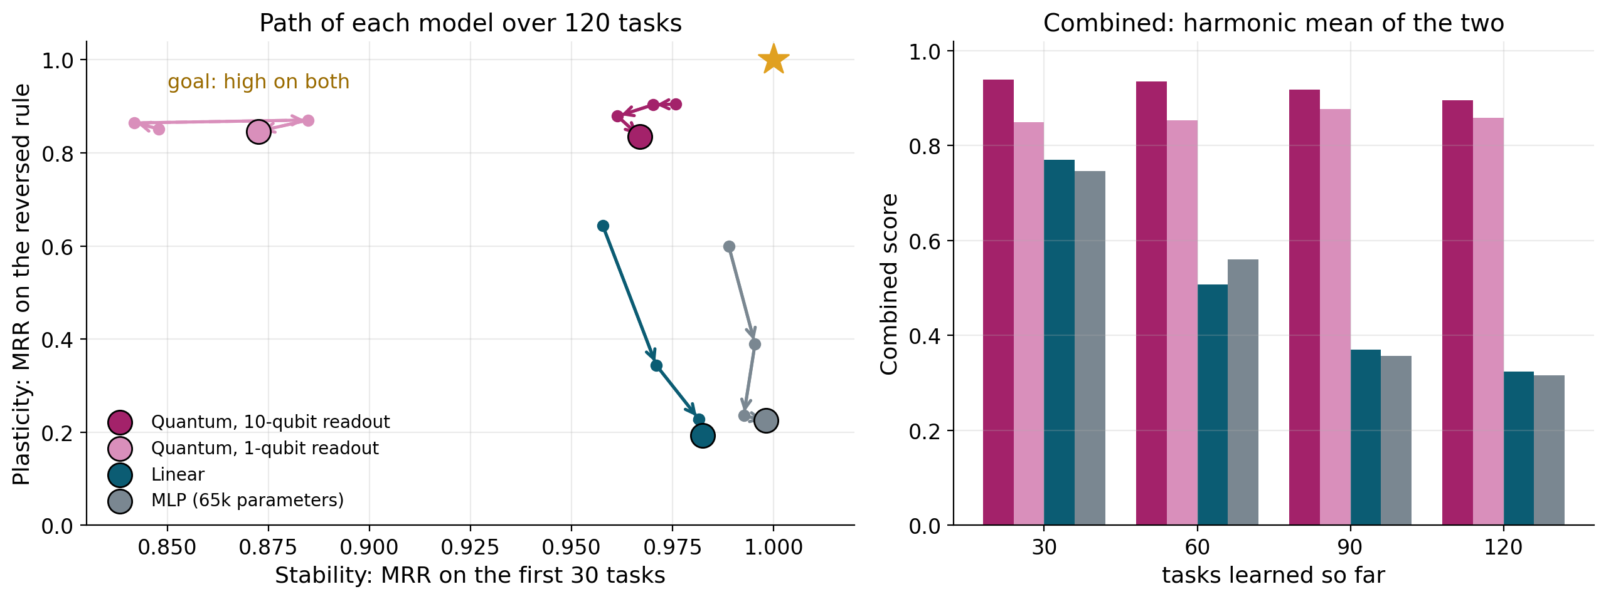
Both together
Each model's path through the stability and plasticity plane
After 120 tasks the combined score is 0.90 for the 10-qubit circuit, 0.32 for linear and 0.32 for the MLP. The classical models end up very stable but much less able to adapt. The circuit stays closer to the top right.
19

Slide 20
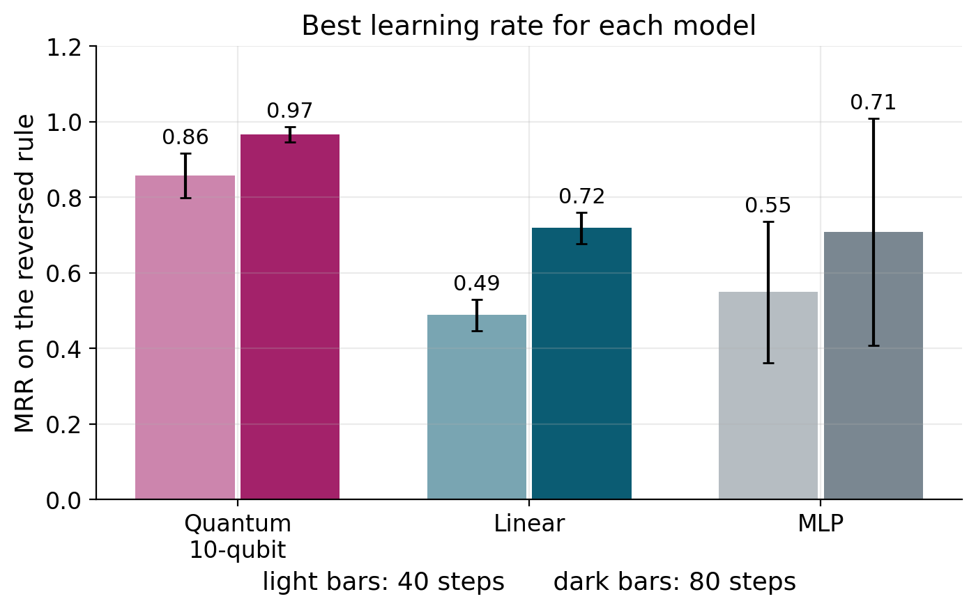
Is it just the learning rate?
Every model re-learns the reversed rule at the best of six learning rates
Partly.
With the best step size and 80 steps, the classical models recover a good part of the loss: linear reaches 0.72 and the MLP 0.71, although the MLP is erratic across seeds (0.95, 0.29, 0.89).
The circuit is still faster and steadier: 0.86 after 40 steps against 0.49 and 0.55, and 0.97 after 80 steps.
The classical models can still learn the new rule. The circuit is faster and more consistent at it.
20

Slide 21
Scorecard
Mean ± standard deviation over 3 seeds, after 120 tasks
Model | Test MRR | Stability | Plasticity | Combined | Parameters
Quantum, 10-qubit readout | 0.974 ± 0.005 | 0.967 ± 0.006 | 0.835 ± 0.030 | 0.896 ± 0.016 | 1,080
Quantum, 1-qubit readout | 0.861 ± 0.028 | 0.873 ± 0.033 | 0.846 ± 0.055 | 0.859 ± 0.041 | 1,080
Linear | 0.974 ± 0.001 | 0.982 ± 0.001 | 0.194 ± 0.008 | 0.323 ± 0.011 | 1,025
MLP | 0.995 ± 0.001 | 0.998 ± 0.001 | 0.225 ± 0.224 | 0.316 ± 0.277 | 65,665
Stability is the score on the first 30 tasks after all 120. Plasticity is the score on the reversed rule after 40 steps, at each model's own learning rate. With the best learning rate and 80 steps it is 0.97 for the circuit, 0.72 for linear and 0.71 for the MLP.
The MLP has the best raw accuracy and stability, with about 60 times as many parameters.
21

Slide 22
What the evidence supports
Each claim and the number behind it
Claim | Status | Evidence
Knowledge in the memory cannot be erased by training | Supported | append-only store, 3 mutation tests rejected
Reading out all qubits closes the ranking gap | Supported | +0.114 MRR on the test split, CI excludes 0
The circuit matches a linear model of the same size | Supported | difference 0.001, CI -0.007 to 0.009
The circuit ranks better than classical models | Not supported | the MLP scores higher (0.995 vs 0.974)
The circuit adapts to new rules faster and more steadily | Supported, with a caveat | 0.97 vs 0.72 and 0.71 at the best learning rate
Stale facts are kept below current ones | Mostly | 0.043 error for the circuit, 0.000 for classical, 0.130 for cosine
Fisher trace shows capacity is preserved | Not supported | noisy, and the MLP's did not fall
Plasticity holds over 1,000+ tasks | Not tested | only 120 tasks were run
22

Slide 23
Limits and next steps
Limits
Next steps
120 tasks is short. The long-run plasticity claim is untested.
The test split has 6 threads, so the significance tests are coarse.
The circuit is simulated exactly. There is no hardware or finite-shot run yet.
The reversed rule is one defined test of plasticity, not a real shift in a conversation.
The circuit still ranks a stale fact first more often than the classical models.
1. Run 1,000 to 3,000 tasks on 3 seeds and track the reversed-rule score at checkpoints.
2. Generate more held-out threads for tighter statistics.
3. Simulate finite shots and noise for the 10-qubit readout.
4. Replace the extractive reader with a real frozen language model.
5. Add a one-command reproduction script and a scaling study over 8, 10 and 12 qubits.
23

Slide 24
Base paper
Intrinsic Preservation of Plasticity in Continual Quantum Learning
Yu-Qin Chen and Shi-Xin Zhang · PRX Quantum 7, 033003 (2026)
It shows that quantum models keep plasticity because unitary evolution confines the parameters to a compact manifold.
It also states that this does not solve forgetting. Both quantum and classical models still need a separate memory.
This project builds the hybrid it points to: a plastic quantum circuit with a classical memory.

