Slide 1
Neuroplasticity in Continual Quantum Learning
for the Stability-Plasticity Dilemma
Engineering Neuroplasticity in Continual Quantum Learning
July 16, 2026
1 / 14

Slide 2
1. Problem Statement
The Grand Challenge in Autonomous Systems
Artificial intelligence operating in dynamic, real-world environments requires the capacity for lifelong, continual learning. However, modern models suffer from a fundamental flaw when transitioning between tasks (e.g., navigating static walls → dodging moving obstacles).
The Core Issue: While Quantum Neural Networks (QNNs) solve the issue of long-term learning capacity, current quantum stability mechanisms are entirely “blind” to physical constraints. Because they calculate memory based purely on general statistical rewards, they treat all learned behaviors equally.
The Consequence: In continuous control environments, this blindness causes quantum agents to frequently overwrite fundamental survival mechanics (e.g., physical collision boundaries) to maximize short-term task rewards.
Neuroplasticity in Continual Quantum Learning for the Stability-Plasticity Dilemma
July 16, 2026
2 / 14

Slide 3
2. Demystifying AI Terminology for Quantum Architecture
Translating Cognitive Science into Quantum Mechanics
Synapses:
In our context, these are the parameterized quantum rotation gates (Rx, Ry, Rz) within a Variational Quantum Circuit (VQC).
Neuroplasticity (Learning):
The ability of the network to freely adjust its rotation angles to learn new tasks without the gradients vanishing.
Stability (Memory):
The ability of the circuit to preserve specific rotation angles that were critical for solving previous tasks.
The Stability-Plasticity Dilemma:
The mathematical tug-of-war. If gates are too plastic, the model forgets. If gates are too stable, the model freezes.
Catastrophic Forgetting:
When the optimizer violently overwrites the quantum state optimized for Task A in order to learn Task B.
Neuroplasticity in Continual Quantum Learning for the Stability-Plasticity Dilemma
July 16, 2026
3 / 14

Slide 4
3.1 Literature Review: The Plasticity Problem
Classical Failures vs. The Quantum Solution
Paper 9 (Dohare et al., 2024): Loss of plasticity in deep continual learning.
• Finding: Proved that classical neural networks eventually lose their ability to learn due to unbounded weight growth. Required forced algorithms (“Continual Backpropagation”) to artificially reset dormant units.
Papers 4 & 5 (Chen & Zhang, 2026) — [Our Base Paper]: Intrinsic Preservation of Plasticity in Continual Quantum Learning.
• Finding: Proved that Quantum Neural Networks naturally overcome plasticity loss. Because quantum operations are constrained by unitary evolution (restricted to compact Lie group manifolds), parameter weights cannot explode. The circuit maintains its capacity to learn across the benchmarks tested.
Minor precision note: “infinite/forever” is shorthand — the paper demonstrates this across tested benchmarks (up to thousands of sequential tasks), not as a mathematical guarantee for every possible architecture.
Neuroplasticity in Continual Quantum Learning for the Stability-Plasticity Dilemma
July 16, 2026
4 / 14

Slide 5
3.2 Literature Review: Forgetting & Explainability
Addressing Catastrophic Forgetting in Quantum Models
Paper 1 (Jiang et al., 2022): Quantum Continual Learning Overcoming Catastrophic Forgetting.
• Finding: Adapted the classical Elastic Weight Consolidation (EWC) algorithm to quantum circuits, using statistical Fisher Information to freeze important gates.
Paper 2 (Zhang et al., 2024): Quantum continual learning on a programmable superconducting processor.
• Finding: Successfully executed Quantum EWC on physical 18-qubit hardware (verified: 92.3% average accuracy across 3 tasks), proving theoretical models can be run on near-term noisy quantum devices.
Paper 3 (Jain): CQural: A Novel CNN based Hybrid Architecture.
• Finding: Addressed the “black-box” nature of hybrid models using GradCAM. However, explainability was strictly bound to highlighting classical input pixels, not the internal quantum gates.
Neuroplasticity in Continual Quantum Learning for the Stability-Plasticity Dilemma
July 16, 2026
5 / 14

Slide 6
3.3 Literature Review: Optimization & Geometry
Mathematical Optimization in Deep Learning
Paper 6 (Aslam et al., 2025): Continual Learning Inspired by Brain Functionality.
• Finding: Mapped biological brain functions to AI, concluding that hybrid models are required for optimal learning, though all tests were limited to unbounded classical geometries.
Paper 7 (Garg et al., 2026): Fisher-Orthogonal Projected Natural Gradient Descent.
• Finding: Demonstrated that projecting parameter updates onto the Fisher-orthogonal complement minimizes interference, proving the importance of Riemannian geometry in learning.
Paper 8 (Wierichs et al., 2020): Avoiding local minima in VQEs with the natural gradient optimizer.
• Finding: Proved that standard optimizers can fail in overparameterized quantum circuits; Natural Gradient (NatGrad) proved most resilient for navigating complex VQE landscapes.
Neuroplasticity in Continual Quantum Learning for the Stability-Plasticity Dilemma
July 16, 2026
6 / 14

Slide 7
4. Identification of Research Gaps
Domain | Analyzed Literature | Core Methodology | Unaddressed Research Gap
Quantum Plasticity | Papers 4, 5, 9 | Deep VQCs with SU(4) gates | Proves quantum models can learn indefinitely, but explicitly leaves the forgetting problem unsolved.
Quantum Memory | Papers 1, 2 | Quantum EWC via statistical gradients | Relies on “blind” rewards; incapable of prioritizing physical safety boundaries in dynamic environments.
Explainable AI (XAI) | Paper 3 | GradCAM pixel mapping | Explainability is bound to classical input pixels; cannot map the internal quantum synaptic memory.
Classical Optimization | Papers 6, 7, 8 | FOPNG Optimizer, NatGrad, & Bio-models | Confined to static landscapes or Euclidean spaces; completely omits continuous control loops (Safe-RL).
Neuroplasticity in Continual Quantum Learning for the Stability-Plasticity Dilemma
July 16, 2026
7 / 14

Slide 8
5. Part A: The Foundation (Quantum Plasticity)
Inheriting the Base Paper's Architecture (Papers 4 & 5)
To ensure our agent has the capacity to learn indefinitely, we utilize the exact structural foundation proven by Chen & Zhang (2026).
The Core:
A Deep Hardware-Efficient Ansatz (VQC).
The Mechanics:
Classical environment data is compressed and encoded into the quantum state via Angle Embedding (Ry gates).
The Advantage:
Because the Rx, Ry, Rz rotation gates evolve unitarily, this “brain” is structurally immune to the gradient decay that destroys classical networks.
The Fix Applied Here:
The classical encoder feeding the circuit must be a fixed, non-trainable compression step — not a deep trainable network — otherwise it reintroduces the exact unbounded-weight problem the quantum layer was meant to avoid.
The Flaw (still open):
While highly plastic, this architecture alone will still catastrophically forget physical boundaries when transitioning to new environments — solved in Part B.
Neuroplasticity in Continual Quantum Learning for the Stability-Plasticity Dilemma
July 16, 2026
8 / 14

Slide 9
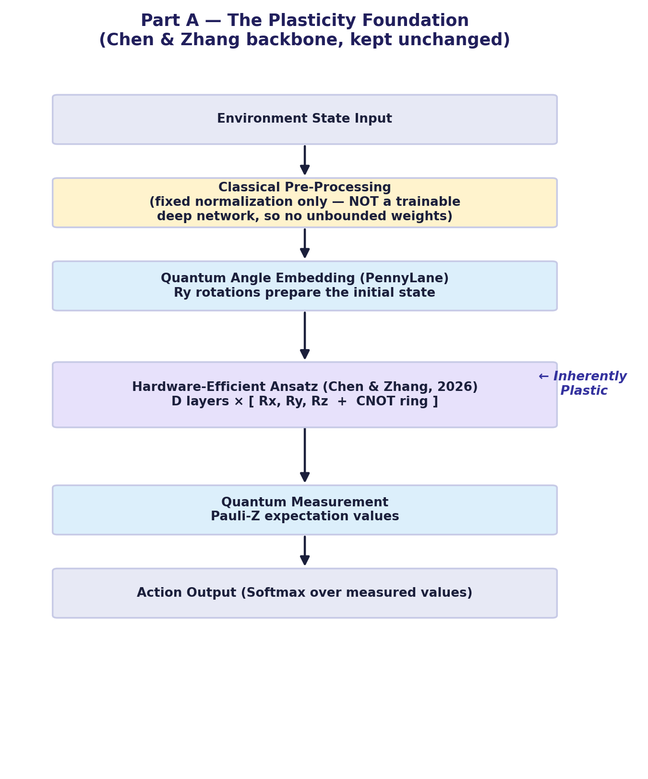
5.1 Part A: Foundation Architecture
The “Plastic” Quantum Brain (Base Paper, with the fixed-encoder correction)
Neuroplasticity in Continual Quantum Learning for the Stability-Plasticity Dilemma
July 16, 2026
9 / 14

Slide 10
6. Part B: The Innovation (Physics-Informed Stability)
The S-FIM Stability Lock
To solve the forgetting problem without losing plasticity, we introduce a novel, physics-aware mathematical constraint to the optimization loop.
Physical Cost Engine:
We define a penalty function C(s, a) based on Euclidean distance to environmental hazards (e.g., walls).
Safety-Weighted Fisher Information Matrix (S-FIM):
Using the quantum parameter-shift rule, we extract the gradients of the rotation gates explicitly against the physical cost function.
Selective Locking:
We mathematically isolate exactly which rotation angles prevented the agent from crashing. We apply a heavy penalty to these specific gates, freezing them, while leaving all other gates plastic.
Why this beats standard EWC (Papers 1, 2): reward-based importance can't tell “this gate scored a bonus” from “this gate prevented a collision.” S-FIM makes that distinction explicit.
Neuroplasticity in Continual Quantum Learning for the Stability-Plasticity Dilemma
July 16, 2026
10 / 14

Slide 11
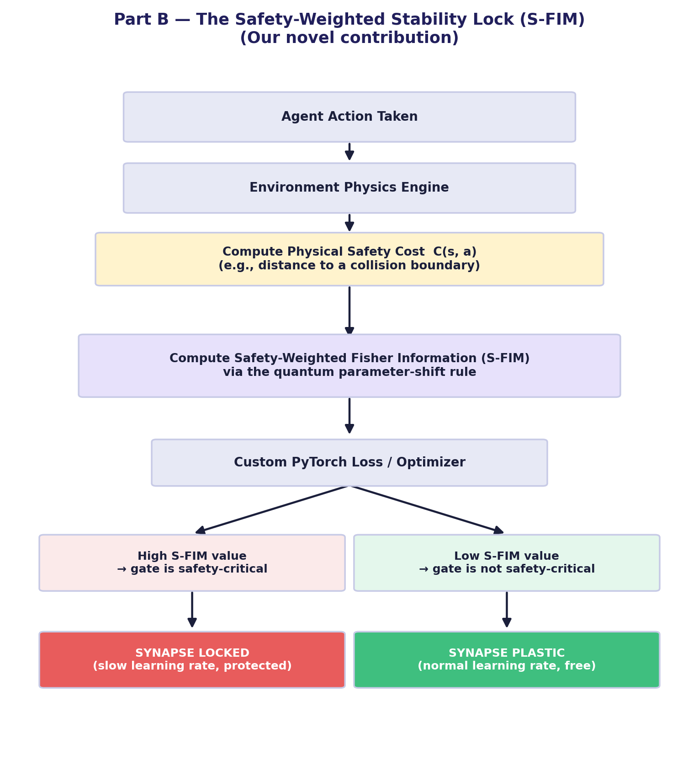
6.1 Part B: Innovation Architecture
Neuroplasticity in Continual Quantum Learning for the Stability-Plasticity Dilemma
July 16, 2026
11 / 14

Slide 12
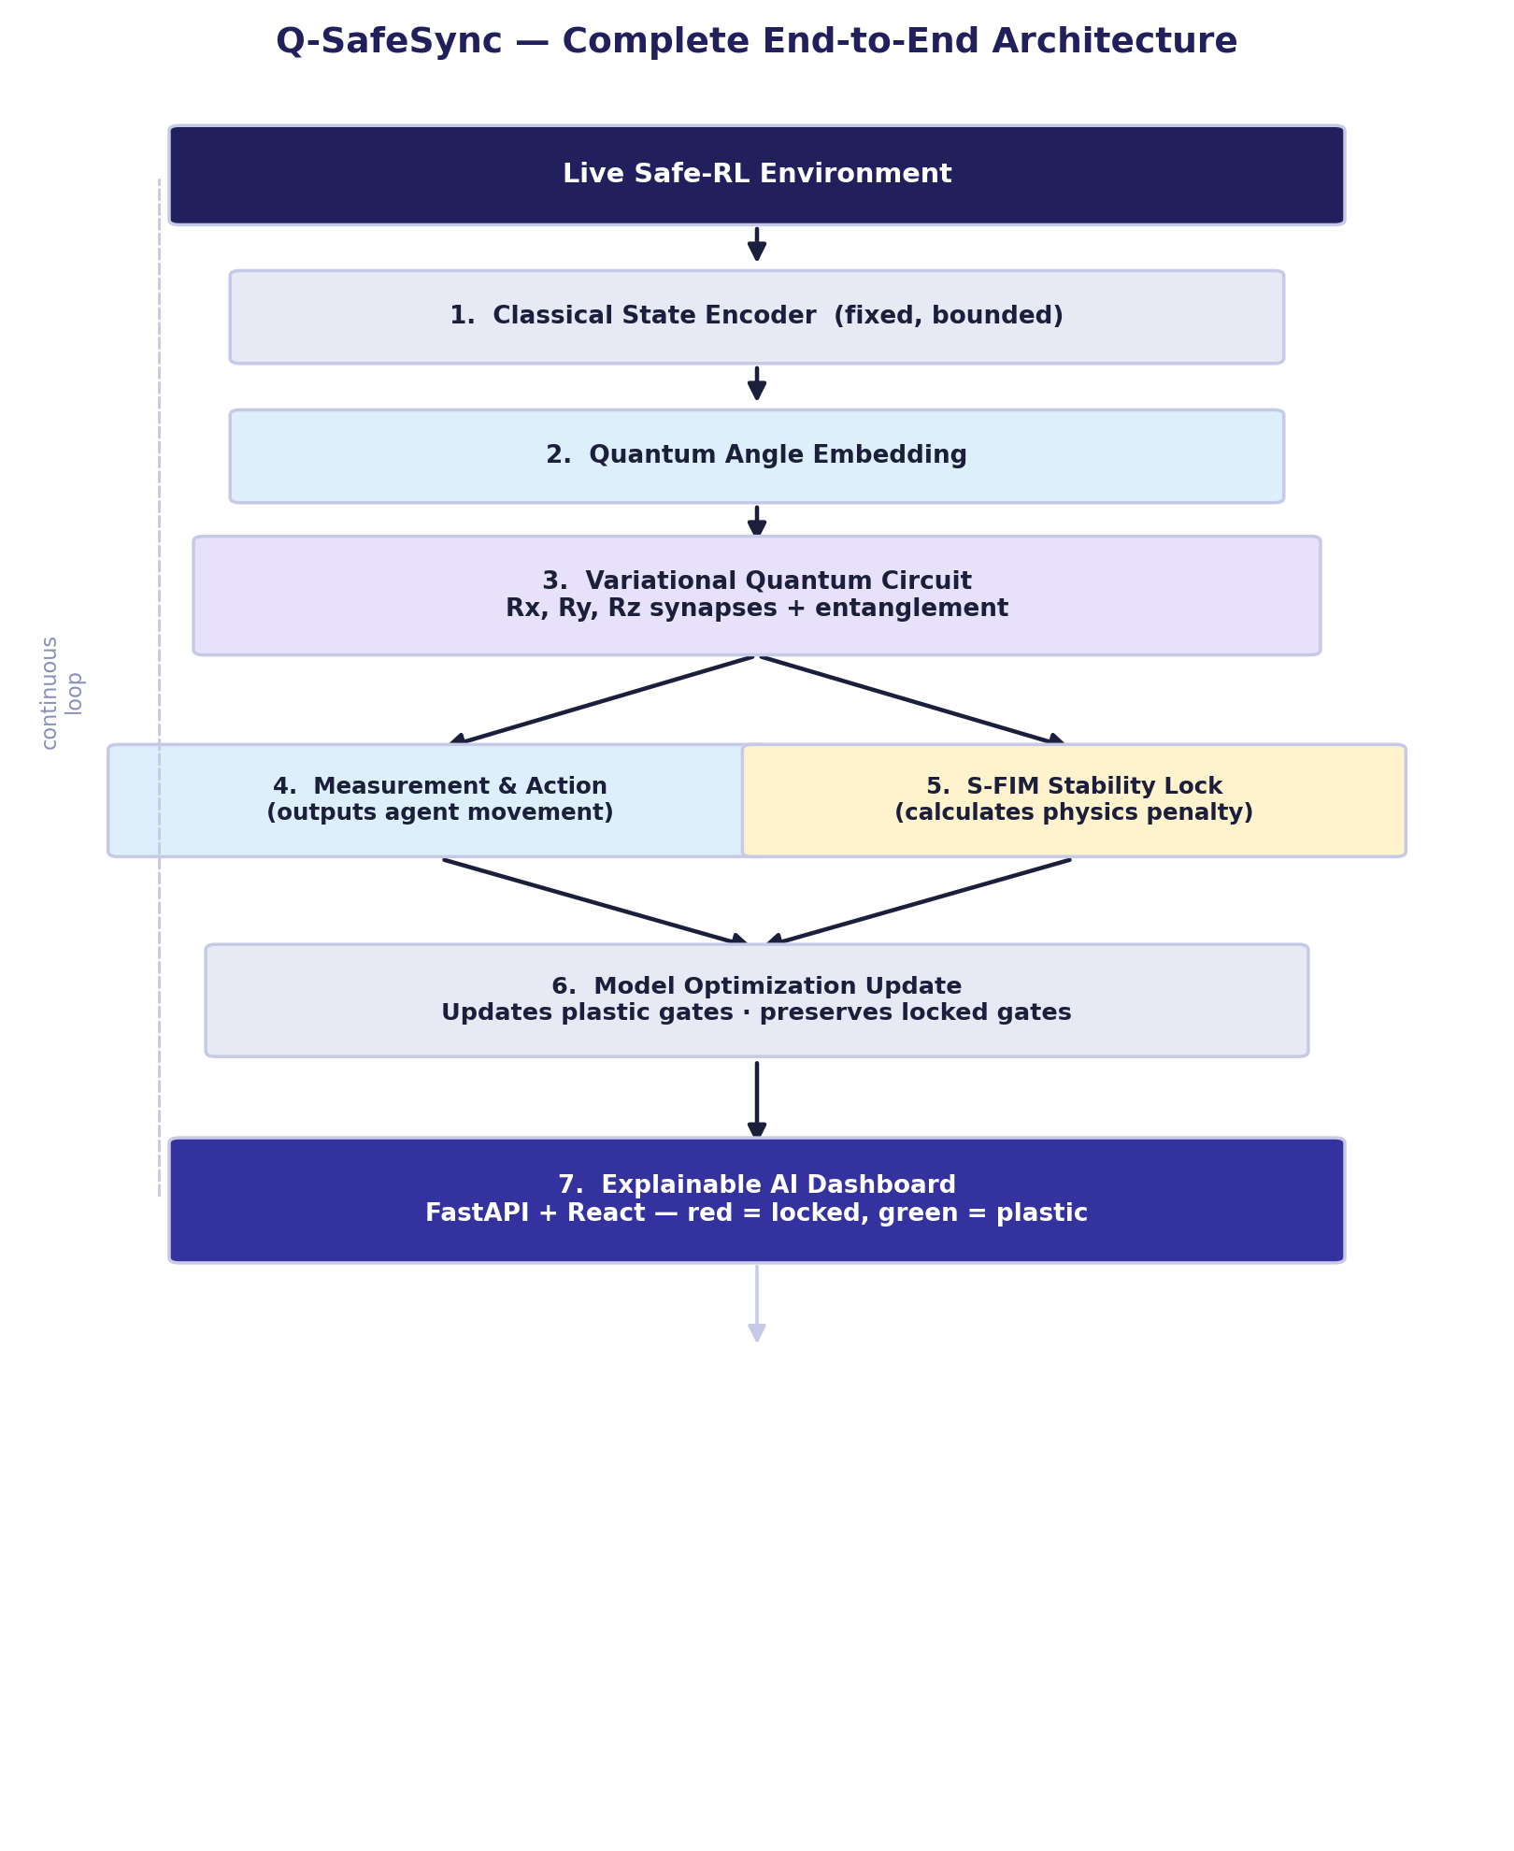
7. Complete End-to-End Pipeline
Neuroplasticity in Continual Quantum Learning for the Stability-Plasticity Dilemma
July 16, 2026
12 / 14

Slide 13
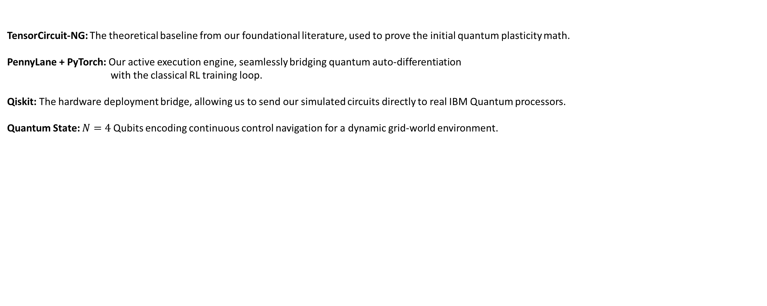
8. Experimental Setup :
Experimental Setup & Tech Stack:
TensorCircuit-NG: The theoretical baseline from our foundational literature, used to prove the initial quantum plasticity math.
PennyLane + PyTorch: Our active execution engine, seamlessly bridging quantum auto-differentiation
with the classical RL training loop.
Qiskit: The hardware deployment bridge, allowing us to send our simulated circuits directly to real IBM Quantum processors.
Quantum State: $N=4$Qubits encoding continuous control navigation for a dynamic grid-world environment.
Neuroplasticity in Continual Quantum Learning for the Stability-Plasticity Dilemma
July 16, 2026
13 / 14

Slide 14
Thank You.
Neuroplasticity in Continual Quantum Learning for the Stability-Plasticity Dilemma
July 16, 2026
14 / 14

