Slide 1
Dual-Manifold ContextSync
Solving the stability–plasticity dilemma in long, multi-user LLM chat threads with a quantum–classical hybrid
Complete build · Phases 0–8 delivered · 88 tests passing
Python 3.14 · PyTorch · PennyLane · Qiskit · TensorCircuit-NG · FAISS · SQLite
Notes:
Opening. The one-line thesis: stability is architectural, plasticity is geometric, and they never share a coordinate system.

Slide 2
What this deck covers
Problem → literature → architecture → every phase → results → what is next
01
The problem
02
Literature
Why long shared threads break language models
What is already known, and the gap that remains
03
Architecture
04
The ten phases
Two manifolds joined by one scalar
Inch by inch, dataset to answer
05
Results
06
What is next
Encoding · circuit · Fisher · stability · plasticity
The experiment that would settle the open question
Every number in this deck was produced by the accompanying code.
2

Slide 3
The problem
A shared chat thread is a hostile environment for a language model
The dilemma
600+
Stability and plasticity are usually carried by the same parameter vector θ ∈ ℝⁿ, so they compete for the same coordinates.
turns in a single thread before any context window can hold it
5
Protect the weights → the model stops adapting
Let them move → earlier knowledge is overwritten
This is not a tuning problem. It follows from storing both properties in one unbounded Euclidean space.
participants stating facts that contradict each other
0.130
of the time plain similarity search returns a fact that was already superseded
Measured on the project corpus with a cosine retriever.
3

Slide 4
Three distinct failure modes
They are usually conflated, and they need different fixes
1
2
3
Catastrophic forgetting
Loss of plasticity
Context saturation
A gradient step taken for turn 500 destroys the representation that encoded turn 40.
Weights inflate, activations saturate, the Fisher trace decays toward zero.
The naive fix is to retrieve more and put more in the prompt.
The information is gone. No retrieval strategy recovers it.
Parameters still exist but are functionally dead — the model has stopped being able to learn.
Attention spreads thinner; quality falls even though the fact is in the window.
The architecture is built so each of these is structurally impossible, not merely mitigated.
4

Slide 5
Literature review
What is established, and what each line of work leaves open
Work | Contribution | What it leaves open
McCloskey & Cohen (1989) | Named catastrophic interference | Descriptive; no preventive mechanism
Kirkpatrick et al. (2017) — EWC | Fisher-weighted penalty anchoring important weights | Knowledge still lives in weights; hyper-parameter sensitive
Lopez-Paz & Ranzato (2017) — GEM | Replay with gradient constraints; the BWT / FWT metrics | Memory cost grows; silent on plasticity
Dohare et al. (2024), Nature | Showed deep nets progressively lose the ability to learn | Fixes are extrinsic patches: resets, injection, regularisers
McClean et al. (2018); Cerezo et al. (2021) | Barren plateaus, and their dependence on the observable | Motivates local readouts and shallow, structured ansätze
Mitarai et al. (2018); Schuld et al. (2019) | Parameter-shift rule for analytic gradients | Assumes involutory generators — untrue for a general SU(4) sum
Lewis et al. (2020) — RAG | Retrieval as external, non-parametric memory | Retrieval ranking is static; no continual adaptation
Liu et al. (2023) — Lost in the Middle | Long contexts degrade even when the fact is present | Confirms saturation; offers no allocation policy
Chen & Zhang (2026), PRX Quantum | Quantum models preserve plasticity intrinsically — compact manifold | States explicitly that it does NOT solve stability
Classic references are cited from the standard literature; the 2026 PRX Quantum paper is the project's direct antecedent.
5

Slide 6
The gap
Quantum circuits keep the ability to learn. They do not keep what was learned.
The reference paper is explicit: both quantum and classical models still forget catastrophically without an explicit stability mechanism, and it names a hybrid — a plastic quantum backbone plus classical memory — as the promising direction.
So the correct division of labour is the opposite of the intuitive one.
Classical, append-only storage
for what must never be lost
A compact quantum manifold
for what must keep learning

Slide 7
The thesis
Put the two properties on two different mathematical objects
ℳ · Stability manifold
𝒰 · Plasticity manifold
Every semantic unit stored verbatim, append-only
Immutability enforced by database triggers, not convention
Nothing here is learned, so nothing here can be unlearned
Forgetting degrades to a retrieval miss — bounded and fixable
A 10-qubit variational circuit, 1,080 angles
Parameters live on a torus: they wrap, they cannot inflate
Unitary evolution bounds every operator norm at 1
Fisher information bounded away from zero — capacity cannot decay
The two meet at exactly one place: the circuit consumes an amplitude-encoded (query, candidate, participant) state and returns one scalar in [0,1]. That is the entire coupling — narrow enough to simulate exactly, and narrow enough to swap for a classical scorer, which is what makes every quantum claim falsifiable.
7

Slide 8
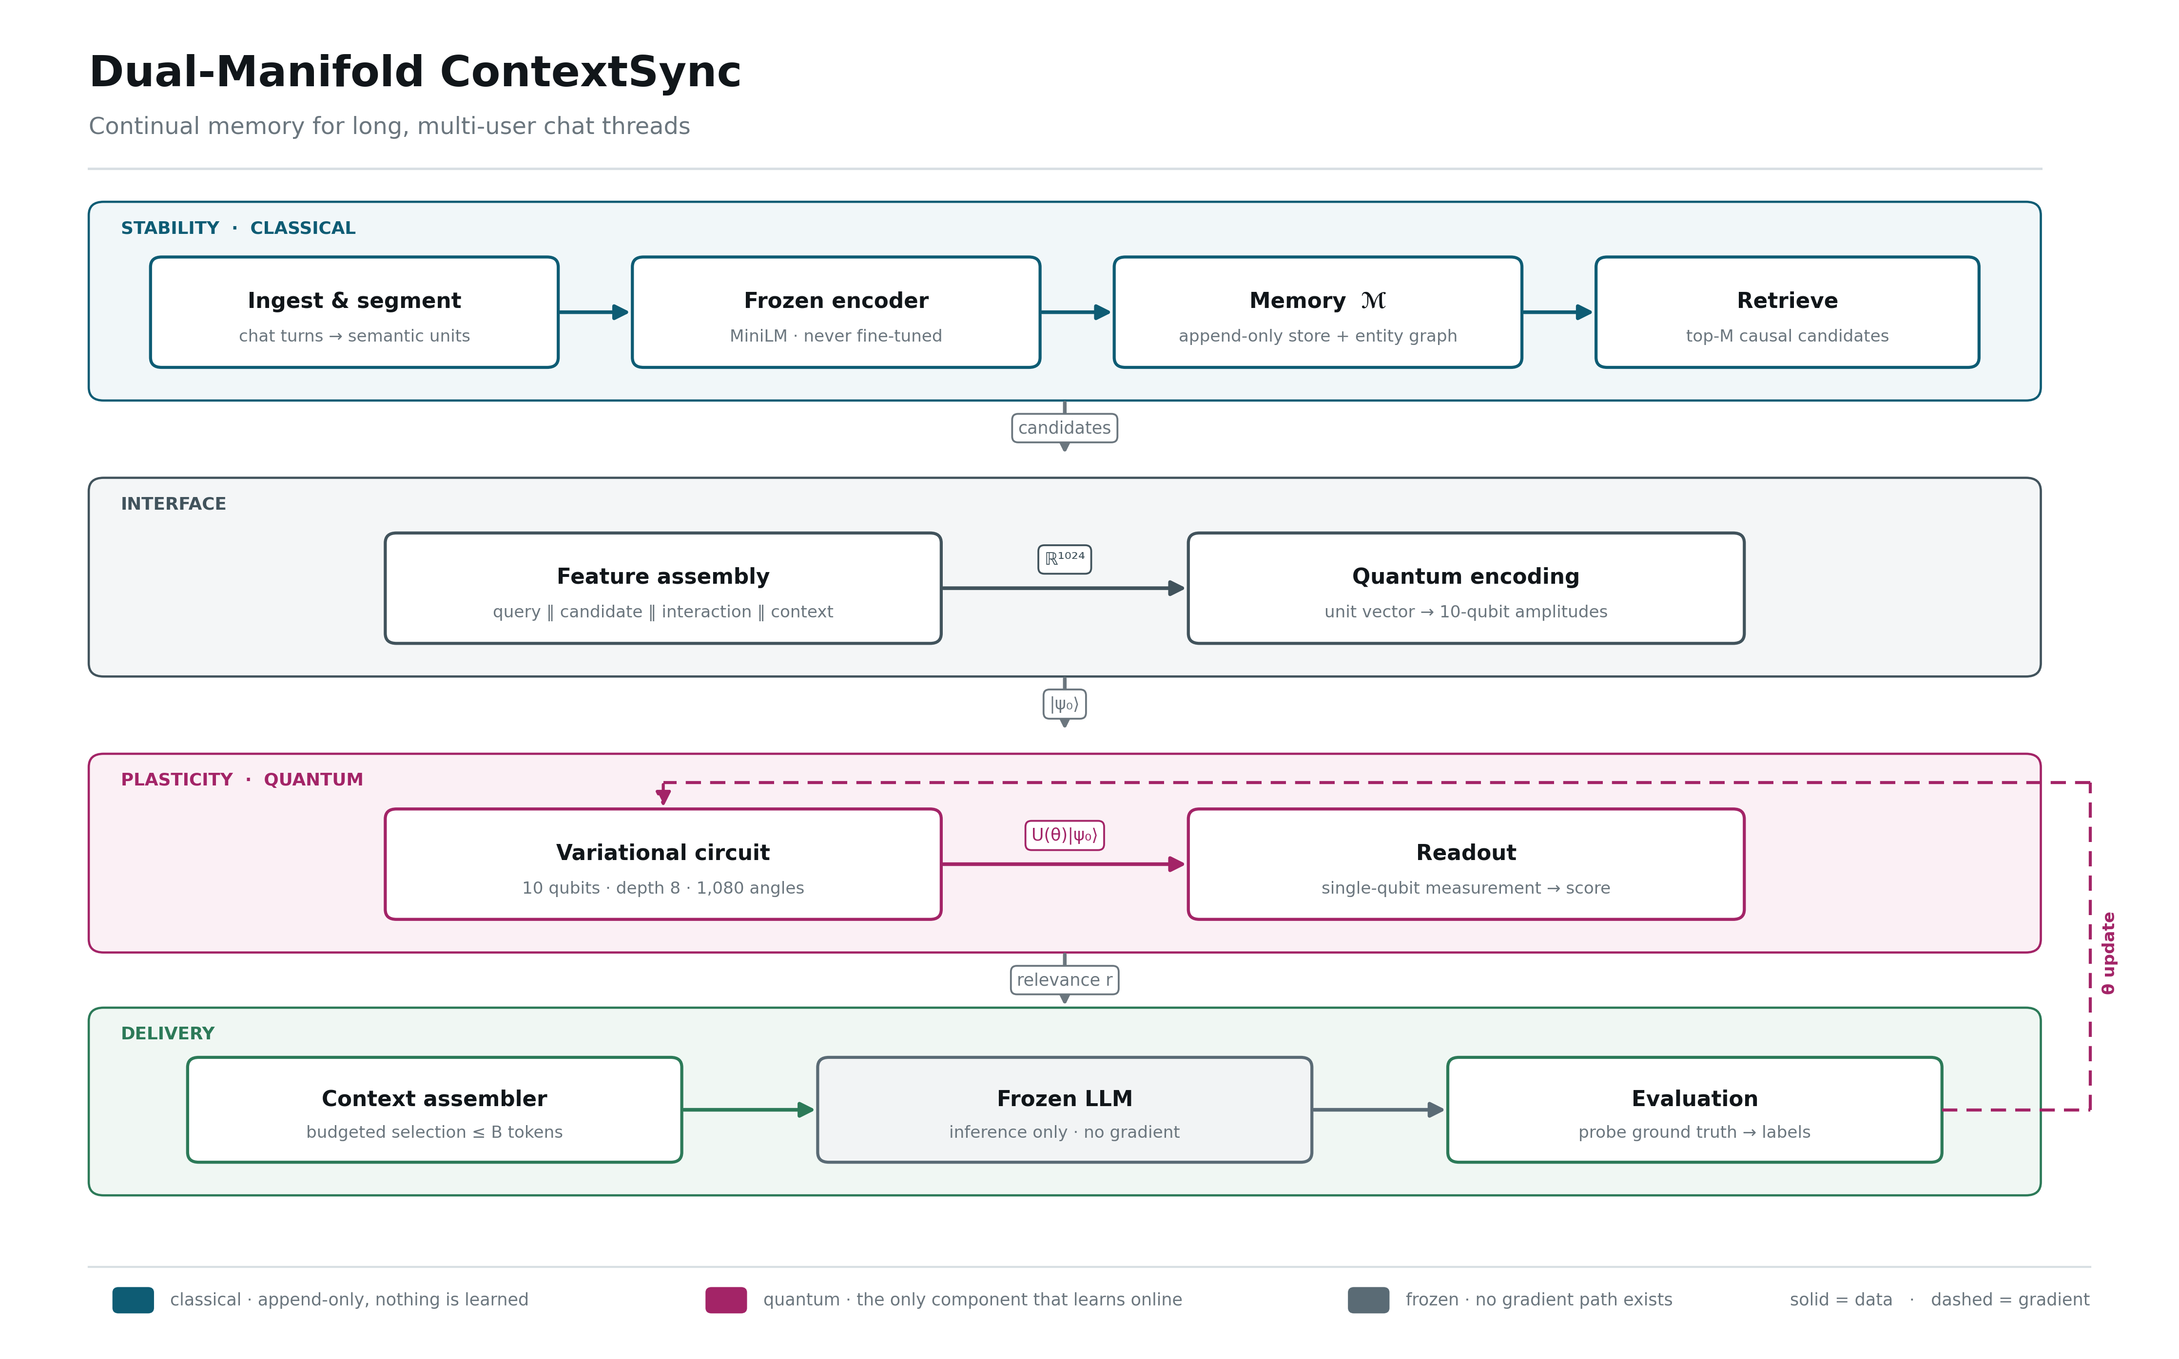
The architecture
Four bands, one direction of flow, one gradient path
Teal = classical and append-only · magenta = the only component that learns · slate = frozen.
8

Slide 9
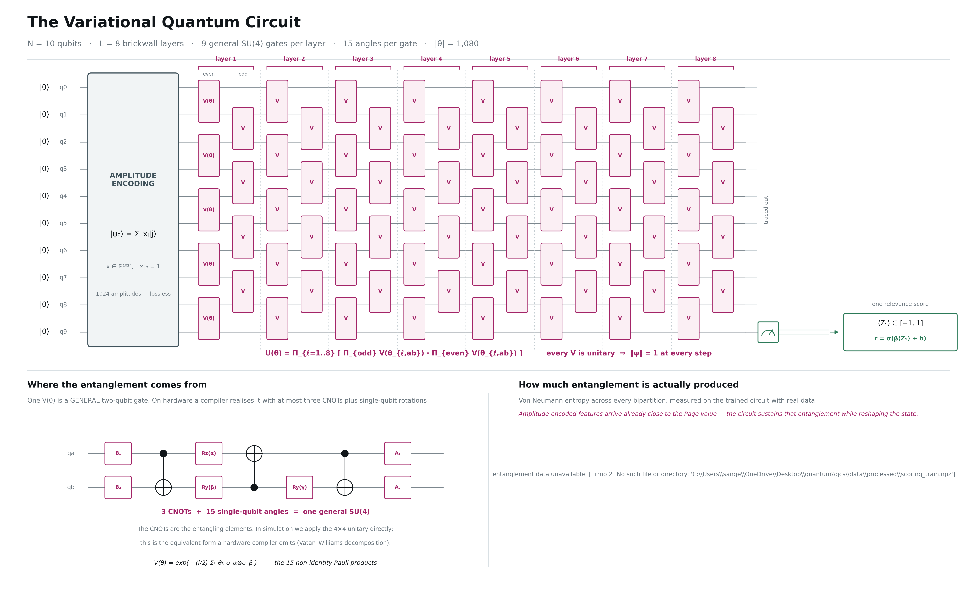
The variational quantum circuit
|0⟩ register · amplitude encoding · 8 brickwall layers of general SU(4) · measurement on q9
1,080
angles — 8 layers × 9 gates × 15
3 CNOTs
per gate on hardware — the entangling elements
depth ≥ 5
light-cone floor, enforced by the config
‖ψ‖ = 1
at every layer — verified against PennyLane
Left inset: the CNOT decomposition a compiler emits for one V(θ). Right inset: entanglement measured on the trained circuit.
9

Slide 10
The dataset
Generated in two steps, because the separation is what creates exact ground truth
1 · PLAN — structured, and IS the ground truth
2 · SURFACE TEXT — templates only
which turn states which fact · which supersedes it · which probes it, at what distance
prose may never add or remove a fact — an LLM writing freely would destroy the ground truth
Turn kind | What it is | Why it exists
fact | a participant states an (entity, attribute, value) they own | the retrieval target
update | a later turn overwrites that fact | creates the stale-versus-current trap
probe | a question answerable only from stated facts | the measurement point
distractor | mentions a real entity with no usable value | defeats keyword matching
filler | ordinary conversation | dilution
18,000
1,800
1,920
1.000
0.042
turns
probes
facts
oracle recall
random recall
Three regimes cycle across threads: single-owner, multi-owner, adversarial.
10

Slide 11
Ten phases
Each phase's exit criterion is the next phase's precondition
0
1
2
3
4
Foundations
Dataset
Encoding
Memory ℳ
Quantum core
reproducible substrate
ground truth by construction
text → unit-norm ℝ¹⁰²⁴
append-only, enforced by the DB
verified circuit, depth by evidence
5
6
7
8
9
Baselines
Continual training
Assembly
Evaluation
Hardening
each arm at its own best lr
120 tasks, full instrumentation
budgeted prompt, frozen generator
seeds, ablations, noise, sealed split
not started — the long-horizon run
Phases 0–8 are complete; phase 9 is the remaining work.
11

Slide 12
Phases 0–3 · building the dataset and the memory
From nothing to an append-only store that cannot lose a fact
Phase | What happens to the data | What comes out | Measured
0 · Foundations | No data yet. Every tunable number moves into one YAML file; seeding uses hashlib, not Python's per-process-salted hash(). | Config, seeding, run logger, typed records | Two identical-seed runs produce identical output
1 · Dataset | Plan each thread first: assign a probe-distance band, then place the fact. Add supersession chains. Realise prose from the plan with templates. | 18,000 turns · 1,800 probes · 1,920 facts · sealed test split | Oracle 1.000 · random 0.042
2 · Encoding | Segment losslessly; embed with a frozen encoder; whiten once on held-out threads; train a projection with InfoNCE then freeze it. | 7,200 semantic units · frozen 384-d and 256-d vectors | Held-out recall@20: 0.879 → 0.996
3 · Memory ℳ | Write every unit verbatim; add summary nodes beside sources; build the supersession graph; track per-user salience; index for causal retrieval. | SQLite store · FAISS index · 9,989 edges | Prefilter recall 1.000 · 3 mutation tests rejected
Exit criteria are hard: nothing in phase 4 was started while any of these was red.
12

Slide 13
Phases 4–6 · the quantum core and the experiment
From a verified circuit to a 120-task continual run
Phase | What happens to the data | What comes out | Measured
4 · Quantum core | Implement the general SU(4) gate, amplitude-encode 1024 features into 10 qubits, arrange 8 brickwall layers, read out one qubit. | A verified circuit with 1,080 parameters | PennyLane fidelity 1.000 · gradient agreement 8.6e-9
5 · Baselines | Build a parameter-matched linear twin (1,025), a wider MLP, cosine, recency, random and oracle — all behind one interface. Tune the learning rate per arm. | Six comparison arms · configs/tuned.yaml | Tuning moved the linear arm 0.063 → 0.965 MRR
6 · Continual training | Stream 120 tasks in order. Train once per task, evaluate on all past tasks, replay uniformly over history, anchor with the quantum Fisher, wrap angles. | Trained scorers · transfer matrix · a metric row per task | BWT positive for every arm · Tr(F) diverges as predicted
Phase 5 is where an unfair comparison was caught and corrected before it could contaminate phase 6.
13

Slide 14
Phases 7–9 · delivery, evaluation and what remains
From scores to an answer, and from an answer to a defensible result
Phase | What happens to the data | What comes out | Measured
7 · Assembly | Count tokens exactly, reserve sub-budgets, select greedily by gain per token with a redundancy penalty, filter superseded facts, render with provenance. | A prompt of at most B tokens · an answer | Budget never exceeded · zero unlabelled stale facts
8 · Evaluation | Three seeds; seven ablations retrained from scratch; depolarising noise by trajectory sampling; open the sealed split; paired bootstrap over threads. | Headline table · ablations · noise curves · significance | Quantum − linear = −0.056 MRR, p = 0.000
9 · Hardening | Not started. Hardware parity with finite shots, a scaling study over qubit count, a real frozen LLM, and a one-command reproduction kit. | Reproduction kit · hardware-parity report | —
Phase 8 produced the project's central negative result, reported rather than buried.
14

Slide 15
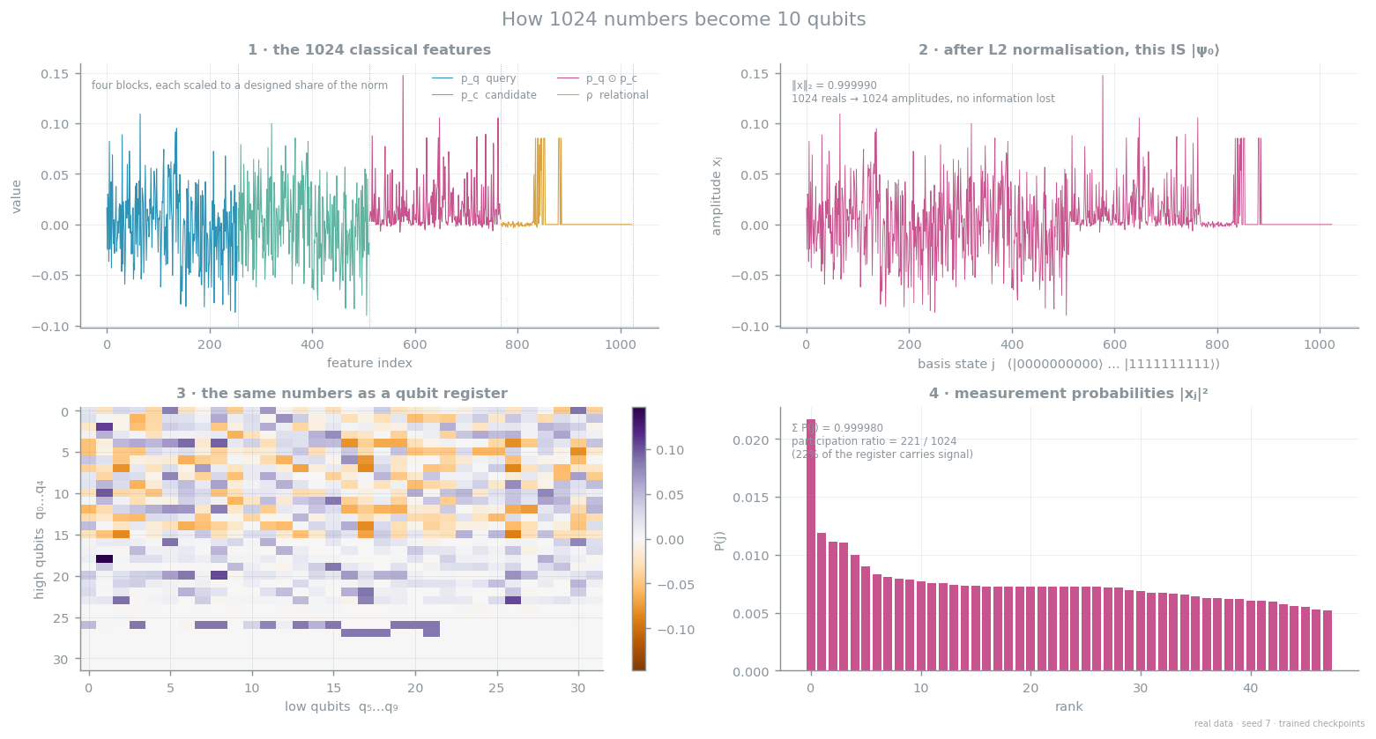
Result 1 · How 1024 numbers become 10 qubits
Amplitude encoding is lossless precisely because the feature dimension equals 2¹⁰
Participation ratio 189 of 1024 basis states — up from 61 before per-block norm balancing.
15

Slide 16
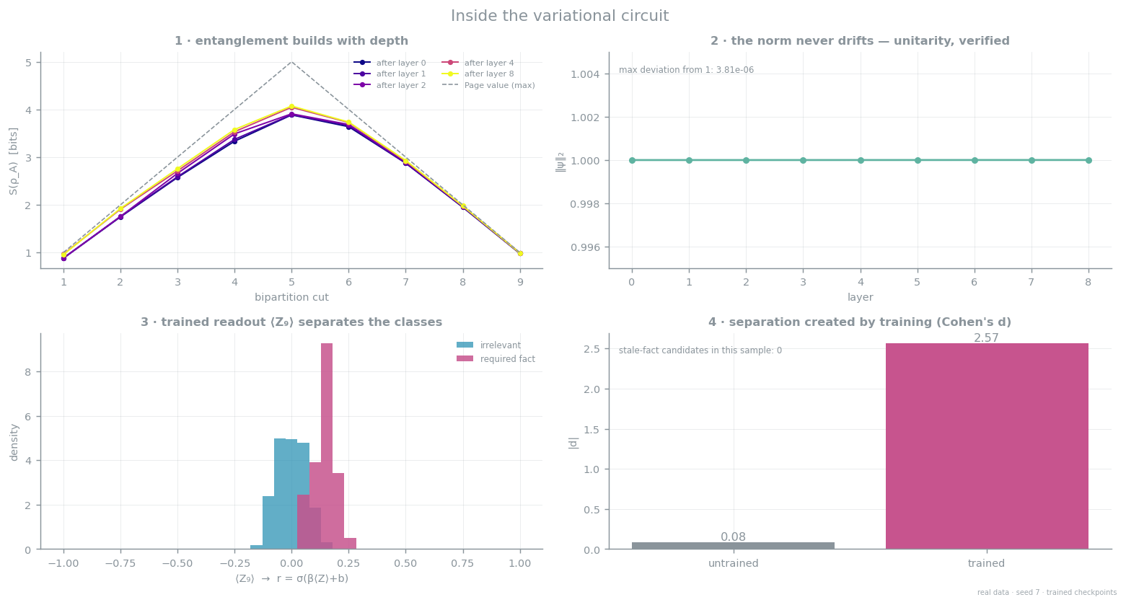
Result 2 · Inside the variational circuit
Entanglement builds with depth, the norm never drifts, and training creates the separation
Readout separation is created by training: Cohen's d rises from ≈0 at initialisation.
16

Slide 17
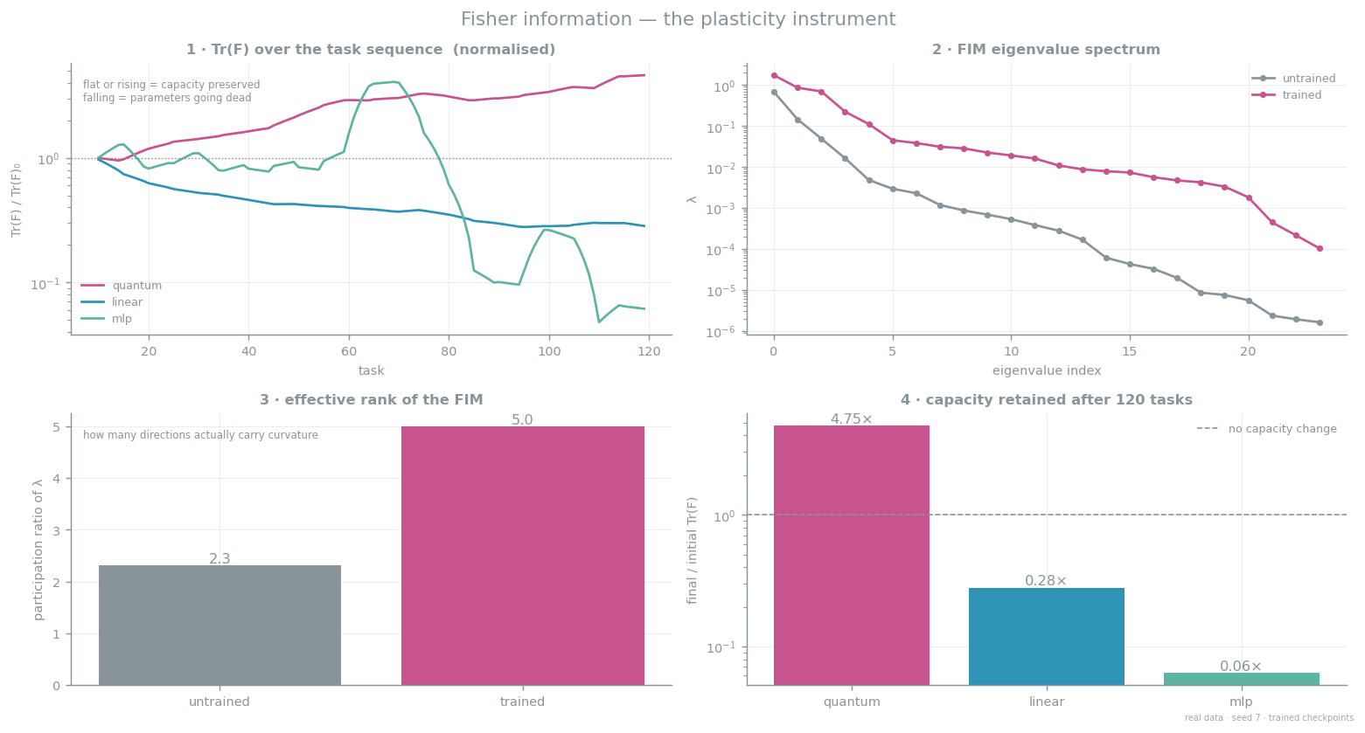
Result 3 · Fisher information — the plasticity instrument
Trace over the task sequence, eigenvalue spectrum, and effective rank
Capacity retained after 120 tasks: quantum 4.75× · linear 0.28× · MLP 0.06×.
17

Slide 18
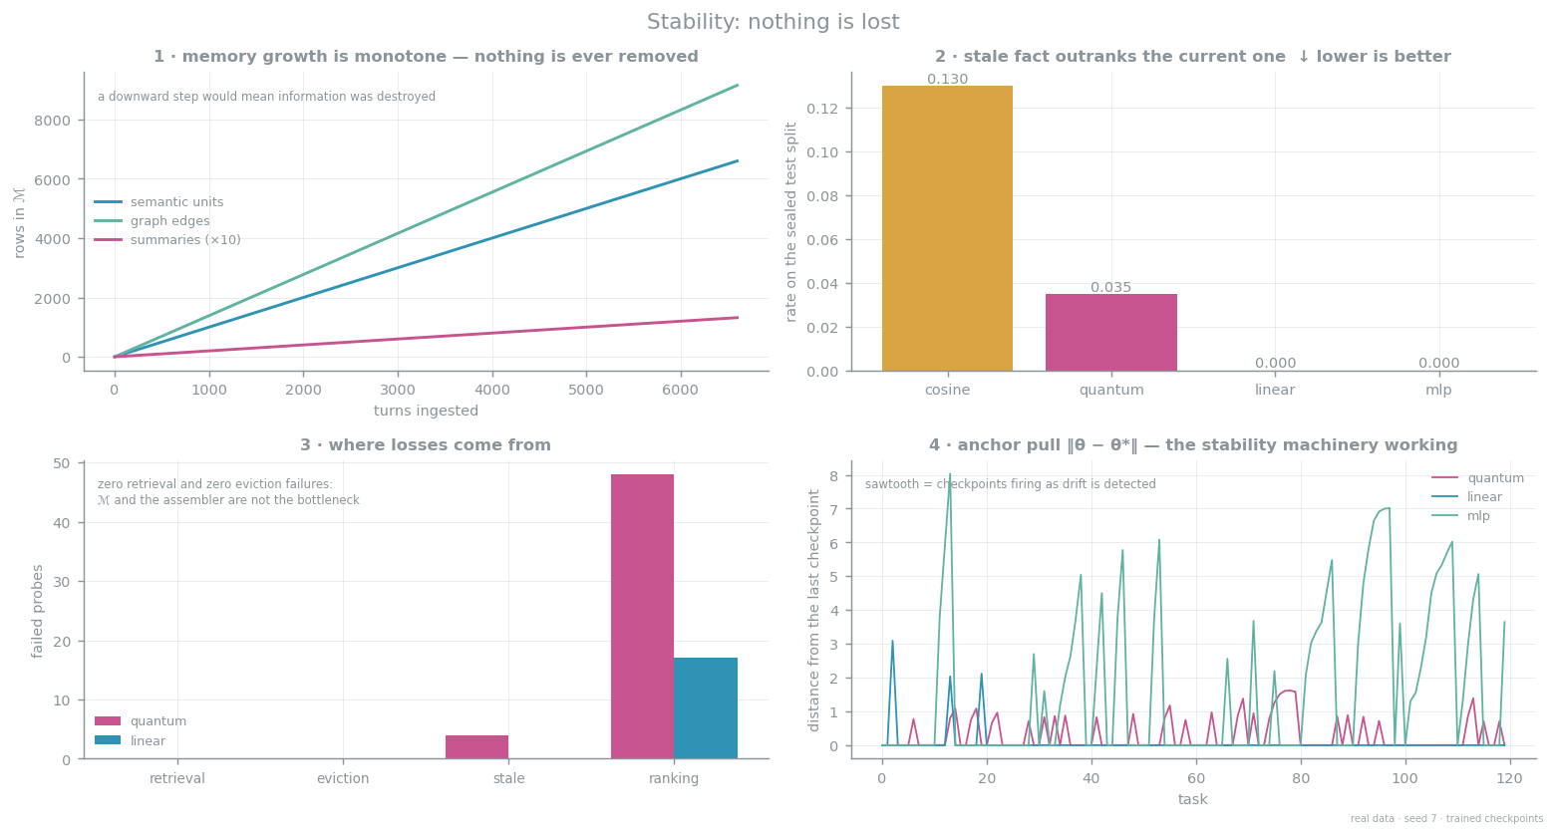
Result 4 · Stability
Memory that only grows, stale facts suppressed, and zero retrieval failures
Every remaining loss is a ranking decision — ℳ and the assembler are not the bottleneck.
18

Slide 19
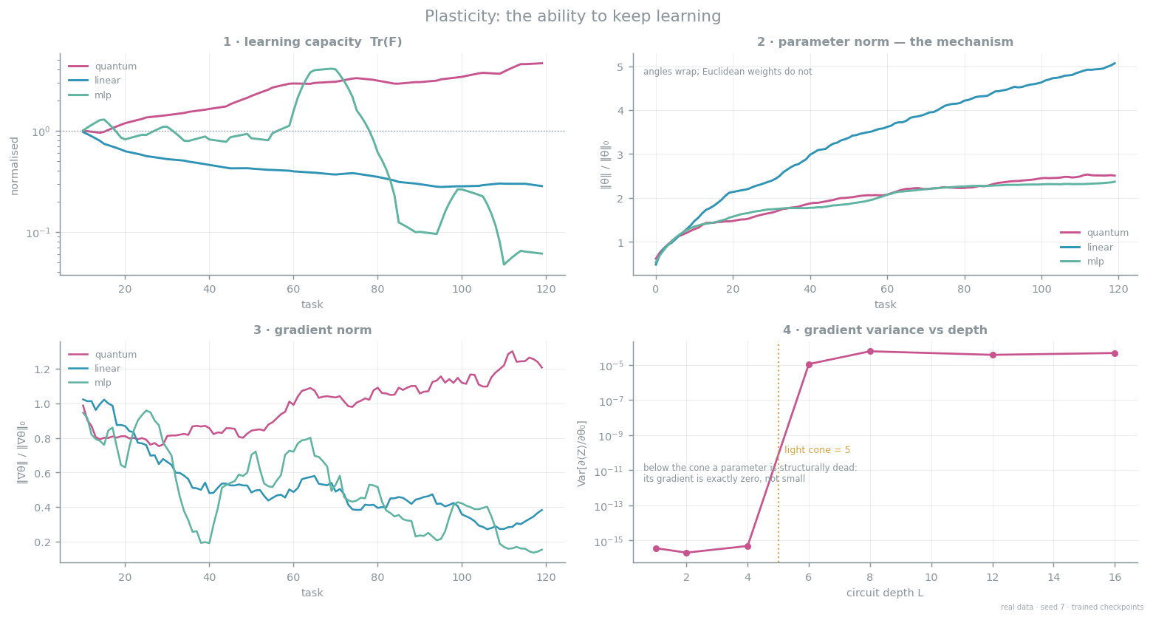
Result 5 · Plasticity
Capacity, parameter norm, gradient norm, and the light cone that sets the minimum depth
The compact manifold is the mechanism: angles wrap, Euclidean weights do not.
19

Slide 20
Headline results
Three seeds · 120 tasks · every arm at its own tuned learning rate
Arm | |θ| | rank-1 | MRR | stale-above ↓ | wall clock
quantum (QRE) | 1,080 | 0.928 ± 0.038 | 0.959 ± 0.022 | 0.015 | 406 s
linear (matched) | 1,025 | 0.979 ± 0.002 | 0.990 ± 0.001 | 0.000 | 3 s
mlp (capacity ref.) | 65,665 | 0.996 ± 0.002 | 0.998 ± 0.001 | 0.000 | 20 s
cosine (no learning) | 0 | 0.894 | 0.943 | 0.078 | —
recency (truncation) | 0 | 0.025 | 0.124 | 0.521 | —
oracle (ceiling) | — | 1.000 | 1.000 | 0.000 | —
The honest headline
The quantum arm is significantly worse than its parameter-matched classical twin: Δ −0.056 MRR, 95% CI [−0.070, −0.043], p = 0.000 by paired bootstrap over threads — at roughly 135× the compute and 19× the seed-to-seed variance. The design required this comparison to be falsifiable; it falsified in the classical arm's favour at this scale.
Sealed test split agrees: quantum 0.919 MRR vs linear 0.975.
20

Slide 21
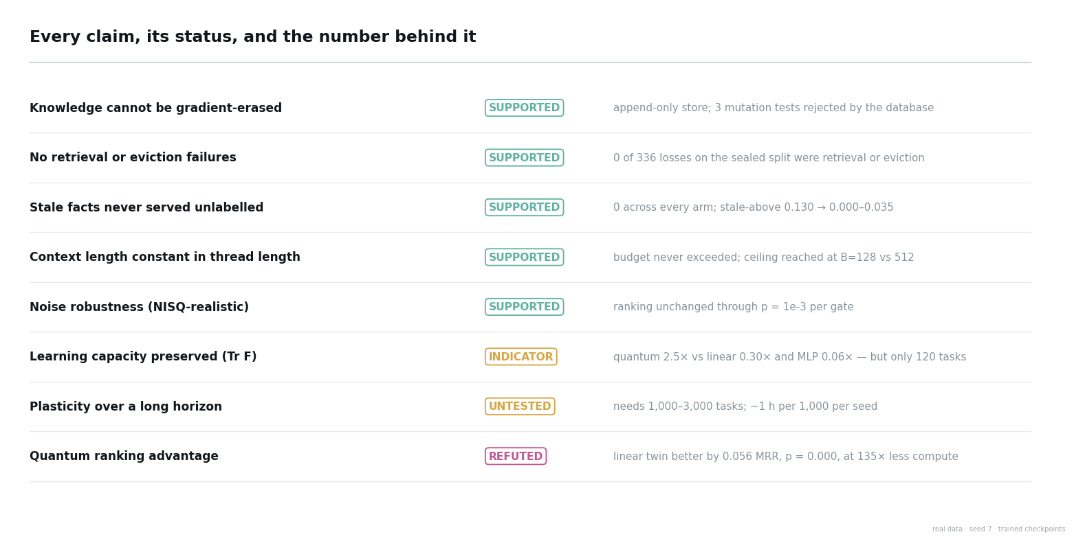
Every claim, and its status
Including the one that did not go our way
A claim is only listed as supported when a specific measurement backs it.
21

Slide 22
Future plans
Five objectives, in dependency order
01
Settle the plasticity question
Run 1,000–3,000 tasks across three seeds on both arms, with Tr(F) and the plasticity index as the primary endpoints.
02
Make the circuit fast enough to do it
Batched multi-candidate state preparation, a GPU backend, or a shallower ansatz — this is what unblocks objective 1.
03
Put a real frozen LLM in place
Replace the extractive reader so attention dilution, and therefore the saturation turnover, becomes observable.
04
Establish hardware parity
Shot-based execution on a real backend; report the shot count at which the score ranking becomes stable.
05
Ship a reproduction kit
One command that regenerates every figure from the raw logs, plus the scaling study across 8, 10 and 12 qubits.

