Slide 1
HANDWRITING RECOGNITION USING MACHINE LEARNING
MAIN PROJECT

Slide 2
INTRODUCTION
The handwriting recognition is a challenging as well as emerging area of pattern recognition. It is a tedious process mainly due to its enormous character set.
Here we propose a novel method for handwriting recognition by using two dissimilar classifiers. It can also be called as an ensemble method in which multiple classifiers are combined to solve a particular problem and thereby improve the performance of the system.
The experiment is conducted in 2 phases.

Slide 3
PROPOSED METHOD
The proposed system uses Image processing as well as the use of two dissimilar classifiers. This is aimed to produce a better and efficient method of solving the digitization problem.
The various phases of the project will be explained in the upcoming slides.

Slide 4
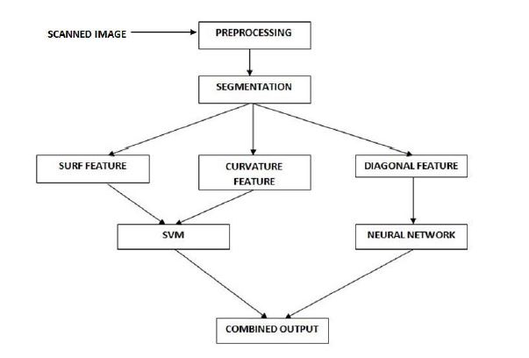
FLOW OF CONTROL

Slide 5
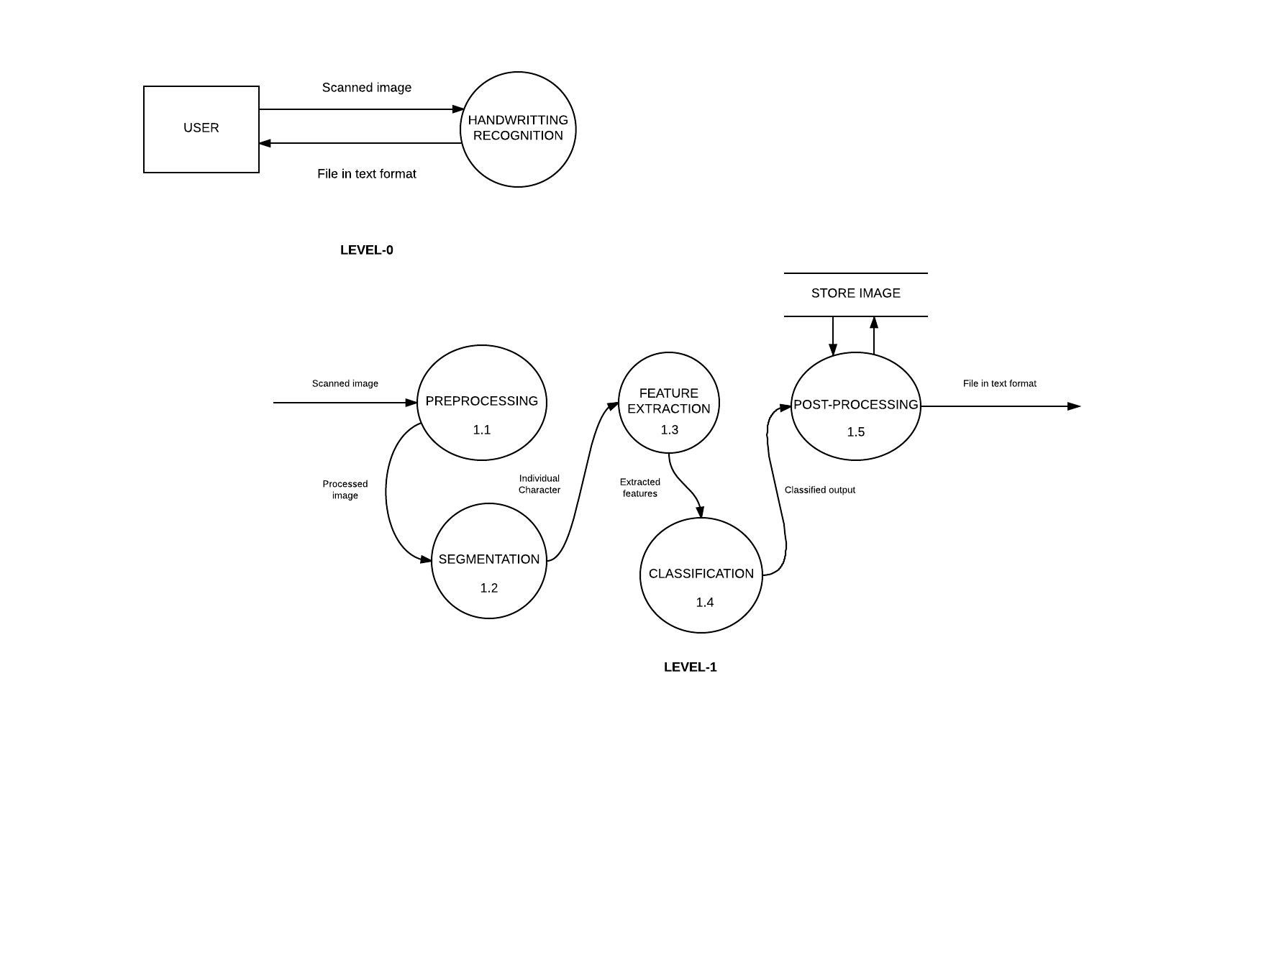
Data flow diagram

Slide 7
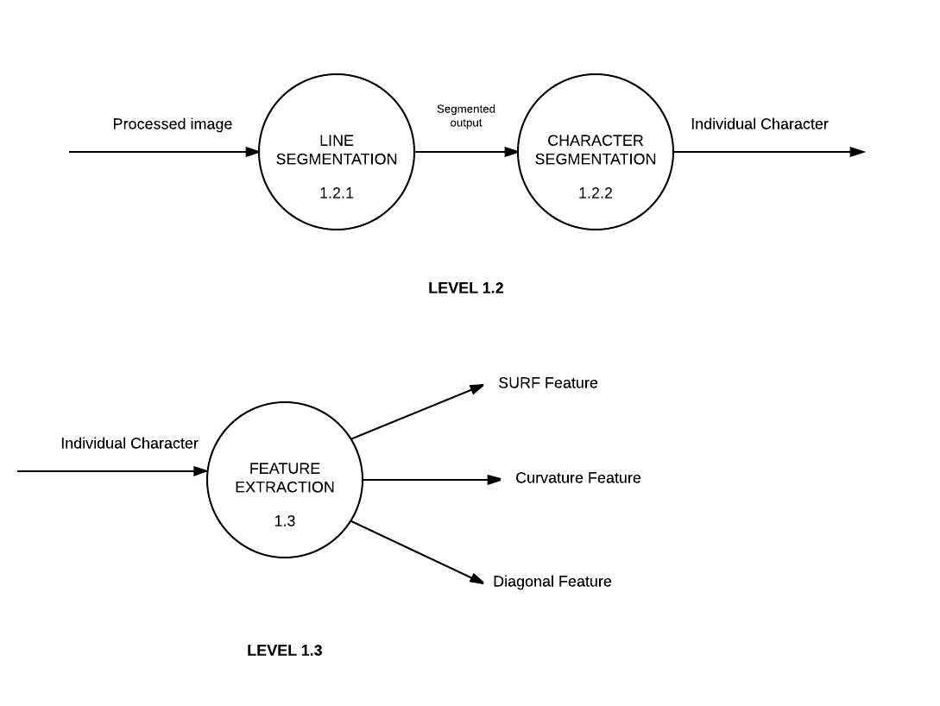

Slide 8
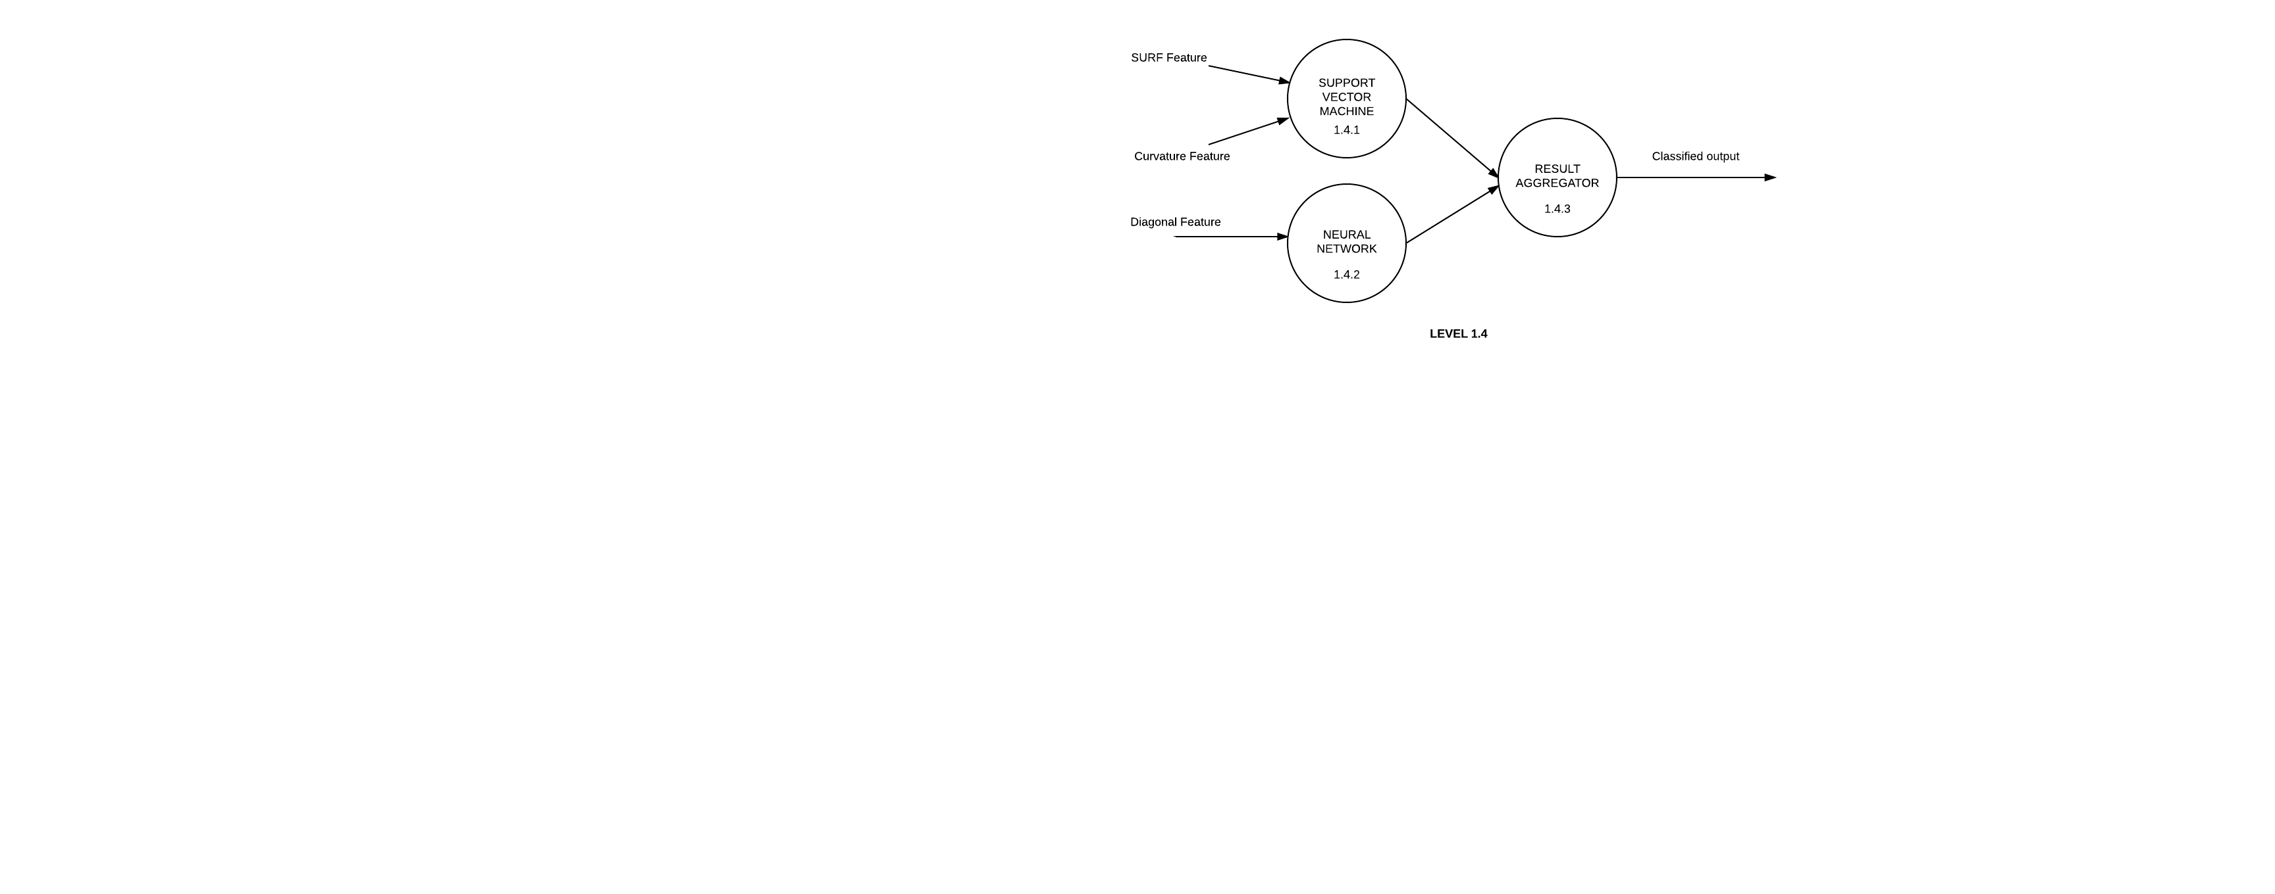

Slide 9
MODULE DESCRIPTION
The different modules that we plan to use to implement the project are;
Image Acquisition
Pre-processing
Segmentation
Feature Extraction
Classification
Post-processing

Slide 10
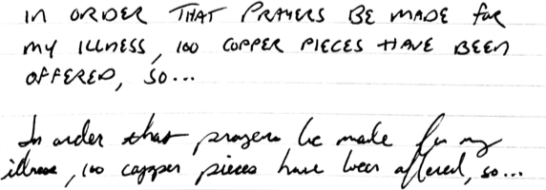
1. Image acquisition
Handwritten scanned Images can be represented in any format such as JPEG, PNG, etc.
The Image should have a minimum resolution
These images are given as input to the system for further steps.

Slide 11
2. Pre-processing
This step removes the distortions in the scanned image. The steps involved are,
Converting to grey scale.
Converting the grey scale image to binary. This is done by using the OTSU’S Method of global thresholding.
Noise reduction using filter.
Relevant features are extracted by thinning using HILDITCH Algorithm.

Slide 12
3. Segmentation
The purpose of this step is to isolate individual characters.
Line segmentation
- Using horizontal projection profile method
Character segmentation
- Using vertical projection profile method
The step produces individual characters from the scanned image

Slide 13
4. Feature extraction
The module extracts salient characteristics of the individual characters. The characteristics are ;
SURF- It is used to distinguish between points and intersections. It produces 3 parts
Interest point detection
Local neighborhood description
Matching
Curvature – It provides clearer structural sketch of the image
Diagonal – Input is divided into zones and the zones provide features to the character

Slide 14
5. classification
In training phase, based on the features extracted unique labels are assigned to each characters. In recognizing phase the characters are mapped to the previously assigned labels stored in the database. Two dissimilar classifiers are used ;
SVM (Support Vector Machine)
It is a supervised learning model that performs linear classification. The SVM learns fast but the prediction is slow.
Neural Network
The Neural Network learns by observing data. The learning process is slow but NN predicts swiftly.

Slide 15
6. post-processing
The characters are mapped to the corresponding Unicode values. These values are used when comparing new data input .
The Post-Processing results are stored in the database in the training phase. In the recognition phase the comparison takes place.

Slide 16

EXPECTED OUTPUT

Slide 17
SCOPE
Now is the age of digitalization. Rather than storing the data on papers, it can be safely stored and easily accessed, then digitalized. Therefore Handwriting Recognition is of prime importance. Handwriting Recognition is an emerging as well as challenging area in the fields of pattern recognition and computer vision. Other applications include automatic number plate recognition, CTS scanning, preservation of degraded documents etc.
The aim of a handwriting recognition system is to convert human readable characters which are present in a photographed or digitized sheet of paper and convert it into a machine editable form.
An upgradation to this project can result in the system to detect a particular persons handwriting. The future scope can be further studies to improve the current system.

Slide 18
CONCLUSION
In this project, we propose a method for the recognition of Handwritten characters using a combination of dissimilar classifiers. The work will be conducted in 2 phases. In order to identify individual characters, we extract SURF, curvature and diagonal feature and for classifying Neural Network and SVM are used.

