Slide 1
Presented By: Sangeeth A. & Shruti Tripathi
Batch: PGP-DSBA-July 2022
Capstone Project
House Price Prediction
Data driven approach using linear regression ,tree based and advanced models

Slide 2
Agenda
01
02
03
04
05
06
INTRODUCTION OF PROBLEM SATATEMNET AND PROJECT OBJECTIVE
EXPLORATORY DATA ANALYSIS
DATA PREPROCESSING
CLUSTERING
MODEL BULDING AND EVALUALTION
FINAL RECOMMENDATION

Slide 3
Introduction
Problem Statement: A House value is more than location and square footage. Like the features that make up a person, an educated party would want to know all aspects that give a house its value. For example, you want to sell a house and you don’t know the price which you may expect – it can’t be too low or too high. To find house price you usually try to find similar properties in your neighbourhood and based on gathered data you will try to assess your house price.
Objective: The objective is to build a model through which price of a house can be predicted, using historical data finding various feature variables available in data which have more impact in terms of pricing.
Scope: To find the optimal model and the variables impacting the target variable (price of house), perform EDA and predictive model analysis using different techniques.
Key variables: Area of house, location, target price, Quality and other relevant factor

Slide 4
Exploratory Data Analysis

Slide 5
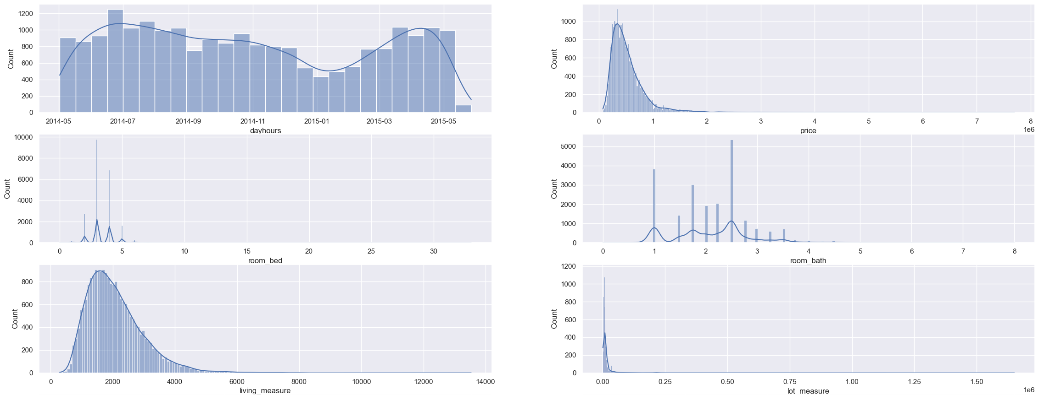
Univariate Analysis

Slide 6
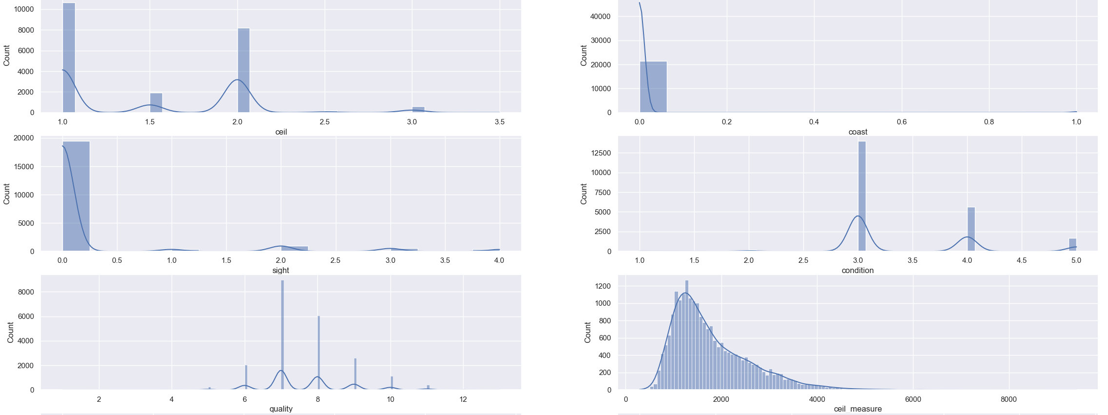
Univariate Analysis

Slide 7
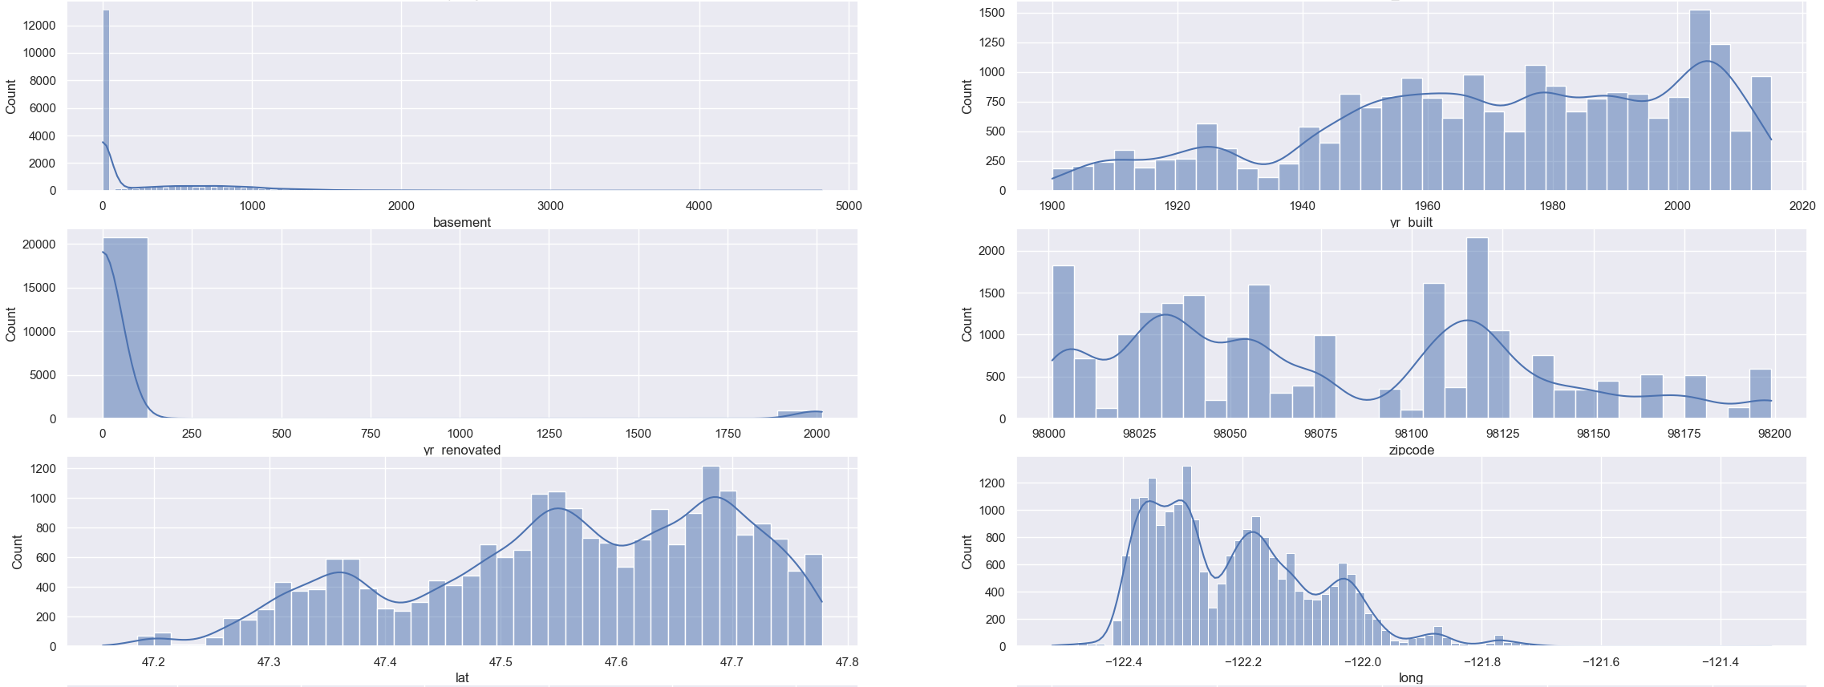
Univariate Analysis

Slide 8
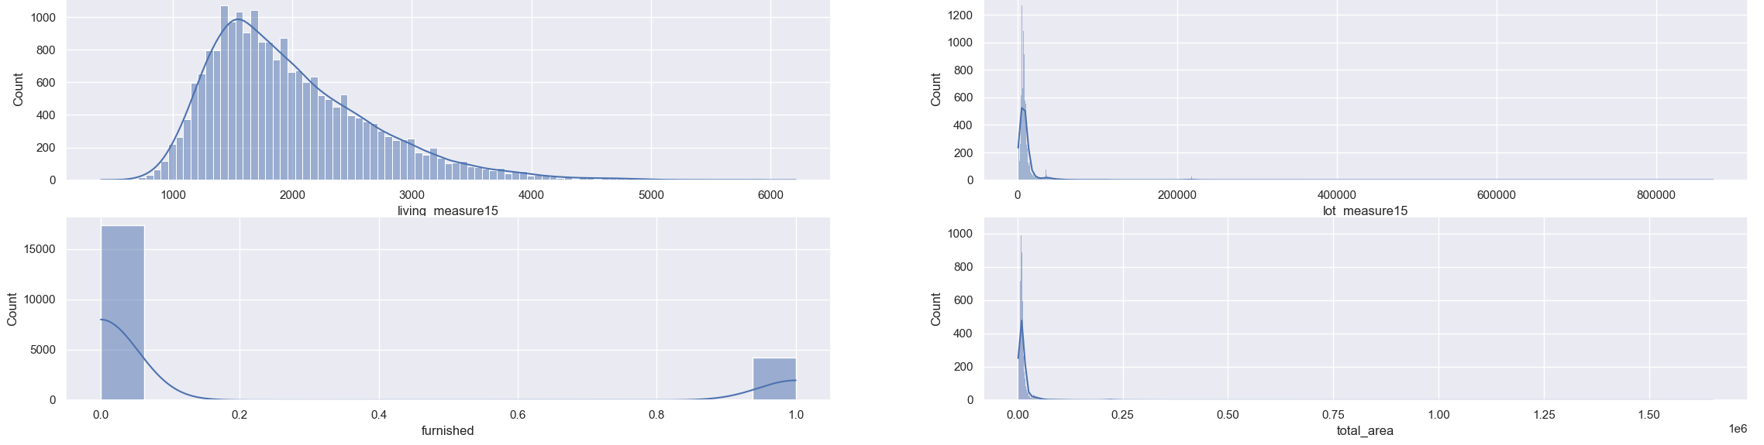
Univariate Analysis

Slide 9
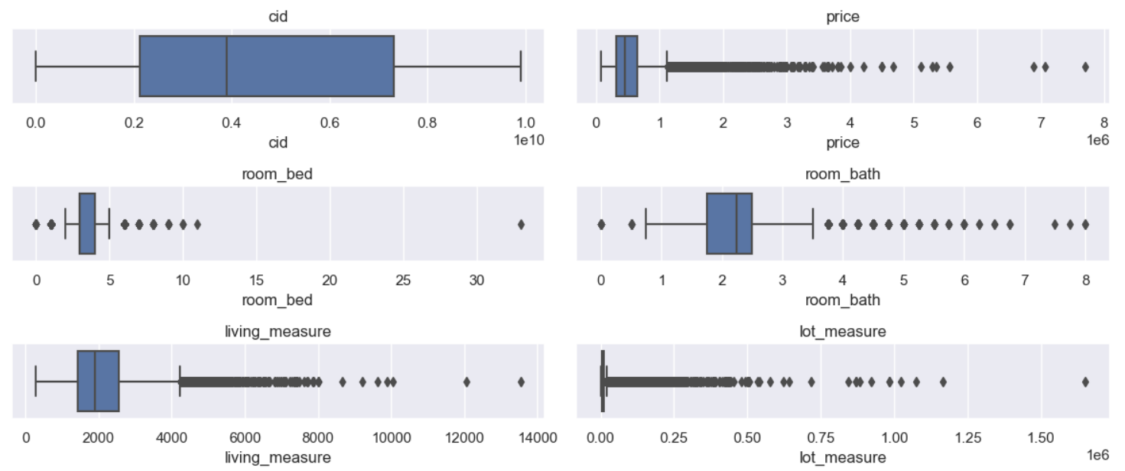
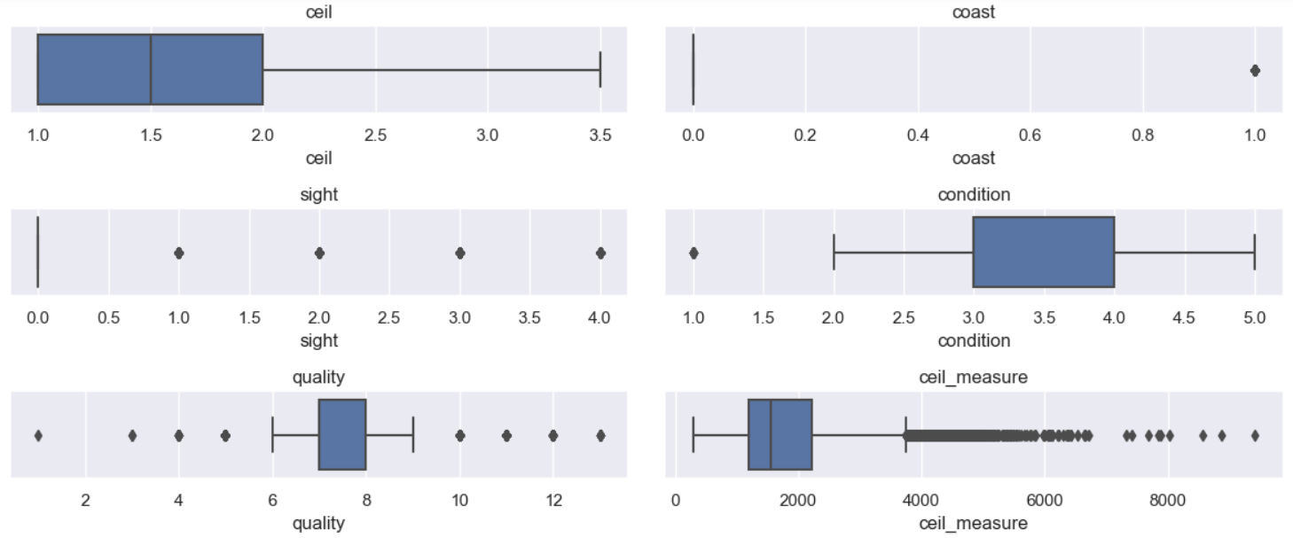
Univariate Analysis

Slide 10
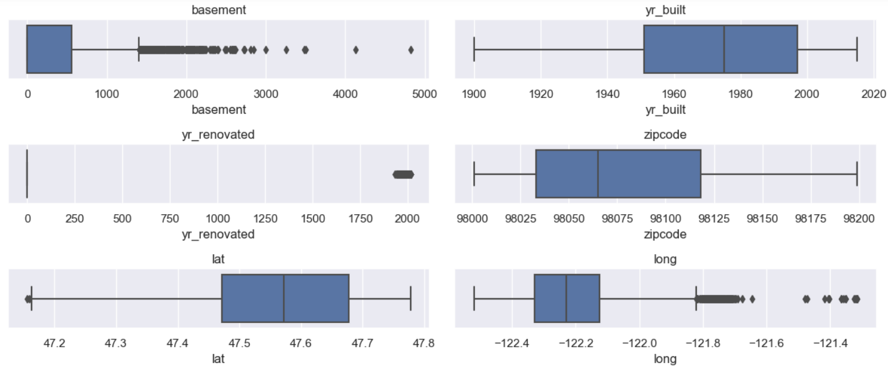
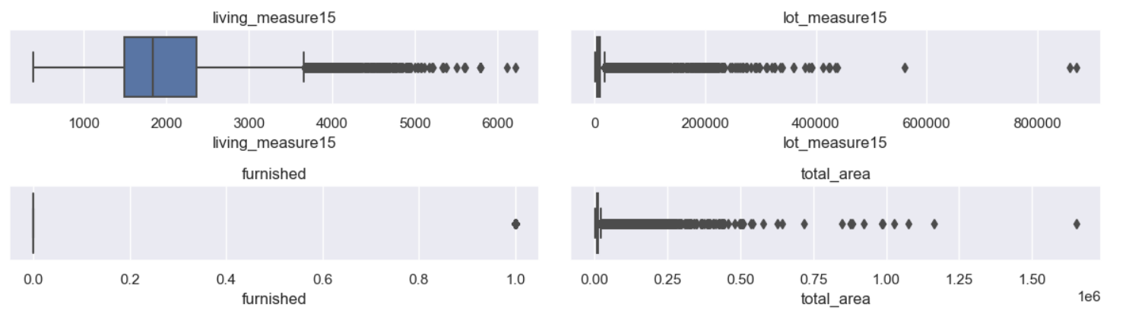
Univariate Analysis

Slide 11
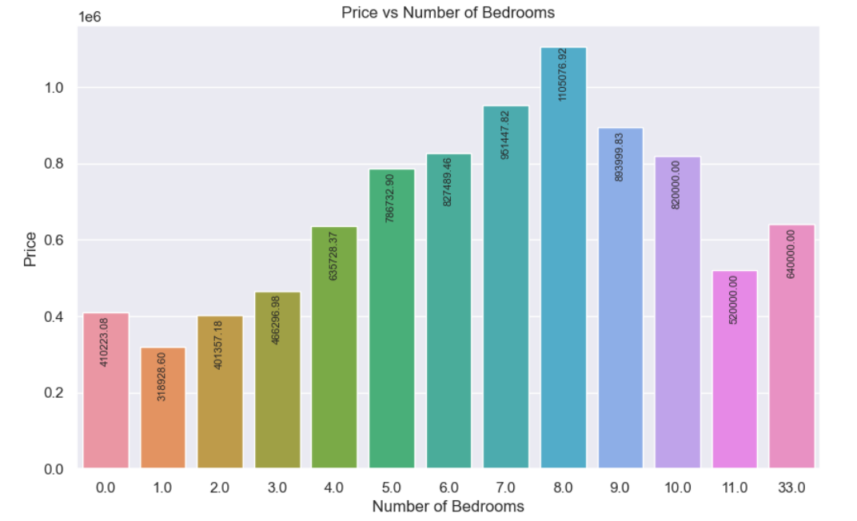
Bivariate Analysis

Slide 12
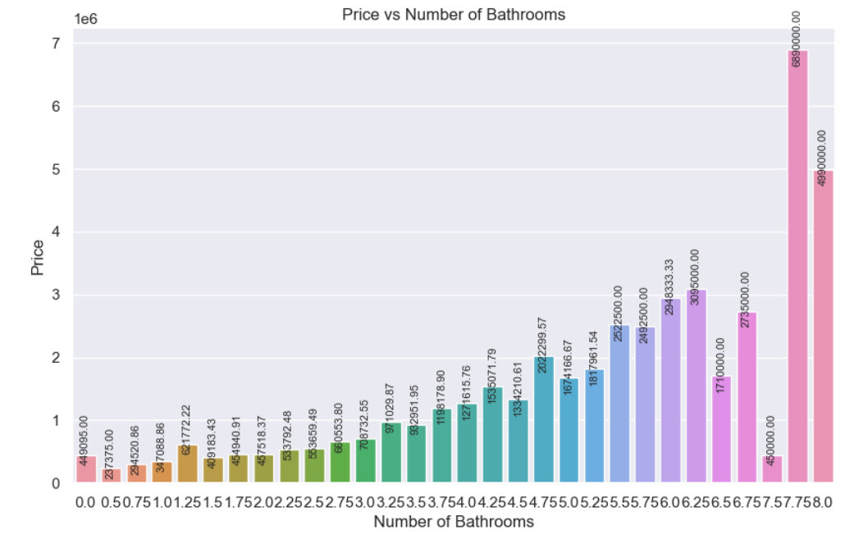
Bivariate Analysis

Slide 13
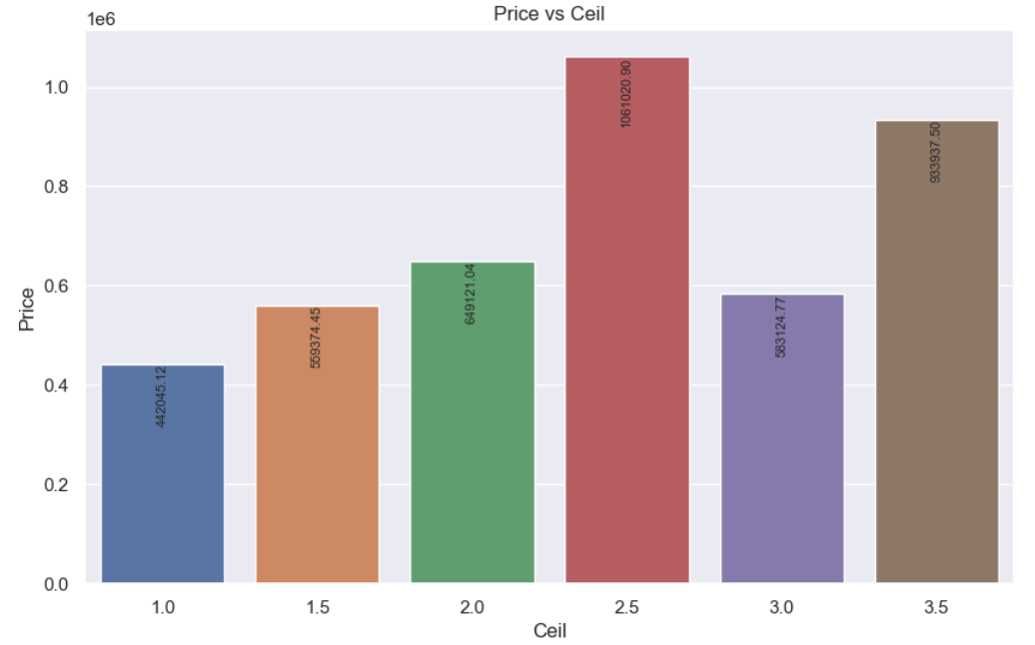
Bivariate Analysis

Slide 14
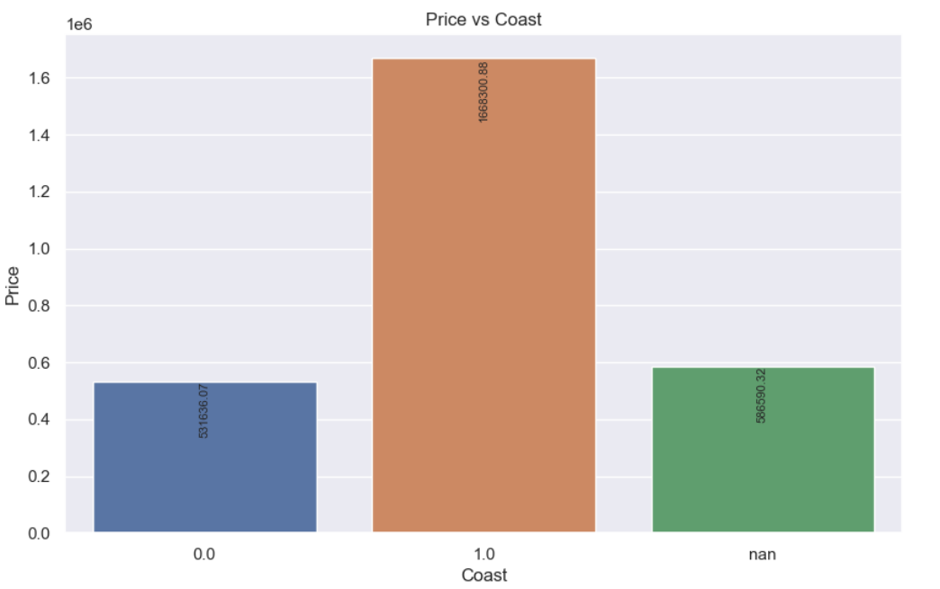
Bivariate Analysis

Slide 15
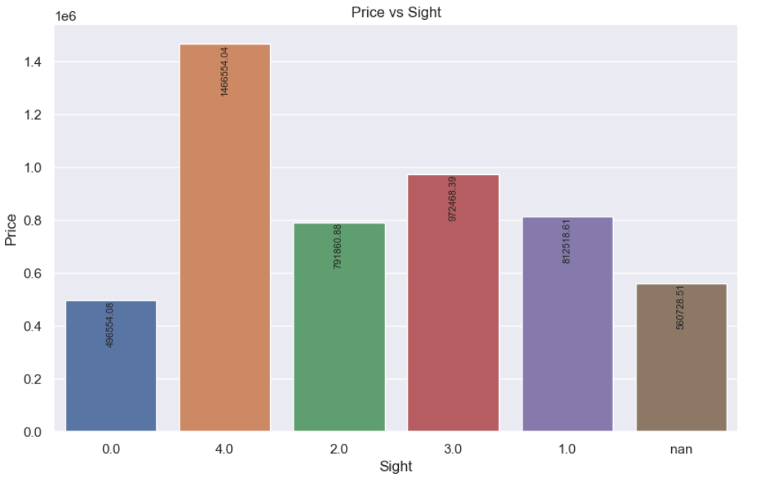
Bivariate Analysis

Slide 16
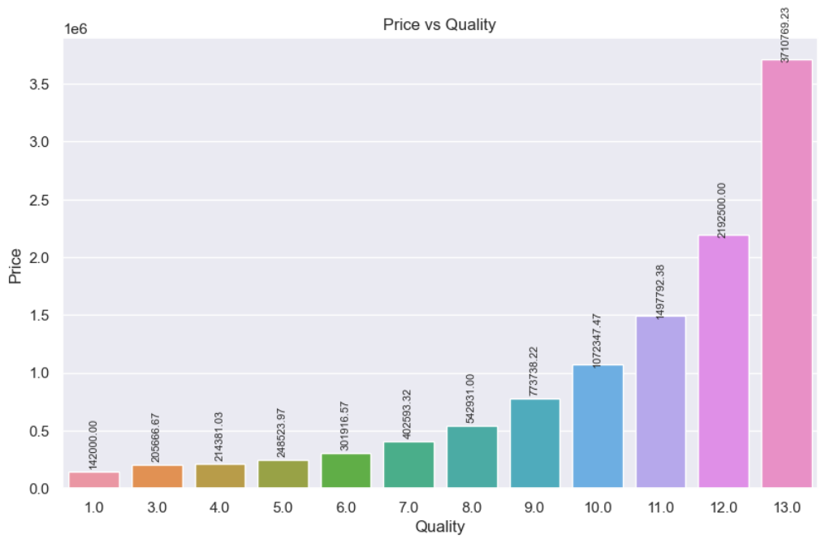
Bivariate Analysis

Slide 17
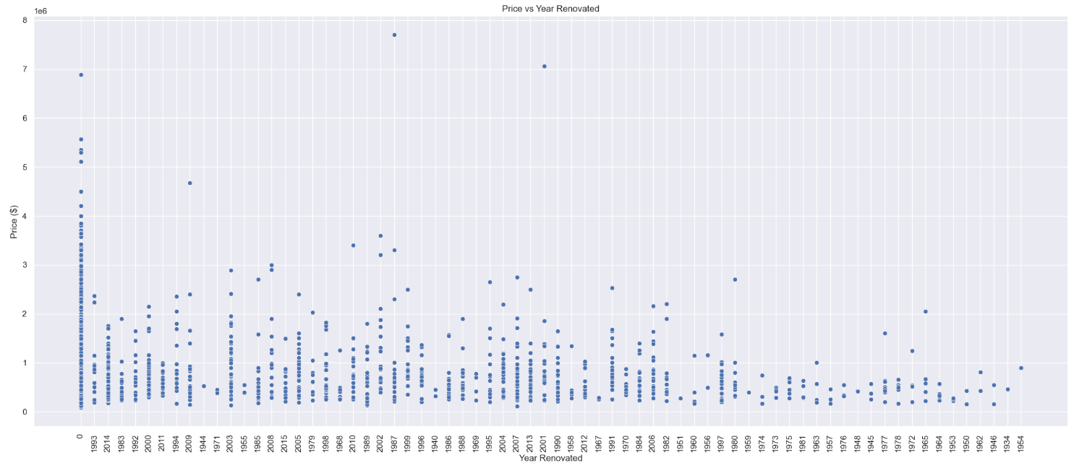
Bivariate Analysis

Slide 18
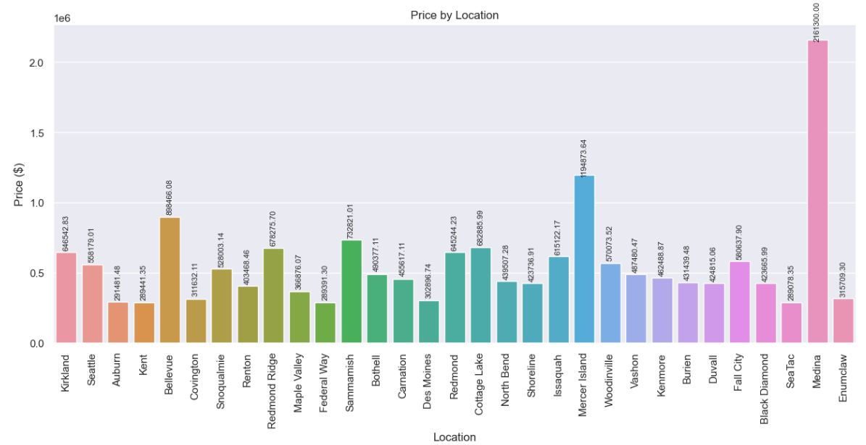
Bivariate Analysis

Slide 19
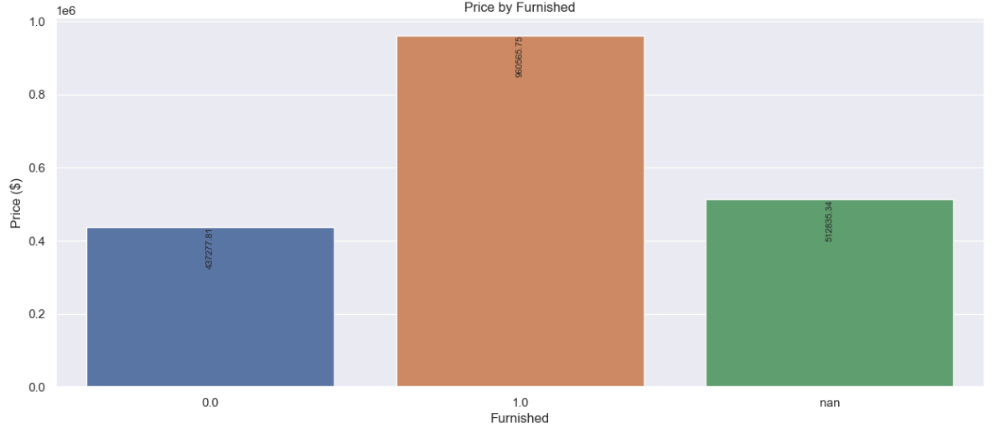
Bivariate Analysis

Slide 20
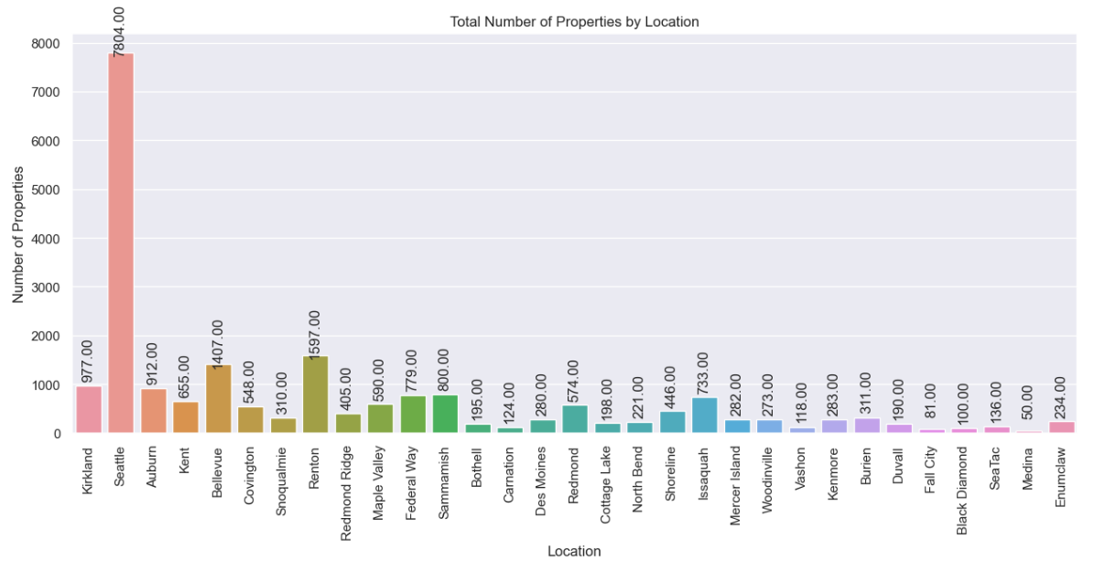
Bivariate Analysis

Slide 21
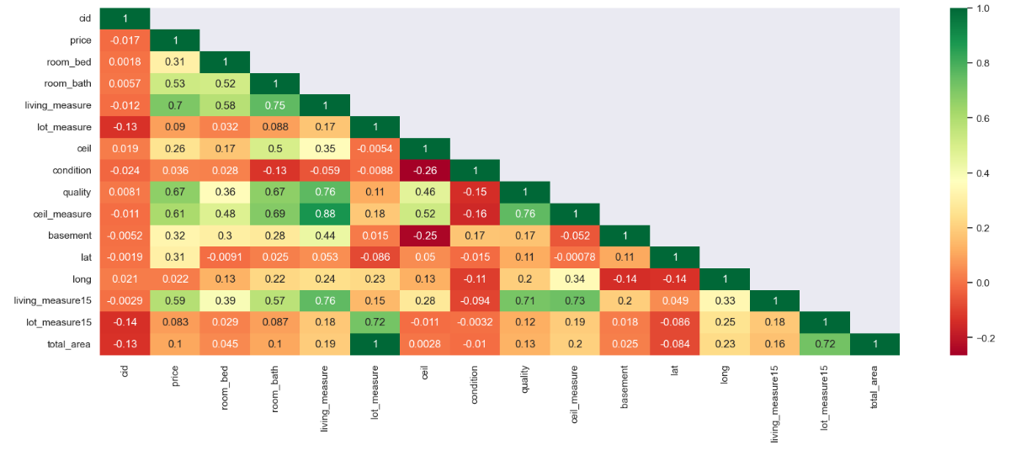
Multivariate Analysis

Slide 22
Business insights from EDA
Data is unbalance and most variable are right skewed even target variable price too is right skewed
Price of house dependent on quality, furnishing, condition, number of sights / views
Coastal area is most preferred
Outliers present but percentage is very low

Slide 23
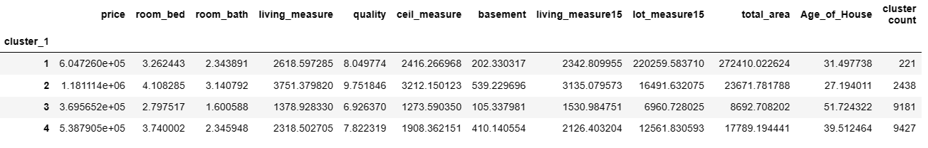
Dataset after Clustering
Dataset for Number of Clusters with count of properties per cluster

Slide 24
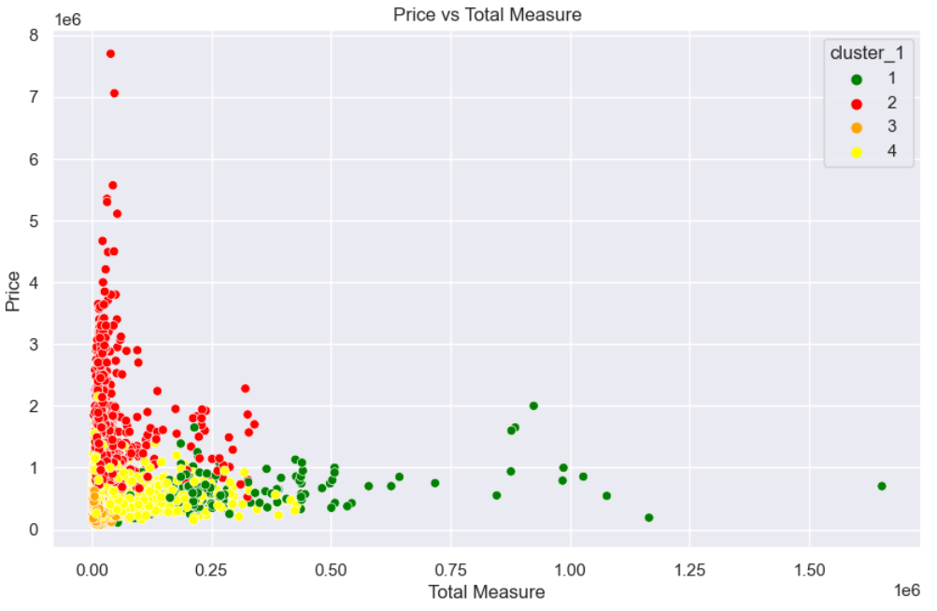
Scatter Plot for distribution of Clusters between Price & Total Measure

Slide 25
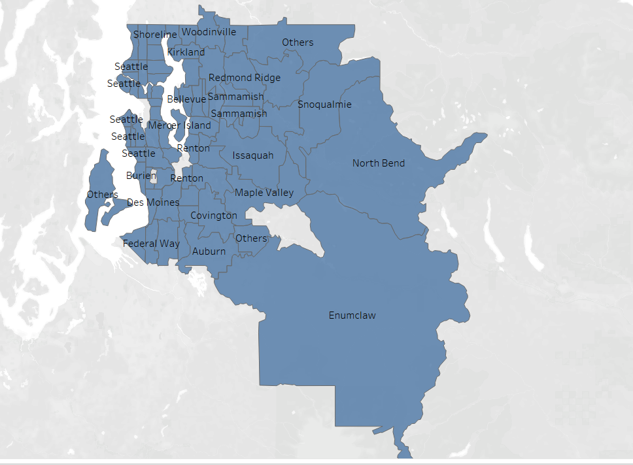
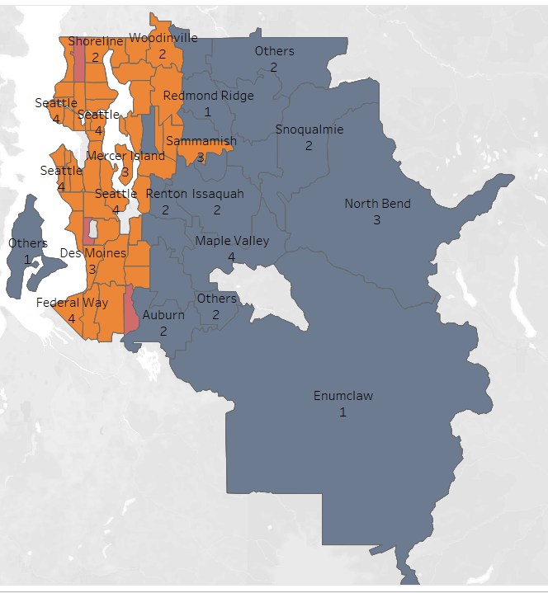
Map Before and After Clustering

Slide 26
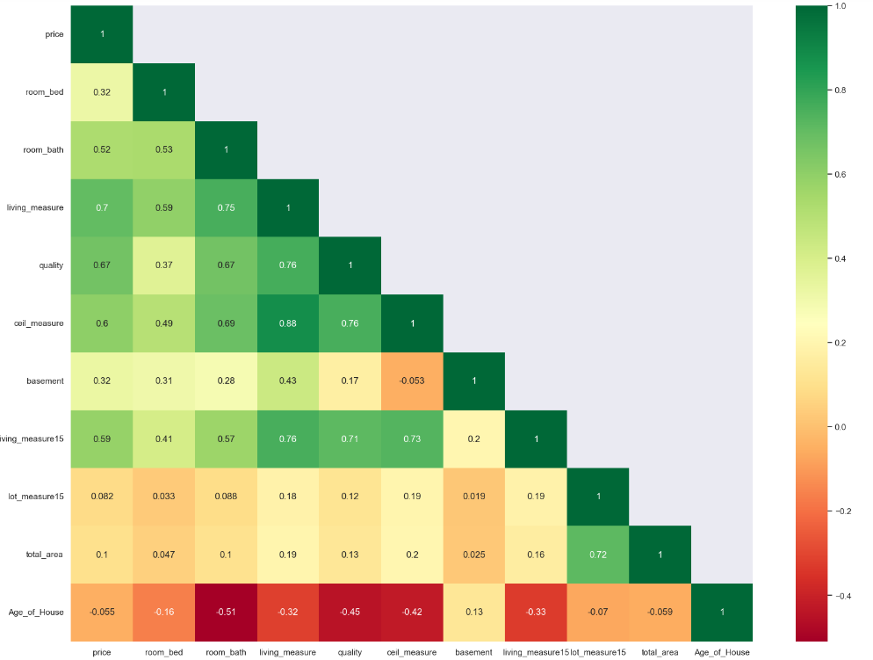
Correlation between variables after reducing size of dataset

Slide 27
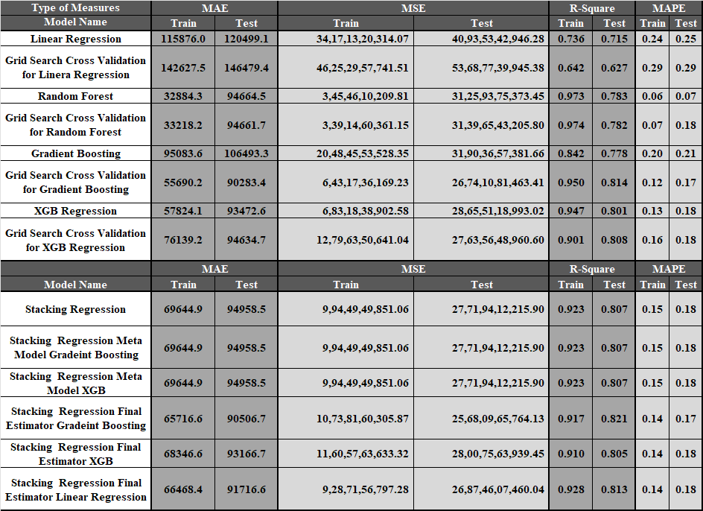
Model Performance Matrix

Slide 28
Best Model Selection
XG Boost regression
High R-square and difference between R-square is less
MAPE value is less
Interpretability

Slide 29
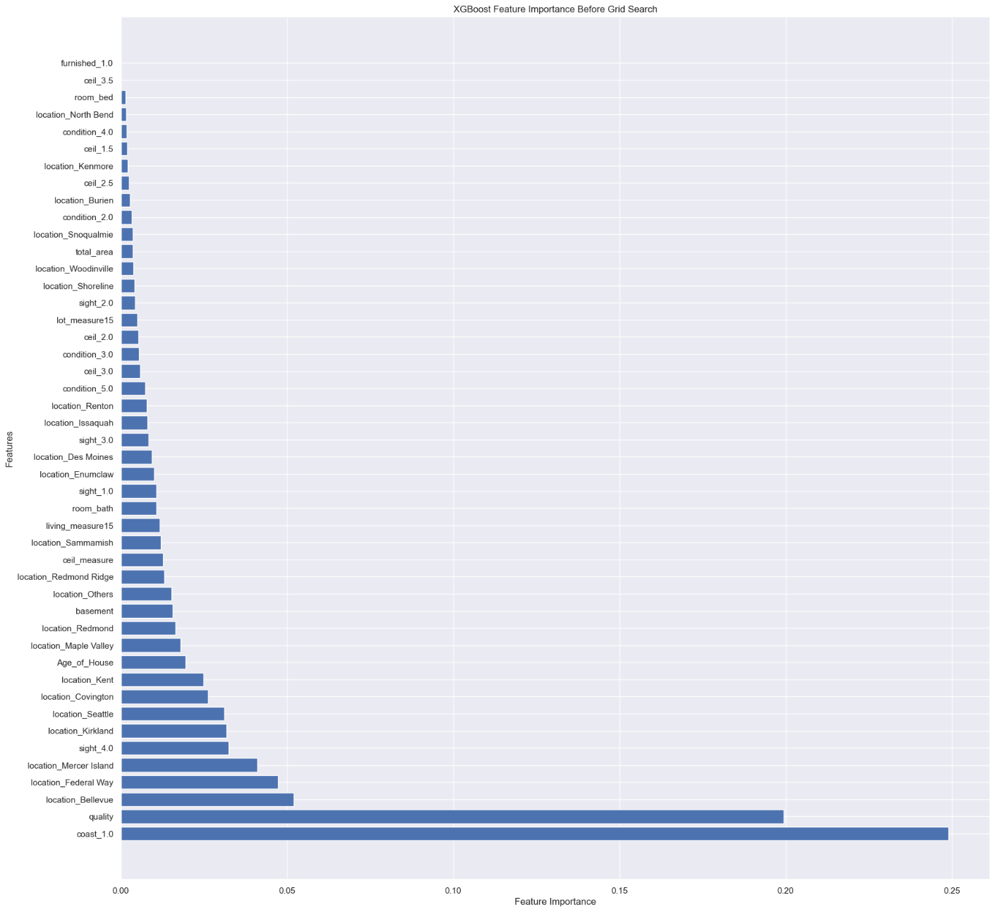
Feature Importance

Slide 30
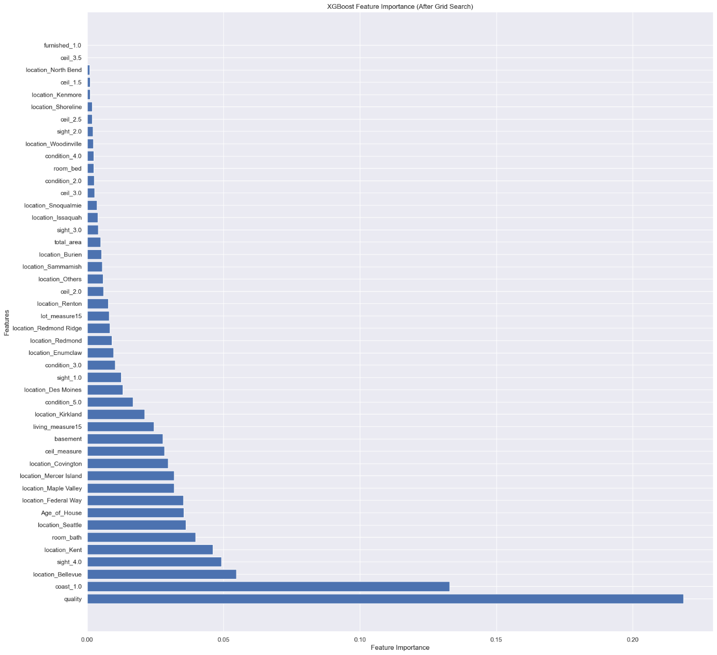
Feature Importance

Slide 31
Final Recommendations
Focus on Key Variables
Other coastal areas development required
Rooftop should be semi constructed
More features required
Price linking to low budget and prime location

