Slide 1

Predicting Cosmetic Product Discontinuation: Machine Learning Analysis of the CSCP Dataset
Sangeeth Kadem
Notes:
Line spacing + Page numbers

Slide 2
Agenda
01 Business Understanding and preparation
02 Data Understanding
03 Modeling and Evaluation
04 Recommendations
05 Conclusion and Next Steps

Slide 3
Business Context & Problem
01
The cosmetics industry faces growing pressure to ensure ingredient safety and transparency.
The California Safe Cosmetics Program (CSCP) dataset tracks cosmetic products sold in California – including each product’s brand, category, ingredients (chemical names and CAS numbers), and whether it has been discontinued.
Our goal is to use CSCP data to uncover why products are discontinued (safety/compliance issues) by identifying patterns linked to brand, category, or chemical composition.
Key business questions: Which product features drive discontinuation? Which brands or product categories have higher adjusted discontinuation risk? Which ingredients (chemicals/CAS IDs) are most associated with discontinued products.
Insights will help manufacturers, regulators, and consumers make data-driven safety decisions (proactive reformulation, targeted inspections, transparent labeling).

Slide 4
Objectives & Success Criteria
01
Build predictive models (Logistic Regression, Random Forest, XGBoost) to estimate each product’s likelihood of discontinuation.
1
Create a Brand & Category Safety Index that ranks brands/categories by their adjusted discontinuation risk.
2
Identify high-impact chemicals and CAS-level patterns that contribute to product removals.
3
Success criteria: Achieve very strong predictive accuracy (ROC-AUC ≈ 0.85, PR-AUC ≈ 0.85) while maintaining model interpretability via SHAP explanations.
4

Slide 5
CSCP Data Overview
02
Source: California Safe Cosmetics Program (CSCP) – a regulatory database of cosmetic products sold in CA.
Contents: Tens of thousands of product records with attributes: product name, brand, primary/sub-category, reported chemicals (names and CAS IDs), reporting dates (initial, most recent), and status (active/discontinued).
Derived Features:
  ChemicalCount – number of unique chemicals per product.
  ProductAgeDays and ReportLagDays – time-based features derived from dates.
  CAS-level metrics (log-scaled global frequency, brand-uniqueness, category-uniqueness of each CAS) and one-hot encoding for brand, category, chemicals.

Slide 6
Data Exploration & Cleaning
02
Class Imbalance: Only ~10–15% of products are labeled “discontinued,” requiring class-weighted modeling.
Feature Distributions: Product age and reporting lag are right-skewed; brand and category follow a long-tail (few brands dominate).
Preliminary Patterns: Discontinued products tend to have shorter lifespans and fewer distinct ingredients. This hinted at potential predictors for modeling.
Data Quality: Missing values were addressed (numeric fields imputed with medians; blanks in categorical fields set to “Unknown”). Duplicated product–chemical rows were removed and naming inconsistencies (brands/chemicals) standardized. Outliers in dates were corrected or excluded to ensure reliability.
Summary: After cleaning and feature engineering, the dataset was ready for modeling with balanced consideration of class imbalance and high-dimensional categorical features.

Slide 7
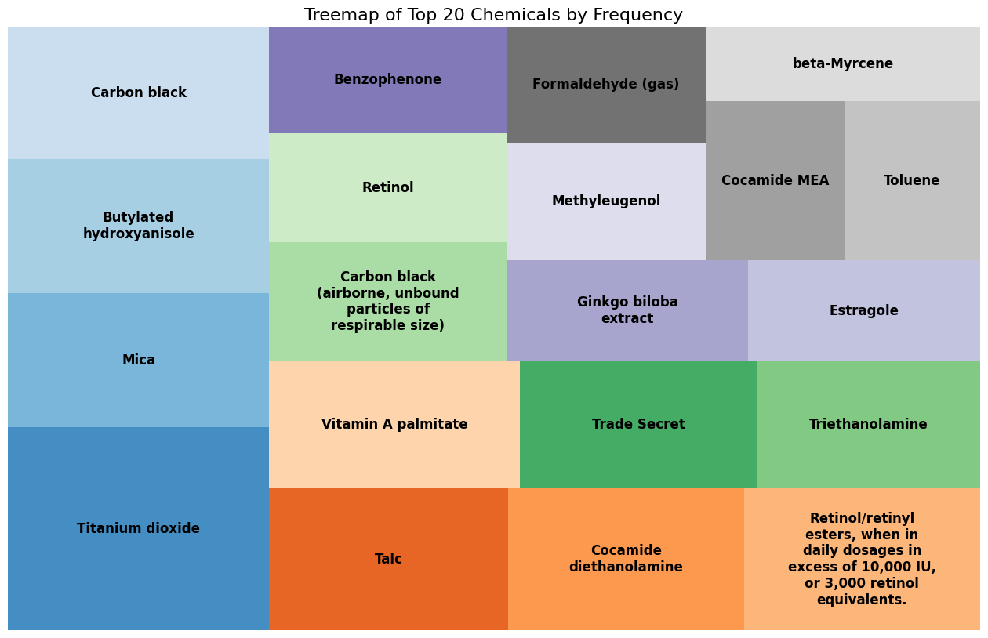
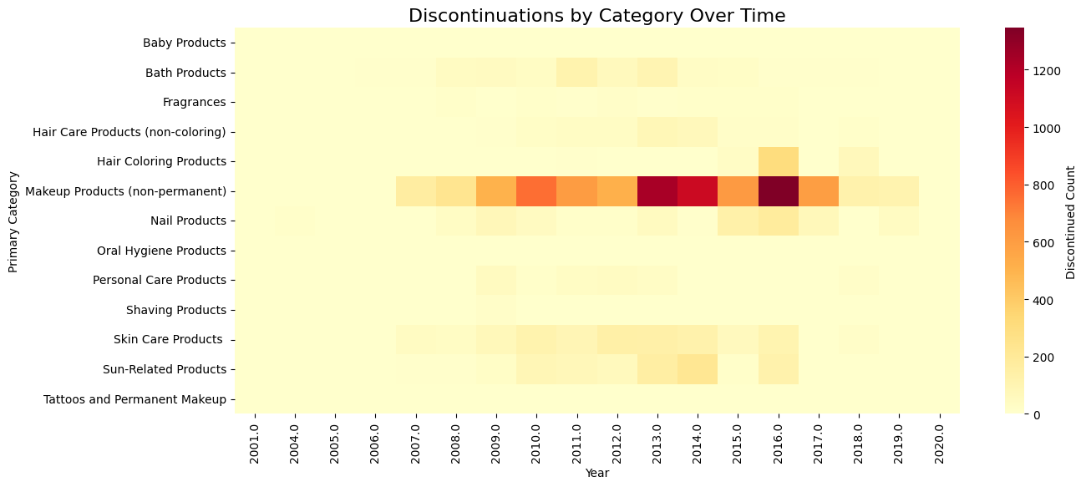
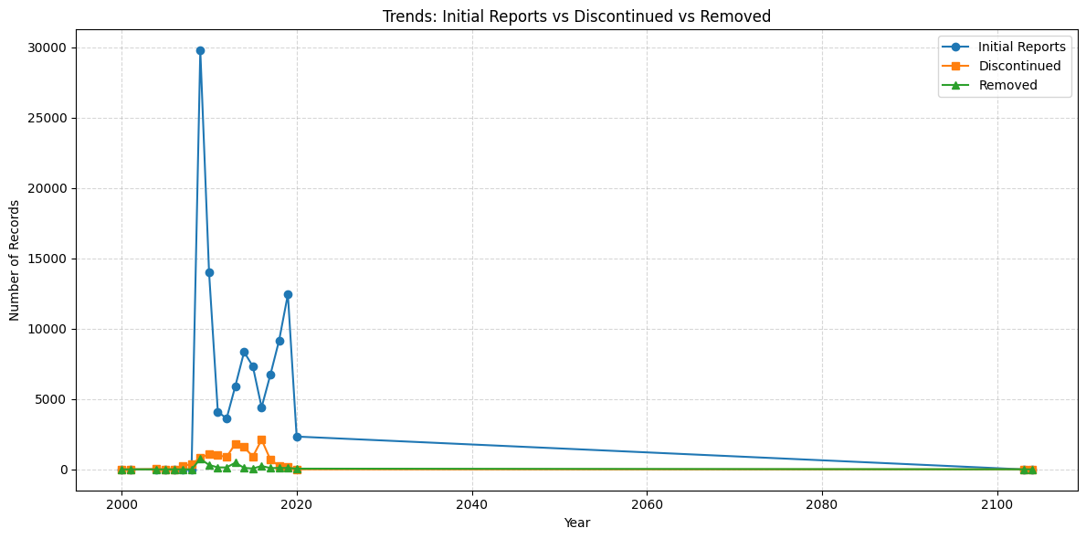

Slide 8
Modeling Approach
03
Models: We trained three models: Logistic Regression (interpretable baseline), Random Forest (robust non-linear ensemble), and XGBoost (gradient-boosted trees).
Preprocessing: All numeric features were scaled (MinMaxScaler); categorical features (brand, category, high-frequency chemicals) were one-hot encoded. After preprocessing, the feature matrix had 250+ columns (including chemical count and CAS metrics).
Training: Used an 80/20 stratified train/test split to preserve the active/discontinued ratio. Models were tuned via 3-fold cross-validation, optimizing Precision–Recall AUC (PR-AUC) due to the rare positive class. Logistic regression used L2 regularization and class weights; ensembles were tuned over n_estimators, depth, etc., for best F1/PR-AUC.
Interpretability: We applied SHAP (SHapley Additive exPlanations) to the Random Forest and XGBoost models to quantify each feature’s contribution to the discontinuation risk. This ensured the “why” behind predictions is accessible.

Slide 9
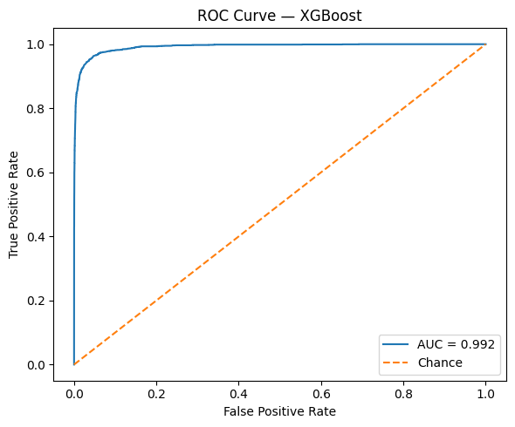
Model Performance
03
Random Forest: ROC-AUC ≈ 0.993, PR-AUC ≈ 0.963, F1 ≈ 0.907.
XGBoost: ROC-AUC ≈ 0.992, PR-AUC ≈ 0.959, F1 ≈ 0.898.
Logistic Regression: ROC-AUC ≈ 0.883, PR-AUC ≈ 0.415 (used as a baseline for comparison).
Both ensemble models achieved near-perfect discrimination on test data, far exceeding the baseline. This confirms product discontinuation is highly predictable from the features.
The models met the success criteria (AUC ~0.99), demonstrating strong predictive reliability. We selected XGBoost as the final model for further analysis due to its high accuracy and ability to be interpreted via SHAP.

Slide 10
Discontinuation Drivers
(Research Study I)
03
Key Findings: Products with shorter market lifespans and fewer ingredients had significantly higher predicted discontinuation risk. High CAS frequency (i.e. presence of very common chemicals) also increased risk.
These attributes had strong positive SHAP contributions in the model, suggesting formulas with ubiquitous or heavily-reported chemicals are more likely to be phased out.
Interpretation: This implies that popular chemicals (e.g. older or mass-used additives) and products quickly replaced in the market tend to be discontinued, possibly due to evolving safety/regulatory pressures.

Slide 11
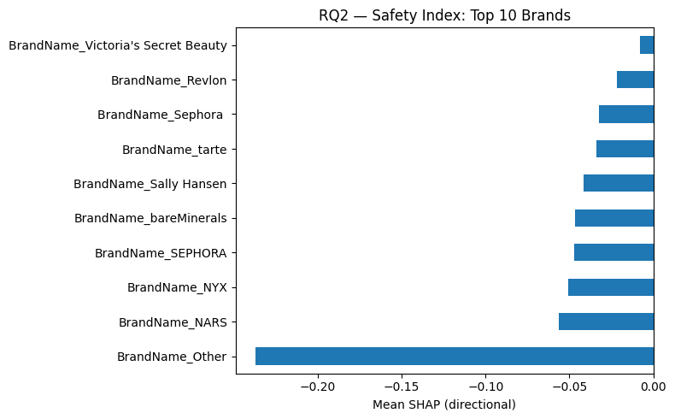
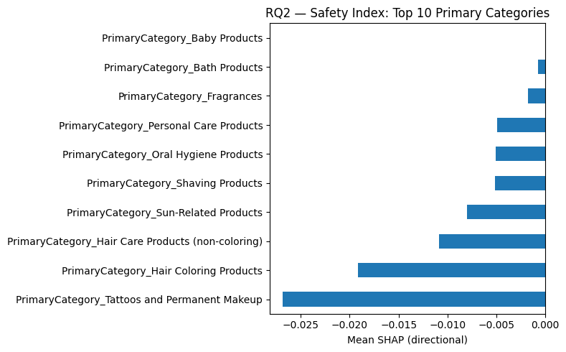
Brand & Category Safety Index
(Research Study II)
03
Approach: We aggregated SHAP values by brand and by product category to create a Safety Index of “adjusted risk”. This neutralizes raw discontinuation rates by controlling for chemistry/time factors.
Findings: Among categories, Makeup (non-permanent) and Nail products had the highest adjusted risk scores, while Skin Care and Baby products had the lowest.
Top Brands: Certain brands (e.g. Mastercuts, Regis Design Line, Careline) showed consistently elevated risk profiles, reflecting more complex or harder-to-formulate products.
Business Value: The Safety Index provides a quantitative benchmark for brand managers and regulators to monitor portfolio risk and compare across industry peers.

Slide 12
Brand & Category Safety Index
(Research Study II)
03
Approach: We aggregated SHAP values by brand and by product category to create a Safety Index of “adjusted risk”. This neutralizes raw discontinuation rates by controlling for chemistry/time factors.
Findings: Among categories, Makeup (non-permanent) and Nail products had the highest adjusted risk scores, while Skin Care and Baby products had the lowest.
Top Brands: Certain brands (e.g. Mastercuts, Regis Design Line, Careline) showed consistently elevated risk profiles, reflecting more complex or harder-to-formulate products.
Business Value: The Safety Index provides a quantitative benchmark for brand managers and regulators to monitor portfolio risk and compare across industry peers.

Slide 13
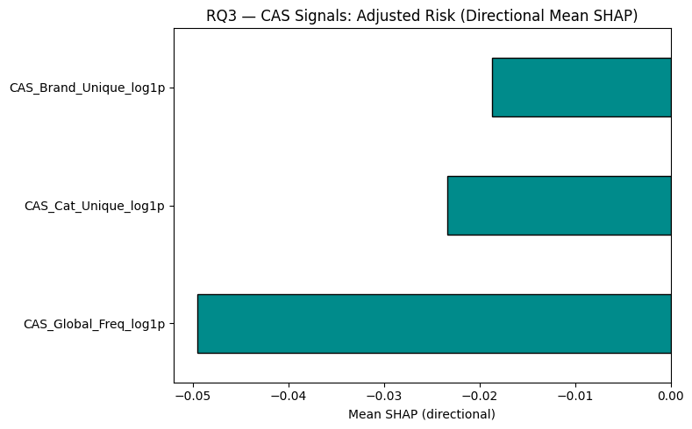
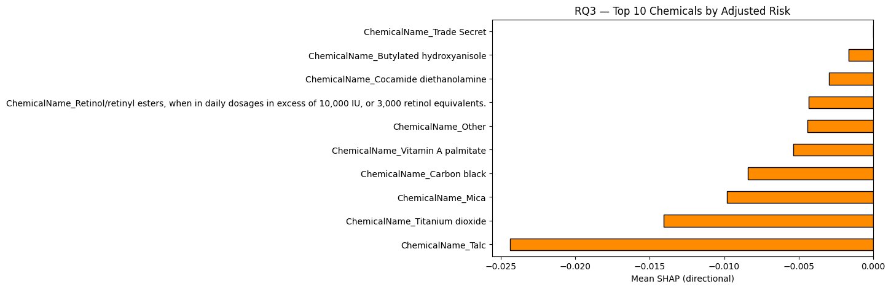
Chemical & CAS-Level Risk
(Research Study III)
03
Dominant Chemicals: SHAP feature importance highlighted a small set of chemicals that heavily drive discontinuation probability. The top contributors were Titanium Dioxide, Talc, Carbon Black, and Butylated Hydroxyanisole (BHA). These align with known toxicological/regulatory concerns.
CAS Features: Chemicals with high global usage frequency and those present across multiple brands or categories (high CAS_Global_Freq, CAS_Brand_Unique, etc.) tended to raise risk. In other words, widely-used or cross-brand chemicals are more prone to phase-out.
Implication: These insights allow stakeholders to flag specific ingredients for further safety review or reformulation.

Slide 14
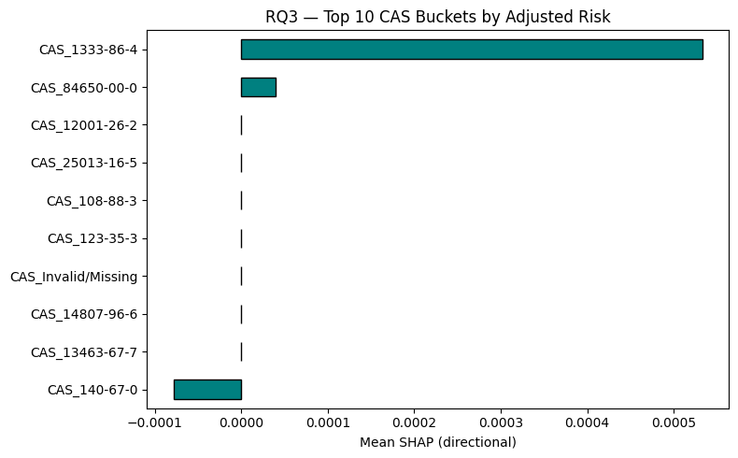
Model Interpretability (SHAP Insights)
03
Using SHAP analysis, we can decompose each model prediction into feature contributions (e.g. how much ChemicalCount, ProductAgeDays, or a particular ingredient drives the score).
This transparency turns the “black box” model into actionable information: for a flagged product, we can say exactly which ingredient or property is raising its discontinuation risk.
Such interpretability builds trust with stakeholders (e.g. regulatory auditors) and satisfies the project goal of clear, explainable results.

Slide 15
Stakeholder Recommendations
04
Manufacturers: Use the model as an early-warning system – flag products with high predicted risk and proactively reformulate to eliminate problematic ingredients. Incorporate the Safety Index into quality control to monitor emerging risks.
Regulators: Leverage the Brand & Category Safety Index to monitor market segments and prioritize inspections. Focus regulatory updates on ingredient classes repeatedly linked to discontinuation in the model.
Brand Managers: Benchmark product portfolios using the Safety Index and track risk trends over time. Use these insights for strategic planning (e.g. align R&D with safety trends). Consumers & Public Health: Publicize the model’s findings on high-risk ingredients and categories to increase transparency. Encourage “clean-beauty” innovation by highlighting which ingredients raise safety concerns.
Ongoing Analytics: Deploy the XGBoost model in a batch pipeline that is retrained periodically. Update dashboards (brand/category/chemical risk) with each new CSCP release to enable continuous monitoring (see Deployment plan).

Slide 16
Conclusion
05
This project successfully built an accurate, interpretable ML framework for predicting cosmetic product discontinuation (achieving ROC-AUC ≈ 0.99).
Deliverables include the Brand & Category Safety Index and a Chemical Risk ranking, which together pinpoint products and ingredients of concern.
These tools provide manufacturers, regulators, and consumers with actionable intelligence to improve product safety, compliance, and transparency.
In essence, we have turned regulatory data into a data-driven foundation for a safer, more responsible cosmetics industry.

Slide 17
Next Steps
05
  Enhance Data: Incorporate external data (e.g. toxicology databases, sales/market trends, recall information) to refine predictions and contextualize discontinuation reasons.
  Extend Safety Index: Build an interactive dashboard that updates the Brand & Category Safety Index with each CSCP data release, enabling real-time monitoring of industry trends.
  Advanced Modeling: Experiment with time-series or survival models to predict when discontinuations may occur and to distinguish between safety vs. commercial reasons. Test the model on other states or countries’ datasets to validate generalizability.
  Transparency & Governance: Formalize the SHAP explanations into an audit trail for compliance. Document all modeling steps for reproducibility and include explainability audits in the regulatory process.

Slide 18
Any Questions?

