Slide 1


TELCO CUSTOMER CHURN PREDICITION AND CLASSIFICATION ANALYSIS IN SAS EM
RESEARCH PROJECT
Sangeeth Kadem

Slide 2
EXECUTIVE SUMMARY
The Telco Customer Churn dataset offers an organized overview of telecommunication customer data, including factors such as customer demographics, duration of account, services used, contract information, and billing details.
This project was aimed at identifying and analyzing patterns in customer behavior, preferences etc. that will determine the likelihood of a customer to leave from the telecom industry.
We explored various classification models that include Logistic regression, three types of decision trees, random forest, and neural network models in determining which factor best determines the reasons behind customer churn.
Key findings revealed that customers on a monthly contract agreements, low satisfaction levels, customers lacking online security and premium technical support are more prone to churn risk.
The best model with a misclassification rate of 0.029 is Auto neural networks which accurately identified the customers who were at risk from leaving the company and satisfied non churners.
These findings were really important to drive specific retention strategies and programs. There would be a more focused approach towards improving customer satisfaction, offering additional value-added services and maintain loyalty among customers.

Slide 3
PROJECT MOTIVATION
The following project has been selected to address one of the very important challenges in the field of telecommunication: customer churn. Customer churn is described as the rate at which customers are leaving the service and therefore directly influences revenue and longer-term growth. Quite often, for telecommunication companies, retaining a customer may be less costly than attracting a new one, and the drivers that cause people to churn may lead to insightful ideas that could reduce churning rates.
In the case study, predictive models will be built in SAS Enterprise Miner on the factors leading to churn so proactive strategies can retain the customers who are at greater risk of leaving. The developed models will enable telecom companies to predict which customers will leave, hence targeted interventions like personalized marketing, improved service offering, or contract adjustments may be considered to retain them.
The project, on one end, depicts how to work with data science within a business environment, but also underlines a very important aspect: customer-oriented approach towards sustainable growth. Effective churn prediction particularly allows telecommunications companies to boost customer loyalty, decrease lost revenues, and strengthen their advantage over the competitors.

Slide 4
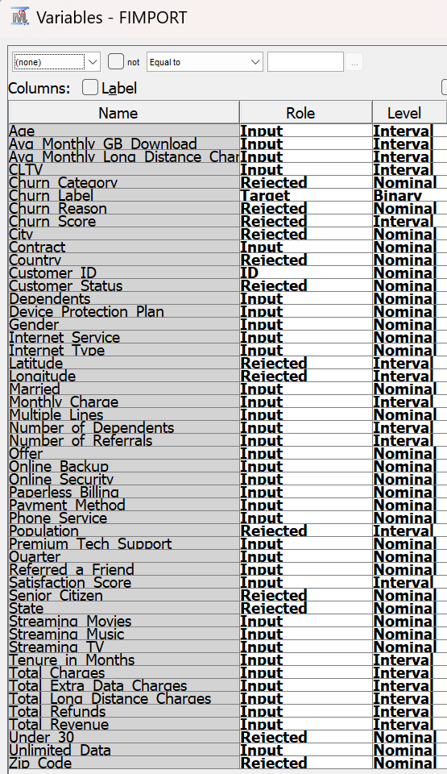
DATA DESCRIPTION
The dataset is a secondary dataset that has been collected from Kaggle.
Source: https://www.kaggle.com/datasets/alfathterry/telco-customer-churn-11-1-3
The Telco dataset consists of 7043 observations and 50 columns. The Telco customer churn data contains information about a fictional telco company that provides home phone and Internet services.
The Telco Customer Churn dataset provides valuable information to help us understand and predict why customers may leave a telecommunications provider. This dataset includes demographic details such as gender, age, and family status, along with details about their service usage, such as internet and phone services, contract type, payment method, and charges. The focus is on the target variable "Churn," which indicates if a customer has canceled their service.
By analyzing these features, we can identify patterns and key factors driving customer churn, enabling telecom companies to enhance customer retention strategies.
The dataset contains different variables as shown:
We have imported data using file import node and edited the variables according to their roles and levels.

Slide 5
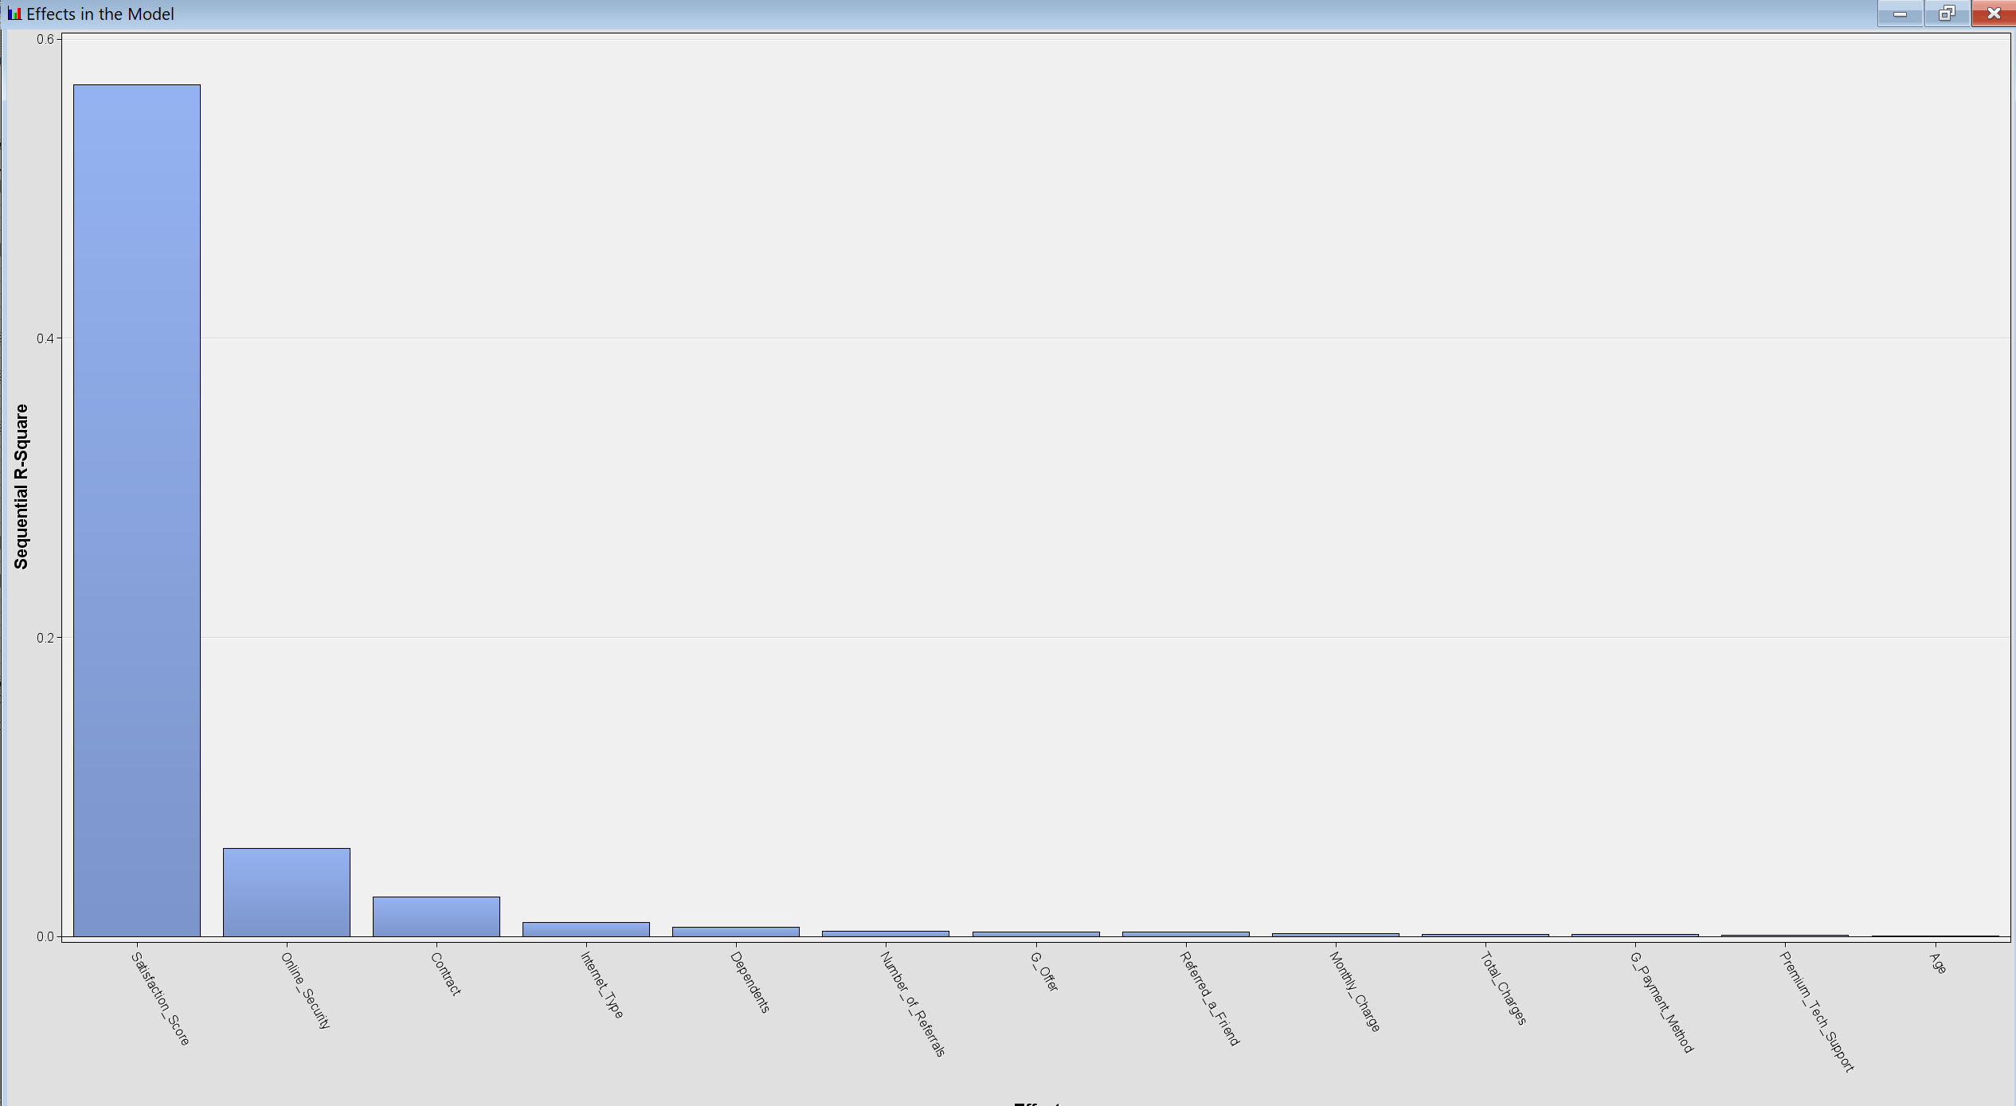
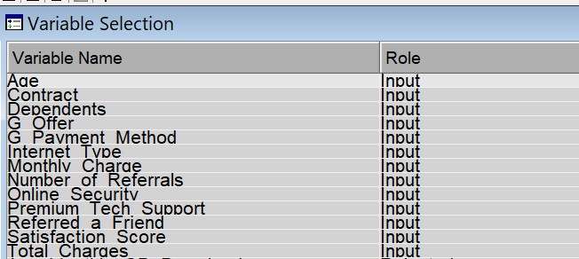
DATA PREPARATION
We have removed a few variables such as Churn Category, Churn Reason, Churn Score, Customer Status because they may reveal about the target variable Churn label directly. Including these variables could potentially cause information leakage.
Some variables in the dataset like City, Country, Population, State, under 30, Longitude, Latitude, Senior citizen were removed because they do not provide any meaning full insights in predicting whether a customer might leave or not.
There were no missing values in our class variables or interval variables.
Skewness of most of the variables were appropriate except for total extra data charges and total refunds which had a skewness of above 4.00. We wanted to check if these variables were important for our model building after variable selection and then perform any transformations.
After variable selection, only a few variables with more sequential R square with the target variable churn were selected. These variables were having the right skewness ranges, so we did not have to transform any variables, but we used a transform for logistic regression to standardize the selected variables.
In terms of outlier analysis, there were no outliers that had a huge difference which would impact the model.
DATA PARTITION
We have used the data partition node to divide the dataset 80% for train and 20% for validation.

Slide 6
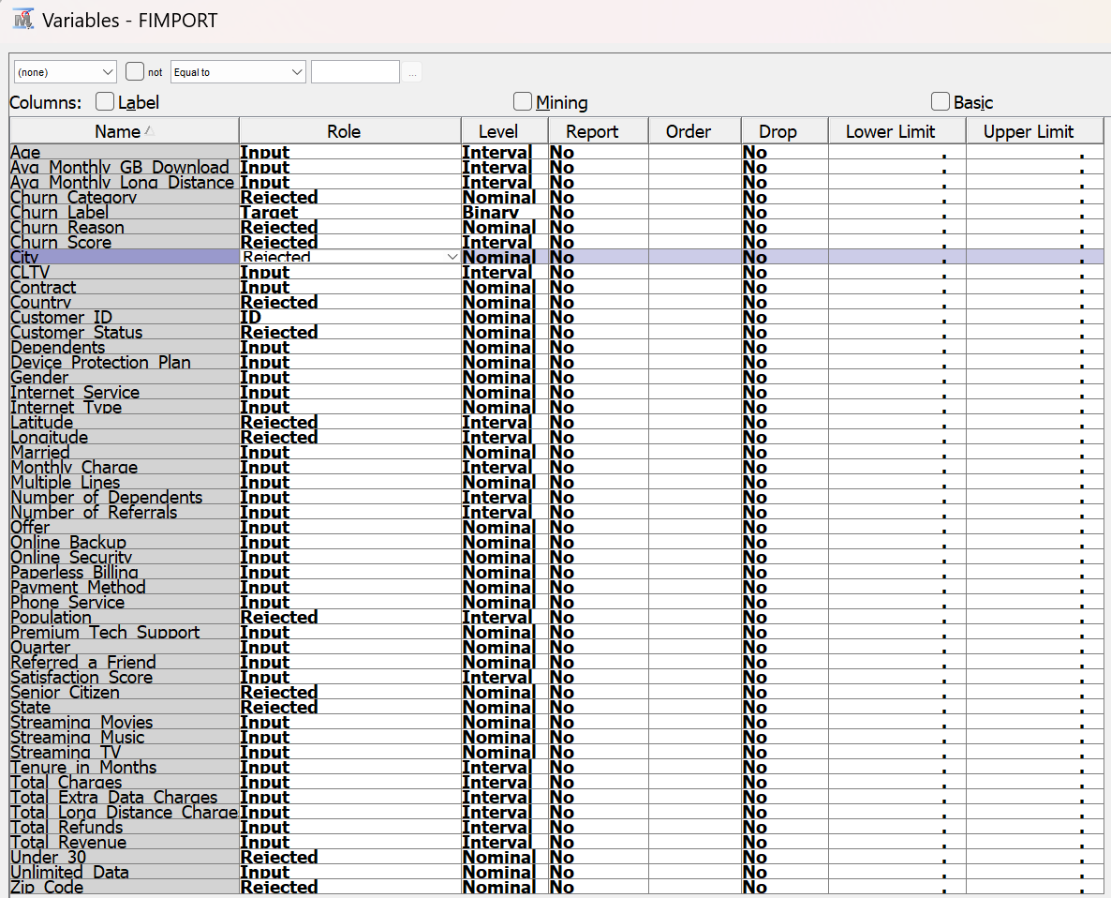
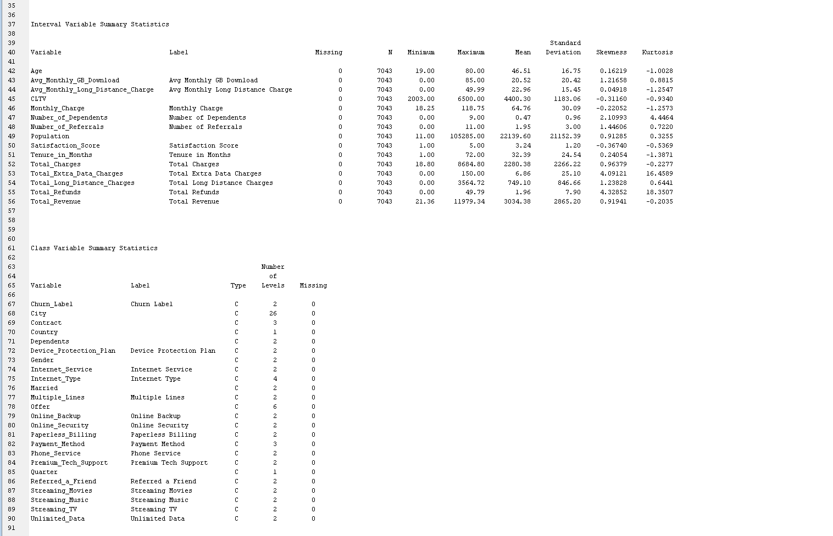
INITIAL VARIABLE EDITING
NO MISSING VALUES

Slide 7
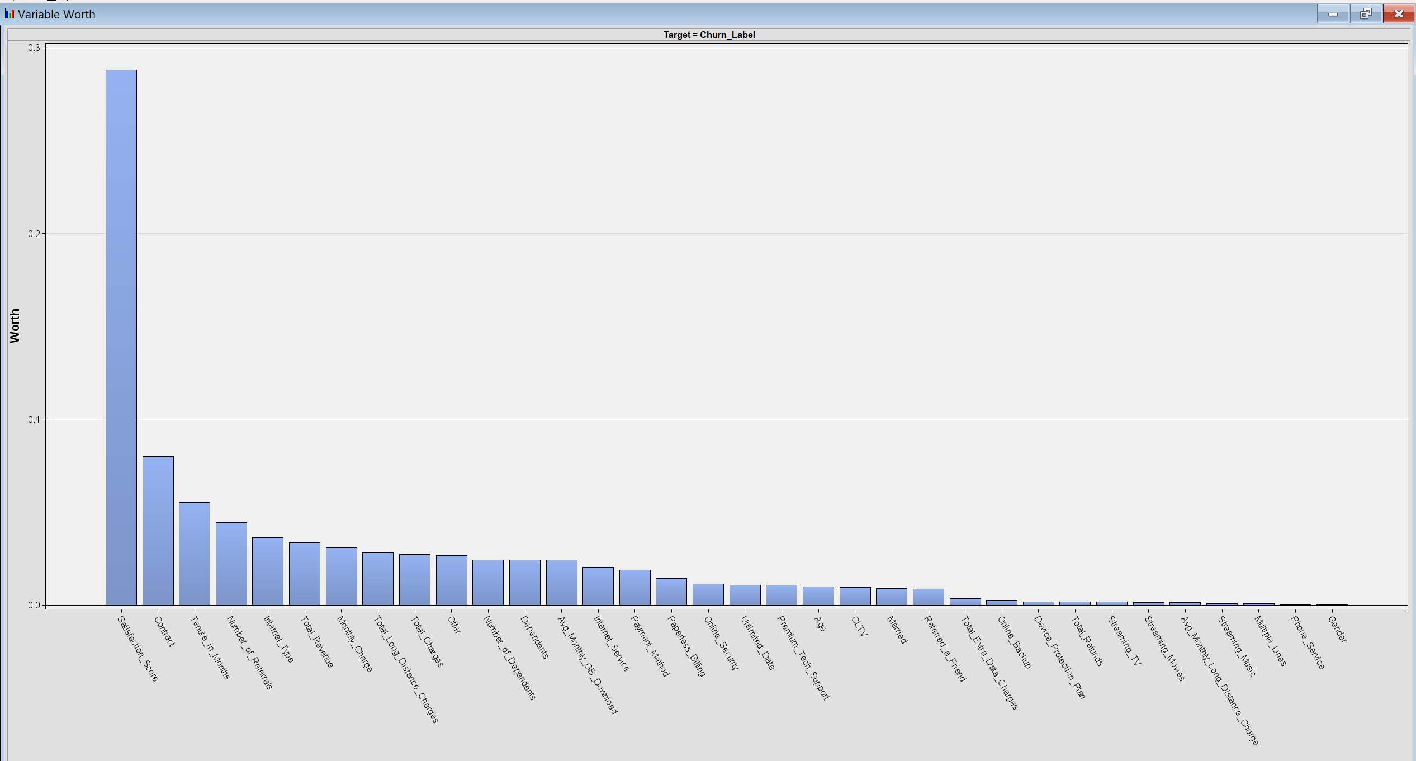
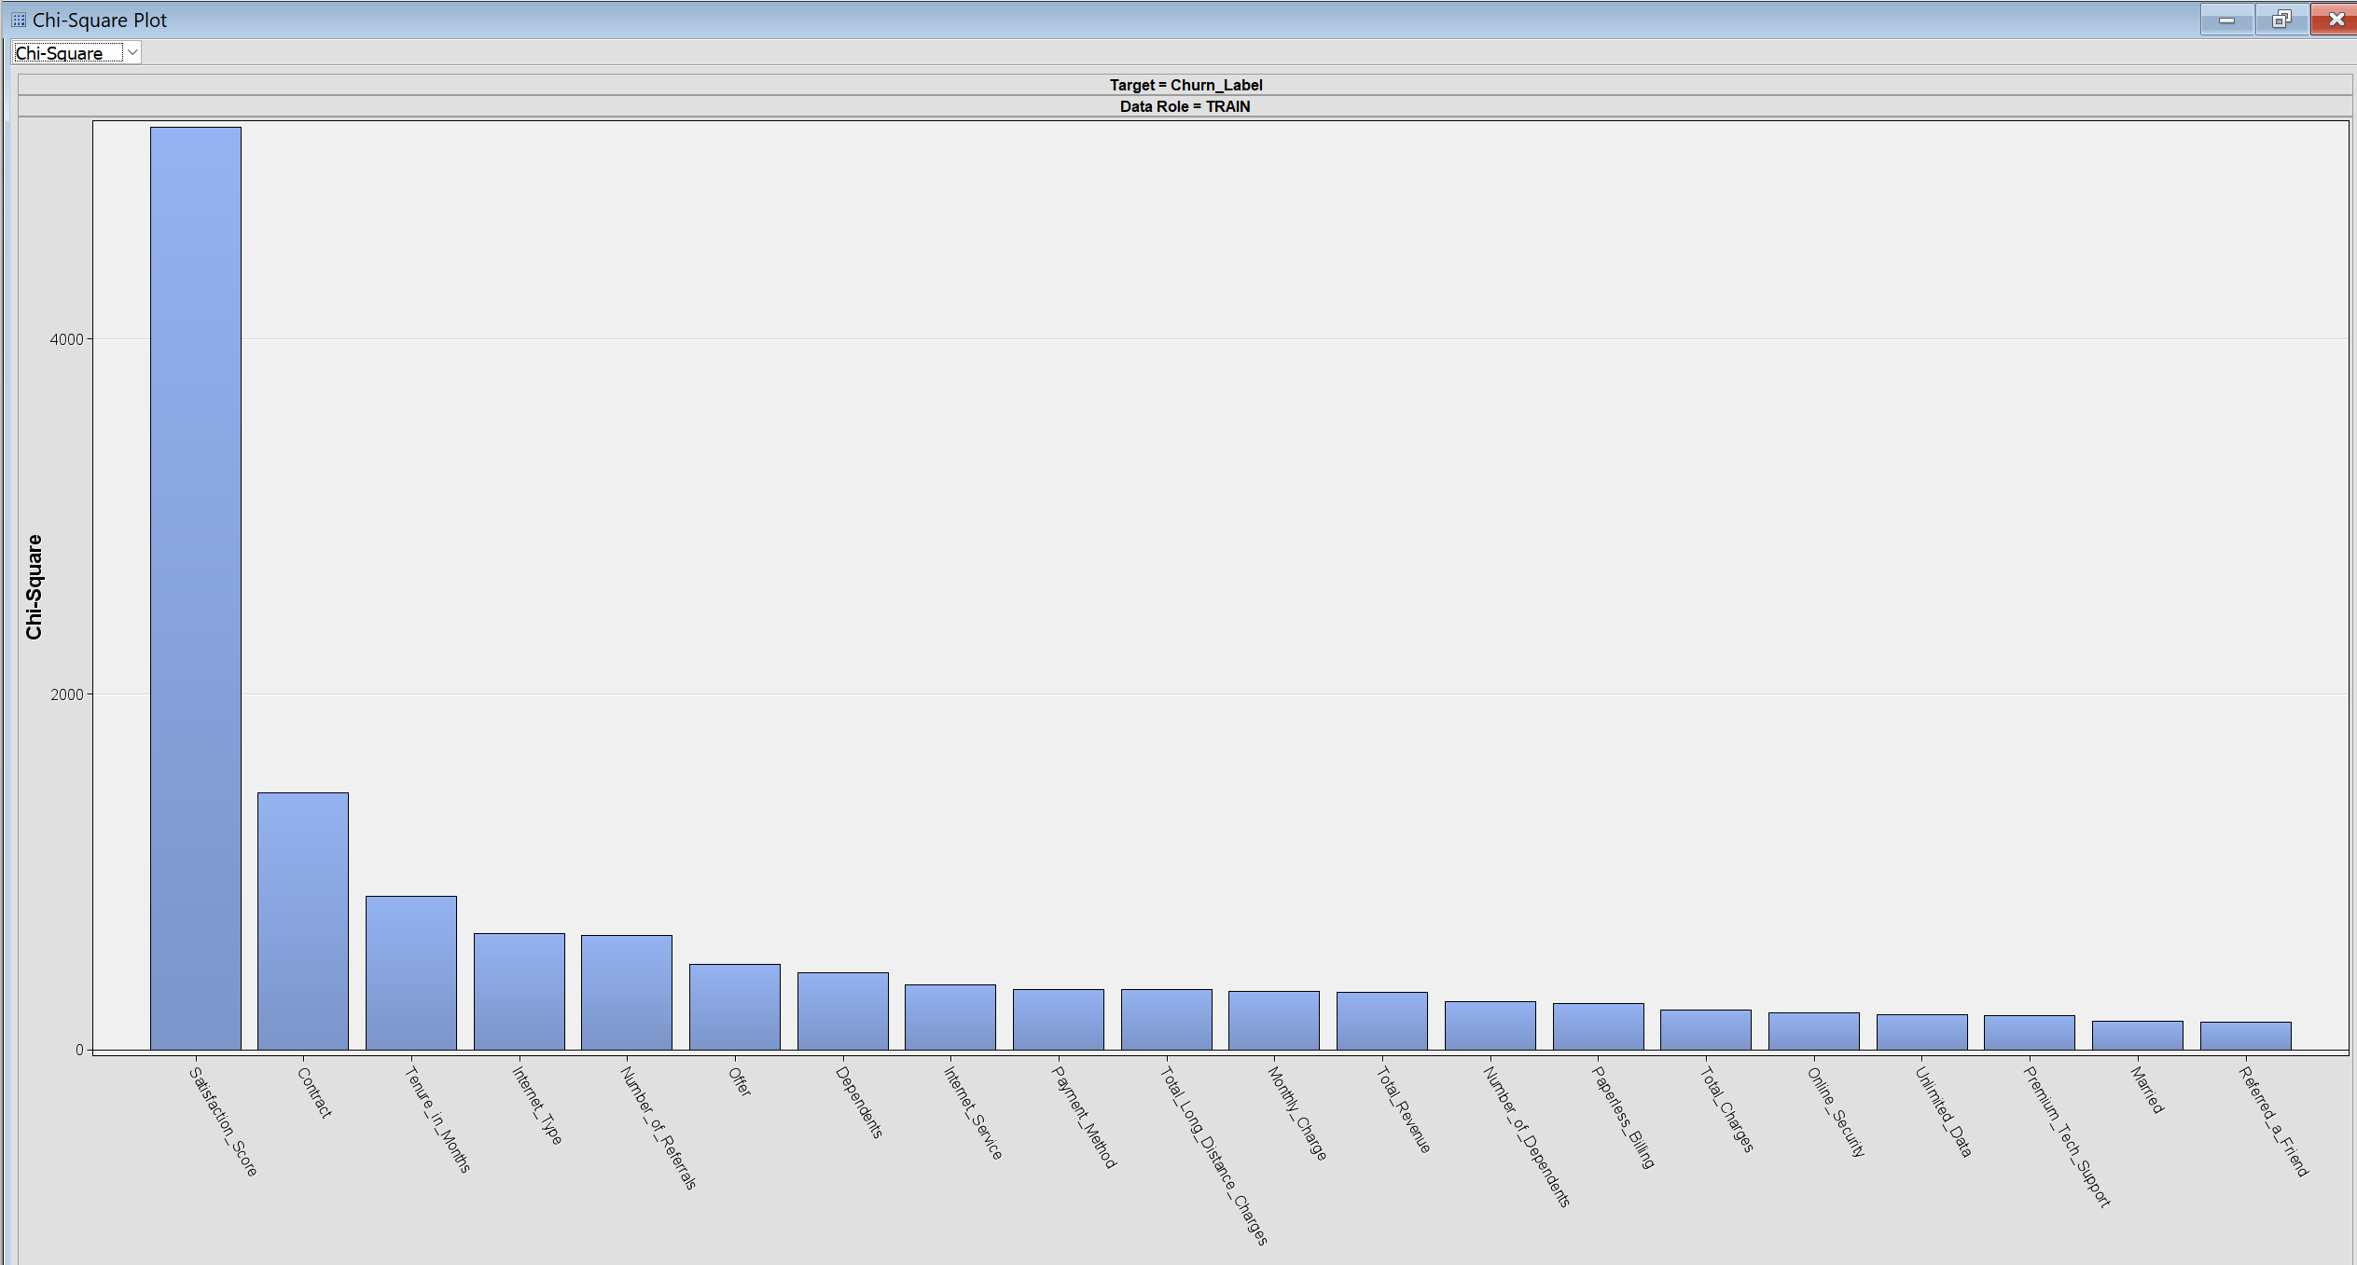
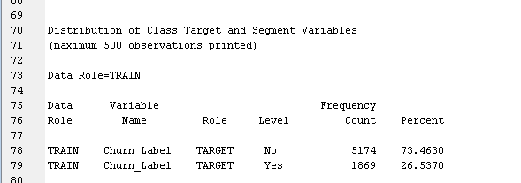
DATA EXPLORATION
VARIABLE WORTH PLOT
We have initially explored the dataset using the DMDB node, which provides us the summary statistics of the input interval variables and class variables.
We have used the StatExplore node to explore the dataset using plots such as Chi-square, Cramer’s V, and understand the summary statistics.
VARIABLE WORTH PLOT
According to the variable worth plot, the three most significant variables in predicting churn were satisfaction score, contract, tenure in months.
CHI-SQAURE PLOT
The chi-square plot shows us the most strongly variables associated with churn. They are Satisfaction score, followed by contract, tenure in months and internet type.
DISTRIBUTION OF TARGET VARIABLE
According to the data, 26.54% of clients leave the company, while 73.46% remain. Given that more than 25% of customers are at risk of leaving, this churn rate causes a serious risk to profitability. The company can increase customer loyalty and customer retention by implementing strategies for retention by precisely identifying and targeting these at-risk consumers.
CHI SQUARE PLOT

Slide 8
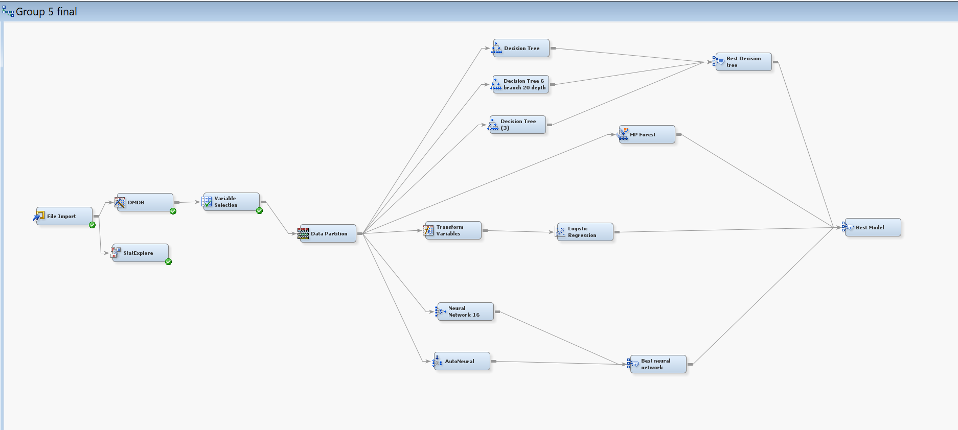
MODELS USED – CLASSIFICATION ANALYSIS
Target Variable: Churn Label
A few types of models were developed and evaluated based on misclassification rates to identify the model that could provide class labels with the lowest possible error.
We have built the following models:
Logistic Regression
Decision Trees- Three type of Decision Trees were built using different maximum branches and maximum depth
HP FOREST (RANDOM FOREST)
Neural Networks- Both Auto-neural network and neural network with 16 hidden units

Slide 9
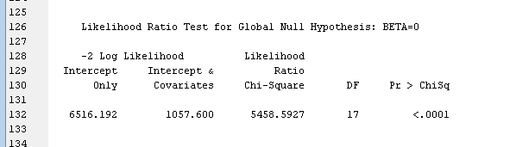
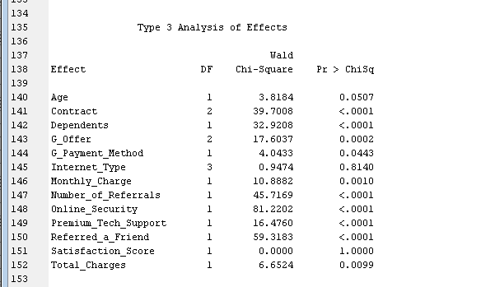
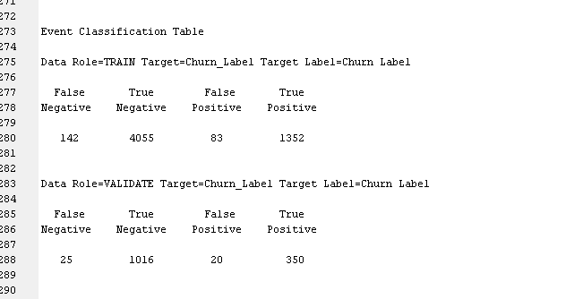
LOGISTIC REGRESSION
According to the Logistic Regression output –
-The model is statistically significant with a low p-value.
The significant predictors of churn are Contract, Number of referrals, premium tech support, and referred a friend, all of them having p-values less than 0.0001. On the other hand, Age (p = 0.0507) and Internet Type (p=0.08140).
According to the event classification table, this model correctly identified 4055 True negatives, and 1352 True positives in the training dataset with 83 false positives and 142 false negatives. In the validation dataset, the model achieved similar accuracy with 1016 True negatives and 350 True positives with 25 False negatives and 20 False positives. These low rates of the model indicate strong predictive accuracy.
MODEL SIGNIFICANCE
TOP SIGNIFICANT PREDICTORS
CONFUSION MATRIX

Slide 10
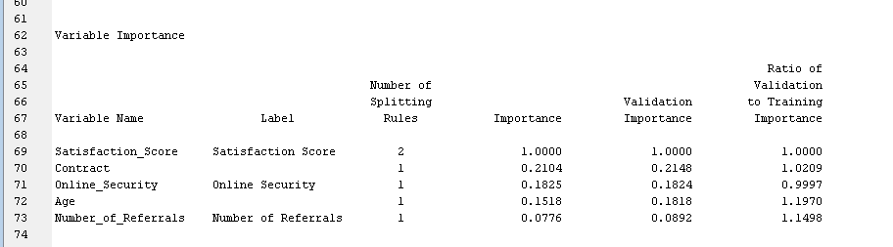
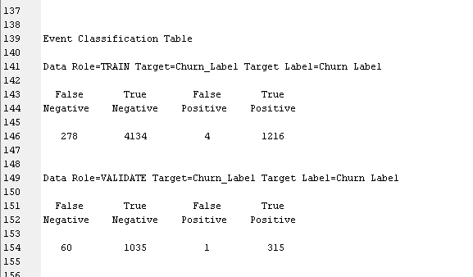
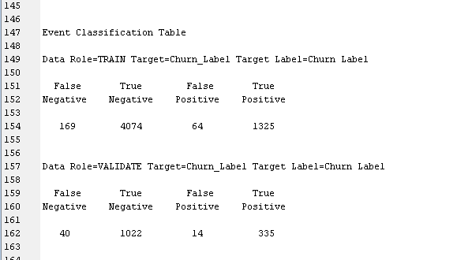
DECISION TREES
Three types of Decision tree models were built.
Basic Decision Tree – 2 maximum branches and 6 maximum depth
According to the Decision tree, the key variables that influence churn are Satisfaction score, being the most critical factor with an importance of 1.000, contract and online security with second and third places, respectively. This indicates that customers who are dissatisfied with the services, with month-month contract type are more likely to leave.
The model predicted true negatives 4,134 and true positives 1,216 indicate high accuracy, with minimal false positives 4 and false negatives 278 in the training dataset. Similarly, the validation set maintains accuracy, with 1,035 true negatives, 315 true positives, and only one false positive and 60 false negatives.
Decision Tree - 6 maximum branches and 20 maximum depth
VARIABLE IMPORTANCE
The event classification table indicates that the model is performing well in distinguishing churn from non-churn cases. In the training set, there are 4,074 true negatives and 1,325 true positives, with 64 false positives and 169 false negatives. For the validation set, there are 1,022 true negatives and 335 true positives, with only 14 false positives and 40 false negatives.
CONFUSION MATRIX OF DECISION TREE 1- 2&6
CONFUSION MATRIX FOR DECISION TREE- 6&20

Slide 11
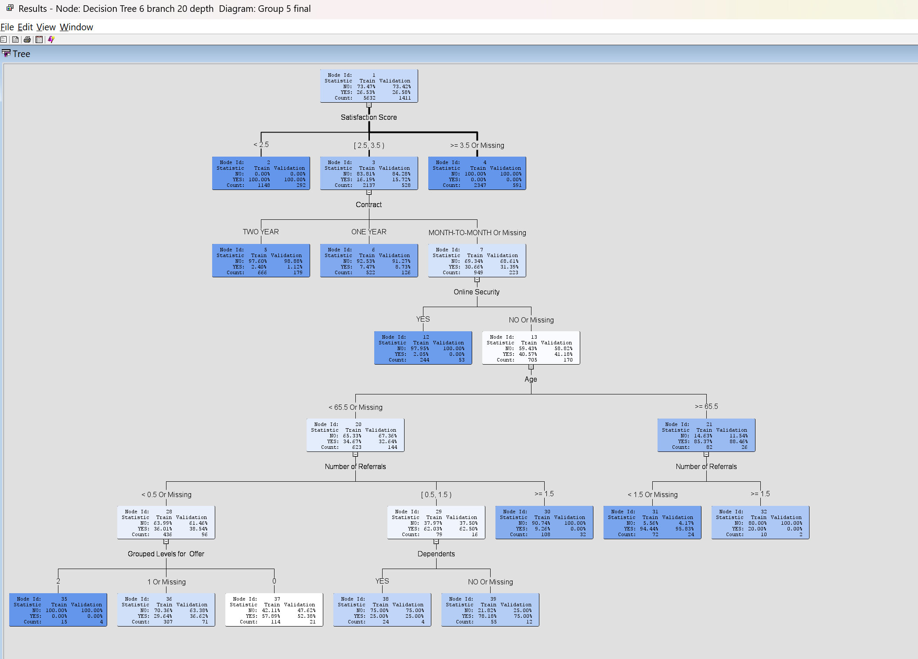
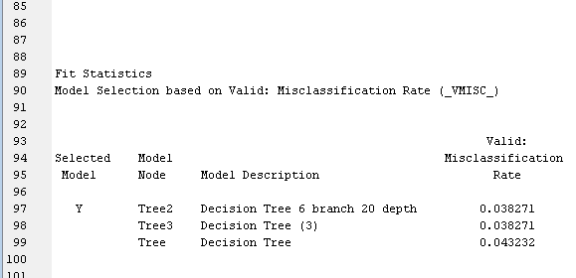
DECISION TREE - CONTINUED
DECISION TREE- 10 maximum branches and 25 maximum depth
The model with 10 maximum branches and 25 maximum depth did not yield any different prediction from the previous model as it predicted the same confusion matrix.
We have compared the Three decision tree models using a model comparison node. Decision Tree- 6 maximum branches and 20 Depth was an optimal decision tree model with a lowest misclassification rate of 0.0387.
TREE DIAGRAM OF DECISION TREE 6 BRANCHES AND 20 DEPTH
MODEL COMPARISON OF DECISION TREES

Slide 12
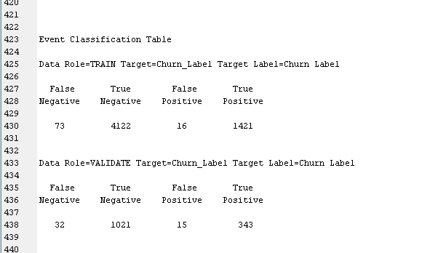
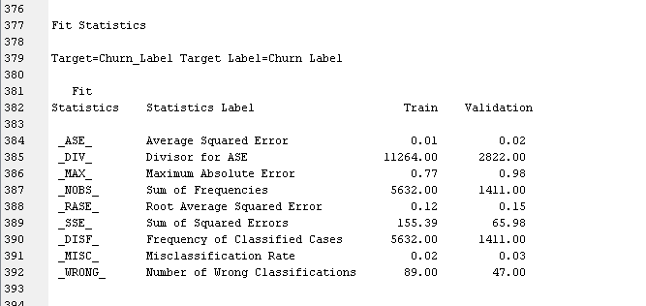
HP FOREST (RANDOM FOREST)
CONFUSION MATRIX
The random forest model had 100 number of trees.
The model accurately predicted 4122 cases of non-churn, and 1421 cases of churn. 16 false positives and 73 false negatives in the training dataset.
In the validation dataset, the model accurately predicted 1021 no churn cases, and 343 churn cases. 15 false positives and 32 false negatives were predicted by this model in the validation set.
The model had a misclassification rate of 0.03 in the validation set.
FIT STATISTICS

Slide 13
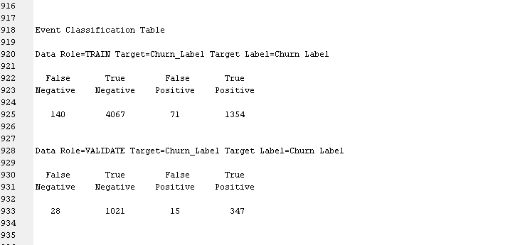

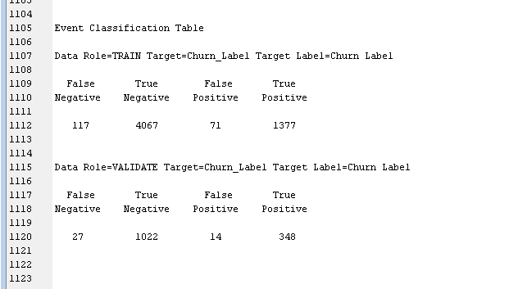
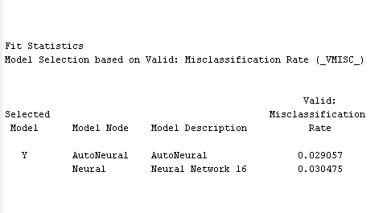
NEURAL NETWORKS
NEURAL NETWORKS WITH 16 HIDDEN UNITS
The neural network model with 16 hidden units effectively classified churners and non churners. In the training set, it achieves high accuracy, with 4,067 true negatives and 1,354 true positives, alongside low misclassification 71 false positives and 140 false negatives. In the validation set, model achieves 1,021 true negatives and 347 true positives, with only 15 false positives and 28 false negatives.
AUTO NEURAL NETWORK (ANN)
The Auto neural network model was built with maximum 20 iterations and 3 hidden units (default properties).
The model was able to classify 4067 no churn cases and 1377 churn cases correctly, with 71 false positives and 117 false negatives in the training dataset.
In the validation dataset, the model accurately predicted 1022 no churn cases and 348 churn cases with 14 false positives and 27 false negatives.
MODEL COMAPIRSON OF NEURAL NETWORKS
We have compared the two neural networks using a model comparison node. Auto-neural was the optimal neural network model with a low misclassification rate of 0.029.
CONFUSION MATRIX FOR NEURAL NETWORK
CONFUSION MATRIX OF ANN
MODEL COMPARISON OF NEURAL NETWORKS

Slide 14
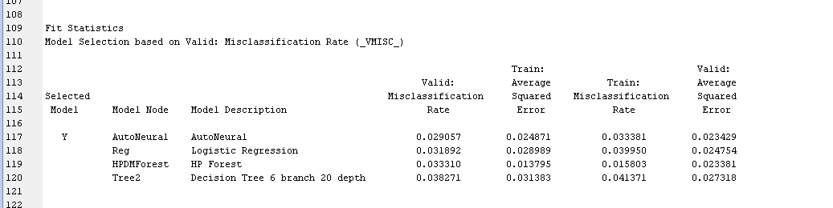
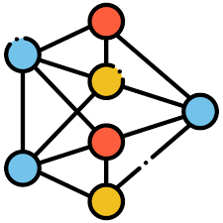

OVERALL MODEL COMAPIRSON
Overall, in this project, we have developed multiple models like logistic regression, decision trees, random forest, neural networks to predict the customer churn. We have compared all these models using a model comparison node and the output of the model comparison node shows that Auto neural network effectively achieved the best model performance with a misclassification rate of 0.029 on the validation set, followed by the logistic regression model with 0.031 misclassification rate.

Slide 15
FINDINGS
LOGISTIC REGRESSION
Type of Contract: Month-to-month customers are six times more likely to churn as compared to two-year customers, so the inference is that length of contract bears much influence on churn likeliness.
Referral Influence: Customers who have referred a friend show lower churn rates, highlighting the positive effect of engagement and referral programs.
Premium Technical Support: In the absence of premium technical support, a greater rate of customers could churn, which indicates for this service to be highly considered in customer retention.
DECISION TREE AND RANDOM FOREST
Satisfaction score: The customers who have less than a 2.5 satisfaction score are 100% churn, hence proving that dissatisfaction with the service is one of the key predictors for customer churning. Solving problems of less satisfied customers can really make a huge difference in improving retention.
Age Factor: Younger customers, less than 65.5, tend to churn less than older customers. Thus, target retention efforts toward younger segments will make them stay longer.
NEURAL NETWORKS
Online security – Online Security: It is likely that customers without online security would churn, and this means that online security service should be promoted as a valuable feature to customers.
Dependents: Customers that have dependents have a lower rate of churning, such as 25% for customers who have 1-1.5 referrals and dependents, which could mean that family-oriented offerings or services retain customers.

Slide 16

MANAGERIAL OR BUSINESS RECOMMENDATIONS
Focus on converting customers who are on monthly basis contract to one-year contract agreements, by offering incentives, discounts, free months or any added benefits program, which will improve customer retention
Analyzing customer behavior is hard as it is influenced by different life stages. Implementing better demographic driven strategies that target those individuals without any dependents by creating personalized offers might help reduce these customers to leave the company.
Promotions to reduce churn must be continuous, developing segmented promotions that target specific group of people with like mindset, especially for loyal customers, would make them feel valued and reduce churn.
Offering bundle services or using loyalty programs might also improve customer satisfaction which indirectly reduces customer churn.
Since early dissatisfaction can be a major reason for churn, creating strong onboarding experience with potential customers and following them up from time to time on their feedback would reduce churn and keep these individuals highly satisfied.
Customers place an extensive interest towards security or premium supports from any company. Offering these customers with a baseline or basic plan of these securities and technical support would make these customers valuable as they might tend to stay loyal to the company that provides the necessities.

Slide 17

CONCLUSION
In this project, we explored different models that can effectively predict if a customer might leave or not. We have identified the factors that significantly influenced and determined customer churn. We have applied different classification models to observe which factors contributed towards customer churn the most and what variables are impacting them to leave.
Our best model is Auto-neural networks, that achieved the lowest misclassification rate of 0.029, which assures that customer who are at risk of leaving the company would be easily identified in the beginning and preventative measures would be taken to increase customer retention.

