Slide 1
JSX
Sonal Karle

Slide 2
What is JSX?
JSX stands for JavaScript XML
It is simply a syntax extension of JavaScript.
It allows us to directly write HTML in React (within JavaScript code).

Slide 3
Can we used React without JSX ?
JSX is not a requirement for using React
But, JSX allows us to write HTML elements in JavaScript and place them in the DOM without any createElement() and/or appendChild() methods. JSX converts HTML tags into react elements. You are not required to use JSX, but JSX makes it easier to write React applications.
createElement() method creates the HTML element specified by tagName, or an HTMLUnknownElement if tagName isn't recognized.
appendChild() method of the Node interface adds a node to the end of the list of children of a specified parent node.

Slide 4
What is Advantages of JSX then JS?
JSX helps for code simpler and Attractive when writing large pieces of code for big React Application
According to the React DOCS, most people find JSX helpful as visual help when working with UI inside
JSX also allows React to Show more useful error and warning messages
JSX is Faster compare normal JavaScript code

Slide 5
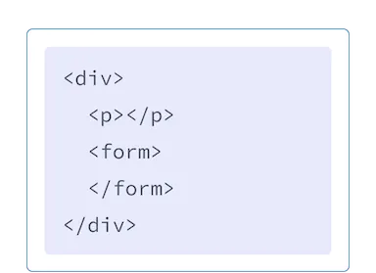
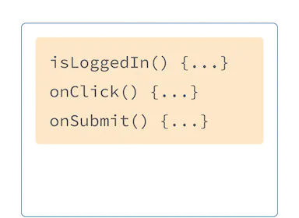
Writing Markup with JSX
The Web has been built on HTML, CSS, and JavaScript. For many years, web developers kept content in HTML, design in CSS, and logic in JavaScript—often in separate files! Content was marked up inside HTML while the page’s logic lived separately in JavaScript

Slide 6
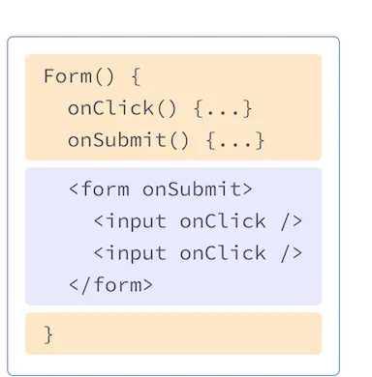
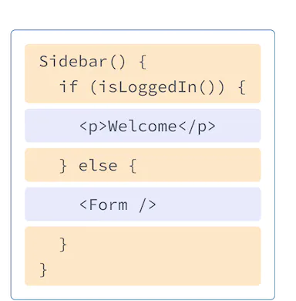
But as the Web became more interactive, logic increasingly determined content. JavaScript was in charge of the HTML! This is why in React, rendering logic and markup live together in the same place—components.
React components use a syntax extension called JSX to represent that markup. JSX looks a lot like HTML, but it is a bit stricter and can display dynamic information

Slide 7
Basic Event in JSX
Event | Description
onchange | An HTML element has been changed
onclick | The user clicks an HTML element
onmouseover | The user moves the mouse over an HTML element
onmouseout | The user moves the mouse away from an HTML element
onkeydown | The user pushes a keyboard key
onload | The browser has finished loading the page

Slide 8
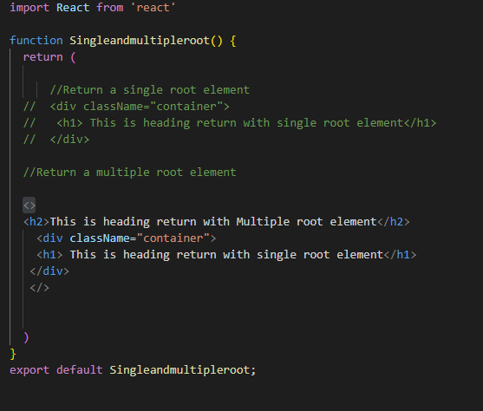
Converting HTML to JSX 3 Rule
Return a single root element
To return multiple elements from a component, wrap them with a single parent tag.
If you don’t want to add an extra <div> to your markup, you can write <> and </> instead:
This empty tag is called a Fragment.

Slide 9
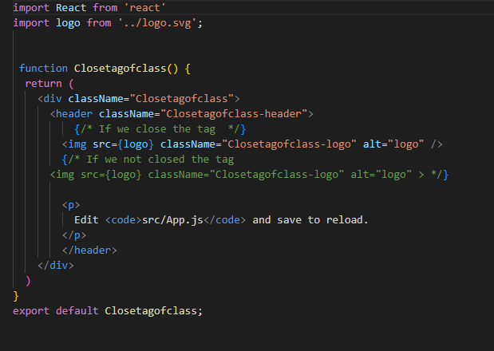
Close all the tags
JSX requires tags to be explicitly closed: self-closing tags like <img> must become <img />, and wrapping tags like <li>oranges must be written as <li>oranges</li>.

Slide 10
camelCase all most of the things!
React, many HTML attributes are written in camelCase. For example, instead of class you use className

Slide 11
JavaScript in JSX with Curly Braces
Passing strings with quotes
When you want to pass a string attribute to JSX, you put it in single or double quotes
But what if you want to dynamically specify the src or alt text? You could use a value from JavaScript by replacing " and " with { and }
Exe.,
<img
className="avatar"
src="img.png"
/>

Slide 12
Using curly braces: A window into the JavaScript world
Where to use curly braces
As text directly inside a JSX tag: <h1>{name}'s To Do List</h1> works, but <{tag}>Gregorio Y. Zara's To Do List</{tag}> will not.
As attributes immediately following the = sign: src={avatar} will read the avatar variable, but src="{avatar}" will pass the string "{avatar}".
Exe.,
<img
className="avatar"
src={imagesoruce}
/>

Slide 13
Using “double curlies”: CSS and other objects in JSX
In addition to strings, numbers, and other JavaScript expressions, you can even pass objects in JSX. Objects are also denoted with curly braces, like { name: "Hedy Lamarr", inventions: 5 }. Therefore, to pass a JS object in JSX, you must wrap the object in another pair of curly braces: person={{ name: "Hedy Lamarr", inventions: 5 }}.
You can really see the JavaScript object inside the curly braces when you write it like this:
<ul style={
{
backgroundColor: 'black',
color: 'pink'
}
}>

Slide 14
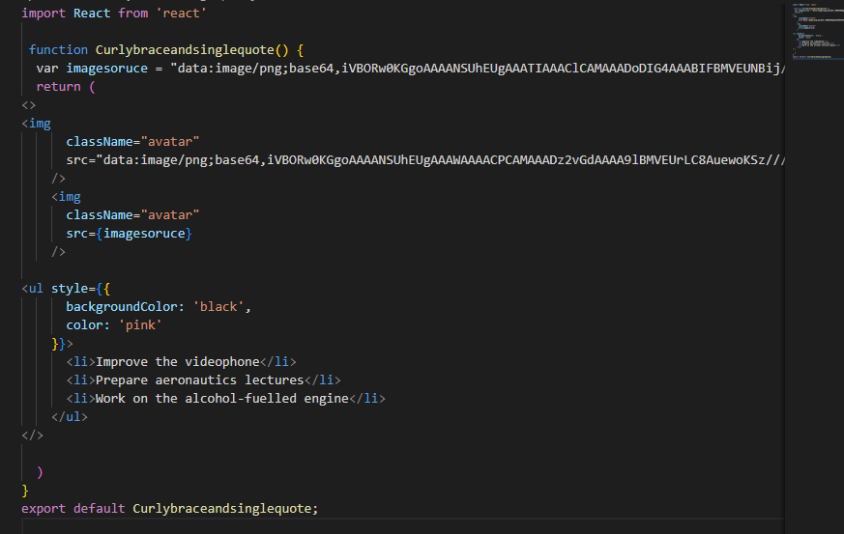

Slide 15
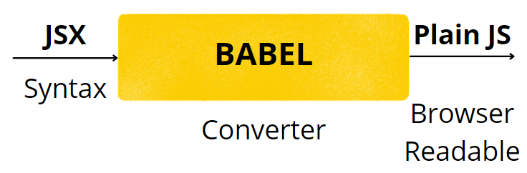
Babel compiles JSX
Babel is a toolchain that is mainly used to convert ECMAScript 2015+ code into a backwards compatible version of JavaScript in current and older browsers or environments.

Slide 16
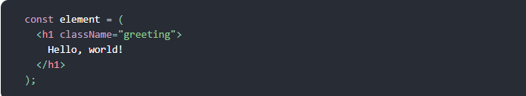
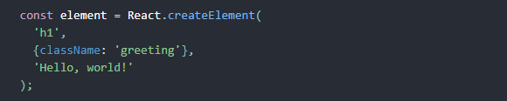
Babel

Slide 17
THANK YOU!!!!

