Slide 1
Rendering
Veena Saseendran

Slide 2
What is Rendering?
Render is the technique that can redirect a page with the help of function render().

Slide 3
Purpose of render()
React renders HTML to the web page by using a function called render().
The purpose of the function is to display the specified HTML code inside the specified HTML element.
In the render() method, we can read props and state and return our JSX code to the root component of our app.
In the render() method, we cannot change the state, and we cannot cause side effects( such as making an HTTP request to the webserver).

Slide 4
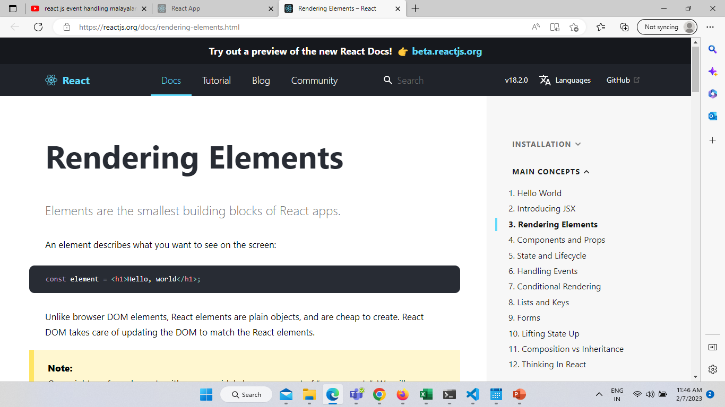
Example of Using Render in React JS
Rendering an Element Using the DOM
Elements are the smallest building blocks of React apps.
1. Declare this below code in your HTML using Div
<div id="root">
</div>
We call this a “root” DOM node because everything inside it will be managed by React DOM.

Slide 5
Example of Using Render in React JS
To render or redirect the element use below code
const root = ReactDOM.createRoot(document.getElementById('root'));
const element = <h1>This is the initial example of React.JS</h1>;
root.render(element);
The ReactDOM package provides client-specific methods used for initializing an app on the client.
CreateRoot is the one of the method used in the client environment.
createRoot() controls the contents of the container node you pass in. Any existing DOM elements inside are replaced when render is called. Later calls use React’s DOM diffing algorithm for efficient updates.
createRoot() does not modify the container node (only modifies the children of the container). It may be possible to insert a component to an existing DOM node without overwriting the existing children.
To render a React element, first pass the DOM element to ReactDOM.CreateRoot(), then pass the React element to root.render()

Slide 6
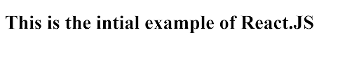
After running the above code snippet it will display the below output:
After running the above code snippet it will display the below output:
Example of Using Render in React JS
After running the above code snippet it will display the below output:

Slide 7
After running the above code snippet it will display the below output:
Example of Using Render in React JS
Updating the Rendered Element Using the DOM
Declare this below code in your HTML using Div:
<div id="root">
</div>
As we discussed, React elements are constant and unchangeable(immutable). Hence it can not be changed its attributes and children once it is defined. It can be displayed in the UI once your page loads.
With our Knowledge so far,the only way to update the UI is to create a new element and pass it to root.render().

Slide 8
After running the above code snippet it will display the below output:
Example of Using Render in React JS
Here is below JS code for updating the render element:
const root = ReactDOM.createRoot(document.getElementById('root’));
function Timertick()
{
const Testelement = (
<div>
<h1>This is the example of updating the render using DOM</h1>
<h2>Here is the current time {new Date().toLocaleTimeString()}.</h2>
</div>
);
root.render(Testelement);
}
setInterval(Timertick, 1000);

Slide 9

Example of Using Render in React JS
After running the above code it will display the below output:

Slide 10
React Conditional Rendering
In React, we can create multiple components which encapsulate behavior that we need. After that, we can render them depending on some conditions or the state of our application. In other words, based on one or several conditions, a component decides which elements it will return. In React, conditional rendering works the same way as the conditions work in JavaScript.
Consider an example of handling a login/logout button. The login and logout buttons will be separate components. If a user logged in, render the logout component to display the logout button. If a user not logged in, render the login component to display the login button. In React, this situation is called as conditional rendering.

Slide 11
There is more than one way to do conditional rendering in React. They are given below.
if
ternary operator
logical && operator
switch case operator
Conditional Rendering with enums

Slide 12
if
It is the easiest way to have a conditional rendering in React in the render method. It is restricted to the total block of the component. IF the condition is true, it will return the element to be rendered. It can be understood in the below example.
function UserLoggin(props) {
return <h1>Welcome back!</h1>;
}
function GuestLoggin(props) {
return <h1>Please sign up.</h1>;
}
function SignUp(props) {
const isLoggedIn = props.isLoggedIn;
if (isLoggedIn) {
return <UserLogin />;
}
return <GuestLogin />;
}
ReactDOM.render(
<SignUp isLoggedIn={false} />,
document.getElementById('root')
);

Slide 13
2. Logical && operator
This operator is used for checking the condition. If the condition is true, it will return the element right after &&, and if it is false, React will ignore and skip it.
import React from 'react';
import ReactDOM from 'react-dom';
// Example Component
function Example()
{
return(<div>
{
(10 > 5) && alert('This alert will be shown!')
}
</div>
);
}

Slide 14
3. Ternary operator
The ternary operator is used in cases where two blocks alternate given a certain condition. This operator makes your if-else statement more concise. It takes three operands and used as a shortcut for the if statement.
render() {
const isLoggedIn = this.state.isLoggedIn;
return (
<div>
Welcome {isLoggedIn ? 'Back' : 'Please login first'}.
</div>
);
}

Slide 15
4. Switch case operator
Sometimes it is possible to have multiple conditional renderings. In the switch case, conditional rendering is applied based on a different state.
function NotificationMsg({ text}) {
switch(text) {
case 'Hi All':
return <Message: text={text} />;
case 'Hello JavaTpoint':
return <Message text={text} />;
default:
return null;
}
}

Slide 16
5. Conditional Rendering with enums
An enum is a great way to have a multiple conditional rendering. It is more readable as compared to switch case operator. It is perfect for mapping between different state. It is also perfect for mapping in more than one condition. It can be understood in the below example.
function NotificationMsg({ text, state }) {
return (
<div>
{{
info: <Message text={text} />,
warning: <Message text={text} />,
}[state]}
</div>
);
}

Slide 17
THANK YOU!!!!

