Slide 1
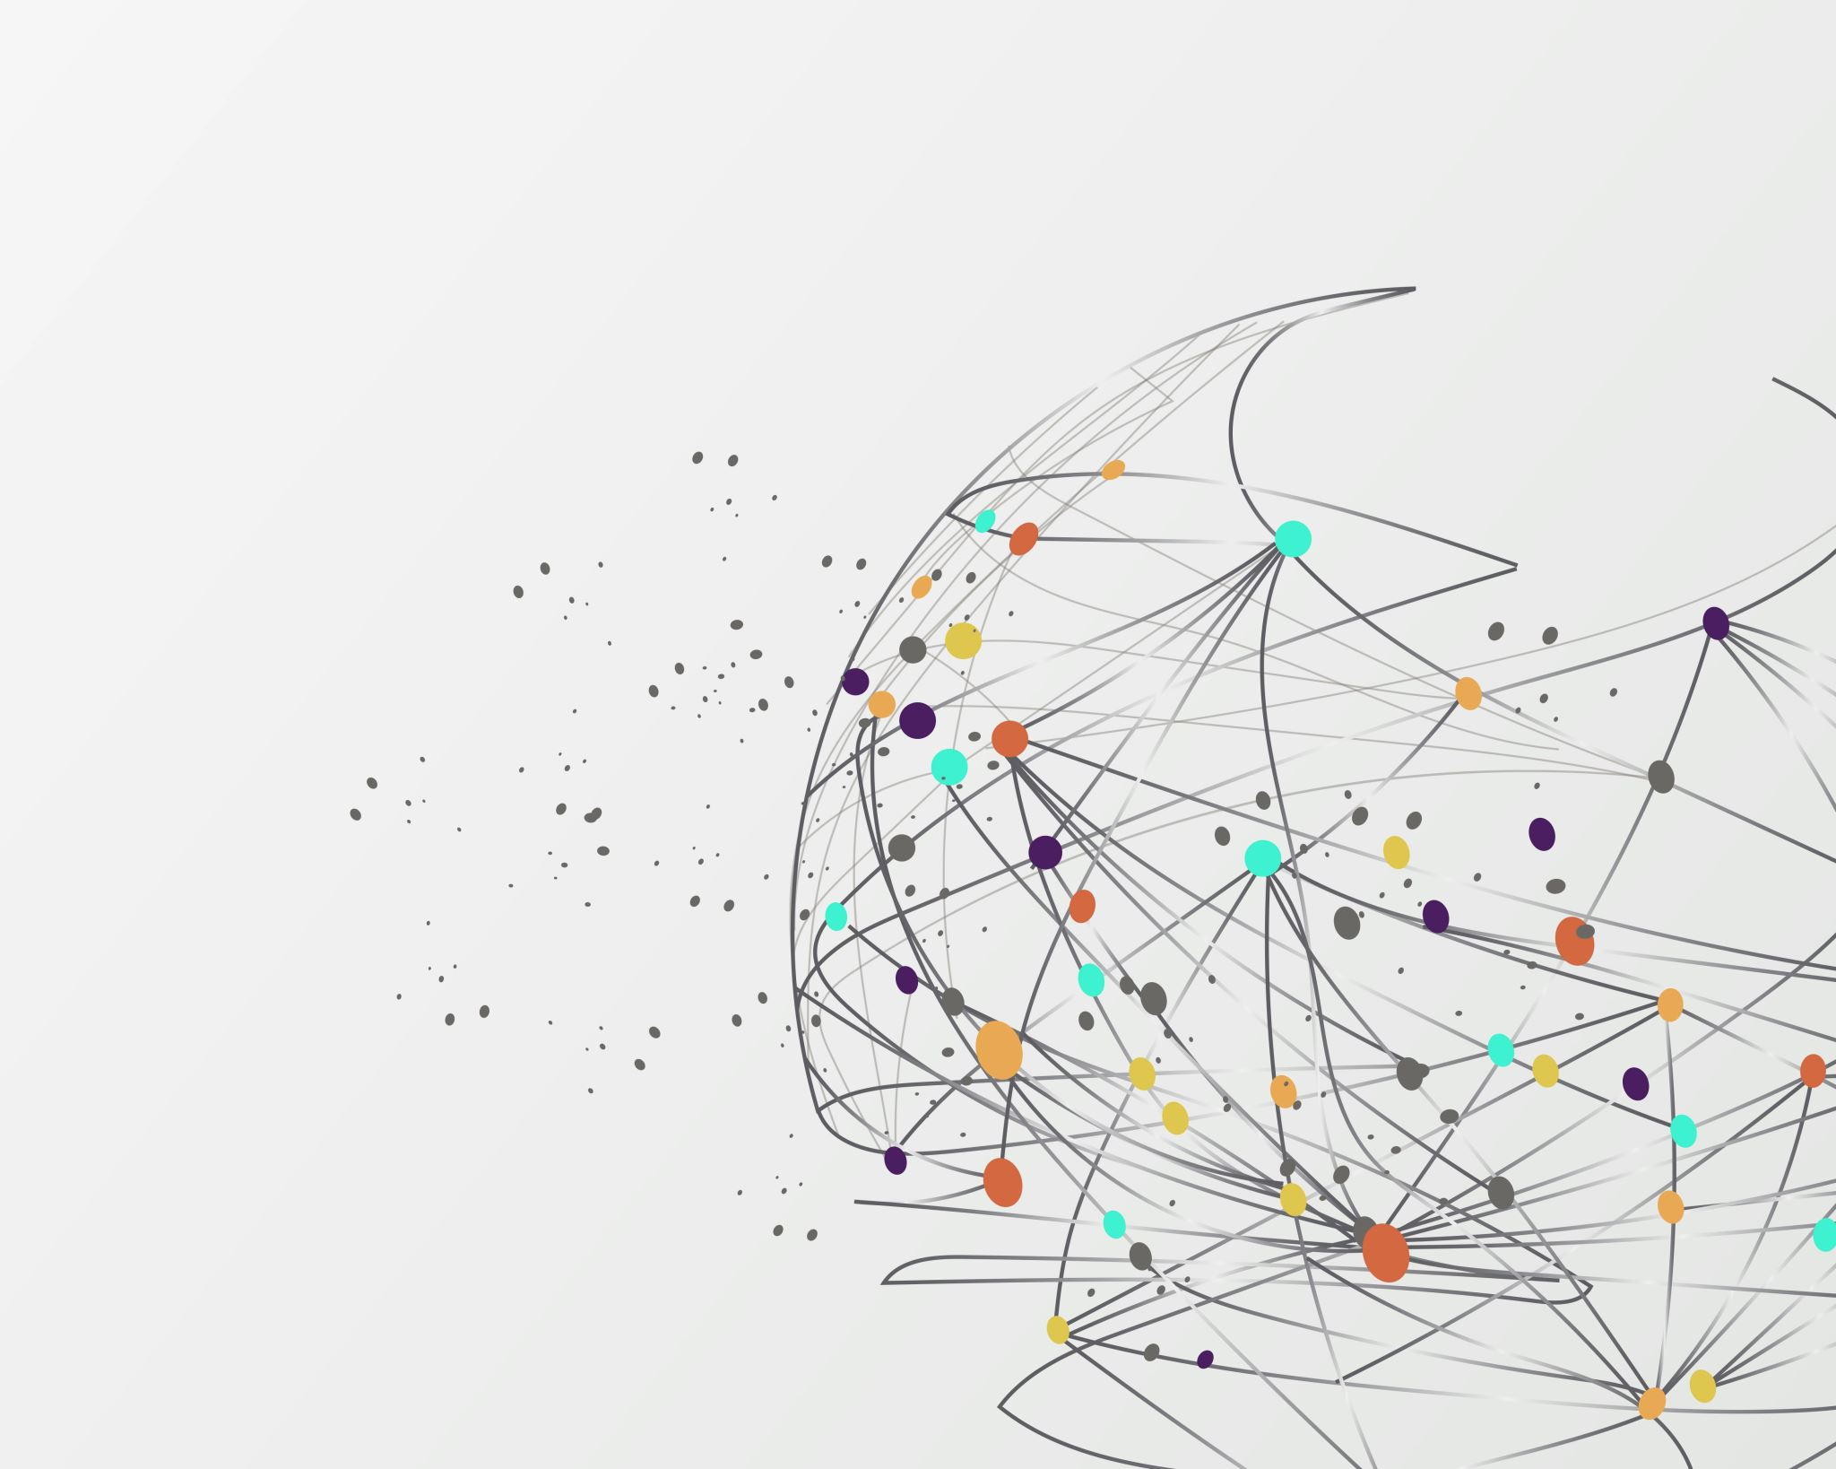
SEQUENCING TECHNOLOGIES
Dr. Sangeetha Kannan
Bioinformatics Specialist

Slide 2
Data from Biological Sources
Mendelian Inheritance Studies: First evidence of data analysis
Hybridization Techniques and assays: Limitations of sample numbers
Sanger Sequencing: Expensive in terms of time and money
Second-generation sequencing (NGS)
Third-generation sequencing
Short-read sequencing
Long-read sequencing

Slide 3
Different Sequencing technologies
Short-read sequencing
Long-read sequencing
First generation Sequencing
Second generation Sequencing
Third generation Sequencing
Sanger’s sequencing
Maxim and Gilbert
dNTPs visualized by electrophoresis
500-1000 bp fragments
454, Solexa, Ion Torrent, Illumina
High throughput
Parallelization of sequencing reactions
50-500 bp fragments
PacBio, Oxford Nanopore
Real time sequencing with single nucleotide resolution
Tens of kb fragments

Slide 4
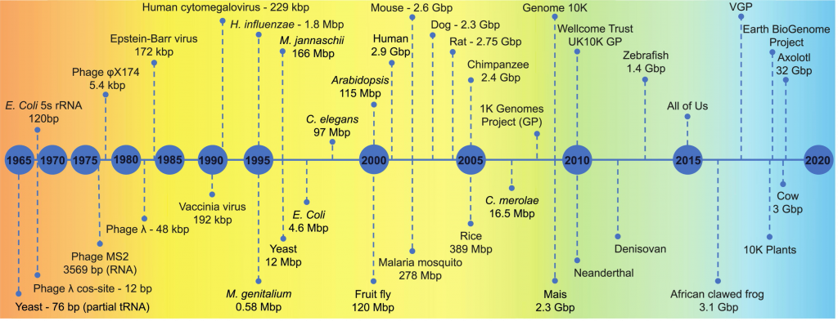
Timeline of DNA sequencing technologies

Slide 5

Next Generation Sequencing (NGS)
High-throughput sequencing technologies that allow for rapid sequencing of DNA and RNA with high accuracy
NGS can process millions to billions of sequences simultaneously, making it a powerful tool for genomics, transcriptomics, and other areas of molecular biology

Slide 6
Key features of NGS
High Throughput
Capable of sequencing millions of DNA fragments concurrently, resulting in massive amounts of data
Speed
Significantly faster than traditional methods, with entire genomes sequenced within days
Scalability
Suitable for a wide range of applications, from small-scale targeted sequencing to large-scale whole-genome sequencing
Cost-Effective
The cost per base sequenced has decreased dramatically, making NGS accessible for many research and clinical applications

Slide 7
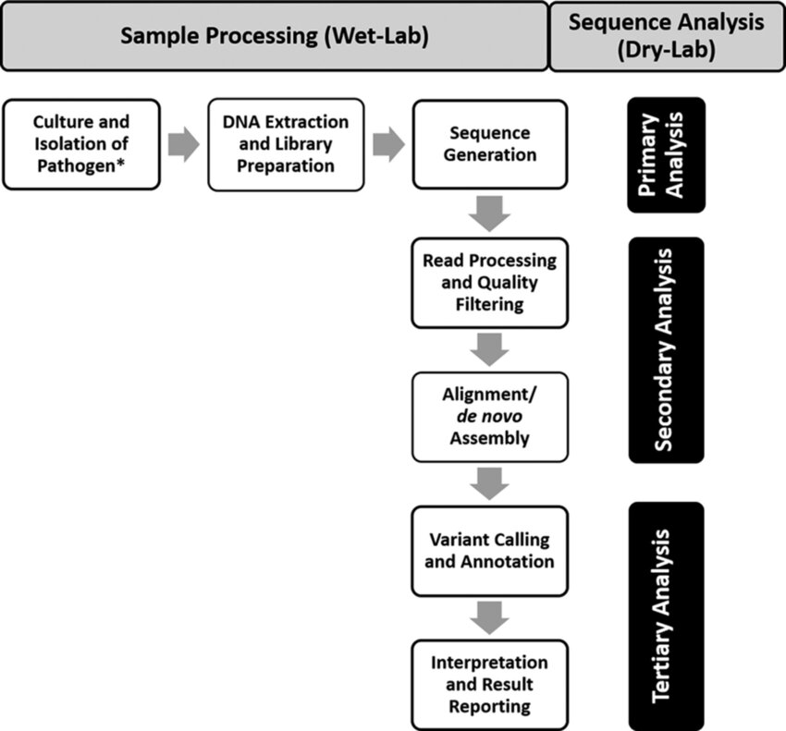
Basic Steps in NGS Workflow

Slide 8
Key terms to know
Adapters: Primer-like sequences ligated to both ends of DNA fragment
Insert size: length of the DNA fragment
Quality score: Description of error rate
Library: Pool of DNA fragments

Slide 9
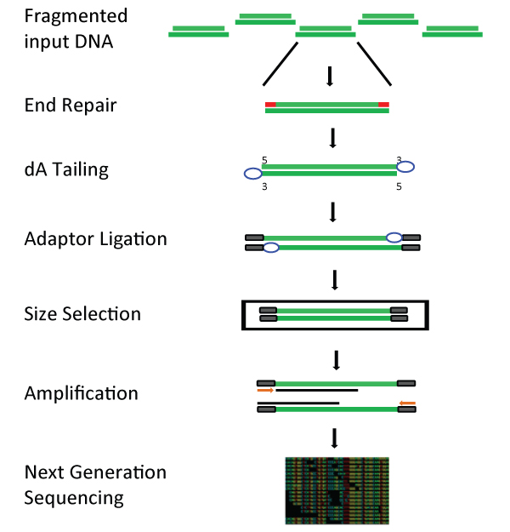
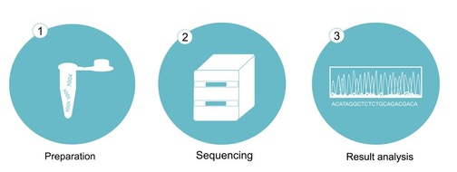
Sample Preparation : Sequencing by synthesis (Illumina)
DNA/RNA Extraction from the sample
Fragment DNA
Library Preparation
DNA fragments ligate with specific adapters

Slide 10
ADAPTERS
Adapters are short, synthetic DNA sequences that are added to the ends of the DNA fragments during the library preparation process.
It has the following purposes
Facilitate Binding to the Sequencing Flowcell: Adapters contain sequences that allow the DNA fragments to attach to the surface of the sequencing flowcell.
Enable PCR Amplification: Adapters provide primer binding sites for PCR amplification of the DNA library.
Include Index Sequences for Multiplexing: Adapters often contain index sequences (also called barcodes) that allow multiple samples to be sequenced together in a single run and later distinguished from one another.

Slide 11
Index sequence (barcode) of Adapter
Short DNA sequence (6-8 base pairs long) included in the adapter
Index sequence is unique to each sample and allows multiple samples to be pooled together and sequenced in the same run
They help identify which sequence data belongs to which sample after
They are designed to be unique and differ significantly from each other to avoid cross-contamination and misassignment of reads
Crucial for efficient and cost-effective NGS, sequencing

Slide 12
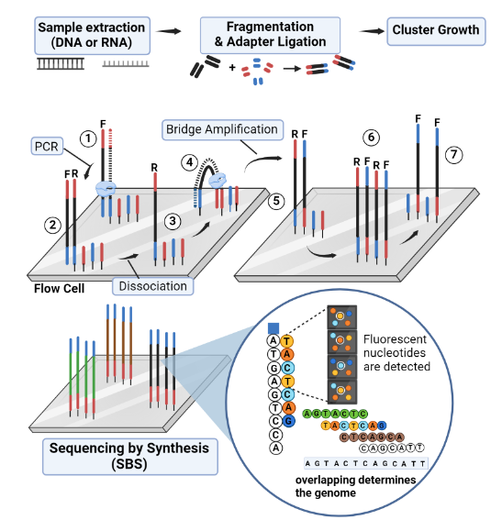
BRIDGE AMPLIFICATION
Attach DNA to Flow cell (has complementary sequence to adapters)
Bridge amplification (Bridge is formed between two adapters); primer gets added and complementary strand gets synthesized) – gives rise to forward and reverse strand
Clonal amplification – multiple copies of the strands are synthesized for helping with quality score generation
Sequencing – each strand is sequenced using fluorescently tagged-dNTPs attaching at the terminal end.
Emissions detected

Slide 13
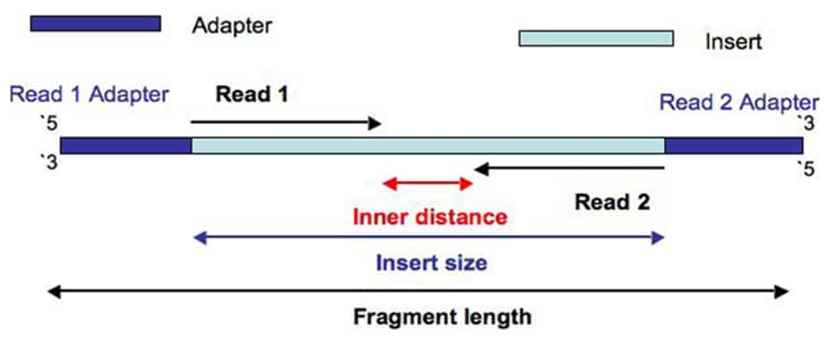
Paired-end data: Instead of sequencing just one end of the fragment (as in single-end sequencing)
Fragmentation and Adapter Ligation:
The DNA is fragmented into smaller piece
Adapters are attached to both ends of each double-stranded fragment
Sequencing process
During sequencing, both ends of each double-stranded DNA fragment are sequenced

Slide 14
Forward Read (Read 1):
Starts from the 5' end of the top strand and sequences towards the 3' end
“Read 1”, often called the “forward read”, extends from the “Read 1 Adapter” in the 5′ – 3′ direction towards “Read 2” along the forward DNA strand.
Reverse Read (Read 2):
Starts from the 5' end of the bottom strand and sequences towards the 3' end
“Read 2”, often called the “reverse read”, extends from the “Read 2 Adapter” in the 5′ – 3′ direction towards “Read 1” along the reverse DNA strand
There is an arbitrary DNA sequence inserted between “Read 1” and “Read 2”, which we’ll call the “Inner sequence”. The length of this sequence is measured as the “Inner distance”.
By definition, the “Insert” is the concatenation of “Read 1”, the “Inner distance” sequence and “Read 2”. And the length of the “Insert” is the “Insert size”. A single “Fragment” includes the “Read 1 Adapter”, “Read 1”, “Inner sequence”, “Read 2” and “Read 2 Adapter”. And the length of this “Fragment” is just the “Fragment length”.

Slide 15
Why is Paired-End Sequencing Useful?
Improved Accuracy: By having two reads per fragment, you can better align and map these reads to a reference genome. This improves the accuracy of identifying where the fragment came from.
Detecting Structural Variations: Paired-end reads help detect structural variations in the genome, like insertions, deletions, and rearrangements. If the forward and reverse reads are further apart or closer together than expected, it can indicate a structural change.
Better Assembly: For de novo genome assembly (building a genome from scratch), having paired-end reads helps to piece together overlapping reads more accurately, creating longer contiguous sequences.

Slide 16
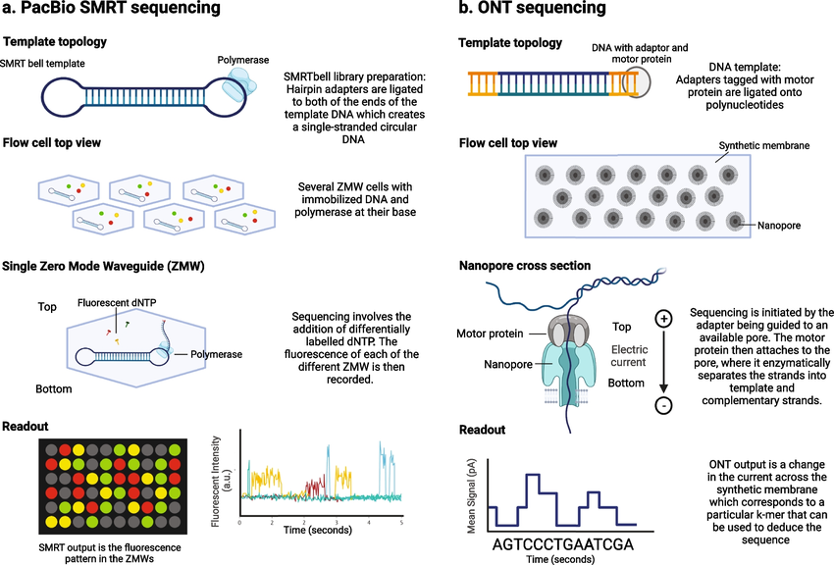

Slide 17
PacBio – Single Molecule, Real-Time (SMRT) sequencing
Fragments are ligated to hairpin adapters forming dumbbell shaped libraries (250 - >25000 bp length)
The primer and polymerase attaches to the dumbbell to initiate sequencing in circular fashion
The millions tiny wells in the flow cell are called zero-mode waveguides (ZMWs) such that single molecule of DNA is immobilized in each well
As polymerase adds each nucleotide, light is emitted and therefore nucleotide incorporation is measure real-time

Slide 18
Oxford Nanopore Technologies (ONT) – Nanopore Sequencing
Has flow cells which contain an array of tiny holes — nanopores — embedded in an electro-resistant bilayered membrane and an unwinding protein
Each nanopore corresponds to its own electrode connected to a channel and sensor chip, which measures the electric current that flows through the nanopore
When a molecule passes through a nanopore, the current is disrupted to produce a characteristic ‘squiggle’
The squiggle is then decoded using basecalling algorithms to determine the DNA or RNA sequence in real time
Upto 10 kb read lengths

Slide 19
Sequence Analysis (Dry-Lab)
Raw Data
Quality Control
Read Mapping
Variant Calling
Variant Annotation

Slide 20
LINUX – popular OS for Bioinformatics computing
Secure
User permissions
Package managers for installations
Streamlining updates

Slide 21
VARIANT CALLING WORKFLOW
FASTQ format
Raw Sequencing data
Post – Alignment Process
GATK variantFiltration
Variant filtration
SAMTools, Picard
Sorting and indexing
Sort and index SAM files, Mark duplicates to avoid PCR artifacts, filter out invalid data by map score
Apply filters to remove false positives
FASTQC
Read Quality control
Identify adapter contamination, low-quality baes, overrepresented sequences
SnpEff, Annovar
Variant annotation
Qualimap, SAMtools
Mapping Quality control (Mapping QC)
Annotate variants to determine which genes are affected and the nature of the mutations
Assess the map quality, check coverage, depth, alignment quality
FASTP, Trimmomatic
Read Corrections
VEP, Integrative genomics viewer (IGV)
Analysis and Visualization
GATK HaplotypeCaller, FreeBayes
Call variants (Each sample)
Trimming low-quality bases and removing adapters
Analyze the annotated variants
Identify variants (SNPs and indels) for each sample
BAM (input) to VCF (output)
BWA, Bowtie2, BWAMan
Mapping Reads to Reference Genome
SIFT, PolyPhen, ClinVAr
Understanding variant Impact
locate reads within the reference genome
GATK CombineVariants, BCFtools
Merging Variants of samples
Assess the biological and clinical significance of variants
FASTQ (input) to SAM (output)
Merge VCF files of individual sample
Alignment

Slide 22
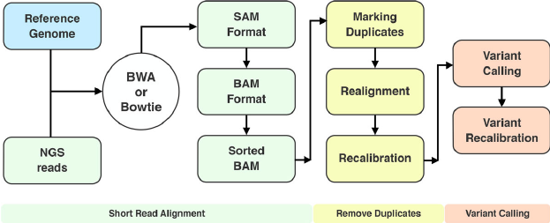
Variant calling workflow
Computational methods and resources for the interpretation of genomic variants in cancer - Scientific Figure on ResearchGate. Available from: https://www.researchgate.net/figure/A-typical-variant-calling-workflow_fig2_278912701 [accessed 17 Jun, 2024]

Slide 23
SRA database
The Sequence Read Archive (SRA) is the National Center for Biotechnology Information (NCBI) database that stores sequence data obtained from next generation sequence technology
The SRA is a broad collection of experimental DNA and RNA sequences that represent genome diversity across the tree of life. Through this database, researchers can search metadata for those sequences to locate the sequence reads for further analyses
The archive is part of the International Nucleotide Sequence Database Collaboration (INSDC), and run as a collaboration between the NCBI, the European Bioinformatics Institute (EBI), and the DNA Data Bank of Japan (DDBJ)
The preferred data format for files submitted to the SRA is the BAM format, which is capable of storing both aligned and unaligned reads
The SRA is integrated with other NCBI resources, such as GenBank, GEO (Gene Expression Omnibus), and BioProject, providing a comprehensive ecosystem for genomic data
Use the SRA Run Selector or the SRA Search page on the NCBI website to find datasets of interest
Data can be downloaded using the SRA Toolkit, a set of command-line tools for retrieving and processing SRA data
The toolkit supports various operations, including downloading, converting formats, and performing basic data manipulations
Once downloaded, SRA data can be analyzed using bioinformatics tools and pipelines tailored for specific types of analyses, such as read alignment, variant calling, and gene expression quantification

Slide 24
Reference genome
A reference genome is a complete or nearly complete sequence of the DNA for an organism's genome. It acts as a template or standard for genomic studies
The reference genome serves as a benchmark for mapping and aligning sequencing reads, identifying genetic variants, and conducting various genomic analyses
UCSC genome browser
hrCh18

Slide 25
How a Reference Genome is Used
Alignment and Mapping:
When sequencing an individual's genome, the short reads generated are aligned to the reference genome. This helps determine where each read comes from within the genome.
Tools like BWA (Burrows-Wheeler Aligner) and Bowtie are commonly used for aligning reads to the reference genome.
Variant Calling:
By comparing the sequenced genome to the reference genome, researchers can identify genetic variants such as single nucleotide polymorphisms (SNPs), insertions, deletions, and structural variations.
Tools like GATK (Genome Analysis Toolkit) are used for variant calling.
Annotation:
The reference genome is annotated to identify genes, regulatory elements, and other functional regions
Databases such as Ensembl and RefSeq provide annotated reference genomes with detailed information on gene locations and functions

Slide 26
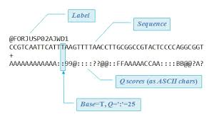
FASTQ format

Slide 27
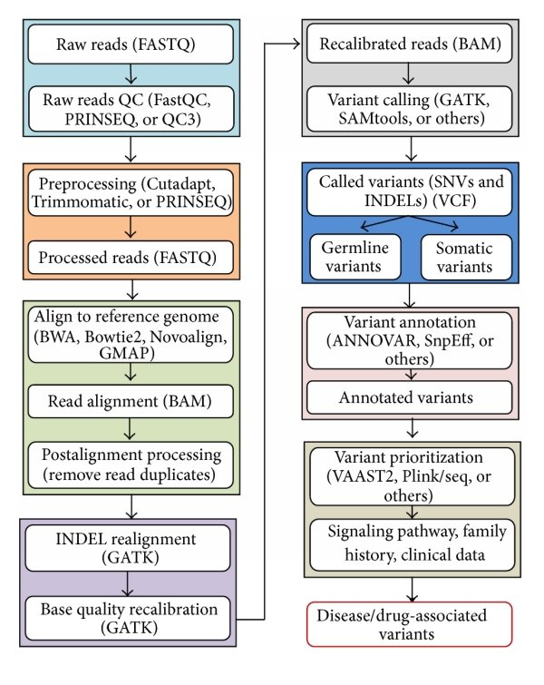
VARIANT CALLING PIPELINE
Carter, Tonia & He, Max. (2016). Challenges of Identifying Clinically Actionable Genetic Variants for Precision Medicine. Journal of Healthcare Engineering. 2016. 1-14. 10.1155/2016/3617572.

