Slide 1
Team Achievers:
Sangeetha Nair (Lead)
Viviana Lopes
Purvi Patel
Nandor Gallo

Slide 2
Summary of Capstone-I
One of the key aspects of us humans is the ability to communicate. Language plays a major role in the way we communicate with each other. In every computing environment, we daily use keyboard. It takes lot of effort for every user to key in each alphabet and develop a word when expressing their thoughts.
It also leads to error when manually typing the English words and creates grammatical error.
To improve our ability to communicate effectively and efficiently and express our thoughts without errors, word prediction tools are important to use.
In our project, we illustrated prediction of next word in a sentence fragment on a webpage. Based on natural language processing, the algorithm predicts the next word for user.

Slide 3
Problem statement for Capstone-II
There are many disabled people who are blind or unable to use their hands effectively to use any kind of device. They may find this as a disappointment as they might be unable to get a proper response from someone or communicate effectively .
That is why, our main aim is to help these kind of people by implementing this project further with advance technology, we are going to develop TTS(Text-to-speech) and STT (Speech-to-text) by using Speech Recognition technology.
As Speech recognition is an evolving technology, Voice assistant is very useful tool by which people can share their information through voice input and can get appropriate supporting text.
Another most important aspect of our project is getting feedbacks from users, which will be provided through a webpage. Back-end developer can use this to fetch feedback from database that will be displayed as a diagram.

Slide 4
Features achieved in capstone-I:
﻿ 1. We created a Web application which can predict technology-based words 2. A Text box for user input which could give recommendations to each user input word
User can choose out of the three recommendations and that word was added in the sentence with Accuracy for each predicted word, which was shown below it based on the usage and prediction of the word by the model 3. We created an excel file which was recording the count and flag of the words and it was updating flag counts which were displayed in UI at the bottom, which were selected by the user along with the previous word. This can be used to retrain the model to enhance accuracy.

Slide 5
Features to be implemented:
1. Database will play a crucial role in this project; instead of excel sheet, our main target is to store data and feedback into database.
Reasons for it:
Databases outperform spreadsheets in terms of efficiency. They can hold effectively unlimited amounts of data, which would bog down any spreadsheet.
Databases, rather than being confined to only one user at a time, may be accessed continuously by multiple users at the same time, allowing for collaboration and giving proper feedback to get more suggestions for improvement.
2. Cloud Deployment
3. Implementation of Speech Recognition Technology
Login page for users and admin
A feedback form, to improve experience of users and to enhance the project

Slide 6
Technology used
Speech Recognition
Python
JavaScript
MySQL
Flask
GitHub
Microsoft Azure

Slide 7
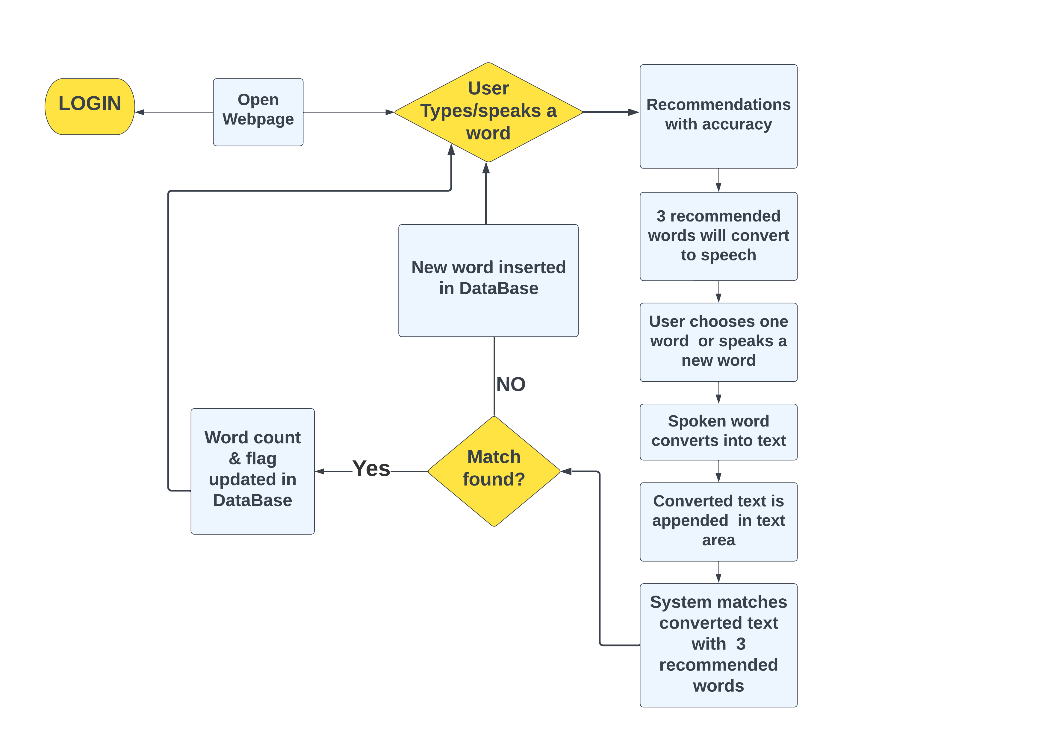
Use - Case Diagram for disabled user

Slide 8
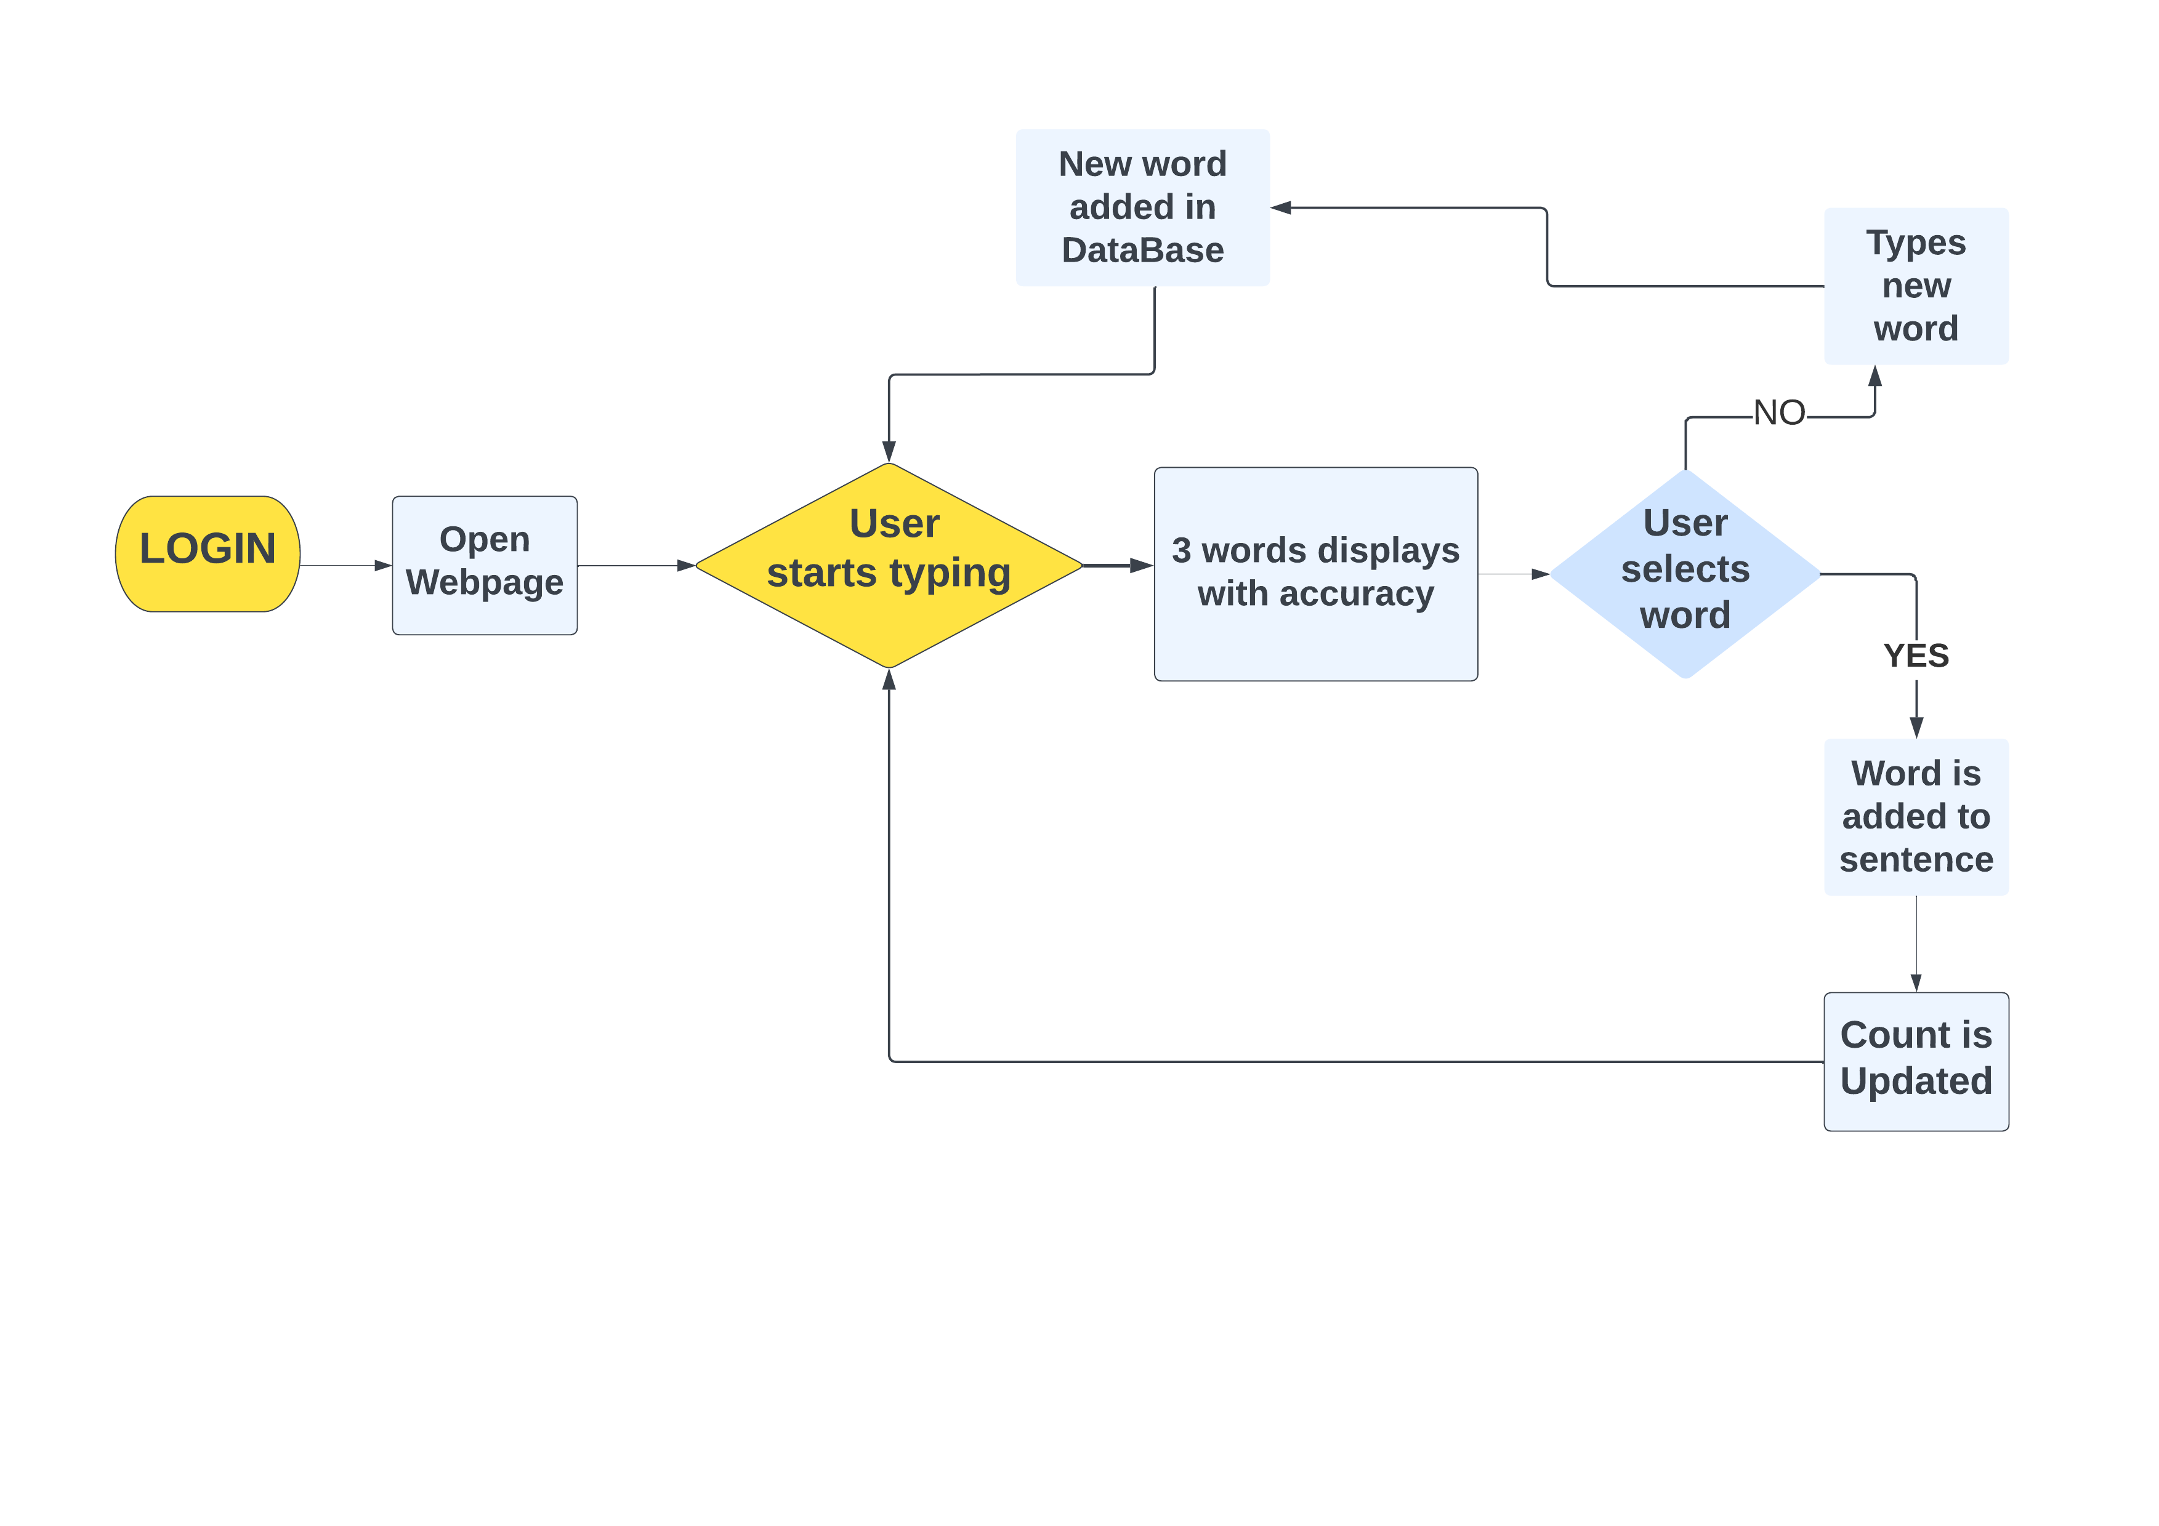
Use - Case Diagram for other users

Slide 9
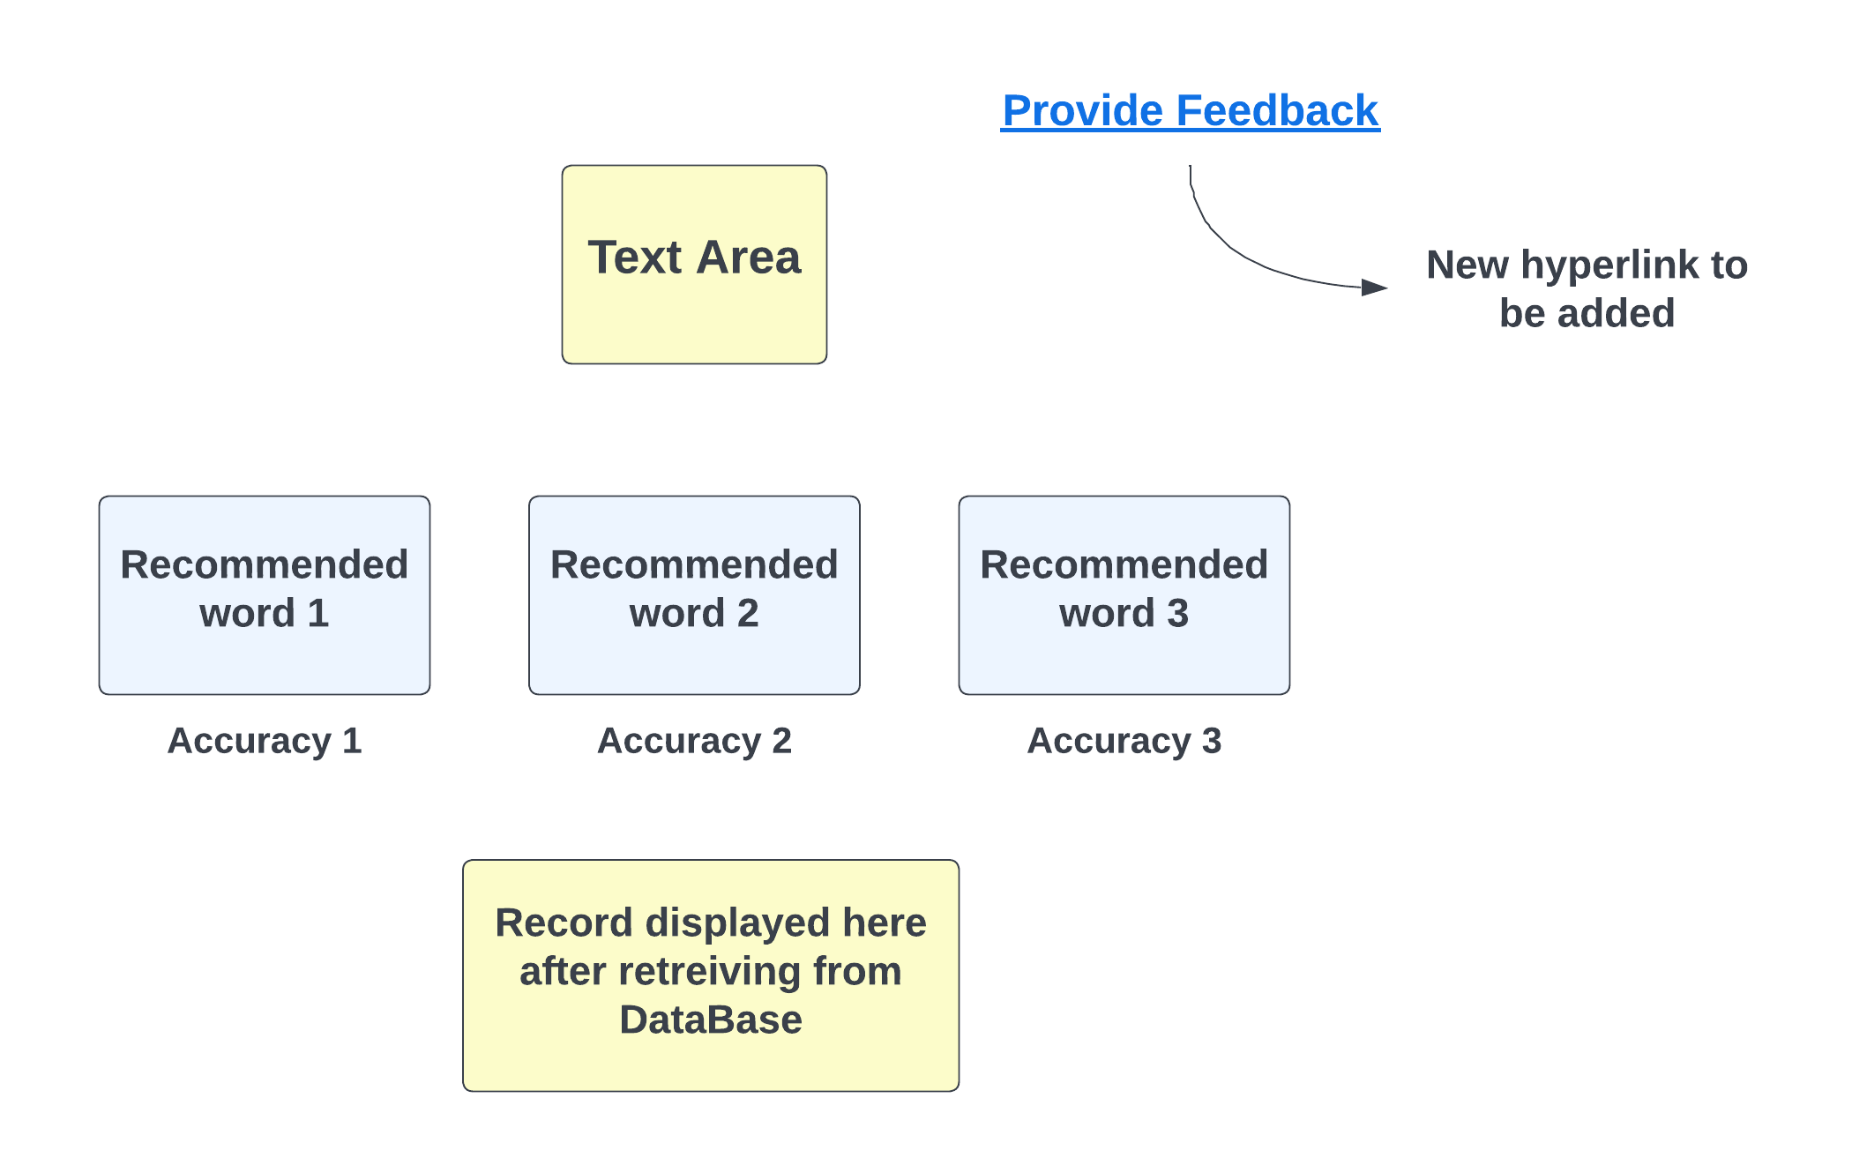
User-interface for users

Slide 10



