Slide 1
Sleep Health and Lifestyle Dataset Analysis
An exploration of factors affecting sleep health
Name : Sangeetha Ayyamperumal
Date: 02-22-25
DataSource: https://www.kaggle.com/datasets/uom190346a/sleep-health-and-lifestyle-dataset

Slide 2
This dataset demonstrates the importance of sleep health and how it impacts the lifestyle.
Nowadays days, sleep is the cause of many health issues, especially stress, so I chose this dataset.
This presentation will clearly explain how the sleep duration, quality of sleep, and physical activity level affect the stress level.

Slide 3
#Correlation between Sleep Duration and Stress Level
This question explores whether individuals who sleep longer
report lower stress levels.
# This correlation shows longer sleep hours people have lower stress levels.
plt.figure(figsize=(10, 6))plt.scatter(Sleep_health['Quality of Sleep'],Sleep_health['Stress Level'], alpha=0.5)plt.title('Quality of Sleep vs Stress Level')plt.xlabel('Quality of Sleep')plt.ylabel('Stress Level')plt.grid()plt.show()

Slide 4
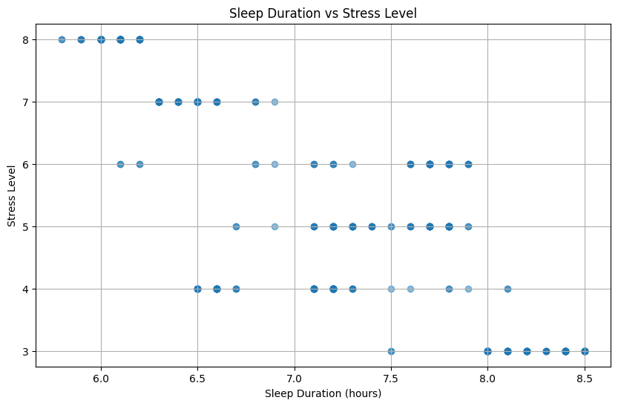
Correlation between Sleep Duration and Stress Level

Slide 5
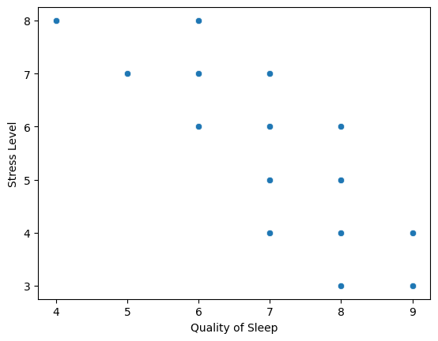
How does Quality of Sleep Affect Stress Level? sns.scatterplot(data=Sleep_health, x='Quality of Sleep', y='Stress Level’) This picture clearly shows a lower quality of sleep, and people have higher stress levels. Axes: <xlabel='Quality of Sleep', ylabel='Stress Level'>

Slide 6
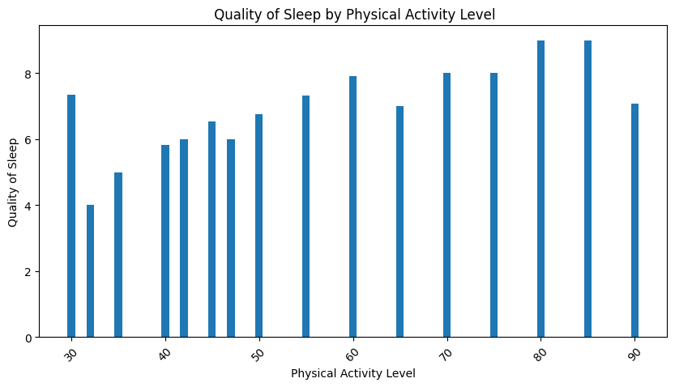
Quality of sleep by physical activity level
Grouping by physical activity level and calculating average sleep quality.
activity_sleep_quality = Sleep_health.groupby('Physical Activity Level')['Quality of Sleep'].mean().reset_index()

Slide 7
Conclusion
The above Three charts show the importance of sleep- health lifestyle.

