Slide 1


SMART HOME
AUTOMATION SYSTEM
Presented By:
1) Sangeetha G (210701229)
2) Sakthilakshmi M (210701223)

Slide 2
INTRODUCTION AND PURPOSE OF THE PROJECT
The advancement in Internet of Things (IoT) has made it possible to automate and control home environments with unprecedented ease and efficiency.
These systems enhance comfort, convenience, and security while also contributing to energy efficiency and cost savings.
PURPOSE:
Say you have a single 13watt led bulb in the room fixture. Operating for 10 minutes you would have wasted a total of 0.00217 kilowatt hours of power.
Convenience and Comfort: To provide homeowners with an easy-to-use interface that allows them to control various aspects of their home environment from a single point of access, whether it be a smartphone, tablet, or dedicated control panel. This ensures that daily tasks can be managed effortlessly and efficiently.
Energy Efficiency: To optimize the use of energy within the home by automating the operation of lights, heating, and cooling systems based on occupancy, time of day, and other environmental factors. This not only reduces energy consumption but also lowers utility billsEnergy Efficiency
Cost Savings: By automating and optimizing household systems, the home automation project aims to reduce operational costs. This includes savings from lower energy consumption and reduced maintenance expenses due to better-managed resources.

Slide 3
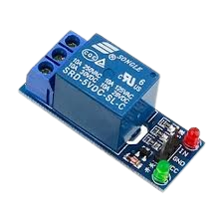
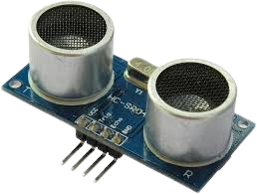
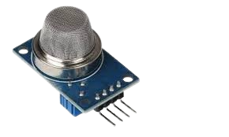
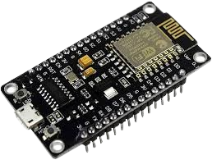
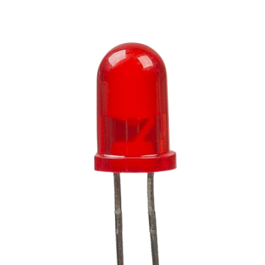
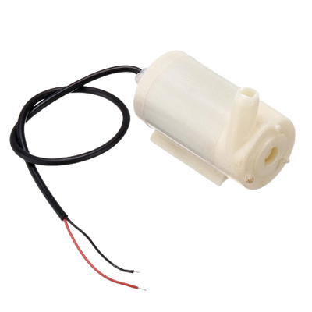
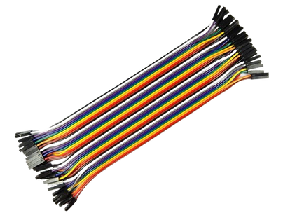

COMPONENENTS USED
ESP 32
ULTRASONIC SENSOR
MQ2 SENSOR
RELAY
LED
PUMP
JUMPER WIRES
ARDUINO IDE

Slide 4
ESP 32
ESP32 is a series of low-cost, low-power system on a chip microcontroller with integrated Wi-Fi and dual-mode Bluetooth.
The ESP32 features a powerful dual-core Xtensa LX6 microprocessor, providing robust computational capabilities suitable for demanding applications.
It has numerous General Purpose Input/Output (GPIO) pins for connecting sensors, LEDs, and other peripherals.

Slide 5
ULTRASONIC SENSOR
Ultrsonic sensors have two piezo electric crystals
called transmitter and receiver.
The transmitter emits the ultrasonic waves.
When the ultrasonic waves hits an object it returns back and received by the receiver.
We can calculate the distance between the ultrasonic sensor and the object by using the formula.
Distance = ( Speed * Time) / 2

Slide 6
MQ2 SENSOR
The MQ-2 sensor is capable of detecting multiple gases including LPG (liquefied petroleum gas), methane, alcohol, hydrogen, propane, carbon monoxide, and smoke.
The sensor operates based on a tin dioxide (SnO2) semiconductor layer that has low conductivity in clean air.
When the target gases are present, they reduce the resistance of the SnO2 layer, increasing conductivity.
The sensor outputs an analog voltage that varies with the concentration of the detected gas.

Slide 7
RELAY
Relays operate using an electromagnetic coil.
When current flows through the coil, it generates a magnetic field that moves an armature, changing the state of the switch.
This allows a small electrical signal to control a larger load.

Slide 8
PROJECT DESCRIPTION
1.Lighting Control Module
The lighting control module leverages the Blynk mobile app to provide residents with remote control over their home lighting system.
By using the app, users can easily switch lights on or off from their smartphones, reducing the need for physical switches and enhancing convenience, especially in large homes or for individuals with mobility issues.
This module eliminates the inconvenience of manually operating lights, thereby minimizing human error, such as leaving lights on unintentionally, which leads to unnecessary energy consumption and increased electricity bills.
Additionally, the system allows for the scheduling of lighting patterns, which can improvehome security by simulating occupancy, deterring
potential intruders.

Slide 9
2. Gas Leak Detection Module
The gas leak detection module incorporates an MQ-2 gas sensor to identify the presence of hazardous gases like carbon monoxide.
This sensor is integrated with the Blynk app, providing real-time alerts to residents in case of a gas leak.
Additionally, a buzzer is activated when a gas leak is detected, providing an immediate audible warning to alert occupants of the danger. Unlike manual detection, which is unreliable and can result in delayed responses, this automated system ensures immediate notification and can trigger safety measures to mitigate risks.
This module significantly enhances home safety by reducing the likelihood of accidents, including fires and explosions, thereby protecting both property and human life. The immediate alerts allow for quick evacuation and prompt action to rectify the leak, ensuring a safer living environment.

Slide 10
3. Water Level Monitoring Module
The water level monitoring module employs an ultrasonic sensor to continuously monitor the water levels in tanks or reservoirs.
The data collected by the sensor is transmitted to the ESP32 microcontroller, which processes the information and updates the Blynkapp in real-time.
This setup provides residents with accurate and up-to-date information on water levels, preventing both overflow and dry conditions.
Manual water level monitoring is often inaccurate and labor-intensive, but this automated solution offers precise measurements with minimal effort.
The module ensures efficient water resource management, reducing wastage and ensuring a consistent water supply.

Slide 11
4. Automated Pump Control Module
Complementing the water level monitoring module, the automated pump control module manages the refilling of water tanks using a relay to control the pump.
When the ultrasonic sensor detects that the water level is low, the system automatically activates the pump via the relay to refill the tank. Once the desired water level is reached, the pump is switched off to prevent overflow.
This automated control minimizes the risks associated with manual pump operation, such as overfilling or underfilling, and ensures optimal water usage.
By preventing wastage and maintaining adequate water levels, this module contributes significantly to the efficient management of water resources within the home.

Slide 12
5. Central Microcontroller and Integration Module
At the heart of the system is the ESP32 microcontroller, which integrates all the modules and processes the data from various sensors.
The ESP32 acts as the brain of the system,executing commands and ensuring smoothoperation of all automated functions.
It communicates with the Blynk app to provide users with real-time updates and alerts, facilitating seamless interaction with the system.
This central integration ensures that all moduleswork together harmoniously, enhancing overall system reliability and performance.

Slide 13
6. User Interface Module
The user interface module, powered by the Blynk mobile app, serves as the primary point of interaction betweenthe residents and the home automation system.The app displays data from the gas leak detection, water level monitoring, and pump control modules, providing users with comprehensive control and oversight. The app also stores data in the form of charts, enablingusers to analyzetrends and optimizetheir resource usage over time.

Slide 14
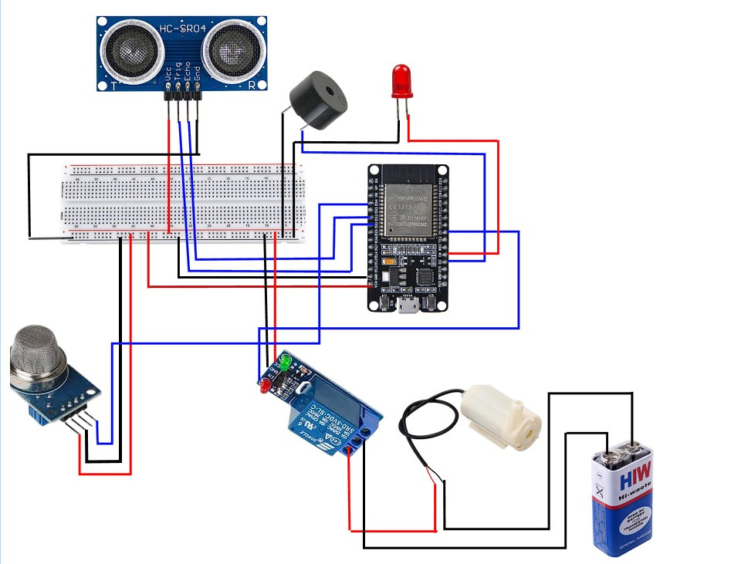
CIRCUIT DIAGRAM

Slide 15
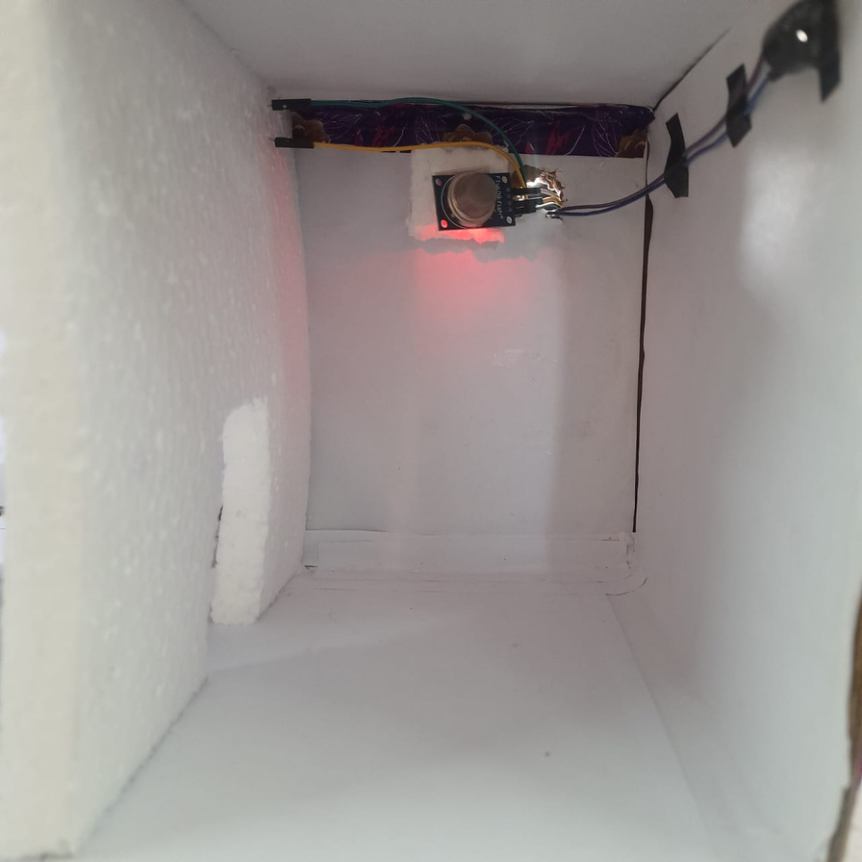
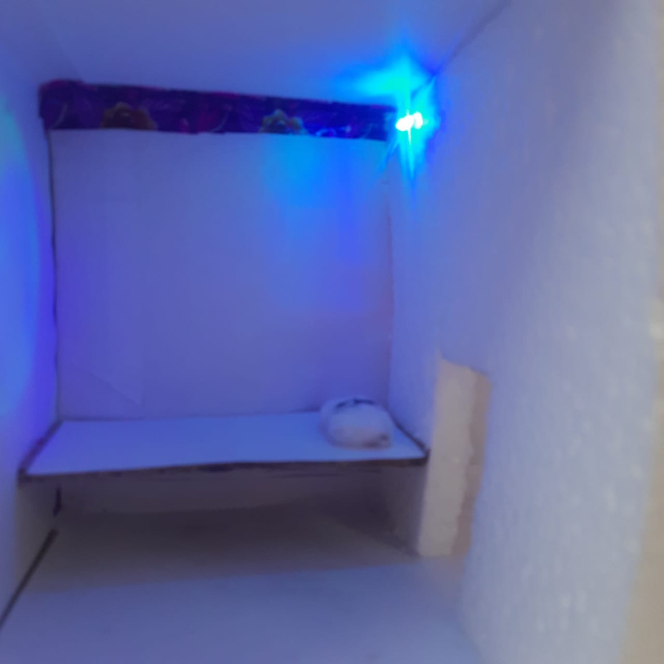
OUTPUT

Slide 16
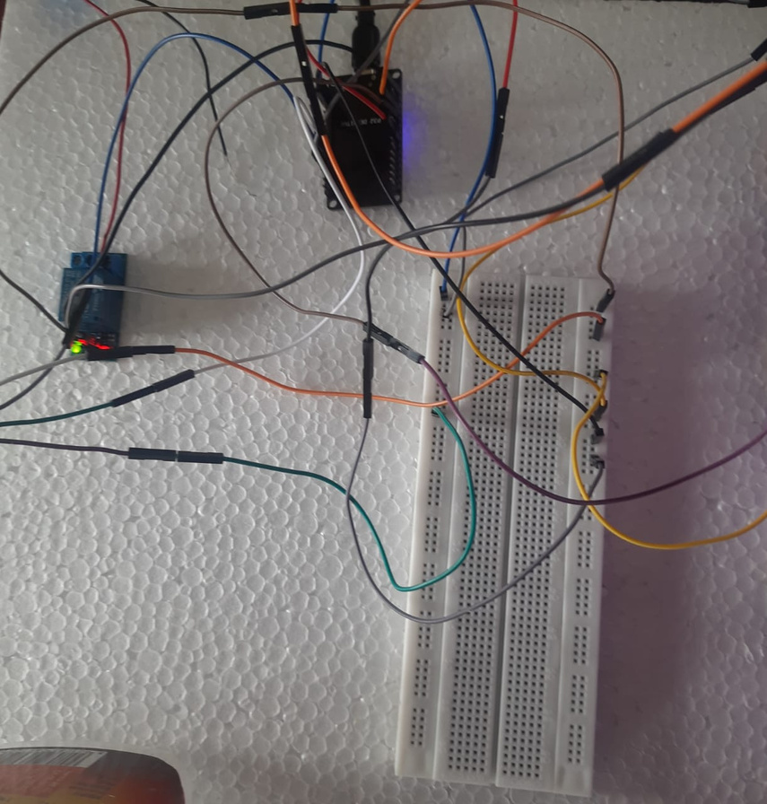
OUTPUT

Slide 17
CONCLUSION
Implementing IoT-based lighting control systems can lead to significant energy savings, typically ranging from 20-50%
Thus using our smart home automation system we can conserve energy that is wasted unnecessarily due to our absent mindedness.
We can control the appliances with convenience and comfort.
Electricity bill will also be reduced.

Slide 18
FUTURE ENHANCEMENT
Integration with voice assistants
Advanced security features such as smart door locks
Enhanced water management using leak detection and
smart irrigation
Smart thermostat to control heating and cooling systems

