Slide 1
IC pin Detection
By Arduino.
Guidance by
Prof. Nagaveni S
By Sangeetha M

Slide 2
AGENDA
PROBLEM STATEMENT..
SOLUTION.
WORKING.
RESULT

Slide 3
PROBLEM STATEMENT
When we have a complex circuit on the breadboard and we want to debug the circuit by using the multimeter…
It will be difficult for us to detect where the connection gone wrong…
So here I came with the solution where we can easily detect where the connection is gone wrong or which pins of the IC is connected…..

Slide 4
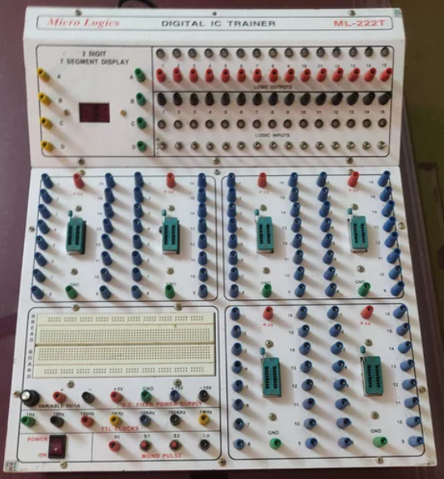
A Digital Trainer Kit(DTK) is an instructional instrument that teaches students the fundamentals of digital electronics through the use of a microcontroller. It teaches students how to create and simulate circuits using breadboards. It serves as a learning tool for engineering students.
Digital Trainer Kit

Slide 5
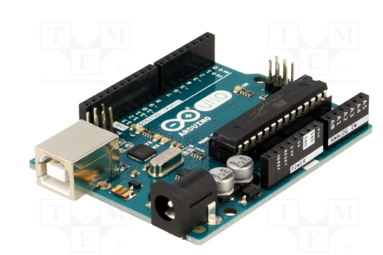
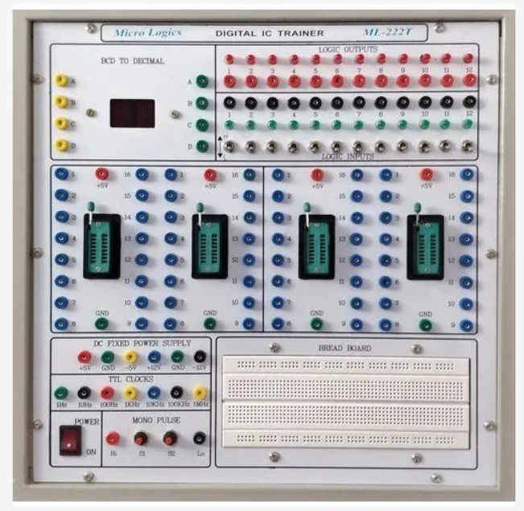
Arduino UNO
Digital Trainer Kit

Slide 6
Yes!
We are going to use the Digital Trainer Kit with Arduino UNO…..

Slide 7
Working Of DTK With Arduino
As of now I am using BreadBoard for the connection.

Slide 8
Working Of The Arduino
The arduino will power the IC’s.
It will detect whether the IC pins are High or Low of the connection.
It will also detect whether there is interconnection between the IC’s.

Slide 9
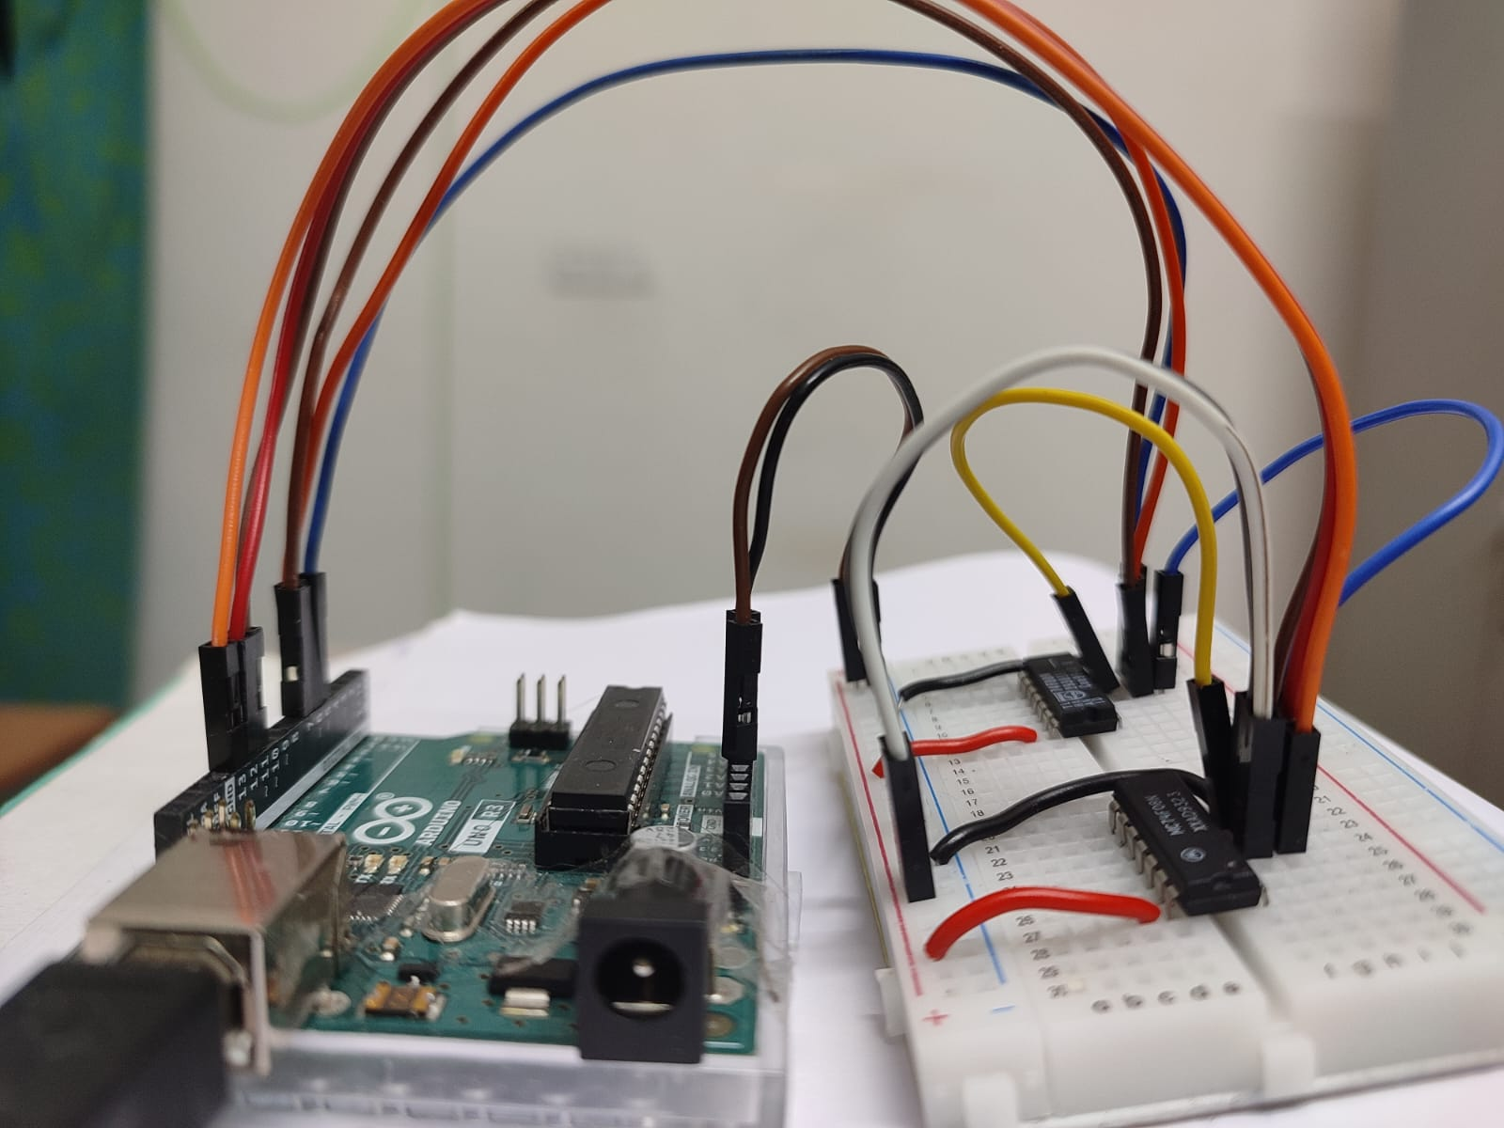
Connection between Arduino and IC pins

Slide 10
ARDUINO CODE DEMO

Slide 11
Form the arduino code output from the Serial monitor we are connecting the arduino to CoolTerm software.
CoolTerm software is a open software tool where it will convert the output in the serial monitor to any format.

Slide 12
Taking To CoolTerm Software…..

Slide 13
From this software we are saving the output in the testfile.txt format.
From this testfile.txt format we are running python code where it will draw the IC’s and its connection.

Slide 14
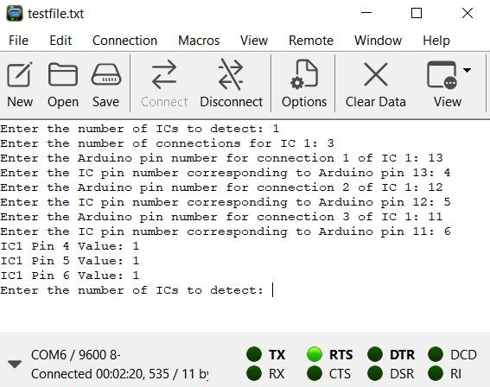
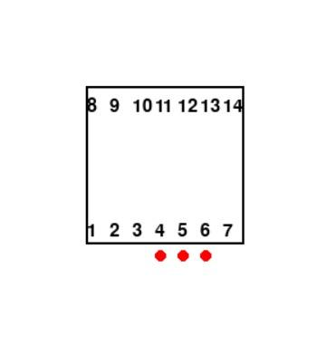
Output of One IC Connection
Taking Inputs and showing results in CoolTerm
Image of one Ic after running in the python

Slide 15
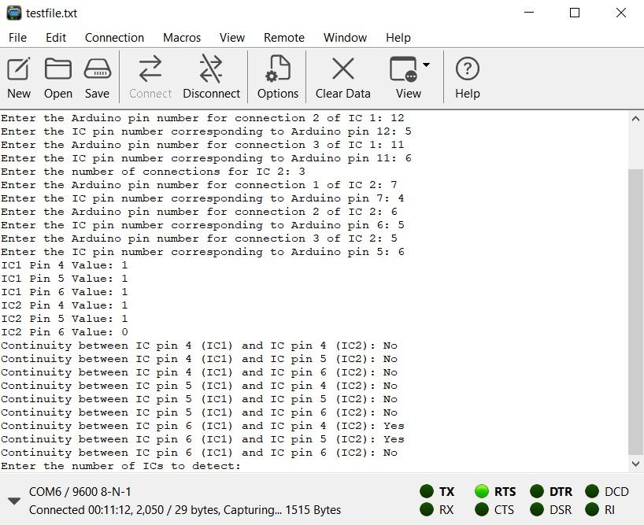
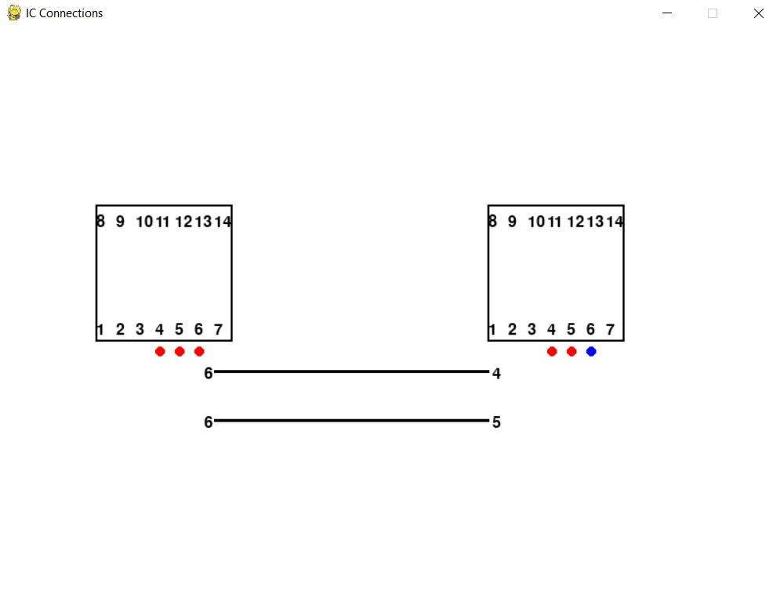
Output of Two IC Connection
Taking Inputs and showing results in CoolTerm
Image of two Ic after running in the python

Slide 16
THANK YOU
M SANGEETHA
200020053

