Slide 1
H1B VISA CERTIFICATION

Slide 2
WHAT IS H1B VISA?
The H-1B visa is one of the most popular non-immigrant visas, which permits the US-based companies to hire foreign workers and let them work in speciality professions that require technical or theoretical expertise.

Slide 3
PARAMETERS OF THE DATASET
Employer name
Class of admission
Country of Citizenship
Work city
Job level
Current wage
Case status(to be predicted)

Slide 4
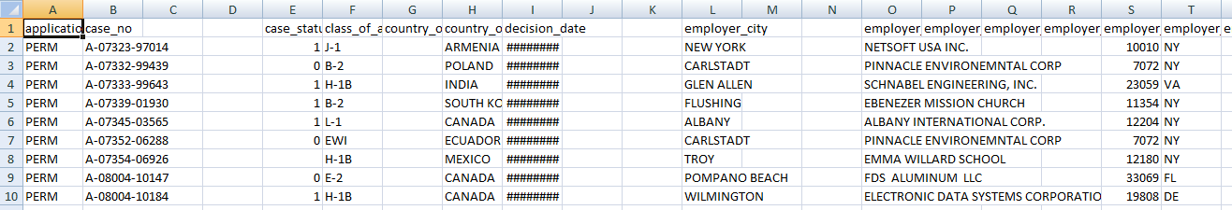
DATASET and SOURCE
https://www.kaggle.com/ksdkalluri/h1b-kaggle/data

Slide 5
Libraries and methods used.
train_test_split() from sklearn.model_selection
DecisionTreeClassifier() from sklearn.tree
get_dummies() from pandas

Slide 6

CODE IN PYTHON

Slide 7
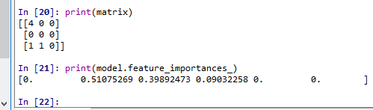
FEATURE IMPORTANCES

Slide 8
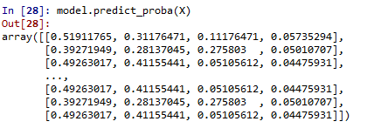
PROBABILITY OF VISA STATUS
Certified
Certified expired
Denied
withdrawn

Slide 9

ACCURACY OF PREDICTED VALUES

Slide 10
We have used a powerful graphical framework called ggpolt2 in R to plot the graphs.
Using the various columns in the dataset and graphically representing them, we have come up with a few conclusions.

Slide 11
PLOTS AND CONCLUSIONS
First, we do some pre processing on the data.
After loading the file, the cases which have status as ”Certified” and visa type as “H1B” are filtered.
These are grouped by country of citizenship and a graph of country v/s count of Certified H1B visas is plotted.

Slide 12
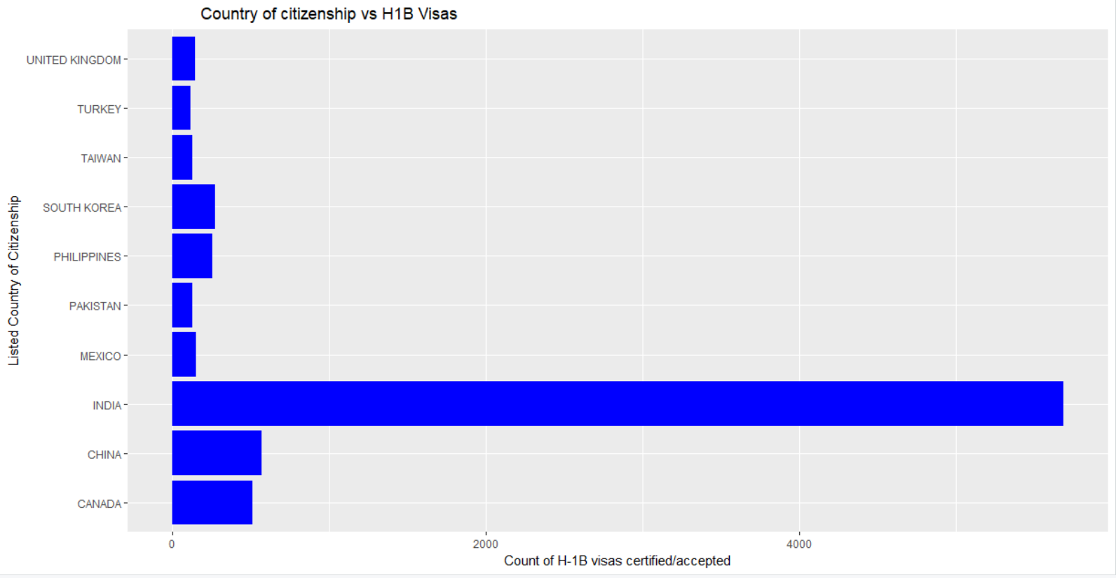

Slide 13
We plot the graph for the top 10 countries.
It is observed that India is the country with the maximum number of accepted and certified H1B visas.
Diving into the specifics, we also have the plot of employers v/s no of certified visas, which would tell the applicant where he would most likely be employed.

Slide 14
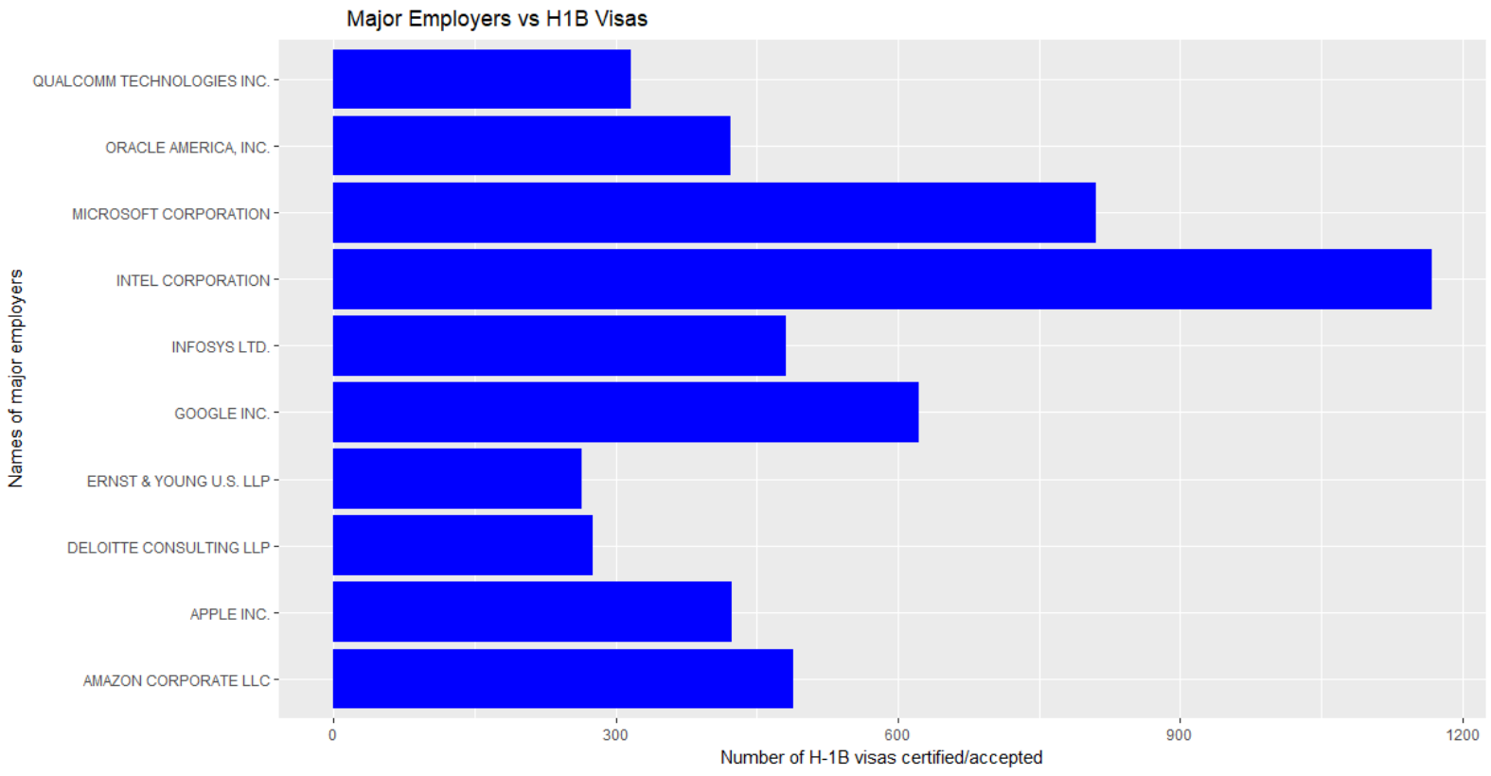

Slide 15
It can be seen that Intel and Microsoft employs the most number of H1B visa holders.
We have plotted a final graph which shows the cities in which the number of H1B visa employers are maximum. A plot of ten top cities are shown below.

Slide 16
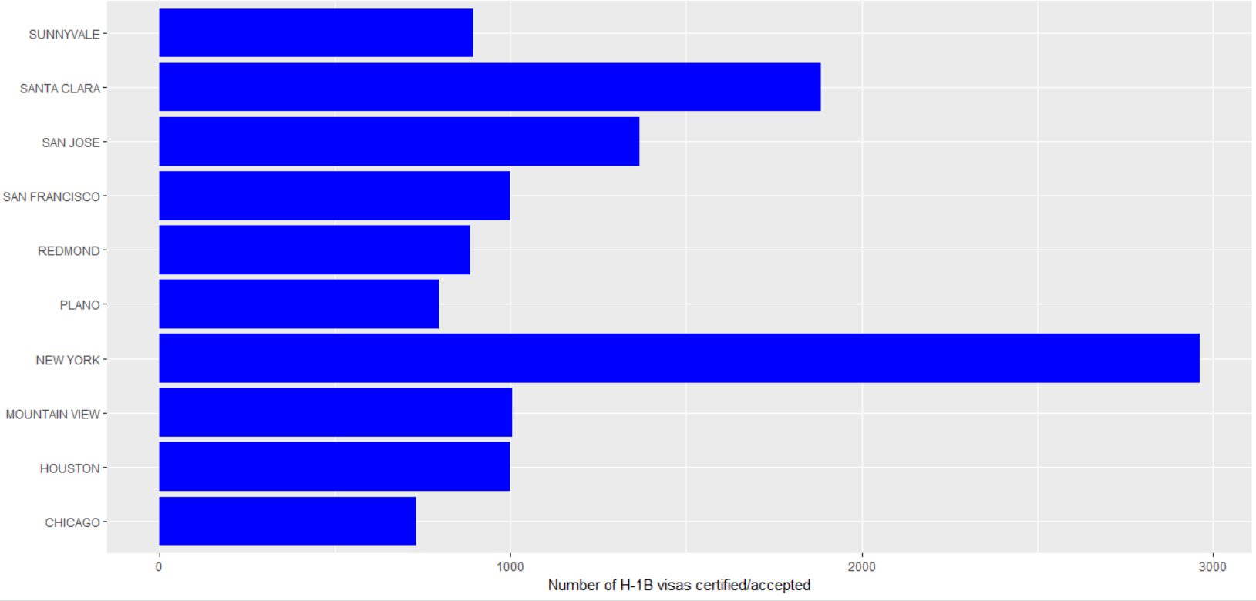

Slide 17
It can be seen that, the United States employs the maximum number of H1B visa holders from India, although the numbers have steadily decreased in recent years, followed by China and Canada.
Intel Corp, Microsoft Corp, Google Inc and Amazon LLC Corp, are the top H1B visa employers.
New York, Santa Clara, Mountain View, Houston are the cities with most number of H1B visas.

Slide 18
THANK YOU

