Slide 1
VAULTOFCODES
FINAL PROJECT – SNAKE GAME
PRESENTED BY : SANGEETHARASU
INTRODUCTION TO SNAKE GAME SETTING UP THE GAME ENVIRONMENT GAME MECHANICS GAME MOVEMENT AND LOGIC SCREEN SHOT USER INTERACTION, CONTROL CONCLUSION

Slide 2
Introduction
What is the Snake Game?
Classic Arcade Game: The snake grows as it eats food and must avoid hitting the walls or itself.
Objective: Achieve the highest score by eating food.
Key Components in Code:
Snake: Represented by a list of coordinates.
Food: Randomly placed on the canvas.
Controls: Arrow keys to change direction; 'p' to pause.

Slide 3
Setting Up the Game Environment
Initialization:
__init__ method creates the main window and sets up the canvas and reset button.
Code Snippet: self.canvas = tk.Canvas(self.frame, width=CANVAS_WIDTH, height=CANVAS_HEIGHT, bg="blue") self.reset_button = tk.Button(self.frame, text="Reset", command=self.reset_game) Explanation:
The canvas is where the snake and food are drawn.
The reset button allows the game to be restarted.

Slide 4
Game Mechanics
Resetting the Game:
Method: 'reset_game()' Reset Snake Position: Start with three segments. Generate Food: Place randomly on the canvas. Direction & State Initialization: Set direction to "Right", and other states like 'paused', 'game_over', and 'speed'.
Code Snippet: self.snake = [(60, 100), (40, 100), (20, 100)]
self.food = self.create_food()
self.direction = "Right"

Slide 5
Explanation: Resets the game variables to start a new round. Drawing Elements on the Canvas:
Method: draw()
Clear Canvas: self.canvas.delete("all")
Draw Snake and Food:
Snake: Green rectangles.
Food: Red rectangle.
Display Score: At the top of the canvas.
Game Over Message: If the game is over.

Slide 6
GAME MOVEMENT AND LOGIC
Handling Movement:
'move' method updates the snake’s position based on the current direction and checks for collisions.
Code Snippet: head_x, head_y = self.snake[0]
if self.direction == "Up": head_y -= CELL_SIZE Game Over Conditions:
Collision with walls or itself.
Speed Adjustment:
Speed increases as the snake eats more food.

Slide 7
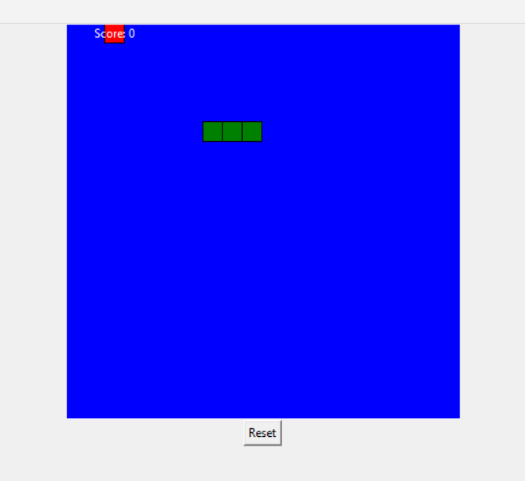
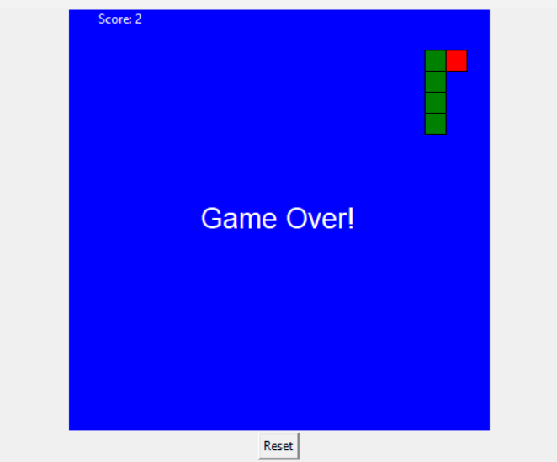

Slide 8
User Interaction, Controls
Handling User Input:
Method: on_key_press(event)
Direction Control:
Arrow keys change the direction unless it's opposite to the current one (e.g., "Up" can't follow "Down").
Pause/Resume:
Press 'p' to pause or resume the game.
Code Snippet: if event.keysym in ["Up", "Down", "Left", "Right"]: self.direction = event.keysym
elif event.keysym == "p":
self.paused = not self.paused

Slide 9
Conclusion
Summary: Recap of the key components discussed.
Further Exploration:
Enhance the game by adding features like levels, obstacles, or different speeds.
Experiment with Tkinter to create more complex games.

Slide 10
THANK YOU

