Slide 1
QR Code Generator Project
A basic Python application

Slide 2
Introduction
This project is a basic QR Code Generator built using Python.
It allows users to input text or a URL and generates a QR code image as output.

Slide 3
Tools and Technologies
- Python 3
- qrcode library
- PIL (Python Imaging Library)
- Command Line Interface

Slide 4
Features
- Simple interface
- Accepts text or URL input
- Generates a QR code image
- Saves the image locally

Slide 5
How It Works
1. The user inputs data (text/URL).
2. The data is passed to the QR code generator.
3. A QR code image is created and saved.

Slide 6
Sample Code
import qrcode
data = input('Enter text or URL: ')
img = qrcode.make(data)
img.save('qrcode.png')

Slide 7
Conclusion
This simple project demonstrates how to use Python libraries to create QR codes.
It can be extended with GUI, decoding, or bulk generation features.

Slide 8
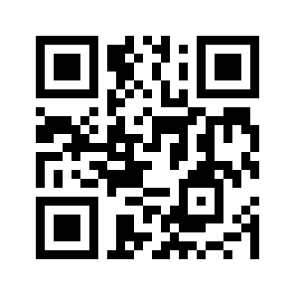
Sample QR Code Output

Slide 9
Future Enhancements
- Add a Graphical User Interface (GUI)
- Support QR code decoding
- Allow customization (colors, size)
- Bulk QR code generation from CSV files
- Integration with web applications

