Slide 1

DOVE
Hypothesis testing

Slide 2
INTRODUCTION
Dove is an American personal care brand owned by the British multinational consumer goods company Unilever. Dove products are manufactured in countries around the world.
The products are sold in more than 150 countries and are offered for both women, men, and babies. Dove's logo is a silhouette profile of the brand's namesake bird. Vincent Lamberti was granted the original patents related to the manufacturing of Dove in the 1950s, while he worked for Lever Brothers.

Slide 3
ADVERTISMENT
Dove first advertisement:
https://youtu.be/jWD0co3qFpI
Dove first shampoo advertisement:
https://youtu.be/3SLDmRjx7Og
Dove latest shampoo advertisement:
https://youtu.be/fNqWUxNgS2Q

Slide 4
ADVERTISMENT IMPACT
Due to the advertisement of the dove people were thought like dove is the product only for female and not for male
So dove announced that Dove can now safely say it is a two-gender brand: over the past several weeks, men have equaled women in their purchase consideration of Dove haircare products, while successfully closing the gender gap on the brand’s skincare and cosmetics offerings, according to YouGov BrandIndex.

Slide 5
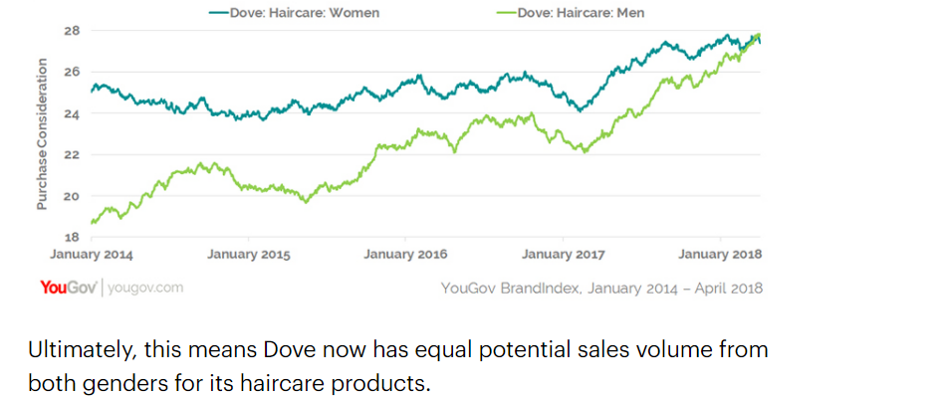

Slide 6
SAMPLES
Women | Men
25 | 19
24 | 21
26 | 23
26 | 24
28 | 28
24 | 23
23 | 23
22 | 24
27 | 20

Slide 7
Hypothesis Testing
Step 1: Y = year
X = women and men
Step 2: alpha=0.05 confidence level = 95.5
Step 3: 2 sample T-test
Step 4: H0 : µB = µA
Step 5: H1: µb =! µA
Step 6: P = 0.05837 | alpha = 0.05
Step 7: P is high
Step 8: Null accepted
Step 9: There is no difference by the advertisment

