Slide 1












Equivariance
$$T′$$
$$φ$$
$$φ$$
Mathematically,
$$φ$$
$$T$$
$$φ$$
$$φ$$
In convolutional layers,
$$T$$

Slide 2
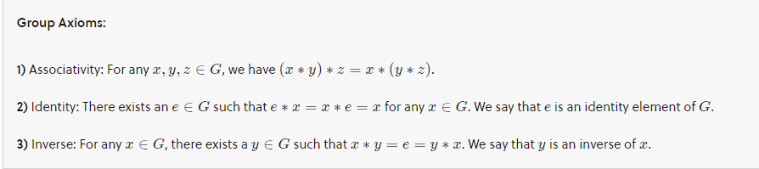
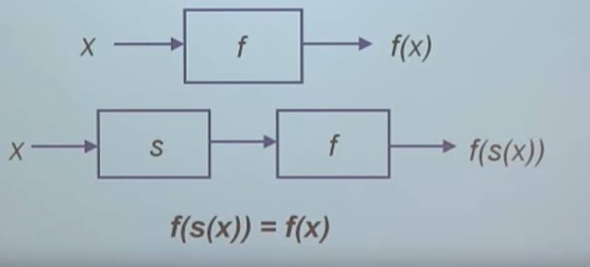
Symmetry groups
Group is a set G with an operation that takes two elements of G and combines them to produce a third element of G.
In symmetry group, group elements are functions and operator is a function composition.

Slide 3

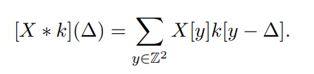

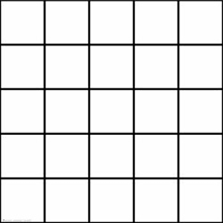
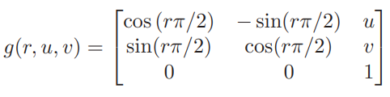
P4 groups
First layer,

Slide 4
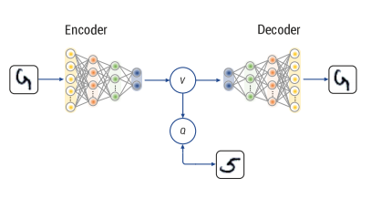
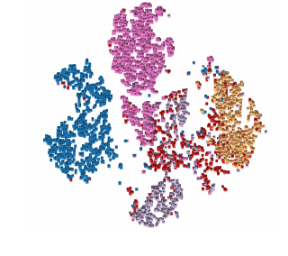
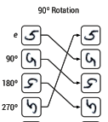


Equivariant Autoencoder
E- CAE
Feature Matrix
V_{p4} € R ^{4 x m}
Equivariance
Invariance
Permutations induced by transformation

Slide 5


Extracting Invariant features
Average Pooling:
1. Encoder maps an input image to an embedding matrix V ∈ R^{n×m.}
2. Average its rows
3. Permutation of rows will only change summation order, making w_{mean} an invariant vector.
Gram Pooling:
1. The value remains constant after any transformation, since permutation changes only order of summation.

Slide 6
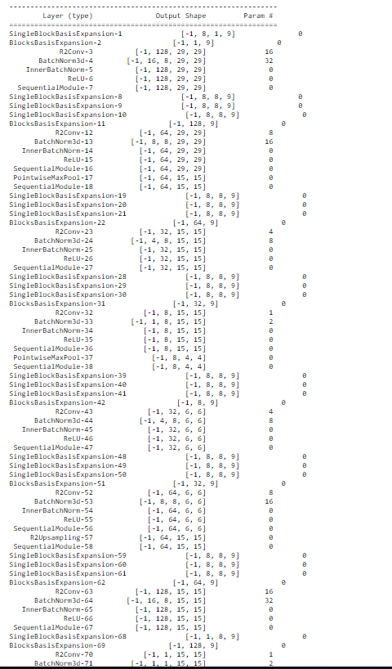
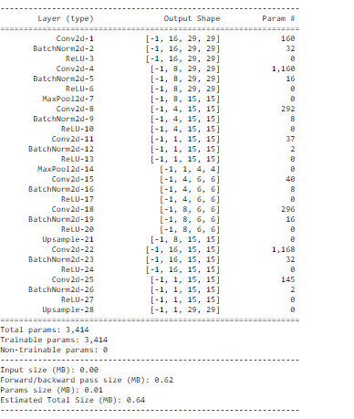
Architecture
Equivariant CAE
CAE

Slide 7

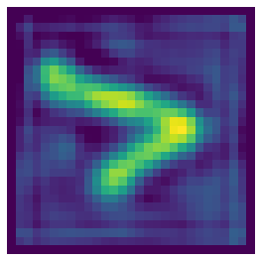
Results
Invariant Embedding's
Neural Network
Compare accuracy
Model | Group | Accuracy – Neural Network
Auto encoder | --- | 33%
ECAE - Average Pooling | P8 | 39%
ECAE - Gram Pooling | P8 | 51%
Original Image
Reconstructed

Slide 8
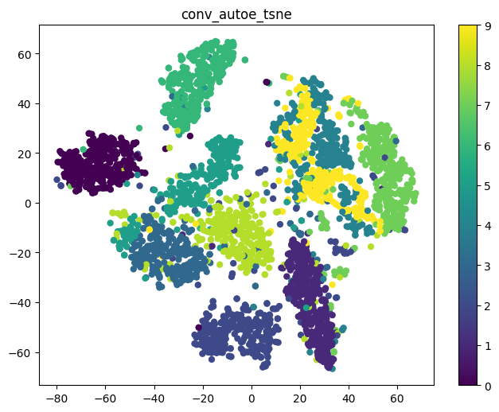
TSNE - Unrotated MNIST as input images

Slide 9
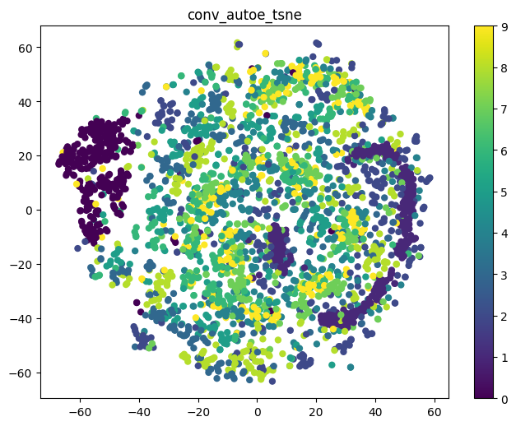
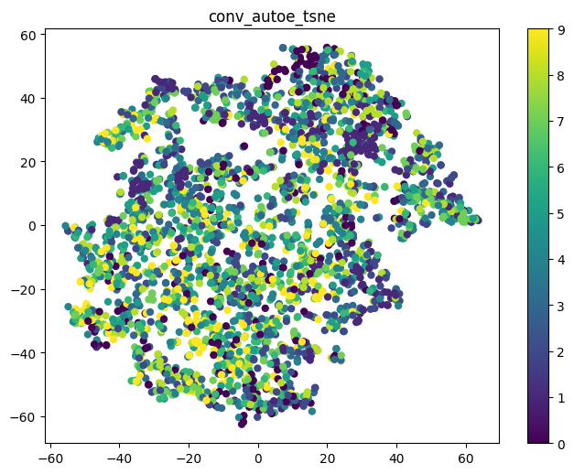
TSNE - Rotated MNIST input images
Input images
Latent space

Slide 10
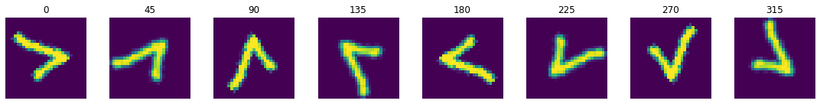
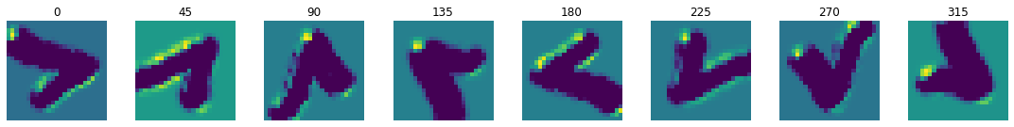
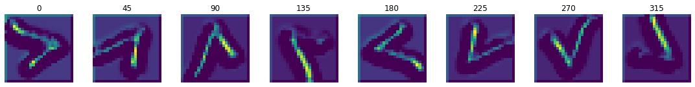
To show equivariance in the layers
Input
First Layer Output of first channel
Second Layer Output of first channel

Slide 11

Equivariance p4
To get transformation of feature maps,
Feature maps are functions of the group G.
When we apply 90 degree rotation on input the output feature map also undergoes the same rotation.

Slide 12
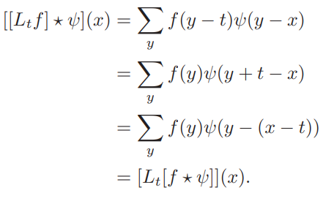
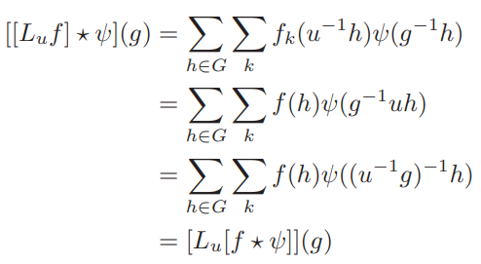
Equivariance - Mathematically
For translation,
For group equivariant nets,

