Slide 1
Data Efficient Assimilation of Multifidelity Information
Sangeeth Balakrishnan
Presentation
Committee:
Dr. Baskar Ganapathysubramanian, Major Professor
Dr. Soumik Sarkar
Dr. Adarsh Krishnamurthy
December 23rd 2019

Slide 2
Contents
Introduction
Applied to OSC – Morphology Generation
Applied to OSC – High and Low Fidelity data
Multi Fidelity Neural Network
Auto encoder Architecture
Sample Example Results
Training Low Fidelity data
Results
Training high fidelity data
Results
Evaluation of the trained network
Conclusion

Slide 3
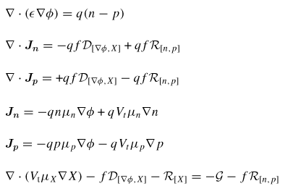
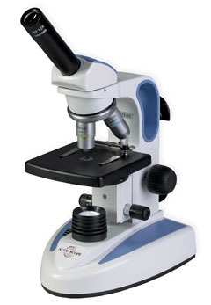
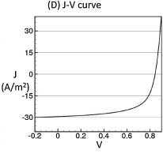
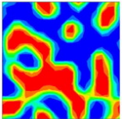
Introduction
Necessary to screen large pool of morphologies for identifying structure property linkages.
Predicting properties at highest level of accuracy has high computation cost, but is crucial.
Sometimes low fidelity methods are used to justify cost and accuracy.
High Fidelity Data
Data
Experiments/Simulations
Property Prediction
Courtesy : [2]
Courtesy : [3]
Courtesy : [4]
Courtesy : [3]

Slide 4
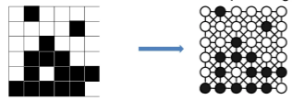
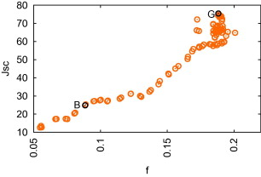



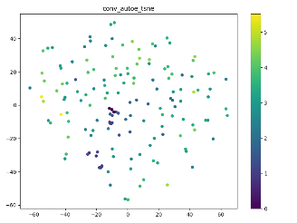
Low Fidelity Data
Data
Feature Engineering
Property Prediction
Courtesy : [1]
g₂
g₁
g₃
Courtesy : [6]
PCA
TSNE
Multi Fidelity Modeling using Machine Learning
Delta Learning
Low fidelity as feature
Co Kriging
Deep Learning
High Fidelity Data
Data
Experiments/
Simulations
Property Prediction

Slide 5
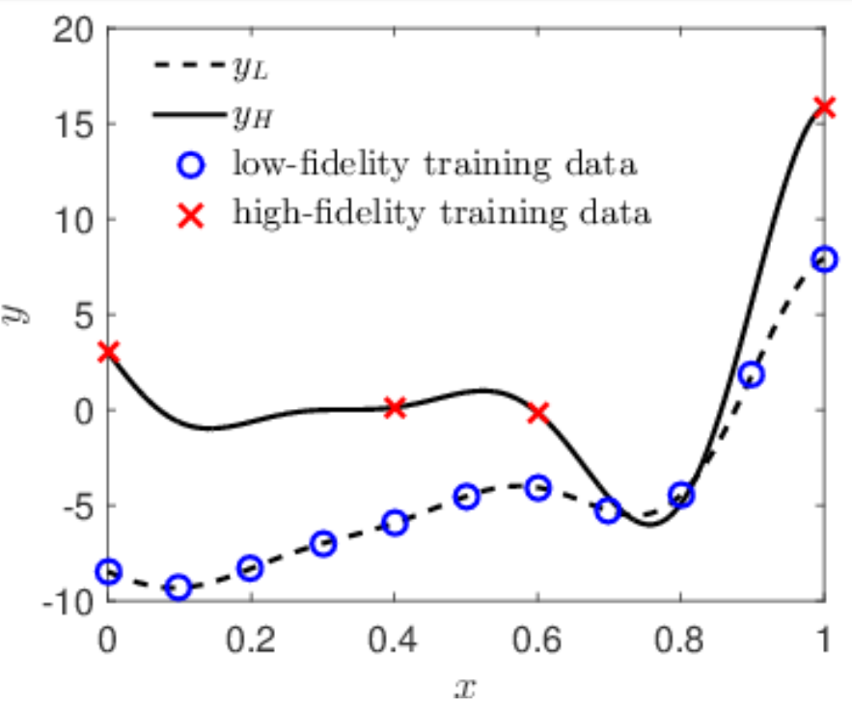
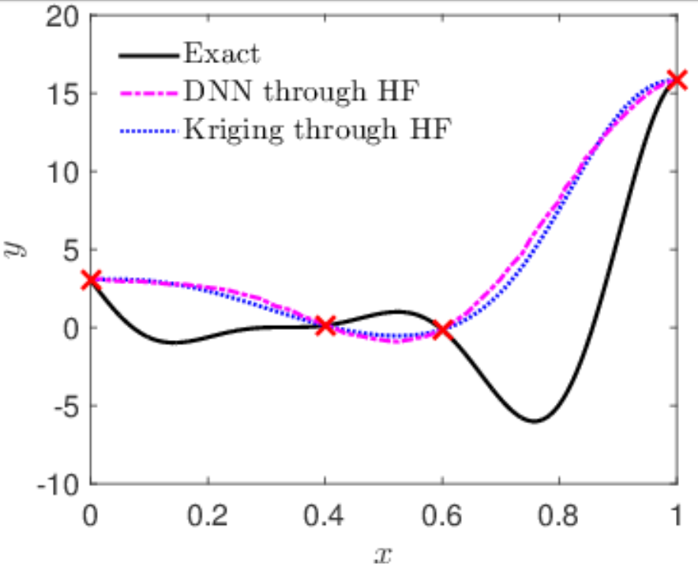
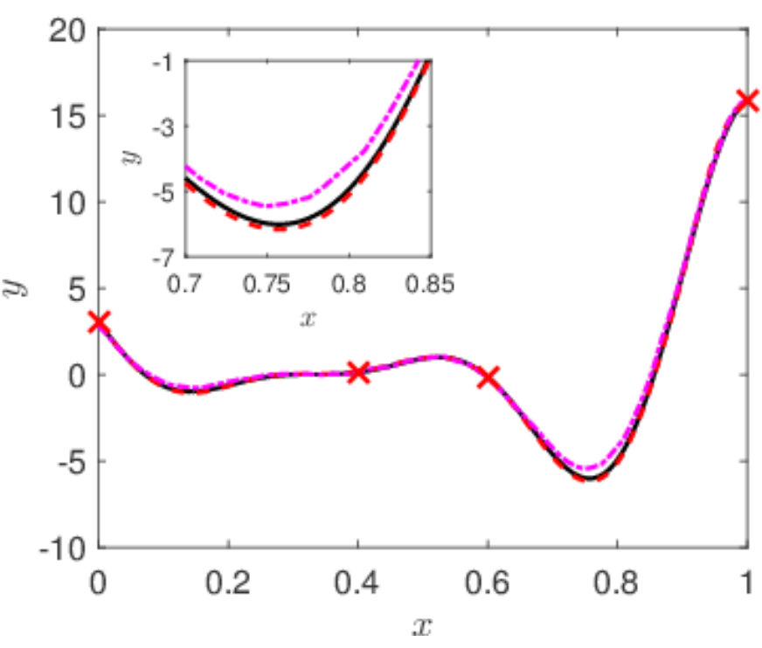
Example of how MFIF improve accuracy
Why Deep Learning?
To consider non linear cross correlation between low and high fidelity properties.
Automatically extract features from morphologies lying on higher dimensional space.
Better accuracy with big data due to high model capacity.
Produce faster predictions.
Courtesy: [5]

Slide 6
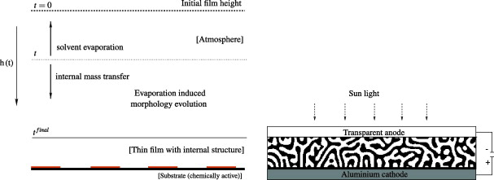
Applied to OSC – Morphology Generation
Solvent based fabrication
Thin film sandwiched between two electrodes
Courtesy: [2]
Courtesy: [2]
Morphology Generation
Cahn Hilliard Equation to simulate morphology evolution
Courtesy: [2]

Slide 7
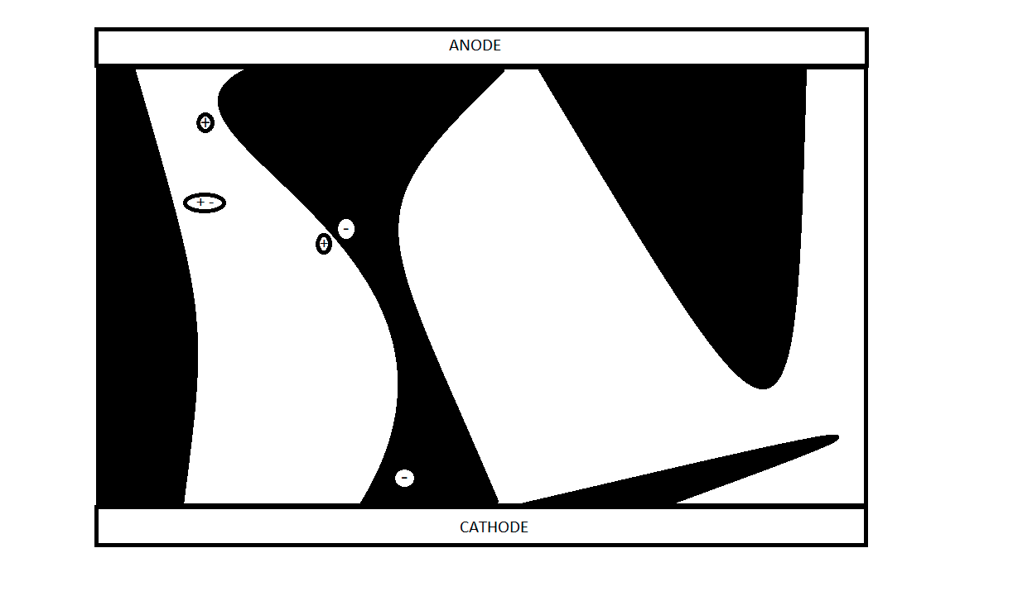
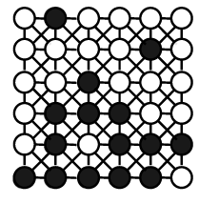
Applied to OSC – High and Low Fidelity data
High Fidelity data
Short Circuit Current
Generation Efficiency
Transport Efficiency
Recombination Efficiency
Courtesy : [3]
Low Fidelity data
Morphology Descriptors
Light Absorption
(i) Fraction of donor atoms
(ii) Weighted fraction of donor atoms
Exciton Diffusion
Fraction of donor atoms within
exciton diffusion distance
Exciton Dissociation
Interfacial Area
Charge Transport
(i) Fraction of non islands
(ii) Fraction of donor acceptor interface
with complementary path to both electrodes
Sun
Anode
Morphology Descriptors
Exciton Diffusion :
Fraction of donor atoms within exciton diffusion distance
Morphology Descriptors
Charge Transport :
(i) Fraction of non islands
(ii) Fraction of donor acceptor interface
with complementary path to both electrodes
Morphology Descriptors
Exciton Dissociation :
Interfacial Area
Graph
Morphology Descriptors
Light Absorption :
(i) Fraction of donor atoms
(ii) Weighted fraction of donor atoms
(iii)
(i)
(ii)
(iv)
Courtesy: [1]
Cathode

Slide 8
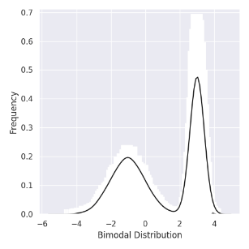
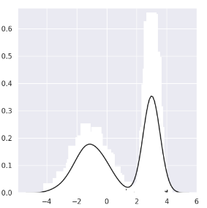
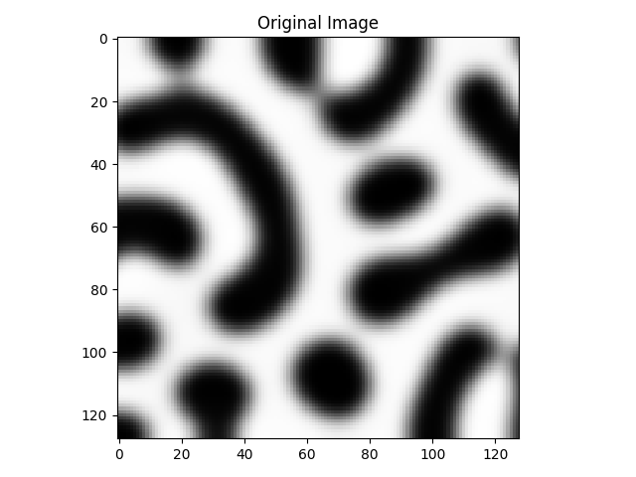
Multifidelity Neural Network
Example: Sampling a KDE distribution
X
Bimodal Distribution
20000 samples
2000 samples
200 samples
KDE Sampling
CNN Encoder
47000 samples for training auto encoder and first neural network.
1% and 10% samples for training second neural network.
G
G, X
CNN Decoder
CNN + F.C. Neural Network
X → Latent space
G → Morphology descriptors
J → Short circuit current
J

Slide 9
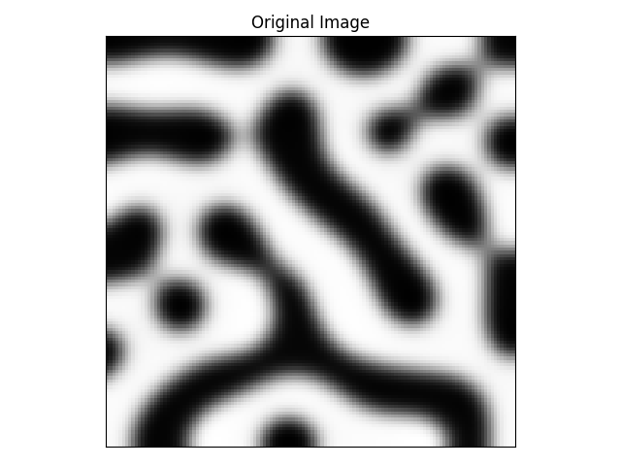
Auto encoder Architecture
To find the low dimensional representation and ignore all correlated input features.
Convolutional layers extract hierarchical features from input image using few number of parameters and max pooling makes the network translation invariant.
Input Image
Ground truth
Conv + BN + Relu
Maxpooling
Up sampling
Sigmoid

Slide 10
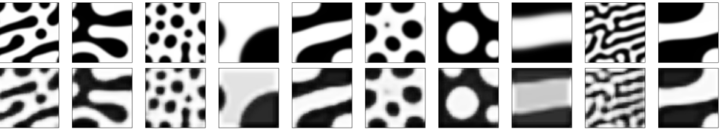
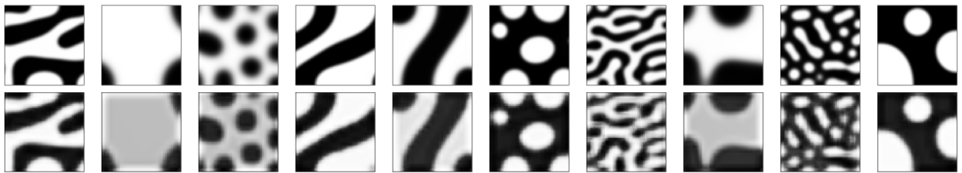
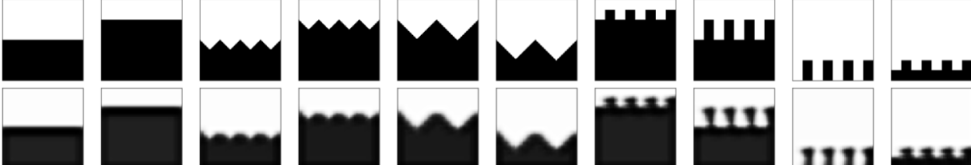
Convolutional AE – Sample Example Results
Training Results
Input
Reconstructed
Testing Results
Input
Reconstructed
Out Sample Results
Input
Reconstructed

Slide 11
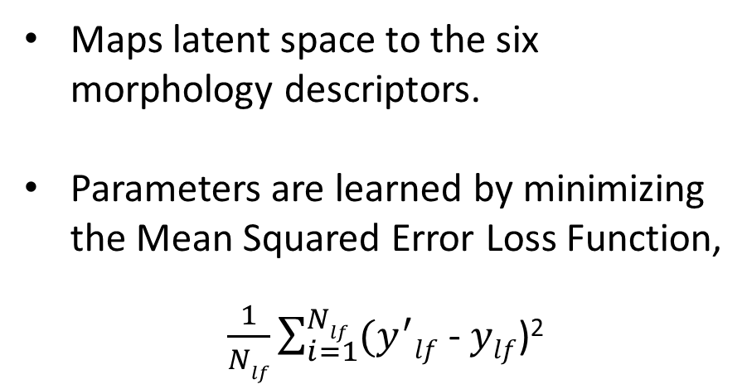
Training Low Fidelity data
Encoder
Decoder
Maps latent space to the six morphology descriptors.
Parameters are learned by minimizing the Mean Squared Error Loss Function,
$\frac{1}{Nlf}\sum_{i=1}^{Nlf}{(y^{′}lf}$ - $ylf$)²
Flatten
Conv + BN + Relu
Max pooling
Dense + Relu
(Low fidelity features)

Slide 12
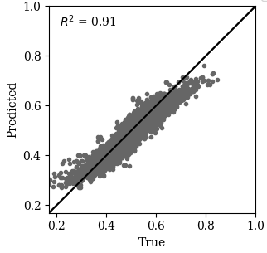
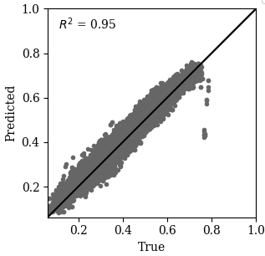
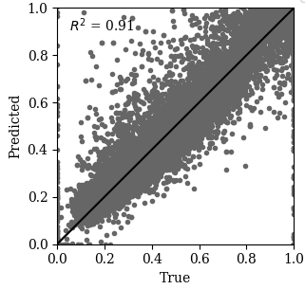
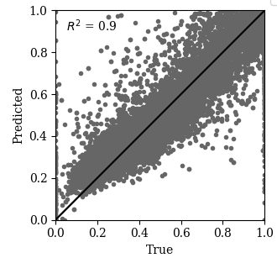
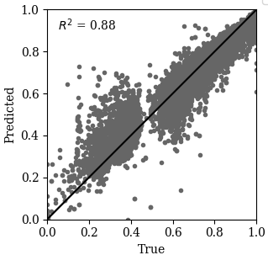
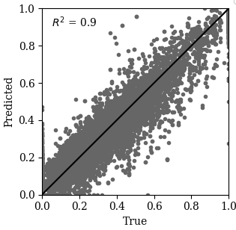
Low Fidelity NN – Test Results
Light Absorption
Weighted Absorption
Diffusion – Black vertices
Diffusion- White vertices
Charge Transport – Non islands
Charge Transport – Comp. path

Slide 13
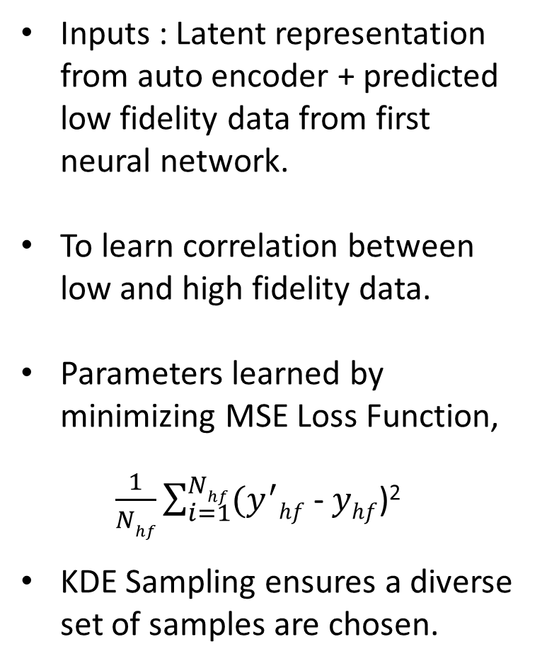
Training High Fidelity data
Inputs : Latent representation from auto encoder + predicted low fidelity data from first neural network.
To learn correlation between low and high fidelity data.
Parameters learned by minimizing MSE Loss Function,
$\frac{1}{Nhf}\sum_{i=1}^{Nhf}{(y^{′}hf}$ - $yhf$)²
KDE Sampling ensures a diverse set of samples are chosen.
Encoder
Decoder
Latent space
Predicted morphology descriptors
from first neural network
Flatten
concatenate
Conv + BN + Relu
(High fidelity features)
Max pooling
Dense + Relu

Slide 14
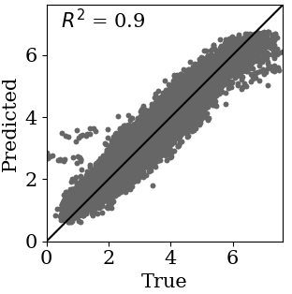
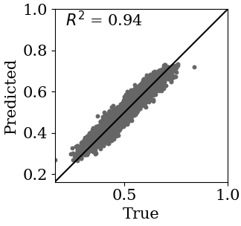
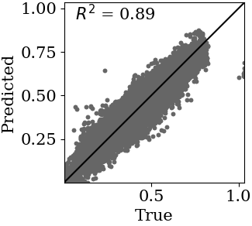
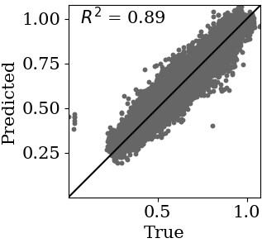
High Fidelity NN – Test Results
10% data
Short Circuit Current
Generation Efficiency
Recombination Efficiency
Transport Efficiency

Slide 15
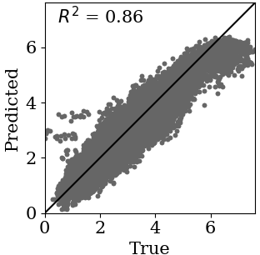
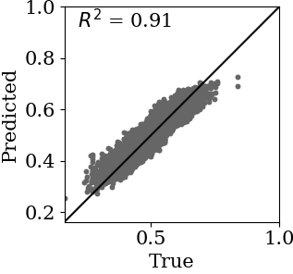
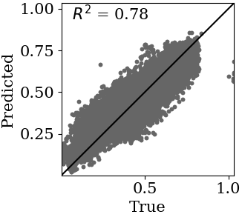
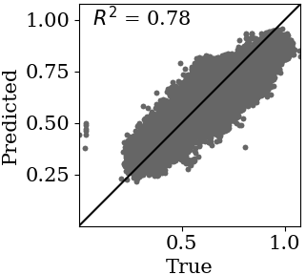
High Fidelity NN – Test Results
1% data
Short Circuit Current
Generation Efficiency
Recombination Efficiency
Transport Efficiency

Slide 16
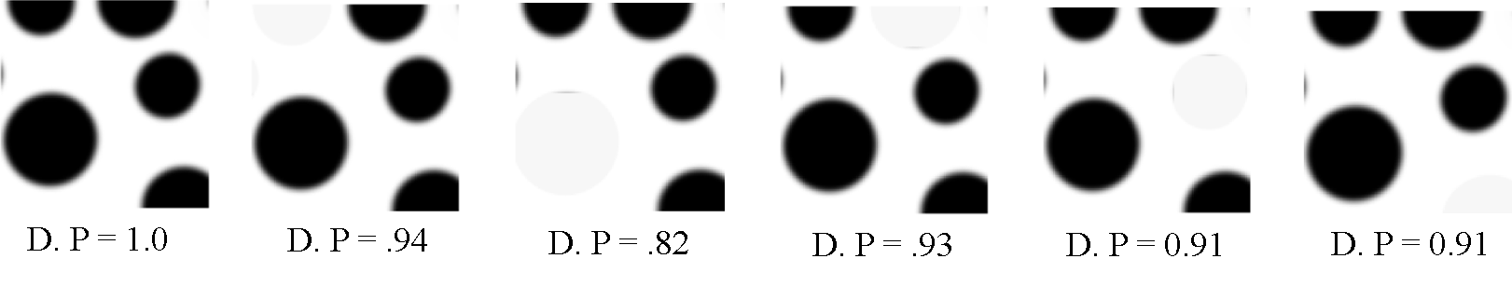
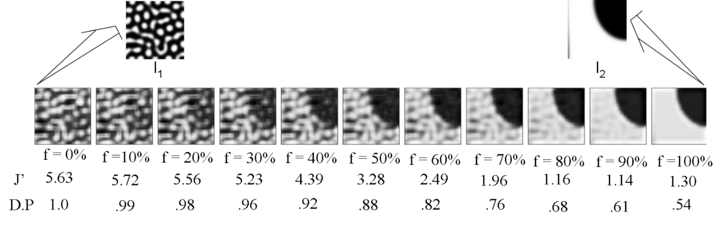
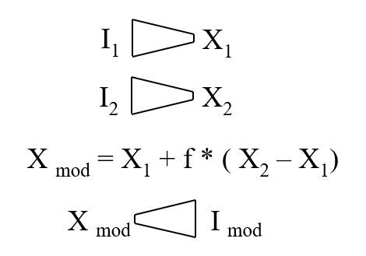
Latent space after tweaking the microstructure
D. P = Normalized Dot Product
= X1. X2/|X1||X2|
Reconstruction after interpolation between two latent vectors

Slide 17
Conclusion
A deep learning framework to provide inexpensive predictions at highest accuracy level.
Provided a proof of concept by implementing the model on Organic Solar Cell.
Predicted matches with true data for test cases, without using low fidelity data.
Model was tested for its robustness, interpretability and transfer ability.
Possible to investigate better materials with multiple properties.
Integrates physical phenomena into the training process.
Future Work
Correlate the latent vector to the morphology descriptors and input image data.
Variational Auto encoders to generate quality images.
Perform a comparative study with three other MFIF strategies –
(1) Delta Learning, (2) Low fidelity as a feature and (3) Multi Fidelity Co-kriging

Slide 18
References
[1] Du, P., Zebrowski, A., Zola, J., Ganapathysubramanian, B., & Wodo, O. (2018). Microstructure design using graphs. npj Computational Materials, 4(1), 50.
[2] Wodo, O., Ganapathysubramanian, B. (2012). Modeling morphology evolution during solvent-based fabrication of organic solar cells. Computational Materials Science, 55, 113-126.
[3] Wodo, O., Zola, J., Pokuri, B. S. S., Du, P., & Ganapathysubramanian, B. (2015). Automated, high throughput exploration of process–structure–property relationships using the MapReduce paradigm. Materials discovery, 1, 21-28.
[4] GreatScopes “Microscope Activities.”, GreatScopes, https://www.greatscopes.com/activity.html
[5] Meng, X., & Karniadakis, G. E. (2019). A composite neural network that learns from multi-fidelity data: Application to function approximation and inverse PDE problems. arXiv preprint arXiv:1903.00104.
[6] Wodo, O., Tirthapura, S., Chaudhary, S., Ganapathysubramanian, B. (2012). A graph-based formulation for computational characterization of bulk heterojunction morphology. Organic Electronics, 13(6), 1105-1113.

Slide 19
Thank you!

Slide 20
Supplementary Information

Slide 21
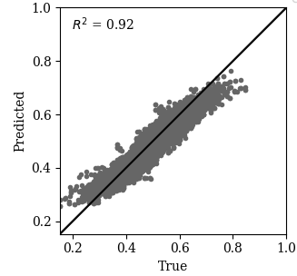
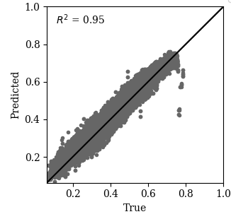
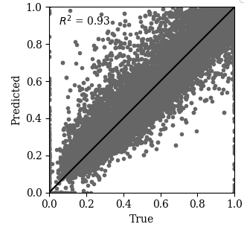
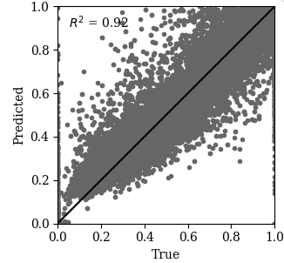
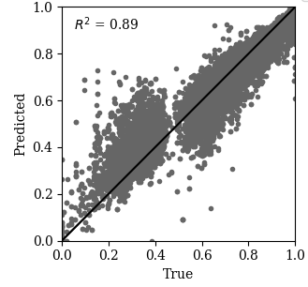
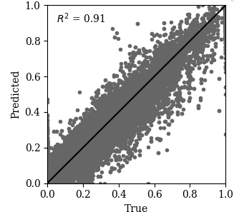
Training results - Low Fidelity
Light Absorption
Weighted Absorption
Diffusion – Black vertices
Diffusion- White vertices
Charge Transport – Non islands
Charge Transport – Comp. path

Slide 22
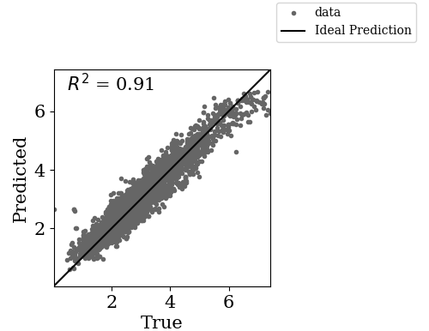
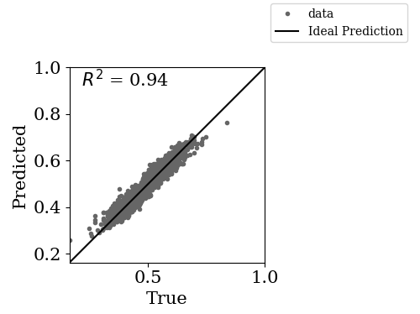
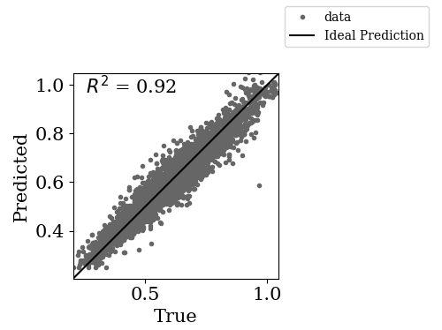
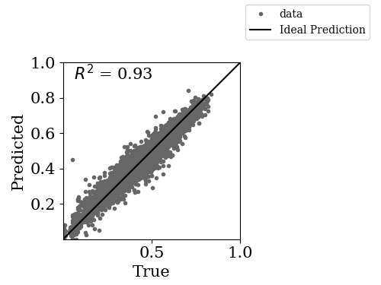
Training Results : High Fidelity
10% data
Short Circuit Current
Generation Efficiency
Transport Efficiency
Recombination Efficiency

Slide 23
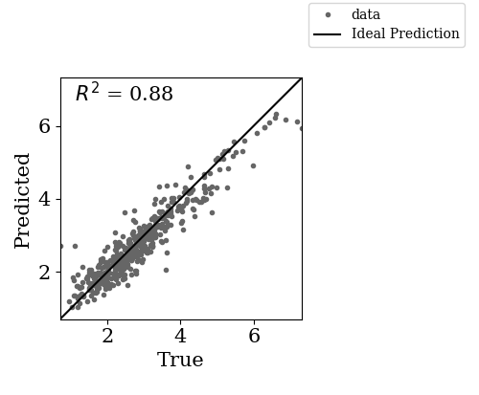



Training Results : High Fidelity
Generation Efficiency
Short Circuit Current
1% data
Transport Efficiency
Recombination Efficiency

Slide 24


Evaluation of the trained network
Reconstruction after tweaking the latent space

Slide 25




Slide 26



Loss Plots
I→X→ I
X → G
G, X → J

Slide 27
Auto encoder Architecture
128@128*128
Convolution
De-convolution
128@128*128
64@64*64
64@64*64
1@32*32
1@32*32
1@16*16
Input Image
Ground truth
Conv + BN + Relu
Maxpooling
Upsampling
Sigmoid

Slide 28
Training Low Fidelity data
Encoder
Decoder
1@16*16
Latent space
2@16*16
64@8*8
Flatten
F.C Layer1 (1024)
F.C Layer2 (64)
Conv + BN + Relu
F.C Layer3 (32)
Max pooling
F.C Layer4 (16)
Output Layer (5)
Dense + Relu
(Low fidelity features)

Slide 29

Training High Fidelity data

