Slide 1
H100 · bf16 · PRE-MEETING
Kernel optimization with NVIDIA
three working tracks
Today's pre-meeting fixes the agenda for the 7/2 offline session. Each track is backed by kernels already built and benchmarked.
오늘 사전 미팅에서 7/2 오프라인 세션의 의제를 정합니다. 각 트랙은 이미 만들고 벤치한 커널이 뒷받침합니다.
We build v1 → NVIDIA optimizes v2 · 1차 개발은 우리가 → 2차 최적화는 NVIDIA가

Slide 2
THE AGENDA · 의제
What we want to agree on today
오늘 합의하려는 것
TRACK 01 Co-optimize the kernels — we build v1, NVIDIA optimizes v2 (fwd / bwd / inference, op by op)
커널 공동 최적화 — 우리가 1차, NVIDIA가 2차 (forward / backward / inference, op 단위)
TRACK 02 AF3-like model inference — large inference on a single ordinary GPU (chunking, CPU offload, fused kernels)
AF3-like 모델 인퍼런스 — 일반 GPU 한 장에서 대규모 인퍼런스 (chunking, CPU offload, 융합 커널)
TRACK 03 Education & ramp-up — from AI-assisted to expert CuTeDSL (material, pairing, learn from each re-optimization)
교육 & 역량 강화 — AI 보조에서 CuTeDSL 전문 수준으로 (자료·페어링·재최적화 학습)

Slide 3
TRACK 01 · CO-OPTIMIZE THE KERNELS
Four kernels — vs the same default & vs NVIDIA's own
All forward, H100, bf16. Baseline = torch.compile'd PyTorch. · 전부 forward, 기준선 = torch.compile PyTorch.
Triangle Multiplication 11.3× vs default · beats cuEquivariance & dt-v1 by 1.2–1.4× at every L
Transition (SwiGLU) 5.5× vs default · one fused kernel, h never touches HBM
LayerNorm + Linear 3.1× vs default · beats TransformerEngine at every (M, d)
LayerNorm 6.0× vs default · cuEquivariance gives only ~1.0× at large d

Slide 4
TRACK 01 · TRIANGLE MULTIPLICATION
Architecture — two fused kernels around one bmm
아키텍처 — bmm을 사이에 둔 두 개의 융합 커널
BASELINE — separate launches · 분리된 다중 launch
LN_in
left
right
gate
transpose
bmm
LN_out
out·gate
OURS — fused · 융합
KERNEL 1 · input proj (tm1)
cuBLAS bmm · L³
KERNEL 2 · output proj (tm2)
Fusion: left+right become ONE gated GEMM; the bdll direct write removes the transpose (TMA); LN_in is folded into the GEMM.
퓨전: 좌+우를 하나의 gated GEMM으로; bdll 직접 기록으로 transpose 제거(TMA); LN_in을 GEMM에 folding.

Slide 5
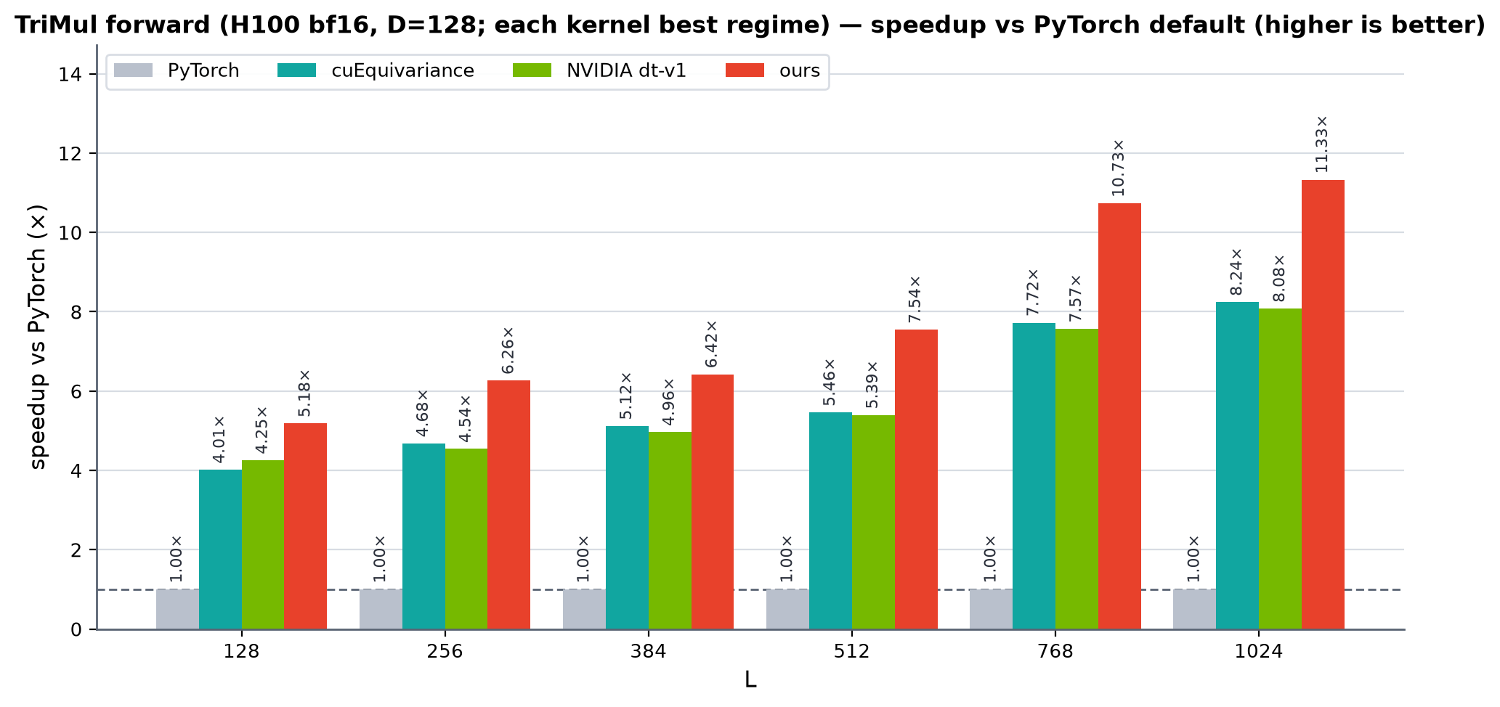
TRACK 01 · TRIANGLE MULTIPLICATION
Two fused kernels around one bmm
bmm을 사이에 둔 두 개의 융합 커널
K1 Input projection (tm1): LN_in + left/right in one gated GEMM, writing bdll directly (no transpose).
입력 사영(tm1): LN_in + 좌/우를 하나의 gated GEMM으로, bdll 직접 기록 (transpose 제거).
K2 Output projection (tm2): LN_out + out-proj ⊙ gate, fused in the epilogue.
출력 사영(tm2): LN_out + out-proj ⊙ gate를 epilogue에서 융합.
→ Best at every L; 1.87 ms @ L=1024 vs cuEquiv 2.57.
모든 L에서 최고; L=1024서 1.87 ms vs cuEquiv 2.57.

Slide 6
TRACK 01 · TRANSITION (SwiGLU MLP)
Architecture — fusion removes HBM round-trips
아키텍처 — 융합으로 HBM 왕복 제거
BASELINE — separate launches · 분리된 다중 launch
LayerNorm
expand ↑4×
SwiGLU
squeeze ↓
OURS — fused · 융합
LN → expand ↑4× → SwiGLU → squeeze (h stays in SMEM / registers)
Fusion: back-to-back fuse the whole MLP into ONE launch — the 4×-wide hidden h stays in SMEM, zero HBM round-trips (baseline does 3).
퓨전: MLP 전체를 한 번의 launch로 b2b 융합 — 4× 넓은 hidden h가 SMEM에 상주, HBM 왕복 0회(baseline은 3회).

Slide 7
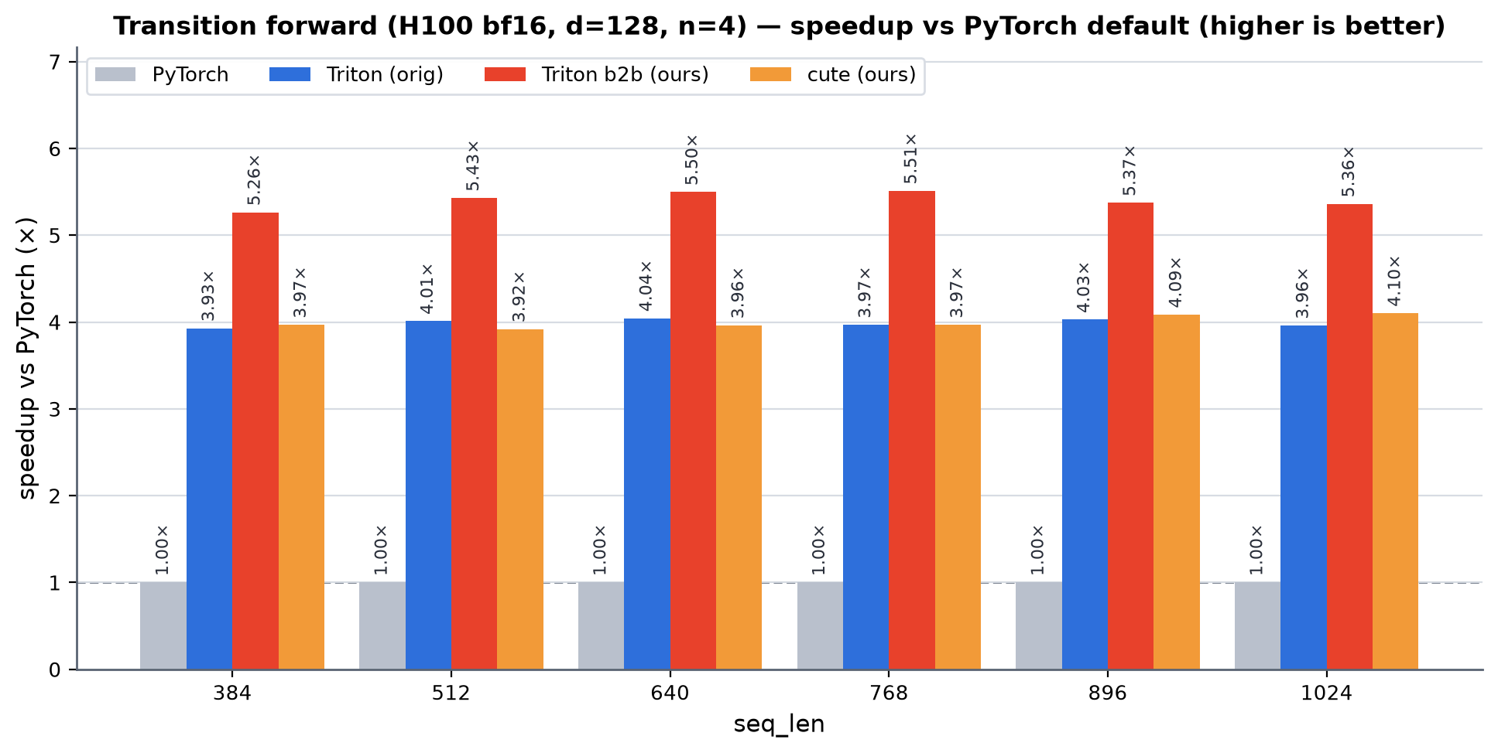
TRACK 01 · TRANSITION (SwiGLU MLP)
One fused kernel — h never touches HBM
한 개의 융합 커널 — h가 HBM에 가지 않음
1 Naive path writes the 4×-wide hidden h to HBM between every stage (3 round-trips).
naive 경로는 4× 넓은 hidden h를 단계마다 HBM에 기록 (3회 왕복).
2 Ours fuses LN → expand → SwiGLU → squeeze into one launch; h stays in SMEM.
ours는 LN → expand → SwiGLU → squeeze를 한 번의 launch로; h는 SMEM 상주.
→ ~5.5× vs PyTorch; 1.24 ms vs 6.67 ms @ 1024.
PyTorch 대비 ~5.5×; 1024서 1.24 ms vs 6.67 ms.

Slide 8
TRACK 01 · LAYERNORM + LINEAR
Architecture — LN folded into the GEMM epilogue
아키텍처 — LN을 GEMM epilogue에 folding
BASELINE — separate launches · 분리된 다중 launch
LayerNorm (mean·rstd·normalize)
X̂ ↔ HBM
Linear / GEMM X̂·W
OURS — fused · 융합
GEMM tile loop: mean/rstd → normalize+affine (epilogue) → X̂·W (X̂ stays in registers)
Fusion: compute LN stats inside the GEMM tile loop and fold normalize+affine into the epilogue — X̂ never reaches HBM.
퓨전: GEMM 타일 루프 안에서 LN 통계를 계산하고 normalize+affine을 epilogue에 folding — X̂가 HBM에 도달하지 않음.

Slide 9
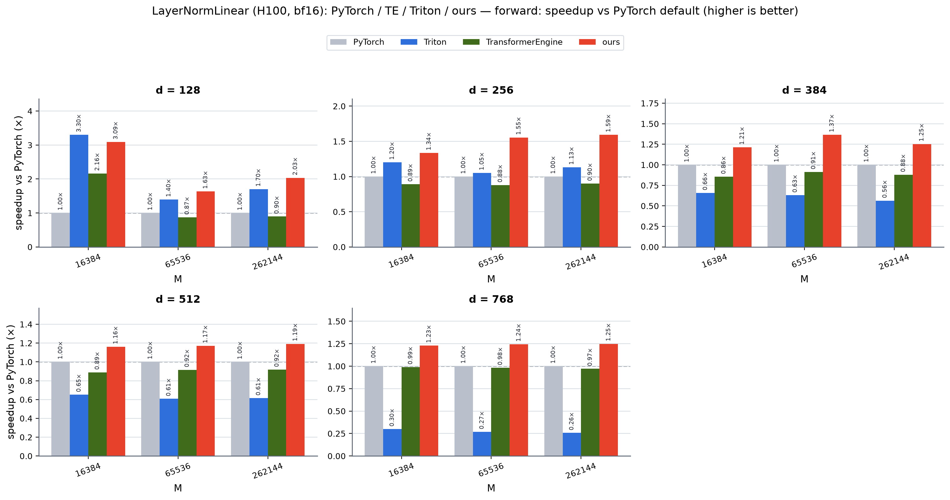
TRACK 01 · LAYERNORM + LINEAR
LN folded into the GEMM epilogue
LN을 GEMM epilogue에 folding — TransformerEngine 능가
1 Baseline writes normalized X̂ to HBM; a GEMM reads it back.
baseline은 정규화된 X̂를 HBM에 기록 → GEMM이 다시 읽음.
2 Ours computes LN stats in-kernel, folds normalize+affine into the epilogue — X̂ never reaches HBM.
ours는 LN 통계를 커널 내에서 계산해 epilogue에 folding — X̂가 HBM에 안 감.
→ TE drops below the compiled-PyTorch baseline at large d; ours leads everywhere.
큰 d에서 TE는 기준선 아래; ours는 전 구간 선두.

Slide 10
TRACK 02 · AF3-LIKE MODEL INFERENCE
The wall — and why existing fixes fall short
Single-GPU wall at ~1–3k residues (pair rep is O(N²); ≈100× more kernel launches than an LLM). · 단일 GPU 벽 ~1–3k residue.
Fold-CP — needs a multi-GPU cluster (dozens–256 GPUs); no help for single-GPU users · 클러스터 필요
FastFold / AutoChunk — chunking is generic / op-agnostic (recompute overhead); mostly AlphaFold2 · 범용·op무관, AF2 중심
LightNobel — a precision tradeoff from quantization · 양자화 정밀도 손실
MegaFold / ScaleFold — training systems, limited inference benefit · 학습 시스템

Slide 11
TRACK 02 · THE GAP · 빈 자리
Why go further — co-design, not generic patches
Each existing line solves one axis generically. None co-designs fused kernels + op-aware chunking for AF3 inference on a single GPU — where the gains compound.
기존 방법들은 각자 한 축을 범용적으로만 풉니다. 융합 커널 + op별 chunking을 AF3 단일 GPU 인퍼런스에 공동설계한 사례는 없습니다.
1 Op-aware chunking / streaming of the O(N²) pair representation. · O(N²) pair 표현의 op-인지 chunking.
2 CPU offload for cold tensors, overlapped with compute. · cold 텐서 CPU offload, 연산과 오버랩.
3 Inference-only fused paths — fewer intermediates → less memory AND less recompute than chunking alone.
인퍼런스 전용 융합 경로 — chunking만 할 때보다 메모리·recompute 둘 다 절감. cuEquivariance는 속도 한계가 아님.

Slide 12
TRACK 03 · EDUCATION & RAMP-UP
From AI-assisted to expert
Where we stand: Triton — write & autotune directly; CuTeDSL — used it, but AI-driven; we validate vs fp64 and read roofline.
현재 수준: Triton 직접 작성·오토튠 / CuTeDSL은 AI 주도 / fp64 검증·roofline 해석 가능.
Where AI plateaus: cute ≈ Triton-level or simple quack variants; not yet fluent in warp specialization, TMA/WGMMA pipelining, epilogue fusion, occupancy budgeting.
AI의 한계: cute가 Triton 수준 / warp specialization·TMA·WGMMA·epilogue 융합·occupancy는 미숙.
What would help: internal CuTeDSL / SM90 material + canonical patterns; light pairing / office hours; profile → next-lever guidance.
요청: 내부 CuTeDSL/SM90 자료 + canonical 패턴, 가벼운 페어링, 프로파일 해석 가이드.
Learn from the diff — we build v1, NVIDIA re-optimizes to v2, we study what changed and why. · diff로 배우기.

Slide 13
OUTCOME · 결과물
From today to 7/2
Today Agree the three tracks — scope, and which kernel / op leads each. · 세 트랙 합의.
Before 7/2 Prepare evidence & questions — TriMul backward; a CuTeDSL question list. · 근거·질문 준비.
7/2 offline Work the diffs together — pick one kernel, do v1→v2 live. · 함께 diff 작업.

Slide 14
METHODOLOGY & SOURCES · 방법론·출처
Honest caveats
· All baselines are torch.compile'd PyTorch (never eager). · 모든 기준선은 torch.compile PyTorch.
· H100 80GB, bf16, B=1. TriMul forward-only; each kernel at its best regime. cuEquiv / dt-v1 reproduce team-gm's harness.
· TriMul backward in development (within ~10% of dt-v1 at large L). · TriMul backward 개발 중.
Sources: Fold-CP arXiv:2603.14806 · MegaFold 2506.20686 · FastFold/AutoChunk PPoPP'24 / 2401.10652 · LightNobel 2505.05893 · AF3 docs

