Slide 1
Department of Computer Science
SeoKyeong University
CS1069
Embedded System
5th Lecture Note
Tel : 9 4 0 – 7 7 6 0
Office : Room 615, Buk-ak Bldg.
E-mail : tejeong@skuniv.ac.kr
Prof. T. E. Jeong

Slide 2
7 Segment

Slide 3
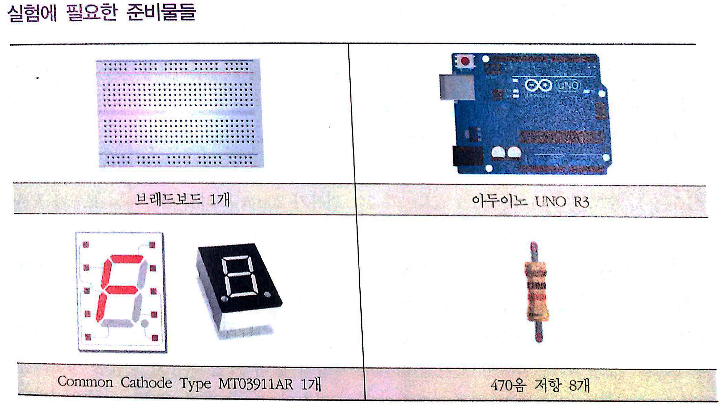
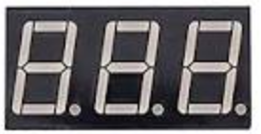
BM-6810 or ZN-4031AS
3 Digit 7 Segment

Slide 4
10(PD0)
BM-6810의 경우
9(PD3)
6(PD7)
Dig3 PD0 PD3 Dig2 Dig1 PD7
5(PD6)
11 10 9 8 7 6
1(PD1)
4(PD5)
2(PD2)
3(PD4)
1 2 3 4 5
e
b
f
PD1 PD2 PD4 PD5 PD6
a
c
g
d
dot

Slide 5
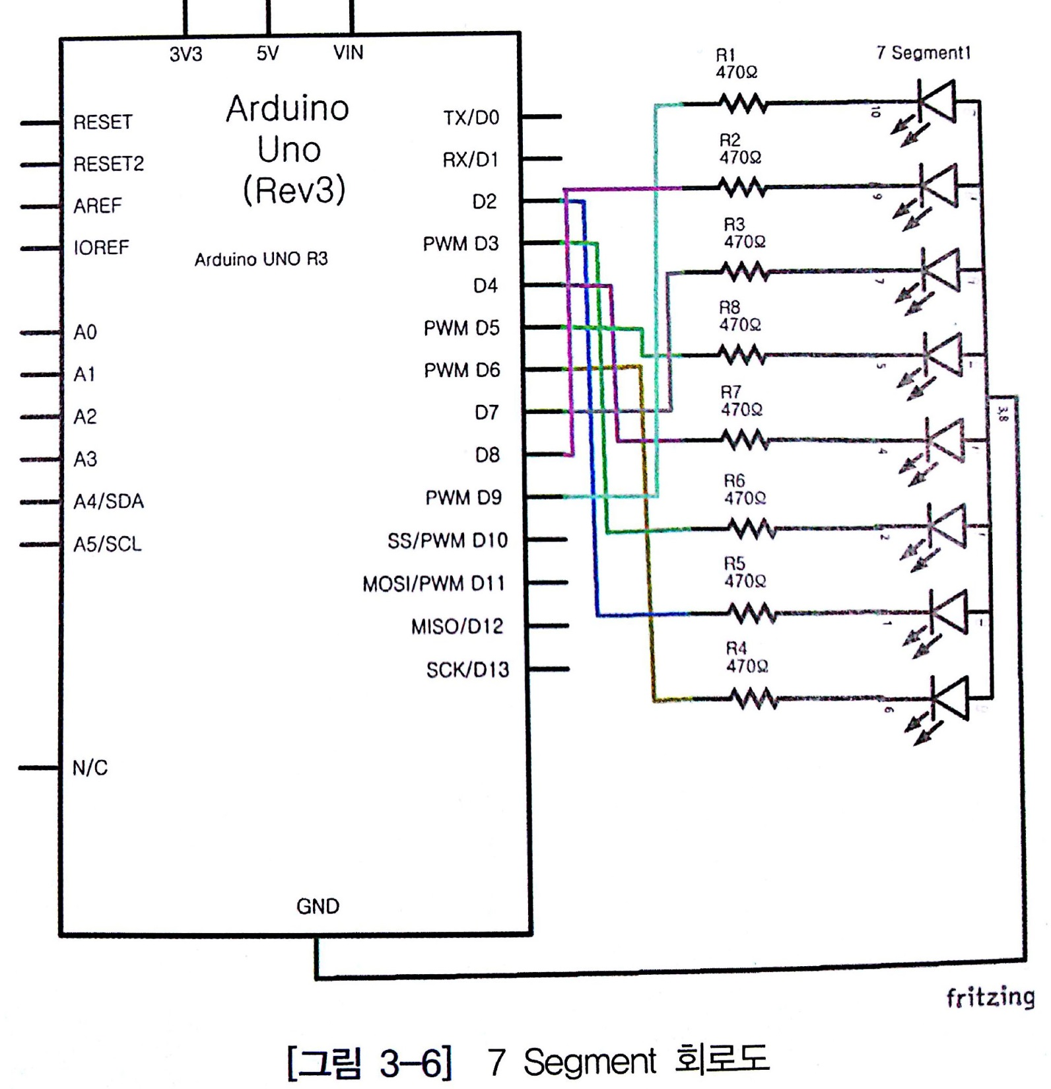
e=10
f=6
g=4
d=2
c=1
b=9
a=5
dot=3
dig1=7
dig2=8
dig3=11

Slide 6
const int _a=2;
const int _b=3;
const int _c=4;
const int _d=5;
const int _e=9;
const int _f=8;
const int _g=7;
const int _dot=6;
int dig1=10;
int dig2=11;
int dig3=12;
void setup() {
// put your setup code here, to run once:
pinMode(_a,OUTPUT);
pinMode(_b,OUTPUT);
pinMode(_c,OUTPUT);
pinMode(_d,OUTPUT);
pinMode(_e,OUTPUT);
pinMode(_f,OUTPUT);
pinMode(_g,OUTPUT);
pinMode(_dot,OUTPUT);
pinMode(dig1, OUTPUT);
pinMode(dig2, OUTPUT);
pinMode(dig3, OUTPUT);
}
void loop() {
// put your main code here, to run repeatedly:
digitalWrite(dig1, HIGH);
digitalWrite(dig2, HIGH);
digitalWrite(dig3, HIGH);
digitalWrite(_e,LOW);
digitalWrite(_b,LOW);
digitalWrite(_c,LOW);
digitalWrite(_d,LOW);
digitalWrite(_g,LOW);
digitalWrite(_f,LOW);
digitalWrite(_a,HIGH);
digitalWrite(_dot,HIGH);
delay(1000);
}
e
 | dig1 | dig2 | dig3
① | H | L | L
② | L | H | L
③ | L | L | H
④ | H | H | H
③ | ② | ①
④ all on
b
f
a
c
g
d
dot

Slide 7
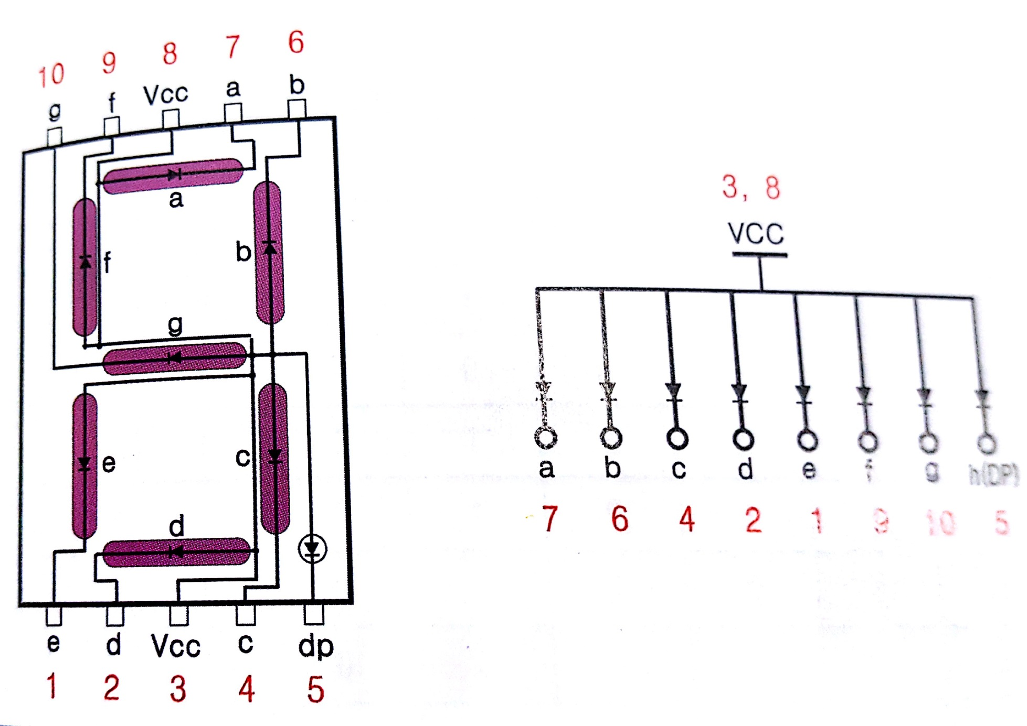
5101AS의 경우

Slide 8
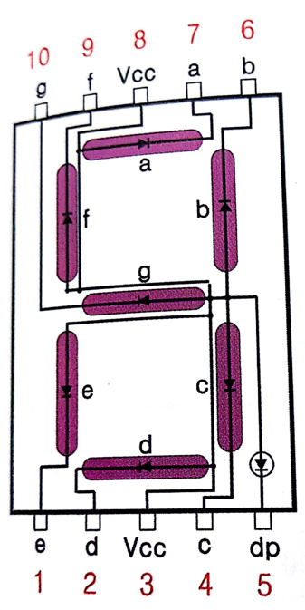
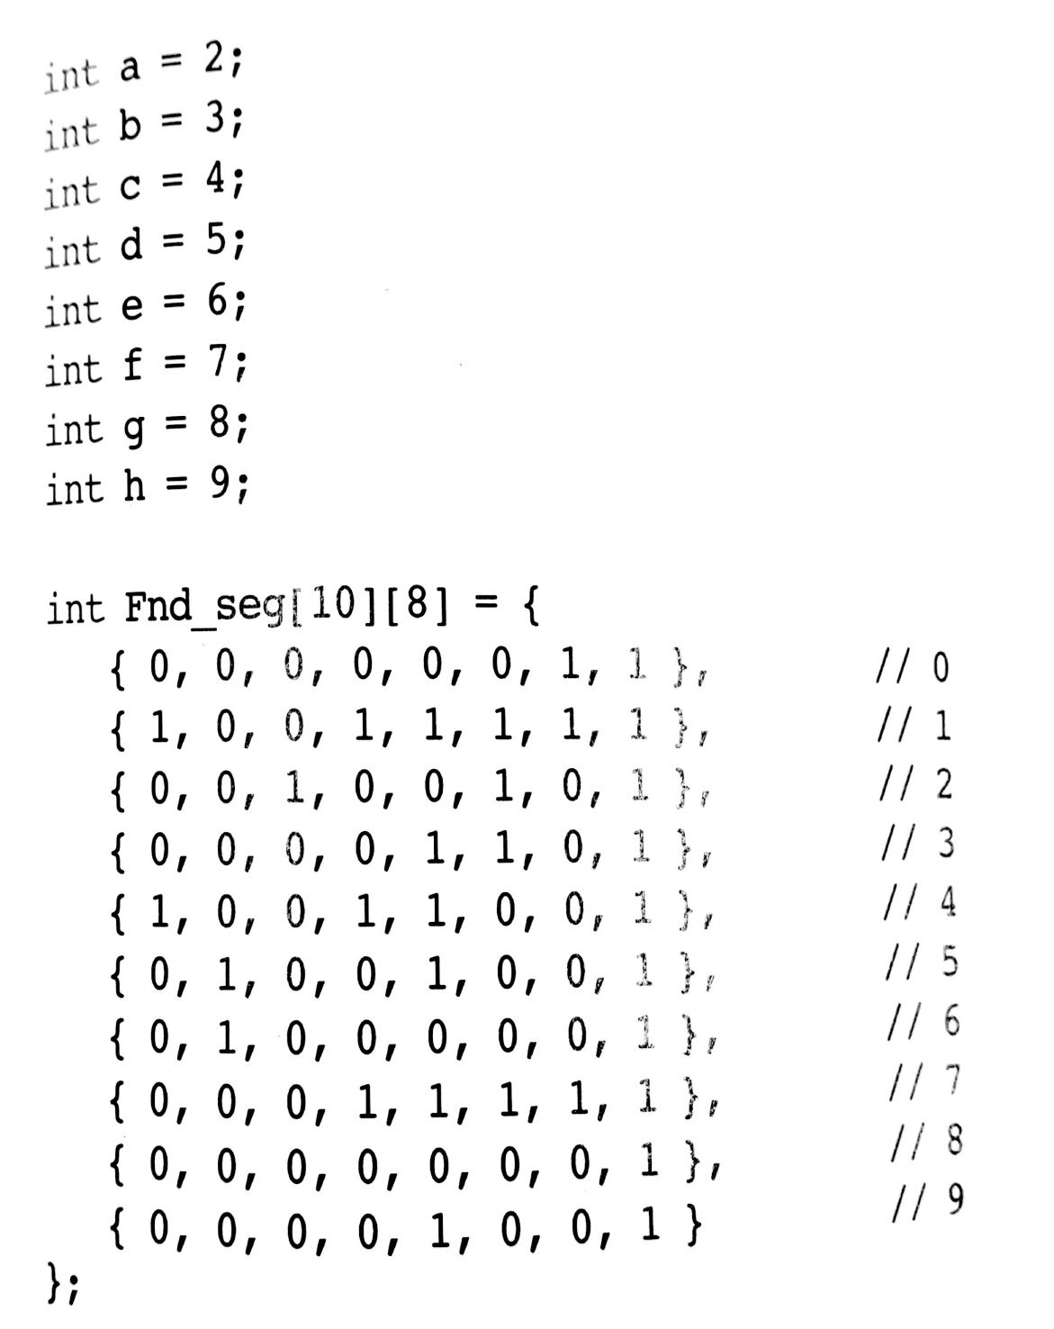
0에서 9까지 숫자 카운터 표시하기

Slide 9
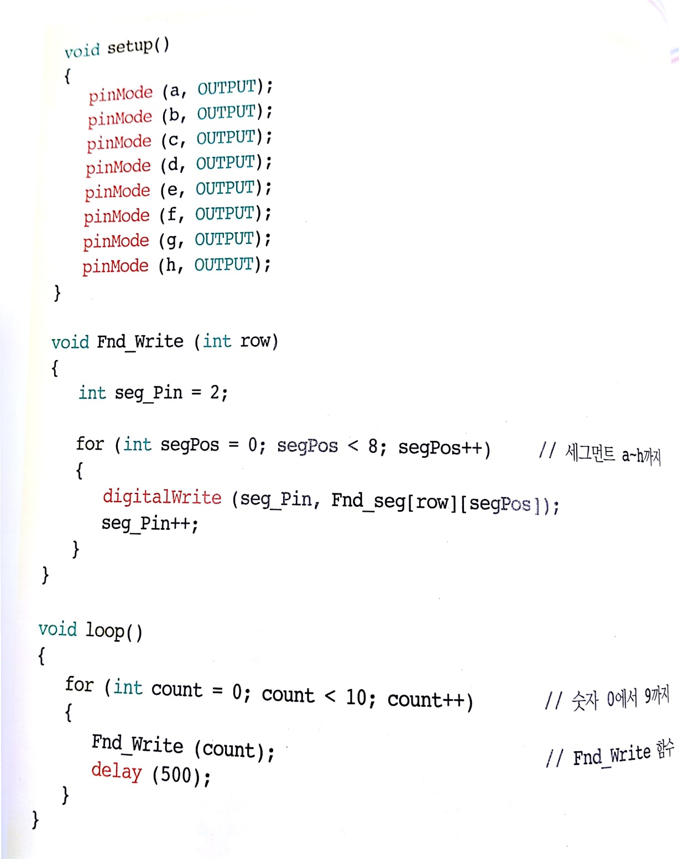

Slide 10
ZN-4031AS의 경우
Dig1 a f Dig2 Dig3 b
a
12 11 10 9 8 7
f
b
g
e
c
1 2 3 4 5 6
d
dot
e d dot c g no connect

Slide 11

dot=3
g=5
f=10
d=2
c=4
b=7
a=11
e=1
dig1=12
dig2=9
dig3=8

Slide 12
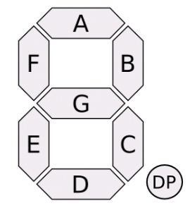
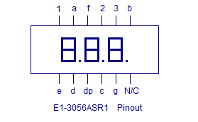
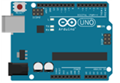
핀 위치 | 역할 | 포트 위치
1 | E | 6
2 | D | 5
3 | Dot | 9
4 | C | 4
5 | G | 8
6 | X(No Connect) | X(No Connect)
7 | B | 3
8 | Dig 3 | 12
9 | Dig 2 | 11
10 | F | 7
11 | A | 2
12 | Dig 1 | 10

Slide 13
const int a=2;
const int b=3;
const int c=4;
const int d=5;
const int e=6;
const int f=7;
const int g=8;
const int dot=9;
int dig1=10;
int dig2=11;
int dig3=12;
void setup() {
// put your setup code here, to run once:
pinMode(g,OUTPUT);
pinMode(f,OUTPUT);
pinMode(e,OUTPUT);
pinMode(d,OUTPUT);
pinMode(a,OUTPUT);
pinMode(b,OUTPUT);
pinMode(c,OUTPUT);
pinMode(dot,OUTPUT);
pinMode(dig1, OUTPUT);
pinMode(dig2, OUTPUT);
pinMode(dig3, OUTPUT);
}
void loop() {
// put your main code here, to run repeatedly:
digitalWrite(dig1, LOW);
digitalWrite(dig2, LOW);
digitalWrite(dig3, LOW);
digitalWrite(a, HIGH);
digitalWrite(f, HIGH);
digitalWrite(e, HIGH);
digitalWrite(d, HIGH);
digitalWrite(c, HIGH);
digitalWrite(b, HIGH);
digitalWrite(g, LOW);
digitalWrite(dot, LOW);
delay(1000);
}
a
f
b
g
e
c
d
dot
 | dig1 | dig2 | dig3
① | H | L | L
② | L | H | L
③ | L | L | H
④ | H | H | H
③ | ② | ①
④ all on

Slide 14
HOMEWORK
Clock (예: 3시 35분)
시간
3
분
3
분
5

