Slide 1

“Online Market Place for Local Business”
Sanjivani Rural Education Society’s
Sanjivani College of Engineering, Kopargaon 423 603
(Affiliated to Savitribai Phule Pune University, Pune )
Department of Computer Engineering
Prepared By,
Mr. Adhav Sangharsh [UCS23M1001]
Mr. Aher Ganesh [UCS23M1002]
Guided By,
Prof. S. S. Gawali

Slide 2
Contents
Sanjivani Rural Education Society’s
Sanjivani College of Engineering, Kopargaon 423 603
(Affiliated to Savitribai Phule Pune University, Pune )
Department of Computer Engineering Research Center
Introduction of project
Functionality of project
Details about Data types used in project
Details about predefine module/libraries used in project
Details about predefined function.6. Output of Code.

Slide 3
Introduction
Sanjivani Rural Education Society’s
Sanjivani College of Engineering, Kopargaon 423 603
(Affiliated to Savitribai Phule Pune University, Pune )
In today's digital age, the need for local businesses to establish a strong online presence is more crucial than ever.
Our platform aims to bridge the gap between traditional brick-and-mortar stores and the vast online market, providing local businesses with a powerful platform to thrive in the digital landscape.
Objectives
Our primary goal is to support and promote local businesses by offering them a dedicated online platform to reach a wider audience.
We aim to create a seamless shopping experience for consumers, allowing them to discover and purchase products from local businesses with ease.

Slide 4
Functionality of Project
Sanjivani Rural Education Society’s
Sanjivani College of Engineering, Kopargaon 423 603
(Affiliated to Savitribai Phule Pune University, Pune )
Display: This function displays details of available products.
Search: It searches for the product that the user wants to buy and shows its details.
Buy: This function allows the user to purchase products according to the required quantities.
Bill: It generates a bill for the user, including any applicable discounts.

Slide 5
Details about Data types used in project
Sanjivani Rural Education Society’s
Sanjivani College of Engineering, Kopargaon 423 603
(Affiliated to Savitribai Phule Pune University, Pune )
List: used to create product list.
Dictionary: used to keep the record of product with quantity and price

Slide 6
Details about predefine module/libraries used in project
Sanjivani Rural Education Society’s
Sanjivani College of Engineering, Kopargaon 423 603
(Affiliated to Savitribai Phule Pune University, Pune )
pandas: used to work with excel.
hashtable:used to store username and password

Slide 7
Details about predefined function
Sanjivani Rural Education Society’s
Sanjivani College of Engineering, Kopargaon 423 603
(Affiliated to Savitribai Phule Pune University, Pune )
read_excel: use to read excel file.
to_excel: used to write object to an excel.

Slide 8
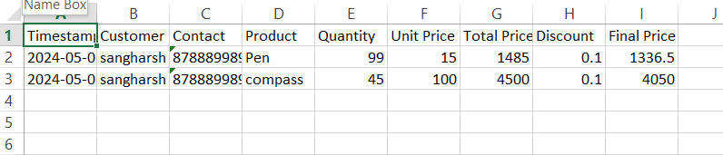
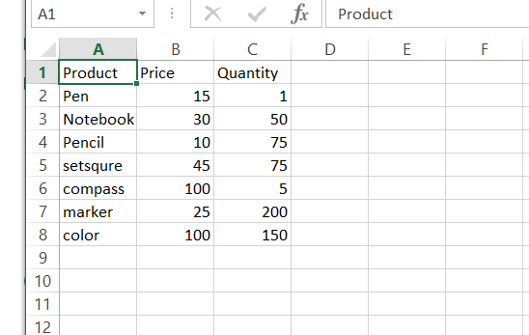
Output
Sanjivani Rural Education Society’s
Sanjivani College of Engineering, Kopargaon 423 603
(Affiliated to Savitribai Phule Pune University, Pune )

Slide 9
Thank You
Sanjivani Rural Education Society’s
Sanjivani College of Engineering, Kopargaon 423 603
(Affiliated to Savitribai Phule Pune University, Pune )

