Slide 1

Presentation
On
SHOES HOUSE
-By Sampurna giri

Slide 2


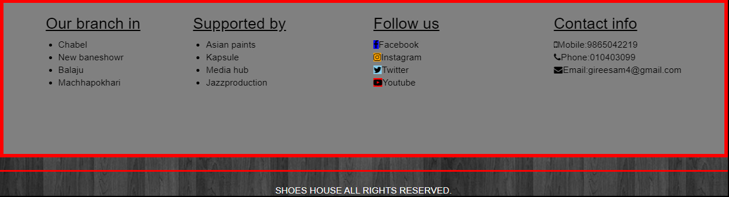
Navbar:
Footer:

Slide 3
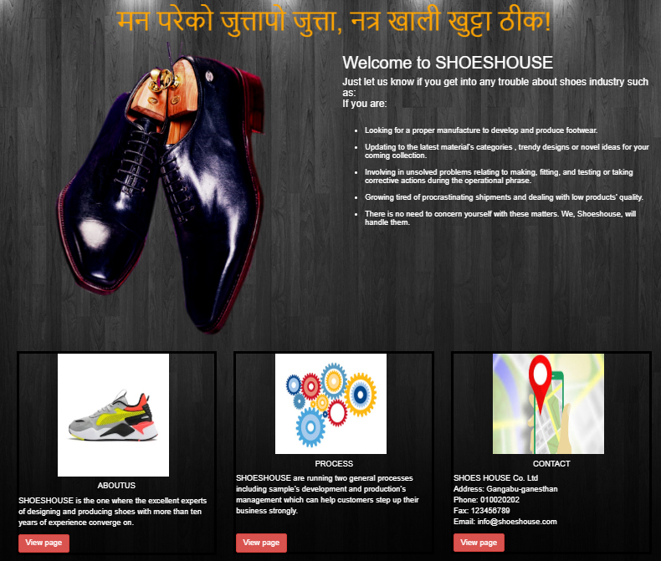
HOME:

Slide 4
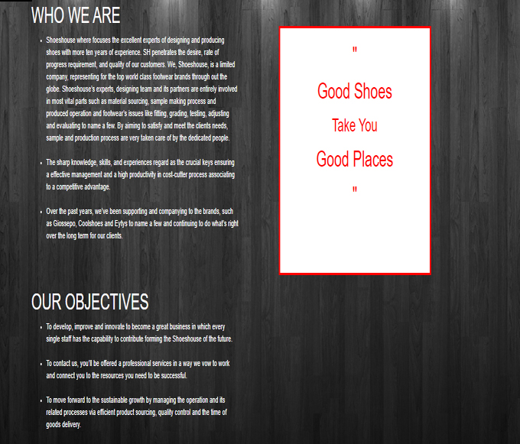
ABOUT US:

Slide 5
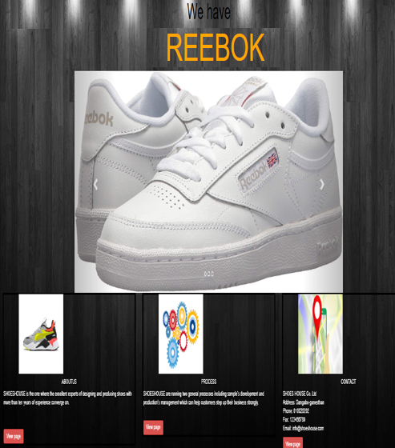
PRODUCT:

Slide 6
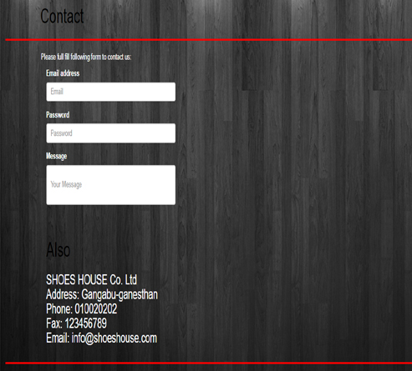
CONTACT:

Slide 7
THE END

